Slide 1









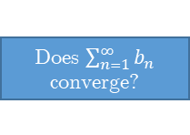

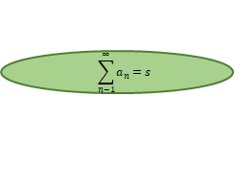
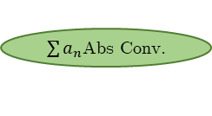
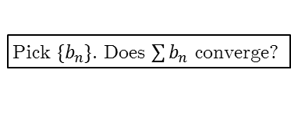
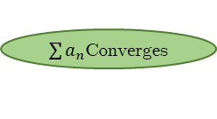
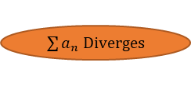


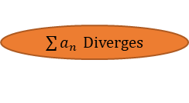




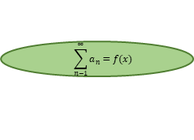


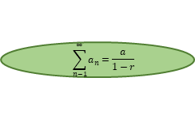
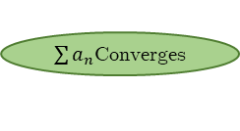

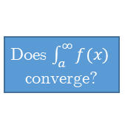

Test for divergence
Does $\lim_{n→∞}{a_{n}}=0$?
No
$\sum{a_{n}}$ $Diverges$
Yes
p-series
Yes
$\sum{a_{n}}$Converges
Does $a_{n}=n^{−p}, n≥1$?
Yes
Is $p>1$ ?
No
No
$\sum{a_{n}}$ Diverges
Geometric series
Yes
$$\sum_{n−1}^{∞}{a_{n}=\frac{a}{1−r}}$$
Does $a_{n}={ar}^{n−1}, n≥1$?
Yes
Is $\left|r\right|<1$ ?
No
No
$\sum{a_{n}}$ Diverges
Alternating series
Does $a_{n}={\left(−1\right)}^{n}b_{n}$ or
$a_{n}={\left(−1\right)}^{n−1}b_{n}$ , $b_{n}≥0$?
Yes
Is $b_{n+1}≤b_{n}$ & $\lim_{n→∞}{b_{n}}=0$ ?
Yes
$\sum{a_{n}}$Converges
No
No
Telescoping series
Do pairs of terms cancel? (May have to use partial fractions or logs to see!)
Does$\lim_{n→∞}{s_{n}=s}$, with finite $s$?
Yes
$$\sum_{n−1}^{∞}{a_{n}=s}$$
Yes
No
$\sum{a_{n}}$ Diverges
No
Taylor series
$$\sum_{n−1}^{∞}{a_{n}=f(x)}$$
Does $a_{n}=\frac{f^{\left(n\right)}\left(a\right)}{n!}{\left(x−a\right)}^{n}$ ?
Yes
Is $x$ in interval of convergence?
Yes
No
$\sum{a_{n}}$ Diverges
Try these:
No
Limit comparison test
Pick $\{b_{n}\}$. Does $\lim_{n→∞}{\frac{a_{n}}{b_{n}}}=c>0$ with $c$ finite & $a_{n},b_{n}>0$?
Yes
Does $\sum_{n=1}^{∞}{b_{n}}$ converge?
Yes
$\sum{a_{n}}$Converges
No
$\sum{a_{n}}$ Diverges
Integral test
$\sum{a_{n}}$Converges
Does $a_{n}=f(n)$ , $f(n)$ is positive, continuous & decreasing on $[a,∞)$?
Yes
Does $\int_{a}^{∞}{f(x) }$ converge?
Yes
No
$\sum{a_{n}}$ Diverges
Ratio test
$\sum{a_{n}}$Abs Conv.
Is $\lim_{n→∞}\left|\frac{a_{n+1}}{a_{n}}\right|≠1$?
Yes
Is $\lim_{n→∞}\left|\frac{a_{n+1}}{a_{n}}\right|<1$?
Yes
Root test
No
$\sum{a_{n}}$ Diverges
Is $\lim_{n→∞}{\sqrt[n]{\left|a_{n}\right|}≠1}$?
Yes
Is $\lim_{n→∞}{\sqrt[n]{\left|a_{n}\right|}<1}$?
Yes
$\sum{a_{n}}$Abs Conv.
No
$\sum{a_{n}}$ Diverges
Comparison test
Yes
Is $0≤a_{n}≤b_{n}$?
Yes
$\sum{a_{n}}$Converges
Pick $\{b_{n}\}$. Does $\sum{b_{n}}$ converge?
No
No (try again)
Is $0≤b_{n}≤a_{n}$?
Yes
$\sum{a_{n}}$ Diverges

