Slide 1

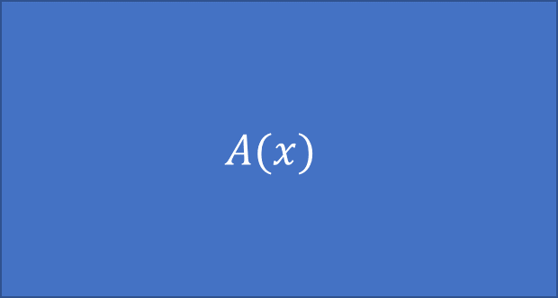
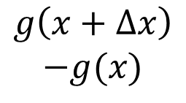


$$h(x)$$
$$h\left(x+Δx\right)−h(x)$$
$$A(x)$$
$$g(x)$$
$$g\left(x+Δx\right)$$
$$−g(x)$$

Slide 2


$$f(x)$$
$$g(x)$$

Slide 3


$$f\left(x+Δx\right)$$
$$g\left(x+Δx\right)$$

