Slide 1
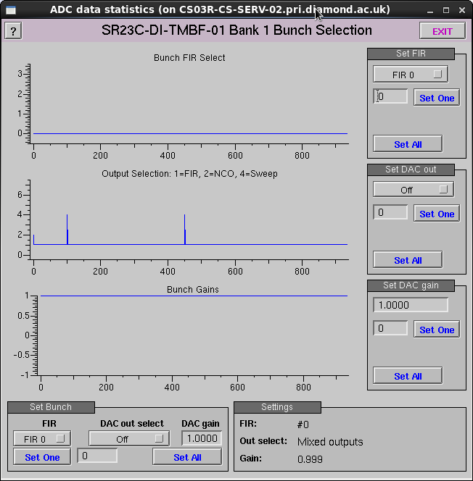
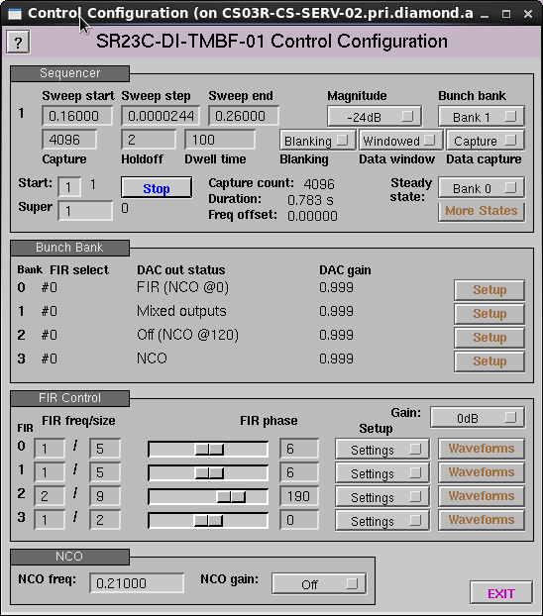
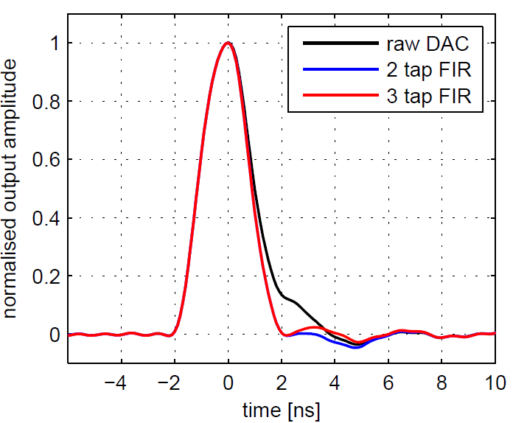
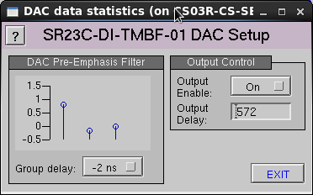
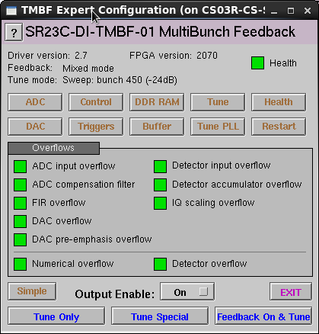
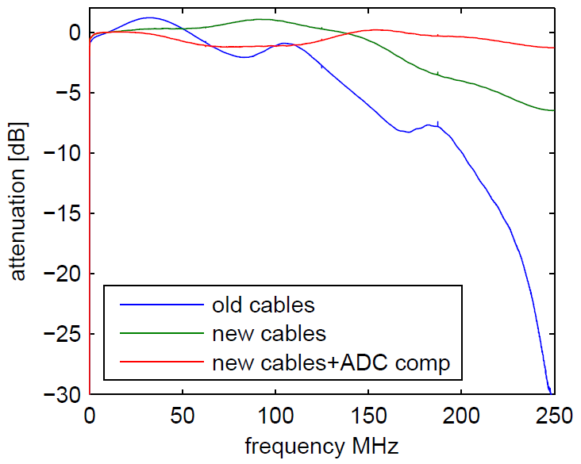
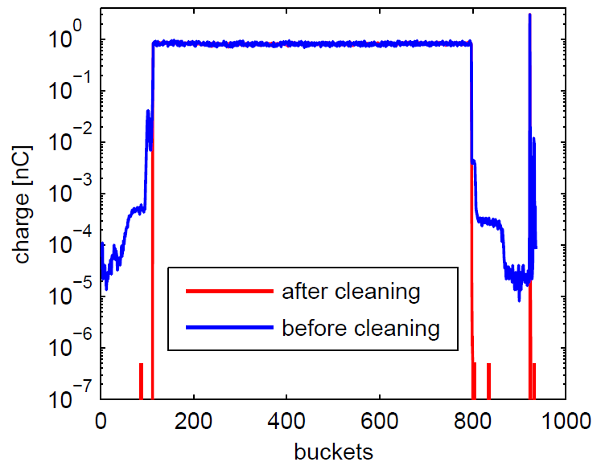
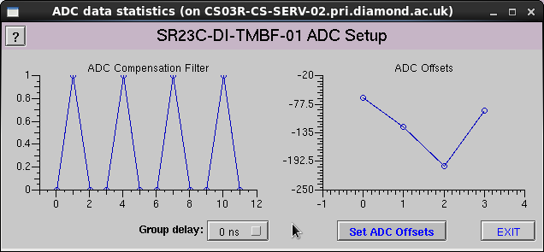
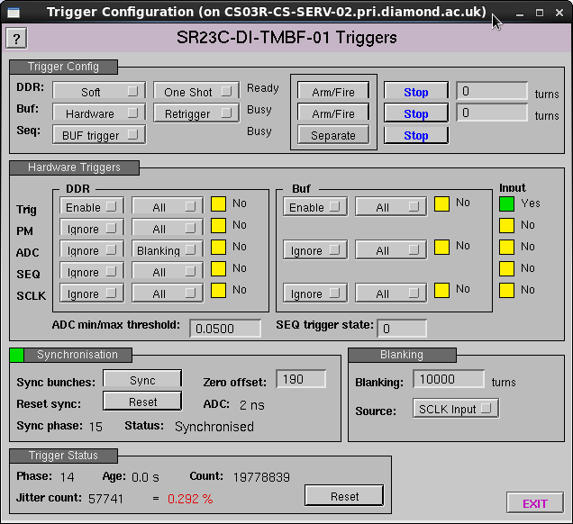
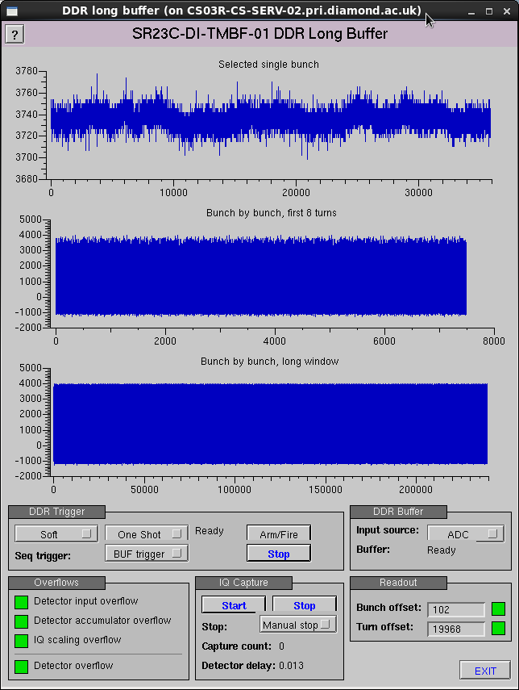
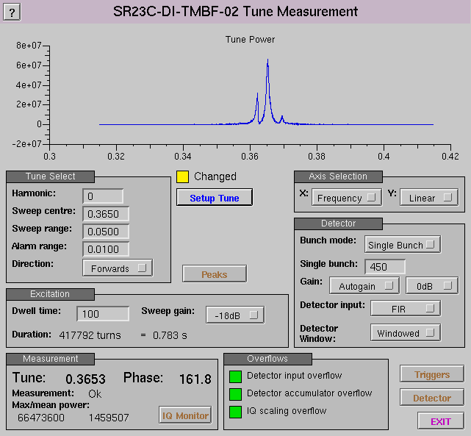
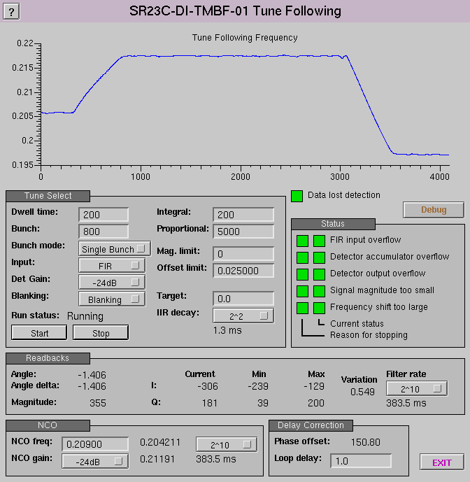
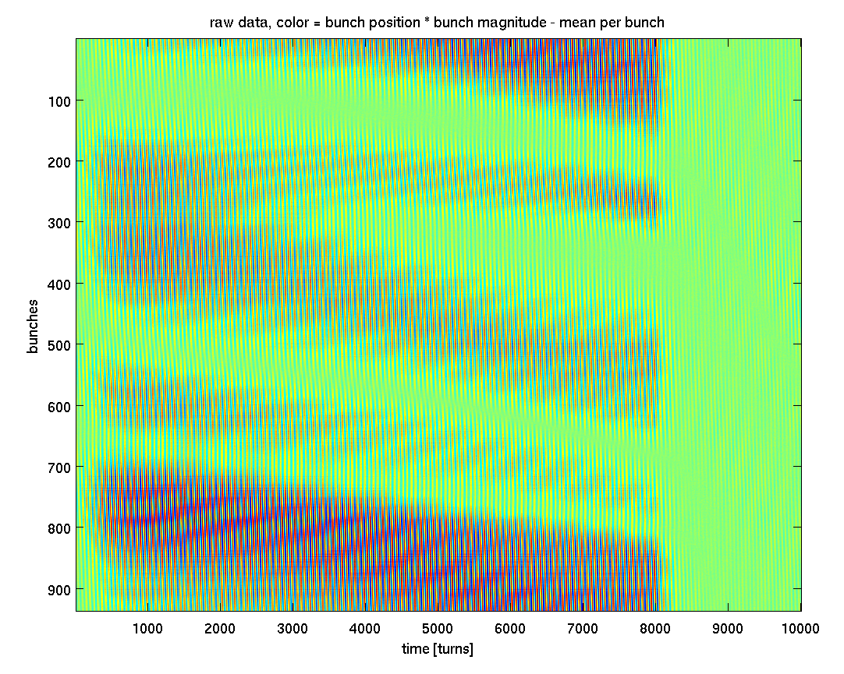
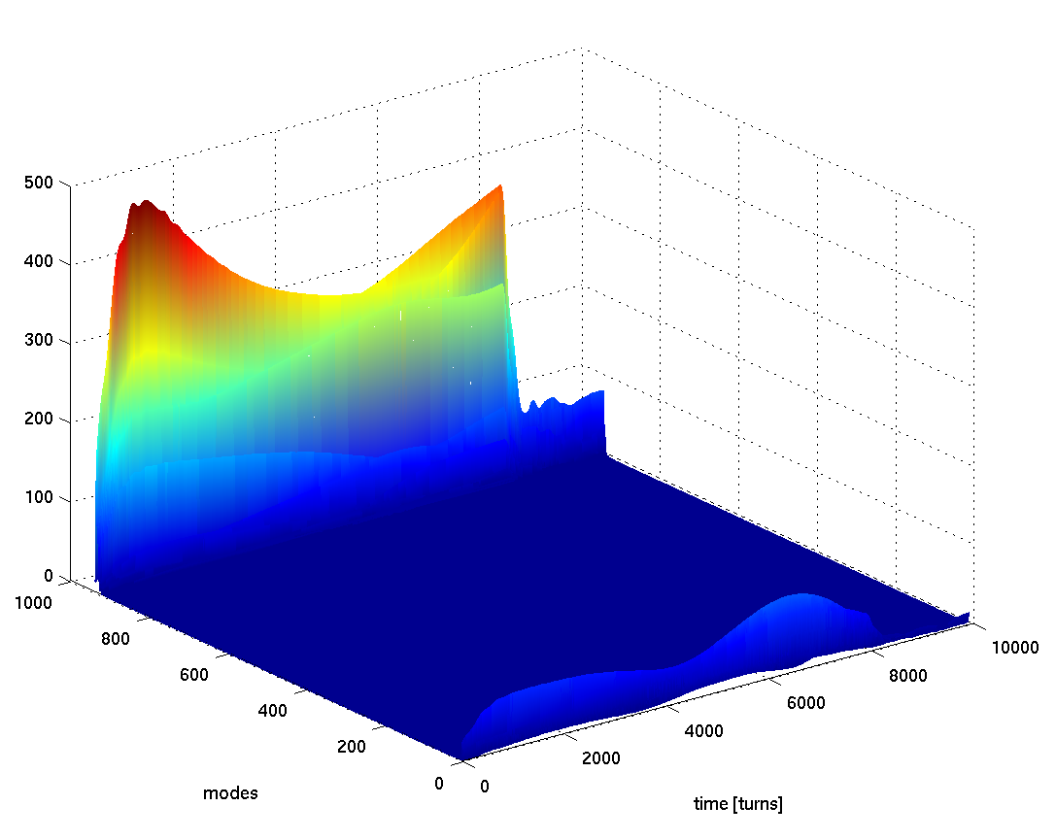
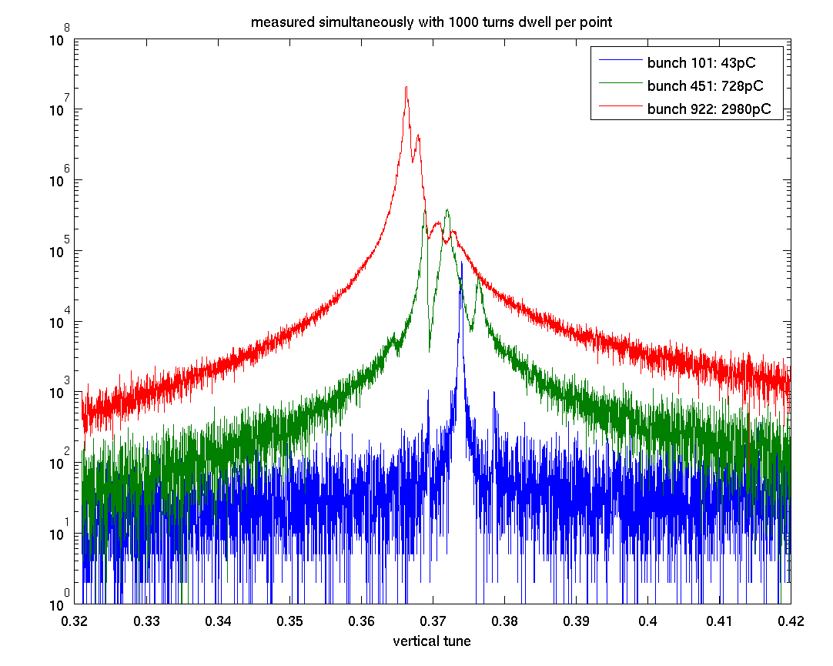
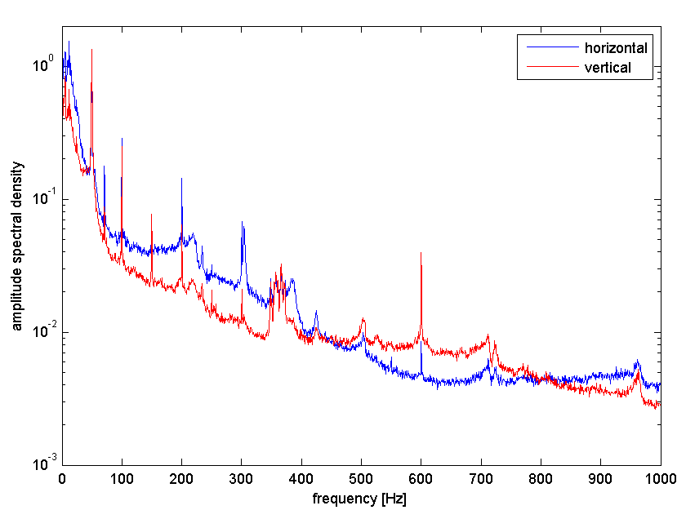
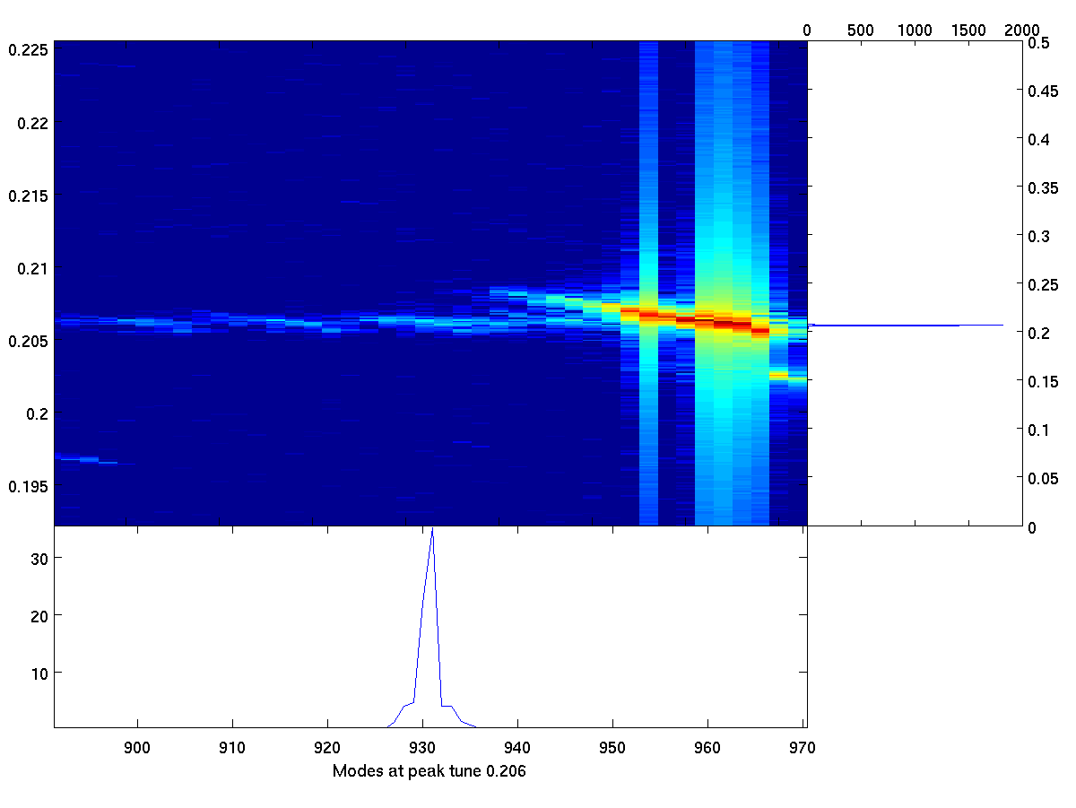
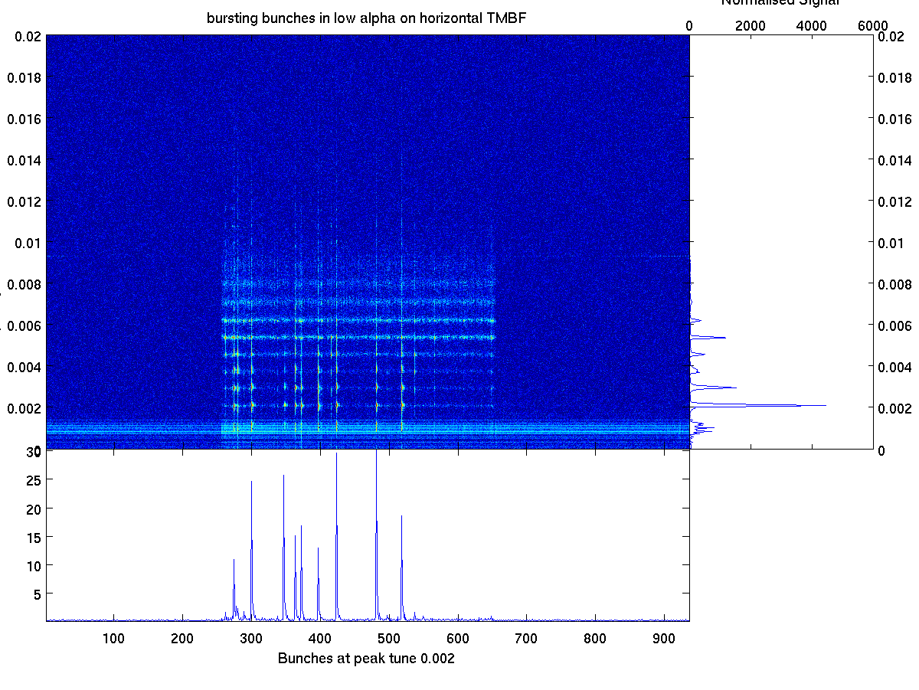
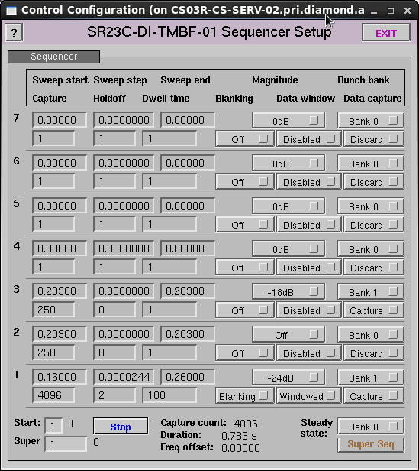
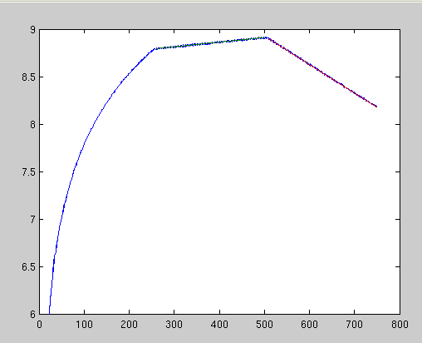
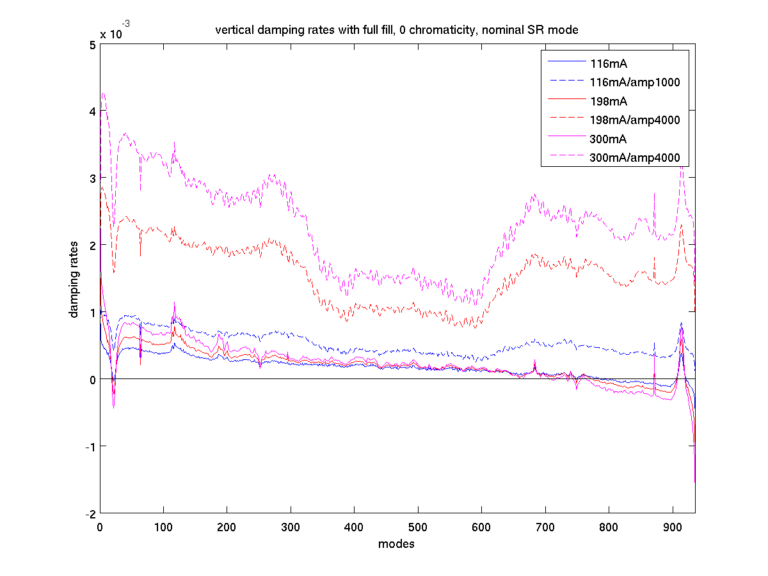
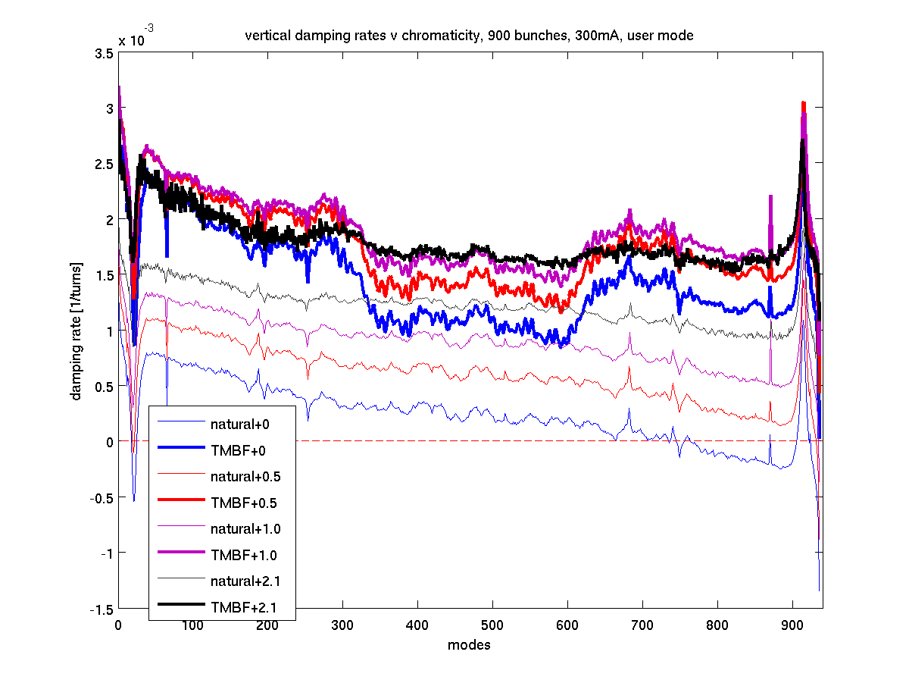
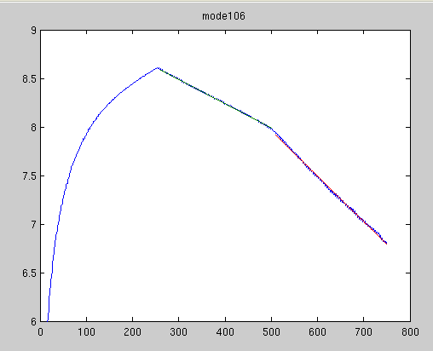
NEW FEATURES AND MEASUREMENTS USING THE UPGRADED
TRANSVERSE MULTIBUNCH FEEDBACK AT DIAMOND
G. Rehm, M. Abbott, A.F.D. Morgan, Diamond Light Source, Oxfordshire, U.K.
Bunch by Bunch Function/Gain/FIR control
and Sequencer for Excitation
Frequency/Impulse Response Correction
DAC pre-emphasis to adjust
impulse response using scope
ADC post-emphasis to round
trip frequency response
Bunch-by-Bunch Data Triggering and Capture
Tune Measurement
Swept excitation and I/Q detection
Phase Locked Loop Tune Tracking
One sweep per second with
4096 points of 100 turns dwell
One tune reading every
100 turns or 187us
Ion instability with poor vacuum
880
modes
936
Fast Scanning of Transverse Mode Damping
Drive one mode for 250 turns
Then record 250 turns natural damping/growth
Then record 250 turns active damping

