Slide 1
Forthcoming Controls Seminars
28/05/14
11/06/14 No seminar due to Medipix Workshop
25/06/14 DH EPICS V4 Update
09/07/14 NB Test Driven Development
23/07/14 AR DDBA
***** No talks through August as it is holiday season *****
03/09/14
26/11/14 AR I10 Switching Scheme
xx/xx/14 IU Xilinx Zynq – All Programmable SoC Architecture
xx/xx/14 IU An Introduction to PCIe
xx/xx/14 ?? Spectroscopy at Diamond
xx/xx/14 ?? Web Services
xx/xx/14 ?? Timing Systems
xx/xx/14 ?? Photon BPMs
xx/xx/14 ?? Fault Tree Analysis
xx/xx/14 ?? HDF5 & Nexus
xx/xx/14 ?? MML & AT
xx/xx/14 ?? CSS an Update
xx/xx/14 ?? Link Aggregation Network Protocols
xx/xx/14 ?? Percival Detector
xx/xx/14 ?? Linux for Diskless IOCs
xx/xx/14 ?? Linux on VME – Experience on PSS & Possible Ways Forward
xx/xx/14 ?? I11 Long Duration Experiments
xx/xx/14 ?? VHDL for The Novice
xx/xx/14 ?? Physics of the Diamond Accelerators
xx/xx/14 ?? An Update on areaDetector
xx/xx/14 ?? Feedforward & Feedback Processes on the Diamond SR
Volunteers to present future seminars from September 2014 are required.
Please contact James O’Hea or Mark Heron with a proposed topic.

Slide 2
Learning to Program with FPGAs:
Experience with Extending TMBF
Michael Abbott
Controls Technical Seminars
14th April 2014

Slide 3
What is an FPGA
Stands for “Field Programmable Gate Array”
A hardware device comprising a collection of logic resources and programmable routing
Typical clock speeds of 125-500 MHz
Programmed in “Hardware Definition Language” (HDL) such as VHDL or Verilog
Immense data throughput is possible with careful design, and reprogrammability allows for huge flexibility of design

Slide 4
What is TMBF
“Transverse Multi-Bunch Feedback” processor
Monitors transverse position (horizontal and vertical) of each bunch in the beam.
Bunches are 2ns apart, need to run 10-tap filter on each bunch position, so FPGA is most practical approach
Uses 10 year old technology, but still has plenty of scope for enhancements

Slide 5
TMBF in Context
Storage Ring
EBPM button block
X
Y
Striplines
Hybrid
Power Amplifier
A
B
C
D
X
Y
Σ
Q
Power Amplifier
Machine RF
TMBF Front End
Libera TMBF (X)
Libera TMBF (Y)
Notes:
This and the following slide go together and say much the same thing

Slide 6
TMBF Processing Framework
Button pickups for ABCD RF signals
RF hybrids convert to X & Y
Libera TMBF front end for signal conditioning
4 x 125 Ms/s 14-bit ADC in Libera TMBF
FPGA performs processing and control
1 x 500 Ms/s 14-bit DAC in Libera TMBF
Power Amplifier drives striplines to couple back to stored beam

Slide 7
TMBF Applications
Instability damping: simple tuned FIR to reverse phase for negative feedback. Works well in part due to very sharp resonance of beam at machine tune frequency.
Tune measurement by tune excitation and detection
Machine physics investigations: probing instabilities
Notes:
General context of TMBF

Slide 8
Libera TMBF
Xilinx Virtex-II Pro FPGA
i-Tech FPGA framework
DLS
FPGA
Code
ADC
4 x 14
DAC
500 Ms/s
14 bit / sample
4 x 125 Ms/s
14 bit / sample
128 MB
DDR
RAM
Triggers
XScale ARM SoC
64 MB RAM
32 MB Flash
100 Mbit
Ethernet
Notes:
Talk about FPGA resources and i-Tech framework. Point out need for framework sources to make needed local modifications.
Perhaps also point out 4 to 1 speed mismatch and associated issues.
Extra slide on FPGA resources?

Slide 9
FPGA Fundamentals
Wires and Logic
Digital in, Digital out
Line driver
Inverters
Analogue in, Digital out
Digital in, Analogue out
ADC
8-bit digital
value
DAC
clock
clock

Slide 10
FPGA Fundamentals:
Logic Gates
A B A&B
0 0 0
0 1 0
1 0 0
1 1 1
A
A & B
B
A B A|B
0 0 0
0 1 1
1 0 1
1 1 1
A
A | B
B
A B A^B
0 0 0
0 1 1
1 0 1
1 1 0
A
A ^ B
B

Slide 11
Building up logic elements
A
1
M
Multiplexer: selects A or B
depending on input S
B
0
S
System Verilog:
logic m;
always_comb
if (s)
m = a;
else
m = b;
A
S
M
or just:
B
wire m = s ? a : b;
or even:
wire m = (s & a) | (b & ~s);

Slide 12
D-Type Flip-Flop or Register
D
Q
D CK Q
X 0 Q
X 1 Q
0 ↑ 0
1 ↑ 1
CK
A simple view:
Output Q captures input D on rising edge of CK
Q only changes on rising edge of CK
This is the fundamental building block of FPGA design.

Slide 13
D-Type Flip-Flop with Enable
D
Q
CK
EN
Functionally equivalent to:
I.e., only update register when enabled, otherwise leave state unchanged.
All FPGA state is recorded using D-type flip-flops with enable.
0
Q
D
1
EN
CK

Slide 14
D-Type Flip-Flop Timing
D
Q
CK
CK
D
Don't care
Q
Setup and hold period:
Input must be stable in
this window for valid output
Output propagation delay:
Output is unpredictable
during this window

Slide 15
D-Type Flip-Flop Timing
D
Q
CK
CK
D
Don't care
Q
Safe window for logic propagation from output to input for next clock.

Slide 16
Fundamental Principle of FPGA Programming
Inputs
Outputs
Combinatorial
Logic
Safe timing window
All flip-flops on common clock
All logic must settle within the safe timing window: tick to tick

Slide 17
Fundamental Principle of FPGA Programming
Inputs
Outputs
Combinatorial
Logic
Data propagates from tick to tick
always_ff @(posedge clk)
outputs <= combination(inputs)

Slide 18
FPGA System View
Inputs
Outputs
Combinatorial
Logic
Outside
World

Slide 19
FPGA Fundamental Principle
The FPGA is a finite state machine
Updated from clock tick to clock tick
Everything in the FPGA happens at once
This means that in general all computations occur on every tick, so the basic choice is to select which results to save at the end of each tick, rather than what to compute.

Slide 20
Crossing Clock Boundaries
Alas it can be impossible to work with a single clock for the entire system (highly recommended if at all possible)
Outside signals are often asynchronous or clocked differently
Crossing clock boundaries is tricky, fraught with pitfalls, and a whole topic in itself

Slide 21
All Computations Occur Together
Example: TMBF output multiplexer
0
// Array of 8 possible multiplexer outputs
logic [7:0] [15:0] dac_out_mux;
always_ff @(posedge adc_clk_i) begin
dac_out_mux[0] <= 0;
dac_out_mux[1] <= fir_i;
dac_out_mux[2] <= hom_0_i;
dac_out_mux[3] <= hom_0_i + fir_i;
dac_out_mux[4] <= hom_1_i;
dac_out_mux[5] <= hom_1_i + fir_i;
dac_out_mux[6] <= hom_1_i + hom_0_i;
dac_out_mux[7] <= hom_1_i + hom_0_i + fir_i;
end
// Choose the desired output
logic [15:0] dac_out_sel;
always_ff @(posedge adc_clk_i)
dac_out_sel <= dac_out_mux[out_mux_sel_i];
Off
FIR
NCO1
FIR+NCO1
NCO2
FIR+NCO2
NCO1+NCO2
FIR+NCO1+NCO2
FIR
NCO1
+
NCO2
+
+
+
Output
Select

Slide 22
FPGA Programming Model
Forget about sequential execution … instead data flows through the FPGA from register to regster.
Need to keep track of when data is valid at each processing stage.
May need to introduce explicit delays to align data, for example in computation of
  a + b * c
may need to delay a so it aligns with b * c
Pipelines everywhere!

Slide 23
A Worked Example
Σ
Input
×
×
Output
Window
Mix
Reset
Try the obvious way:
logic [SUM_WIDTH-1:0] sum;
always_ff @(posedge clk)
if (reset)
sum <= 0;
else
sum <= sum + input * window * mix;
assign output = sum;

Slide 24
A Worked Example
Σ
Input
×
×
Output
Window
Mix
Reset
Try the obvious way:
logic [SUM_WIDTH-1:0] sum;
always_ff @(posedge clk)
if (reset)
sum <= 0;
else
sum <= sum + input * window * mix;
assign output = sum;
The principle is good … sort of nearly works, but not a chance. This computation just cannot be completed in time.

Slide 25
Built in Multipliers
Have built-in multipliers: can perform 18×18→36 multiply in one clock tick (8ns) with dedicated hardware.
Need to give them time to do their work with pipelines. Safest to go register to register thus:
A
Note: Data takes two clock ticks to from labelled input to labelled output. This sort of delay is what we have to account for.
×
A×B
B

Slide 26
Making it work with pipelines
Σ
Input
×
×
Output
Window
Mix
Reset
logic [IN_WIDTH-1:0] windowed_input;
logic [IN_WIDTH-1:0] mixed_input;
logic [SUM_WIDTH-1:0] sum;
always_ff @(posedge clk) begin
windowed_input <= input * window;
mixed_input <= windowed_input * mix;
if (reset)
sum <= 0;
else
sum <= sum + mixed_input;
end
assign output = sum;
Solve all timing problems with pipelines … but now the various input signals are out of step with each other. This is probably best compensated for elsewhere, externally in software if at all possible!

Slide 27
Refining the result
Σ
Input
×
×
Output
Window
Mix
Reset
logic [IN_WIDTH-1:0] windowed_input;
logic [IN_WIDTH-1:0] mixed_input;
logic [SUM_WIDTH-1:0] sum;
always_ff @(posedge clk) begin
windowed_input <= input * window;
mixed_input <= windowed_input * mix;
if (reset) begin
sum <= 0;
output <= sum;
end else
sum <= sum + mixed_input;
end
Now the output is stable between resets, much more useful.

Slide 28
Alas, we're not quite there yet
Σ
Input
×
×
Output
Window
Mix
Reset
logic [IN_WIDTH-1:0] windowed_input;
logic [IN_WIDTH-1:0] mixed_input;
logic [SUM_WIDTH-1:0] sum;
always_ff @(posedge clk) begin
windowed_input <= input * window;
mixed_input <= windowed_input * mix;
if (reset) begin
sum <= 0;
output <= sum;
end else
sum <= sum + mixed_input;
end
These multiplies need to be scaled and shifted and probably rounded. If we decide to round the result then another pipeline stage will be needed. Also, of course, input and reset are out of step which may need attention.
Finally, overflow detection on the accumulator would be wise.

Slide 29
FPGA Resources (Vertex-II Pro)
Hundreds of I/O pins
Tens of thousands of logic cells and registers
136 fast multipliers (18×18→36 bits in 8ns)
136 dual-port block RAMs (18×1024 or 36x512 bits with 8ns access)
This is a ten year old device, modern large devices are much larger. The TMBF design uses around 65% of logic resources and takes around 15 minutes to build.

Slide 30
TMBF Build Report
Device Utilization Summary:
Number of BUFGMUXs 7 out of 16 43%
Number of DCMs 3 out of 8 37%
Number of External DIFFMs 21 out of 320 6%
Number of LOCed DIFFMs 21 out of 21 100%
Number of External DIFFSs 21 out of 320 6%
Number of LOCed DIFFSs 21 out of 21 100%
Number of External IOBs 213 out of 644 33%
Number of LOCed IOBs 213 out of 213 100%
Number of MULT18X18s 71 out of 136 52%
Number of RAMB16s 99 out of 136 72%
Number of SLICEs 8765 out of 13696 63%

Slide 31
New TMBF Capabilities
Bunch-by-bunch control of filter, output, gain.
Three output sources: FIR, two NCOs
Programmable sequencer
Tune following PLL
Output pre-emphasis filter, input compensation to come
2ns resolution triggers and synchronisation
Compensation for all offsets and delays
Notes:
This is why we're here: all the new stuff. Was originally a very small upgrade project, but took off as we discovered more capabilities and Guenther came up with more ideas.

Slide 32
Architecture and Implementation
Split between EPICS IOC (written in C) and FPGA (written in System Verilog)
Offset and delay compensation in software where possible: 19 delay parameters automatically measured and compensated
Libera platform provides SBC, DDR RAM, ADC, DAC. Everything else in DLS code

Slide 33
19 Compensated Delays
# DDR readout delays
DDR_ADC_DELAY = 230
DDR_FIR_DELAY = 1
DDR_RAW_DAC_DELAY = 5
DDR_DAC_DELAY = 10
# Buffer trigger delays
BUF_ADC_DELAY = 229
BUF_FIR_DELAY = 0
BUF_DAC_DELAY = 9
# MinMax buffer delays
MINMAX_ADC_DELAY = 228
MINMAX_DAC_DELAY = 8
# Bunch selection offsets
BUNCH_FIR_OFFSET = 228
BUNCH_GAIN_OFFSET = 0
# Detector single bunch offsets and phase
# skews
DET_ADC_OFFSET = 1
DET_FIR_OFFSET = 232
# These two values represent actual phase
# delays in bunches relative to an
# aligned single turn.
DET_ADC_DELAY = 0
DET_FIR_DELAY = 12
# Tune following delays
FTUN_ADC_OFFSET = 3
FTUN_FIR_OFFSET = 0
FTUN_ADC_DELAY = 928
FTUN_FIR_DELAY = 940
All measured automatically when testing a new FPGA version

Slide 34
FPGA System Overview
Loopback for Debug
input
FIR
FIR
output
ADC
NCO1
DAC
NCO2
DAC
capture
FIR
ADC
sequencer
&
detector
bunch
control
ADC
IQ
FIR
ADC
tune PLL
FIR
Notes:
Architectural overview of new system implementation showing the available system resources.

Slide 35
Data Capture
min/max
ADC
min/max
DAC
DDR
RAM
64M x 16
ADC
FIR
DAC
block
RAM
16k x 16 x 2
2 of 3
IQ

Slide 36
Output Control
Overflow
Detect
0
Off
FIR
NCO1
FIR+NCO1
NCO2
FIR+NCO2
NCO1+NCO2
FIR+NCO1+NCO2
FIR
NCO1
+
×
pre-
emphasis
FIR
delay:
0-935
NCO2
DAC
+
+
+
capture
Output
Select
Output
Gain
Bunch by bunch
control

Slide 37
A Fragment of FPGA Code
// DAC selection input multiplexer. The intermediate selection is 16 bits wide
// so we can detect overflow when adding up to three 14 bit values.
logic [7:0] [15:0] dac_out_mux = 0;
always_ff @(posedge adc_clk_i) begin
dac_out_mux[0] <= 0;
dac_out_mux[1] <= signed'(fir_dat_i);
dac_out_mux[2] <= signed'(hom_0_dat_i);
dac_out_mux[3] <= signed'(hom_0_dat_i) + signed'(fir_dat_i);
dac_out_mux[4] <= signed'(hom_1_dat_i);
dac_out_mux[5] <= signed'(hom_1_dat_i) + signed'(fir_dat_i);
dac_out_mux[6] <= signed'(hom_1_dat_i) + signed'(hom_0_dat_i);
dac_out_mux[7] <=
signed'(hom_1_dat_i) + signed'(hom_0_dat_i) + signed'(fir_dat_i);
end
wire [15:0] dac_out_sel = dac_out_mux[out_mux_sel_i];
// Latch final result and detect overflow
logic [13:0] dac_mux_out = 0;
logic mux_overflow = 0;
always_ff @(posedge adc_clk_i) begin
dac_mux_out <= dac_out_sel;
mux_overflow <= ~&dac_out_sel[15:13] & |dac_out_sel[15:13];
end

Slide 38
Bunch by Bunch Control
Different feedback on different bunches, helpful for unusual fill patterns
Precise control over tune sweeps (can measure up to four channels at once)
Low risk user time experiments on a single bunch (nobody cares too much if we break one bunch!)
Notes:
This was the first major capability upgrade.

Slide 39
Bunch Control
Current bunch configuration
FIR select
(one of 4)
Bank select
from
sequencer
Output select
(8 options)
Output gain
(range ±1023)
Sequencer selects one of four bunch control configurations. Selected configuration determines bunch by bunch behaviour.
Bunch configuration:
for each of 936 bunches selects:
FIR (2 bits)
output (3 bits)
gain (11 bits).
Bunch counter,
advances every
2ns
Notes:
This needs some explanation! The 8 output options are any selection from three outputs (FIR and two NCOs).

Slide 40
Tune Measurement
Excite system under test with fixed frequency sin wave
Measure response by mixing with original excitation: use both phases to get IQ response
Sweep excitation frequency to get response over a frequency range
device
under
test
cos
∿
detector
IQ
cos,sin

Slide 41
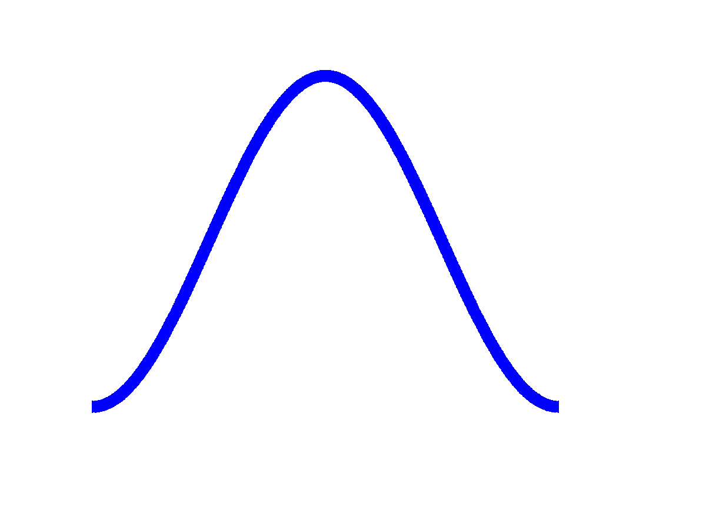
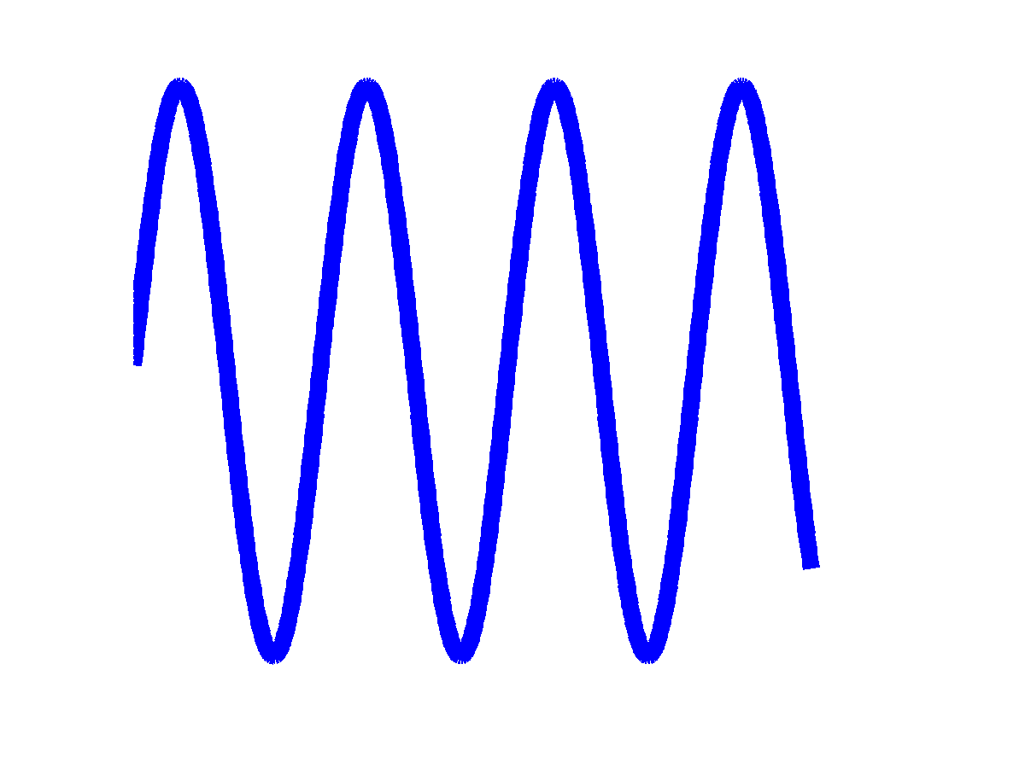
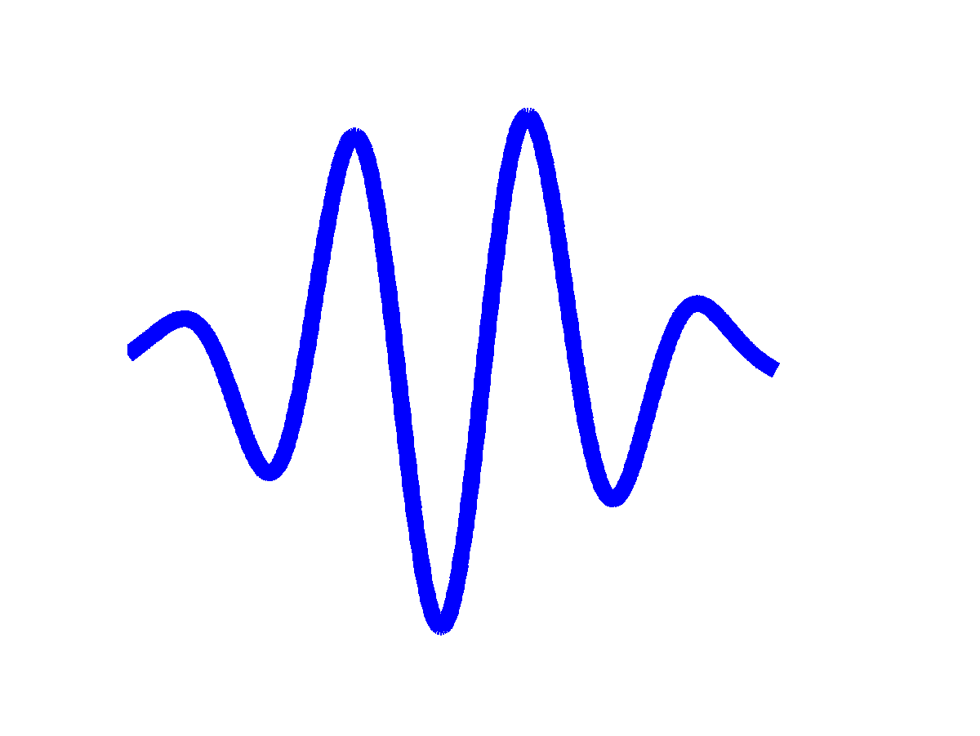
Detector Features
Blanking signal. External signal during injection to suspend detector during injection to avoid spurious noise.
Window. Windowing sine wave that doesn't fit into detector window controls leakage from adjacent frequencies:
⨯

Slide 42
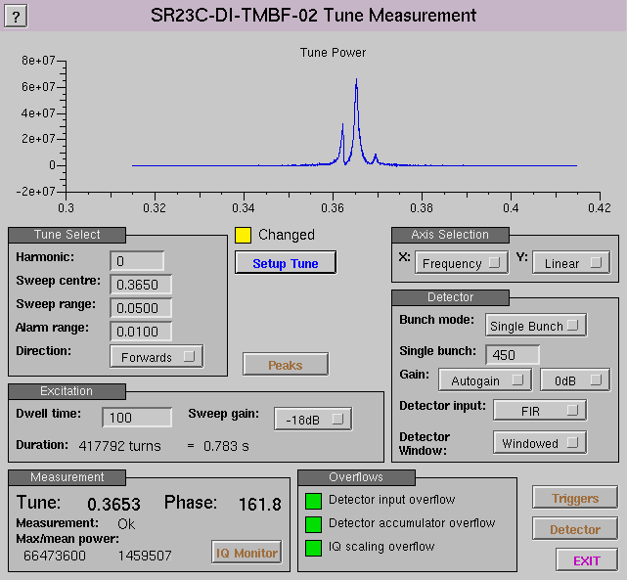
Tune Measurement Screen

Slide 43
Sequencer and Detector
DETECTOR
×
I
Σ
gain
ADC
×
FIR
IQ
×
Q
write IQ
blanking
event
NCO
NCO
cos
gain
NCO1
sin
frequency
gain
sequencer
window
bank
select

Slide 44
Programmable Sequencer
For tune sweeps and timed feedback control experiments. For up to 7 sequenced states can select:
Bunch configuration from one of four selections
Frequency sweep for NCO
Optional IQ data capture for sweep response
Duration of state
Notes:
This is the other major upgrade and the one with the most complex implications.

Slide 45
Sequencer Programme
Start on trigger
N state programme
State0
StateN
…
State1
State0
COUNT = C1
DWELL = D1
HOLDOFF = H1
Dwell0
Dwell1
...
DwellC-1
f1
f1+δf1
f0+(C1-1)δf1
H1 Turns
D1 turns: detector active
H1+D1 Turns
detector window
Notes:
Structure of a sequencer programme: a sequence of states, each state consisting of a sequence of dwells at each frequency as the NCO frequency is swept, each dwell consists of an optional holdoff followed by a detector capture period. Each dwell results in the capture of one (optional) IQ point.

Slide 46
Sequencer Applications
Tune sweep: one extra state with sweep
Complex machine investigations. For example, grow/damp exploration of unstable modes, can perform the following experiment:
  Running in feedback with standard feedback
  Turn feedback off, excite one mode for 100 turns
  Wait for natural growth of mode, eg 1000 turns
  Run an alternate feedback filter for 1000 turns
  Restore standard feedback, capture 1000 turns
Notes:
Sweeping, or all the complicated ideas that Guenther wants. This is just a slightly contrived example application.

Slide 47
Implementing Grow/Damp
State # | FIR | Output | Duration | Dwell time | Bank #
0 | Standard | FIR | - | - | 0
4 | - | Sweep NCO | 100 | 1 | 1
3 | - | Off | 1000 | 1 | 2
2 | Alternate | FIR | 1000 | 1 | 3
1 | Standard | FIR | 1000 | 1 | 0
0 | Standard | FIR | - | - | 0
Here we use four out of seven available sequencer states, two of four available feedback filters, and all four available bunch control banks.
The result of this experiment is 3100 IQ sample points.
Can also simultaneously capture turn by turn data into the fast DDR buffer if desired, have room for up to 35,000 turns in the buffer, but readout is relatively slow, around 1,200 turns per second.
Notes:
Digging into the contrived example to illustrate how the sequencer is designed to be used.

Slide 48
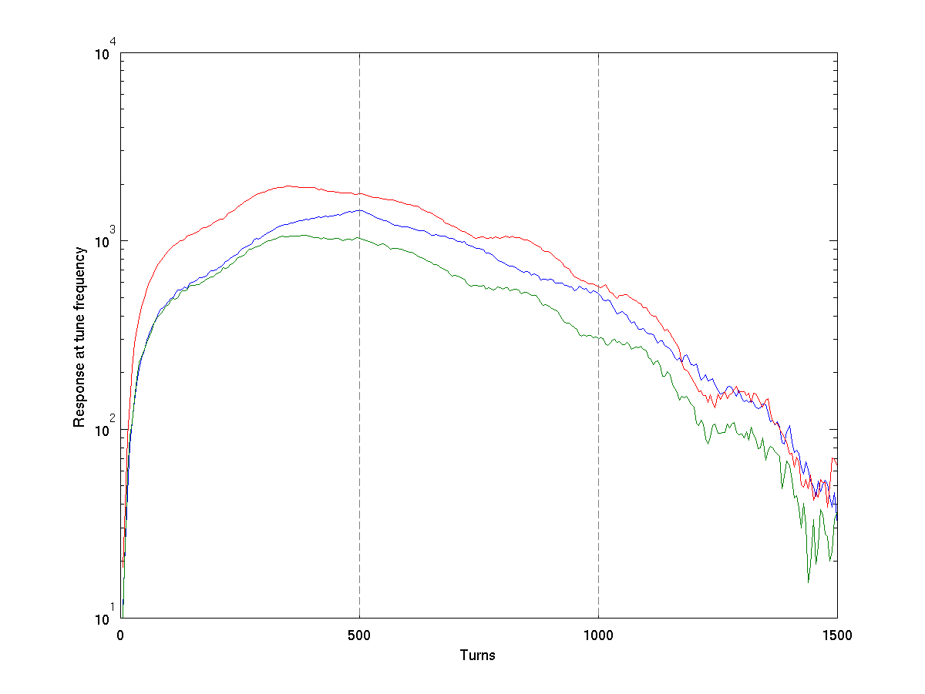
Graph of a Grow/Damp Experiment
Excite at tune and
selected mode
for 500 turns
Feedback off,
observe natural
damping
Feedback
restored
Notes:
A rather rough snapshot from a recent grow damp experiment (alas, not the four state one I was describing). Cleaner data would be nice...

Slide 49
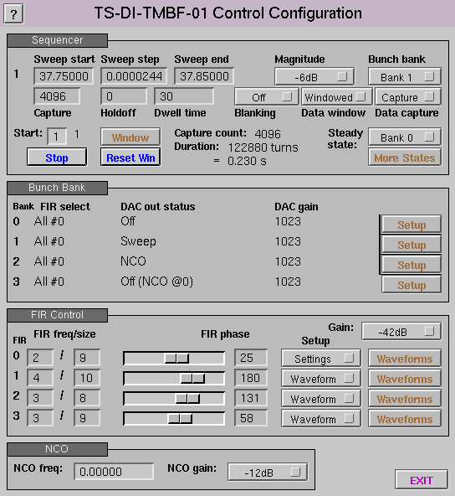
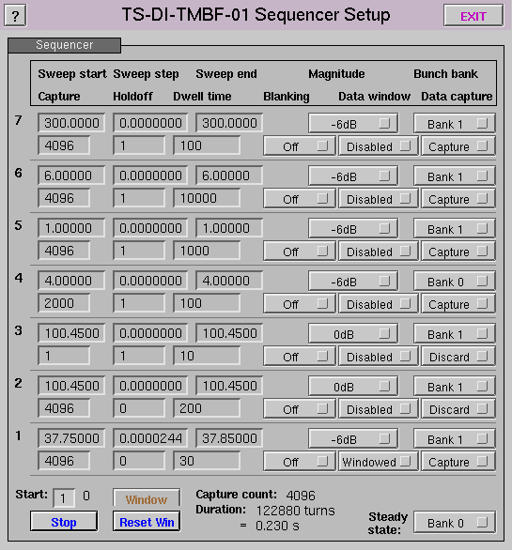
Low Level Control Screens

Slide 50
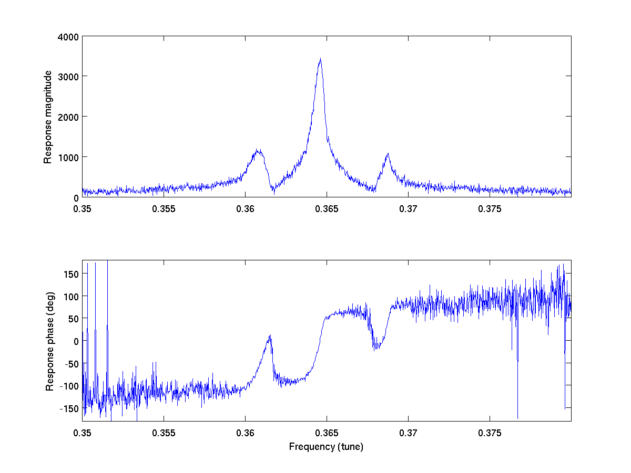
Tune Measurement
Peak response
at tune frequency
Synchrotron
sidebands
Note rapid phase change
when sweeping through
peak of resonance

Slide 51
Tune Phase Locked Loop
Take advantage of rapid phase change through tune frequency peak
Measure phase at, eg, 2.6 kHz (every 200 turns)
Run simple controller to track frequency to keep phase at target value
Result is high update rate tune measurement
Can quickly measure tune width by stepping phase through ±45°

Slide 52
Tune Phase Locked Loop
ADC
detector
CORDIC
IQ
phase
−
reference
phase
FIR
phase
error
cos,sin
NCO
NCO2
IIR
+
frequency correction
PI controller
KP
×
×
KI
buffer
reference
frequency
Σ
+

Slide 53
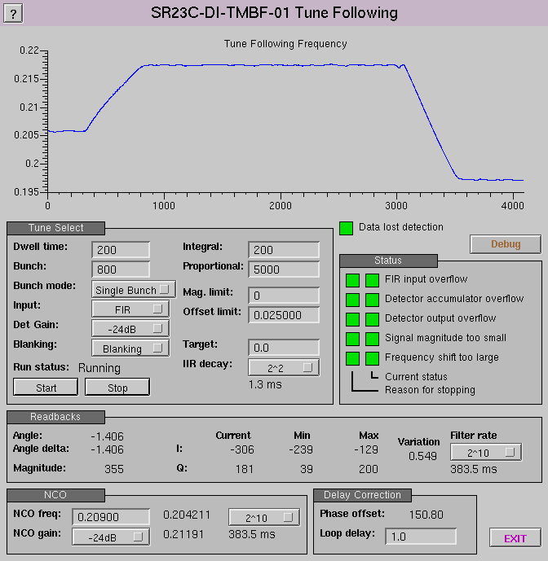
Tune PLL Screen
BBA orbit changes
cause changes in tune

Slide 54
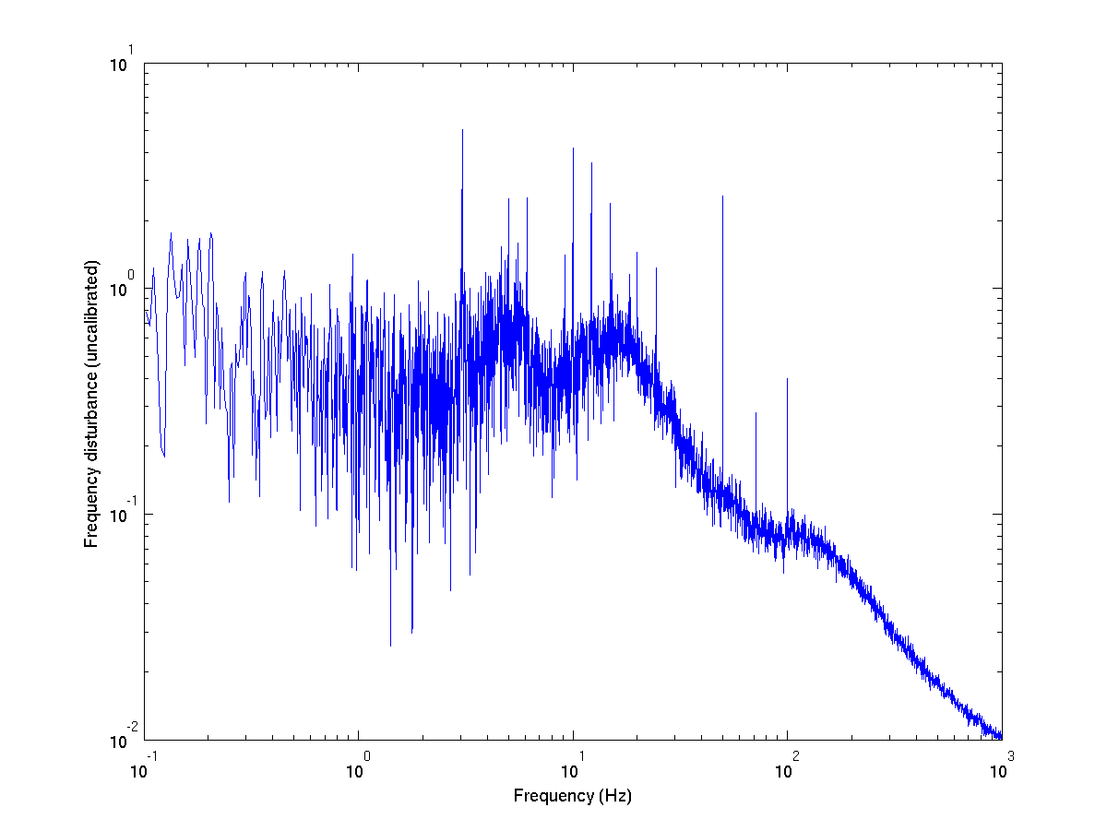
First PLL Tune Measurements
5, 10, 15 Hz, etc – injection?
3, 6, 9, 12 Hz, etc –
mystery signal, not seen
before this measurement
Mains (50 Hz, 100 Hz)
Long term 71.2 Hz signal
Believe comes from one
steerer, have seen this
signal for several years!
Broadband low frequency,
comes and goes.
Ground motion?
Controller mistune?
Controller rolloff

Slide 55
Output Pre-Emphasis
Loss of gain at high frequencies from DAC, Amplifier, ADC
Can partially compensate with 3-tap FIR in DAC output
Will also add 3-tap FIR to ADC input to compensate ADC high frequency droop

Slide 56
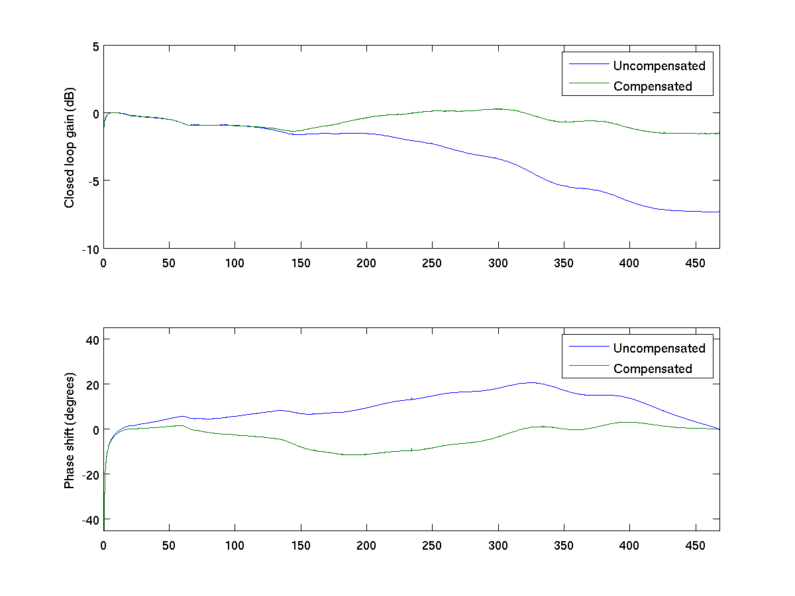
Closed Loop Gain Compensation
Filter coefficients: +1.323 -0.485 +0.162

Slide 57
2ns Trigger Synchronisation
FPGA runs with 8ns cycle: 4 machine bunches per tick
Need to identify which bunch is synchronous with incoming trigger
Need to identify trigger edge with 2ns precision

Slide 58
Discovering Trigger Edge
DDR
D-DDR
A
φ
φ
2φ
B
Trigger
Trigger with phase detect
φ
φ
C
2φ
φ
φ
D
φ
φ
A
B
C
D
A
B
C
D
Here we see ABCD go from
0000 to 0011 and can infer precise phase of trigger edge
0
0
0
0
0
0
1
1
φ
φ
φ

Slide 59
Lessons Learnt
Register readback is surprisingly expensive: read/write registers aren't generally worthwhile.
Do as much as possible in software – FPGA development is slow and painful.
Debugging FPGA designs can be excruciating. A good simulation tool can help a lot. Requires a lot of extra writing and doesn't do everything.
Open tools are effectively nonexistent, everything is vendor specific.

Slide 60
Programming Languages
VHDL. Very well supported, rather low level and verbose to write, can produce reliable and predictable results.
Verilog. Fairly well supported, a bit higher level, a badly flawed language.
System Verilog. Hacks a few improvements on top of Verilog, but remains a horribly flawed language.
Other languages?

Slide 61
System Verilog
Does not properly distinguish between simulation and synthesis, it is too easy to write rubbish … which synthesises to rubbish.
No support for data timing and validity information, for instance how long does it take for data to propagate through a module?
Signed arithmetic can be unpredictable. If all words are not identical size then beware!
Verilog functions are almost worthless: can't parameterise by word size.

Slide 62
Any Questions?

