Slide 1
Extending the Capabilities of the
Transverse Multibunch Feedback Processor at Diamond
Michael Abbott, Diamond Light Source
Libera Workshop 2014
10th April 2014

Slide 2
TMBF in Context
Storage Ring
EBPM button block
X
Y
Striplines
Hybrid
Power Amplifier
A
B
C
D
X
Y
Σ
Q
Power Amplifier
Machine RF
TMBF Front End
Libera TMBF (X)
Libera TMBF (Y)
Notes:
This and the following slide go together and say much the same thing

Slide 3
TMBF Processing Framework
Button pickups for ABCD RF signals
RF hybrids convert to X & Y
Libera TMBF front end for signal conditioning
4 x 125 Ms/s 14-bit ADC in Libera TMBF
FPGA performs processing and control
1 x 500 Ms/s 14-bit DAC in Libera TMBF
Power Amplifier drives striplines to couple back to stored beam

Slide 4
Libera TMBF
Xilinx Virtex-II Pro FPGA
i-Tech FPGA framework
DLS
FPGA
Code
ADC
4 x 14
DAC
500 Ms/s
14 bit / sample
4 x 125 Ms/s
14 bit / sample
128 MB
DDR
RAM
Triggers
XScale ARM SoC
64 MB RAM
32 MB Flash
100 Mbit
Ethernet
Notes:
Talk about FPGA resources and i-Tech framework. Point out need for framework sources to make needed local modifications.
Perhaps also point out 4 to 1 speed mismatch and associated issues.
Extra slide on FPGA resources?

Slide 5
TMBF Applications
Instability damping: simple tuned FIR to reverse phase for negative feedback. Works well in part due to very sharp resonance of beam at machine tune frequency.
Tune measurement by tune excitation and detection
Machine physics investigations: probing instabilities
Notes:
General context of TMBF

Slide 6
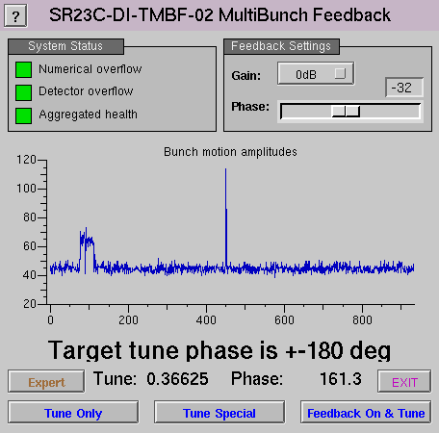
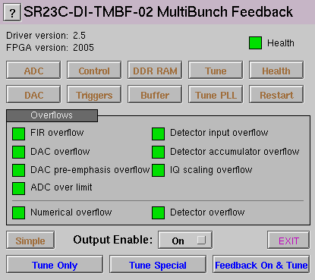
Top Level EPICS Control

Slide 7
New TMBF Capabilities
Bunch-by-bunch control of filter, output, gain.
Three output sources: FIR, two NCOs
Programmable sequencer
Tune following PLL
Output pre-emphasis filter, input compensation to come
2ns resolution triggers and synchronisation
Compensation for all offsets and delays
Notes:
This is why we're here: all the new stuff. Was originally a very small upgrade project, but took off as we discovered more capabilities and Guenther came up with more ideas.

Slide 8
Architecture and Implementation
Split between EPICS IOC (written in C) and FPGA (written in System Verilog)
Offset and delay compensation in software where possible: 19 delay parameters automatically measured and compensated
Libera platform provides SBC, DDR RAM, ADC, DAC. Everything else in DLS code

Slide 9
19 Compensated Delays
# DDR readout delays
DDR_ADC_DELAY = 230
DDR_FIR_DELAY = 1
DDR_RAW_DAC_DELAY = 5
DDR_DAC_DELAY = 10
# Buffer trigger delays
BUF_ADC_DELAY = 229
BUF_FIR_DELAY = 0
BUF_DAC_DELAY = 9
# MinMax buffer delays
MINMAX_ADC_DELAY = 228
MINMAX_DAC_DELAY = 8
# Bunch selection offsets
BUNCH_FIR_OFFSET = 228
BUNCH_GAIN_OFFSET = 0
# Detector single bunch offsets and phase
# skews
DET_ADC_OFFSET = 1
DET_FIR_OFFSET = 232
# These two values represent actual phase
# delays in bunches relative to an
# aligned single turn.
DET_ADC_DELAY = 0
DET_FIR_DELAY = 12
# Tune following delays
FTUN_ADC_OFFSET = 3
FTUN_FIR_OFFSET = 0
FTUN_ADC_DELAY = 928
FTUN_FIR_DELAY = 940
All measured automatically when testing a new FPGA version

Slide 10
FPGA System Overview
Loopback for Debug
input
FIR
FIR
output
ADC
NCO1
DAC
NCO2
DAC
capture
FIR
ADC
sequencer
&
detector
bunch
control
ADC
IQ
FIR
ADC
tune PLL
FIR
Notes:
Architectural overview of new system implementation showing the available system resources.

Slide 11
Data Capture
min/max
ADC
min/max
DAC
DDR
RAM
64M x 16
ADC
FIR
DAC
block
RAM
16k x 16 x 2
2 of 3
IQ

Slide 12
Output Control
Overflow
Detect
0
Off
FIR
NCO1
FIR+NCO1
NCO2
FIR+NCO2
NCO1+NCO2
FIR+NCO1+NCO2
FIR
NCO1
+
×
pre-
emphasis
FIR
delay:
0-935
NCO2
DAC
+
+
+
capture
Output
Select
Output
Gain
Bunch by bunch
control

Slide 13
A Fragment of FPGA Code
// DAC selection input multiplexer. The intermediate selection is 16 bits wide
// so we can detect overflow when adding up to three 14 bit values.
logic [7:0] [15:0] dac_out_mux = 0;
always_ff @(posedge adc_clk_i) begin
dac_out_mux[0] <= 0;
dac_out_mux[1] <= signed'(fir_dat_i);
dac_out_mux[2] <= signed'(hom_0_dat_i);
dac_out_mux[3] <= signed'(hom_0_dat_i) + signed'(fir_dat_i);
dac_out_mux[4] <= signed'(hom_1_dat_i);
dac_out_mux[5] <= signed'(hom_1_dat_i) + signed'(fir_dat_i);
dac_out_mux[6] <= signed'(hom_1_dat_i) + signed'(hom_0_dat_i);
dac_out_mux[7] <=
signed'(hom_1_dat_i) + signed'(hom_0_dat_i) + signed'(fir_dat_i);
end
wire [15:0] dac_out_sel = dac_out_mux[out_mux_sel_i];
// Latch final result and detect overflow
logic [13:0] dac_mux_out = 0;
logic mux_overflow = 0;
always_ff @(posedge adc_clk_i) begin
dac_mux_out <= dac_out_sel;
mux_overflow <= ~&dac_out_sel[15:13] & |dac_out_sel[15:13];
end

Slide 14
Bunch by Bunch Control
Different feedback on different bunches, helpful for unusual fill patterns
Precise control over tune sweeps (can measure up to four channels at once)
Low risk user time experiments on a single bunch (nobody cares too much if we break one bunch!)
Notes:
This was the first major capability upgrade.

Slide 15
Bunch Control
Current bunch configuration
FIR select
(one of 4)
Bank select
from
sequencer
Output select
(8 options)
Output gain
(range ±1023)
Sequencer selects one of four bunch control configurations. Selected configuration determines bunch by bunch behaviour.
Bunch configuration:
for each of 936 bunches selects:
FIR (2 bits)
output (3 bits)
gain (11 bits).
Bunch counter,
advances every
2ns
Notes:
This needs some explanation! The 8 output options are any selection from three outputs (FIR and two NCOs).

Slide 16
Tune Measurement
Excite system under test with fixed frequency sin wave
Measure response by mixing with original excitation: use both phases to get IQ response
Sweep excitation frequency to get response over a frequency range
device
under
test
cos
∿
detector
IQ
cos,sin

Slide 17
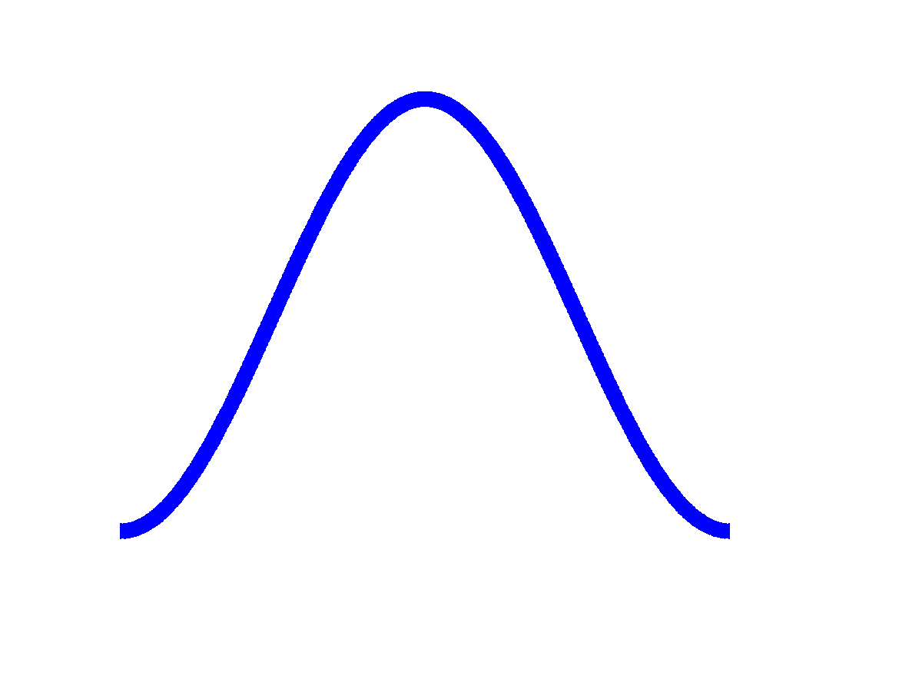
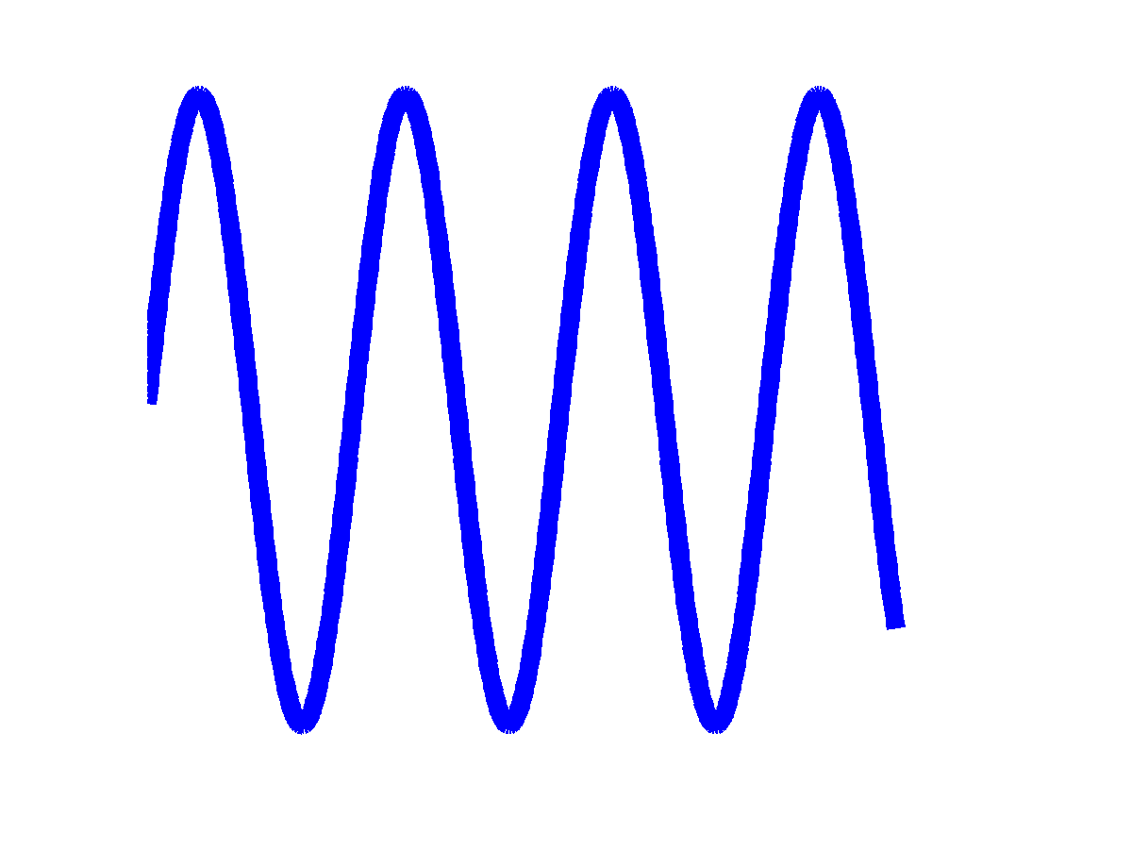
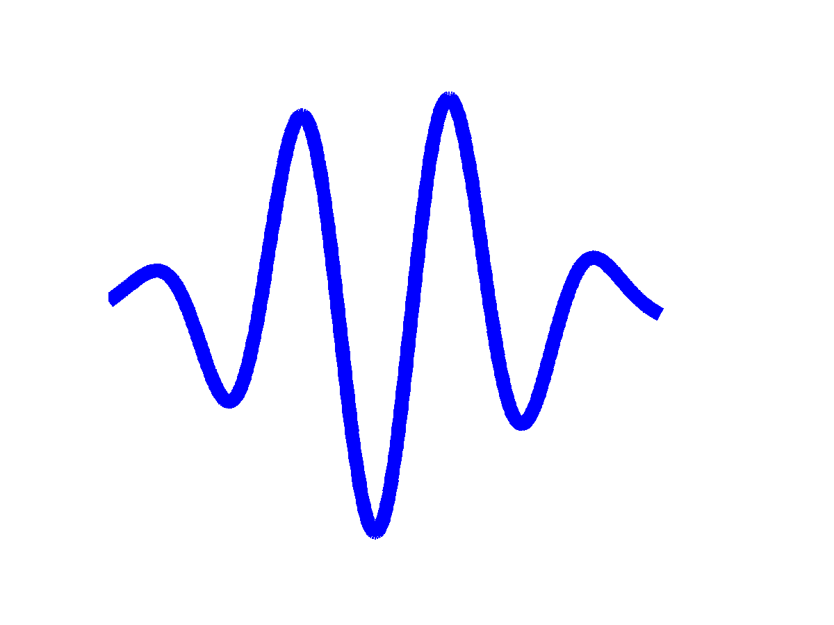
Detector Features
Blanking signal. External signal during injection to suspend detector during injection to avoid spurious noise.
Window. Windowing sine wave that doesn't fit into detector window controls leakage from adjacent frequencies:
⨯

Slide 18
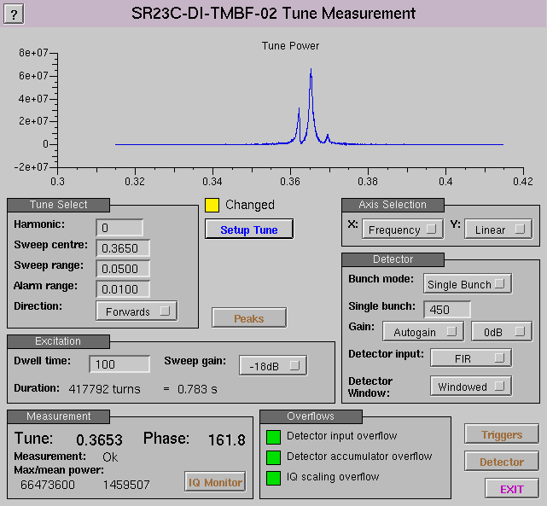
Tune Measurement Screen

Slide 19
Sequencer and Detector
DETECTOR
×
I
Σ
gain
ADC
×
FIR
IQ
×
Q
write IQ
blanking
event
NCO
NCO
cos
gain
NCO1
sin
frequency
gain
sequencer
window
bank
select

Slide 20
Programmable Sequencer
For tune sweeps and timed feedback control experiments. For up to 7 sequenced states can select:
Bunch configuration from one of four selections
Frequency sweep for NCO
Optional IQ data capture for sweep response
Duration of state
Notes:
This is the other major upgrade and the one with the most complex implications.

Slide 21
Sequencer Programme
Start on trigger
N state programme
State0
StateN
…
State1
State0
COUNT = C1
DWELL = D1
HOLDOFF = H1
Dwell0
Dwell1
...
DwellC-1
f1
f1+δf1
f0+(C1-1)δf1
H1 Turns
D1 turns: detector active
H1+D1 Turns
detector window
Notes:
Structure of a sequencer programme: a sequence of states, each state consisting of a sequence of dwells at each frequency as the NCO frequency is swept, each dwell consists of an optional holdoff followed by a detector capture period. Each dwell results in the capture of one (optional) IQ point.

Slide 22
Sequencer Applications
Tune sweep: one extra state with sweep
Complex machine investigations. For example, grow/damp exploration of unstable modes, can perform the following experiment:
  Running in feedback with standard feedback
  Turn feedback off, excite one mode for 100 turns
  Wait for natural growth of mode, eg 1000 turns
  Run an alternate feedback filter for 1000 turns
  Restore standard feedback, capture 1000 turns
Notes:
Sweeping, or all the complicated ideas that Guenther wants. This is just a slightly contrived example application.

Slide 23
Implementing Grow/Damp
State # | FIR | Output | Duration | Dwell time | Bank #
0 | Standard | FIR | - | - | 0
4 | - | Sweep NCO | 100 | 1 | 1
3 | - | Off | 1000 | 1 | 2
2 | Alternate | FIR | 1000 | 1 | 3
1 | Standard | FIR | 1000 | 1 | 0
0 | Standard | FIR | - | - | 0
Here we use four out of seven available sequencer states, two of four available feedback filters, and all four available bunch control banks.
The result of this experiment is 3100 IQ sample points.
Can also simultaneously capture turn by turn data into the fast DDR buffer if desired, have room for up to 35,000 turns in the buffer, but readout is relatively slow, around 1,200 turns per second.
Notes:
Digging into the contrived example to illustrate how the sequencer is designed to be used.

Slide 24
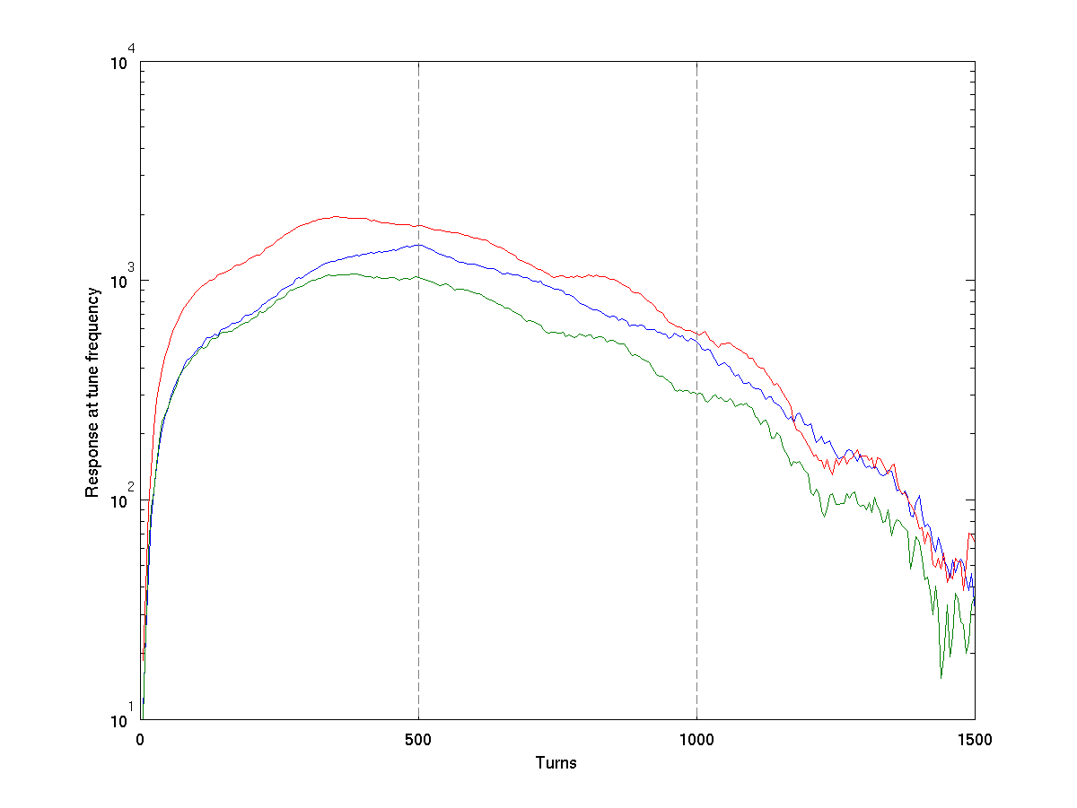
Graph of a Grow/Damp Experiment
Excite at tune and
selected mode
for 500 turns
Feedback off,
observe natural
damping
Feedback
restored
Notes:
A rather rough snapshot from a recent grow damp experiment (alas, not the four state one I was describing). Cleaner data would be nice...

Slide 25
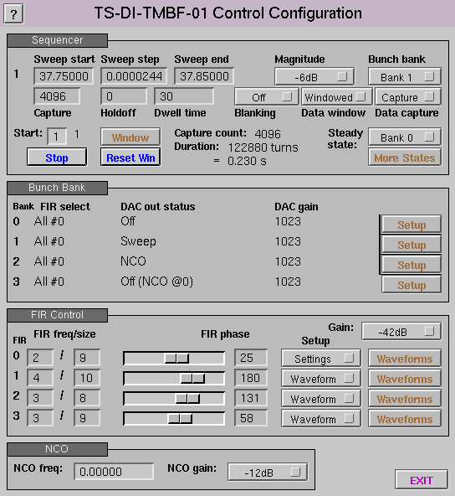
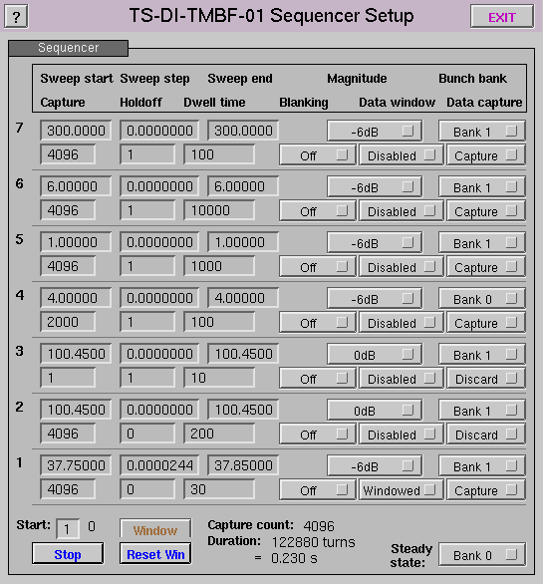
Low Level Control Screens

Slide 26
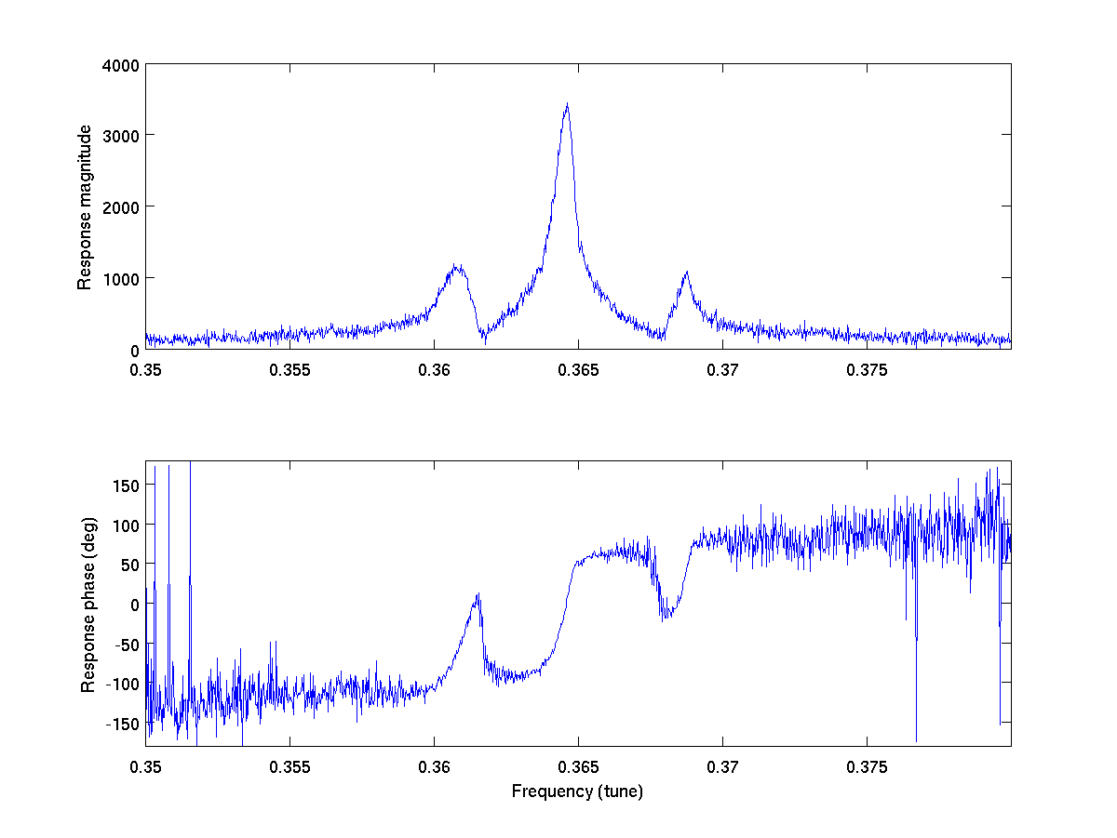
Tune Measurement
Peak response
at tune frequency
Synchrotron
sidebands
Note rapid phase change
when sweeping through
peak of resonance

Slide 27
Tune Phase Locked Loop
Take advantage of rapid phase change through tune frequency peak
Measure phase at, eg, 2.6 kHz (every 200 turns)
Run simple controller to track frequency to keep phase at target value
Result is high update rate tune measurement
Can quickly measure tune width by stepping phase through ±45°

Slide 28
Tune Phase Locked Loop
ADC
detector
CORDIC
IQ
phase
−
reference
phase
FIR
phase
error
cos,sin
NCO
NCO2
IIR
+
frequency correction
PI controller
KP
×
×
KI
buffer
reference
frequency
Σ
+

Slide 29
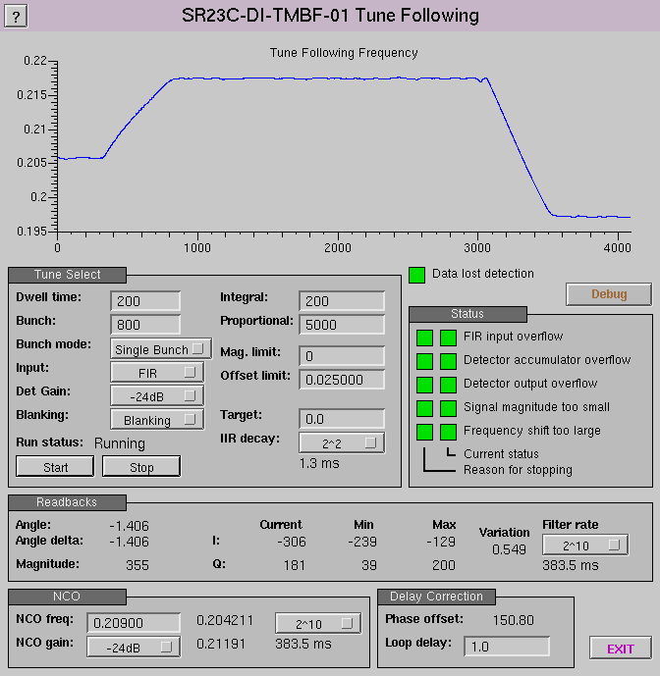
Tune PLL Screen
BBA orbit changes
cause changes in tune

Slide 30
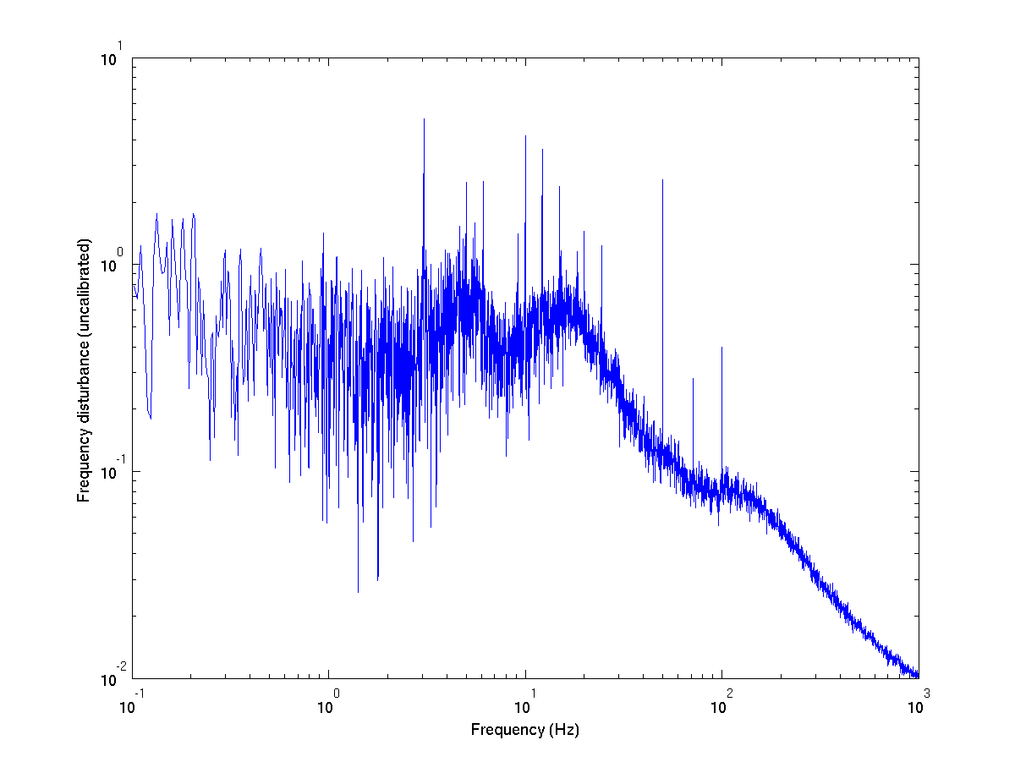
First PLL Tune Measurements
5, 10, 15 Hz, etc – injection?
3, 6, 9, 12 Hz, etc –
mystery signal, not seen
before this measurement
Mains (50 Hz, 100 Hz)
Long term 71.2 Hz signal
Believe comes from one
steerer, have seen this
signal for several years!
Broadband low frequency,
comes and goes.
Ground motion?
Controller mistune?
Controller rolloff

Slide 31
Output Pre-Emphasis
Loss of gain at high frequencies from DAC, Amplifier, ADC
Can partially compensate with 3-tap FIR in DAC output
Will also add 3-tap FIR to ADC input to compensate ADC high frequency droop

Slide 32
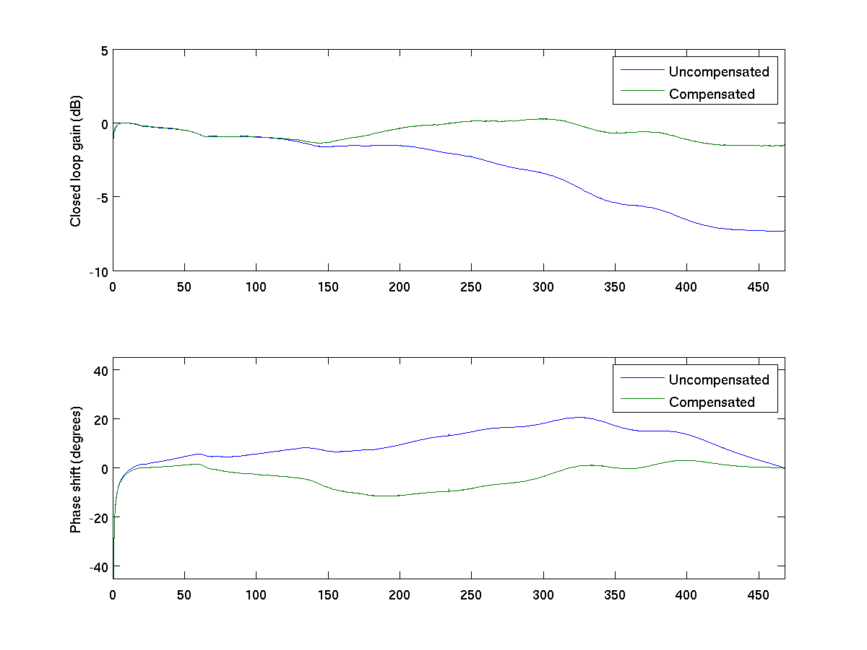
Closed Loop Gain Compensation
Filter coefficients: +1.323 -0.485 +0.162

Slide 33
2ns Trigger Synchronisation
FPGA runs with 8ns cycle: 4 machine bunches per tick
Need to identify which bunch is synchronous with incoming trigger
Need to identify trigger edge with 2ns precision

Slide 34
Discovering Trigger Edge
DDR
D-DDR
A
φ
φ
2φ
B
Trigger
Trigger with phase detect
φ
φ
C
2φ
φ
φ
D
φ
φ
A
B
C
D
A
B
C
D
Here we see ABCD go from
0000 to 0011 and can infer precise phase of trigger edge
0
0
0
0
0
0
1
1
φ
φ
φ

Slide 35
FPGA from a software perspective
You need a helpful FPGA expert! Isa's help and advice was invaluable
Completely different mind set: everything happens at once, not in sequence
Open tools are practically nonexistent, entire philosophy is very bound to vendors
System Verilog a horribly flawed language
Timing constraints always a perpetual problem
Solve problems with more pipelining!

Slide 36
Conclusions
Developing driver software and FPGA together: very satisfying and flexible
Many many thanks to:
  Isa Uzun for first version of FPGA and lots of advice
  Guenther Rehm for detailed steering, guidance, many ideas, and in-depth evaluation
  Graham Naylor for initial FPGA design
  I-Tech for the Libera TMBF platform

