Slide 1
Implementing, Extending and Comparing Choreographic Programming Languages and Session Types

Slide 2
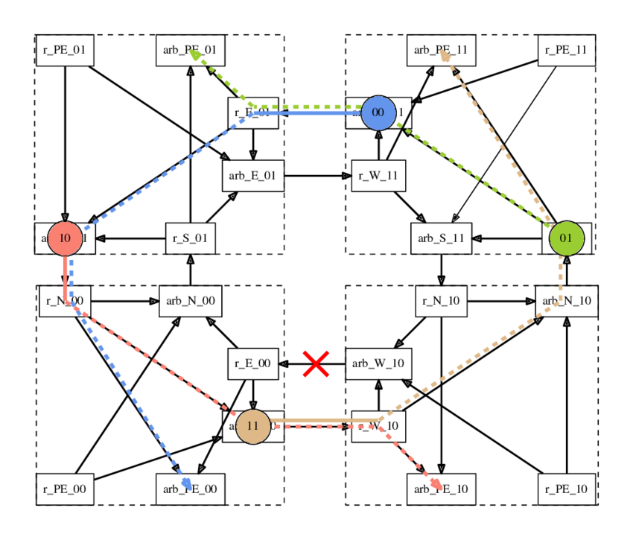
Concurrent Programming
Isolated systems are hard enough
Contracts with others even harder!
Main problem: Deadlocks!
Hard enough
Even
harder
https://www.researchgate.net/figure/llustration-of-a-deadlock-caused-by-a-cyclic-communication-dependency-Each-packet-is_fig2_293334968
Notes:
https://www.youtube.com/watch?v=w2wGwz_zNIw

Slide 3

Introduction
Had to shift goals multiple times
  Reflected in this presentation
Chronologic walkthrough
Point of reference: ChorLean

Slide 4
Overview
Implementing session types
Extend ChorLean
Mechanization of λ^{χ}

Slide 5
Goal: Implement Thiemann’s session types in Lean

Slide 6
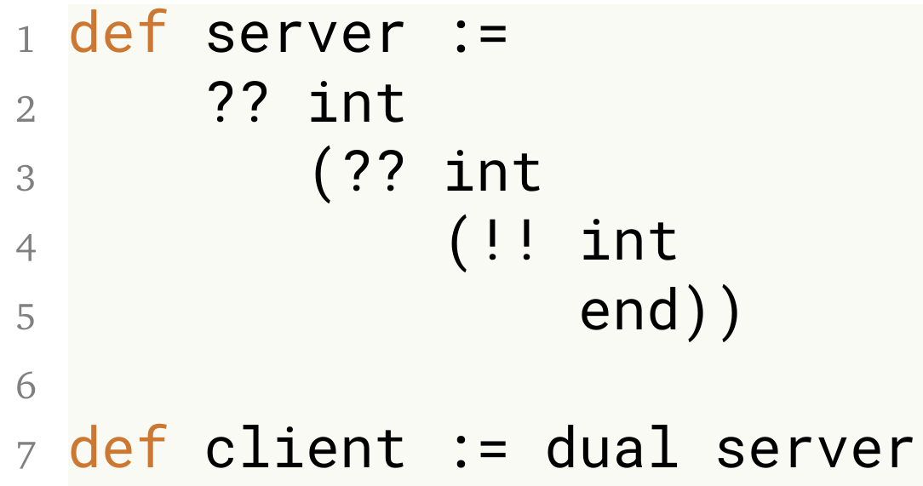
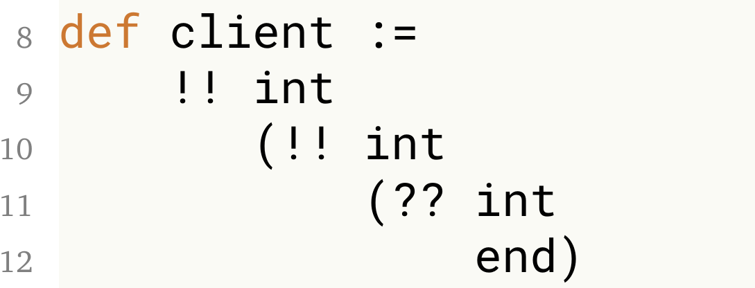
Implement Thiemann’s session types
Continuation = Rest of the program
Usually linear type system necessary
  Every value only used exactly once
Define communication protocol
Add 2 numbers and return result

Slide 7
Goal: Extend ChorLean

Slide 8
Choreographic Programming
Distributed program
Single program is compiled to multiple endpoints
Prevents deadlocks
com instead of send and recv
Located values
msg : string@client = "Hello"
receivedMsg : string@server
= com(server, msg)
Compiled to
Client:
Server:
msg : string = "Hello"
send(to=server, msg)
receivedMsg : string
= recv(from=client)

Slide 9
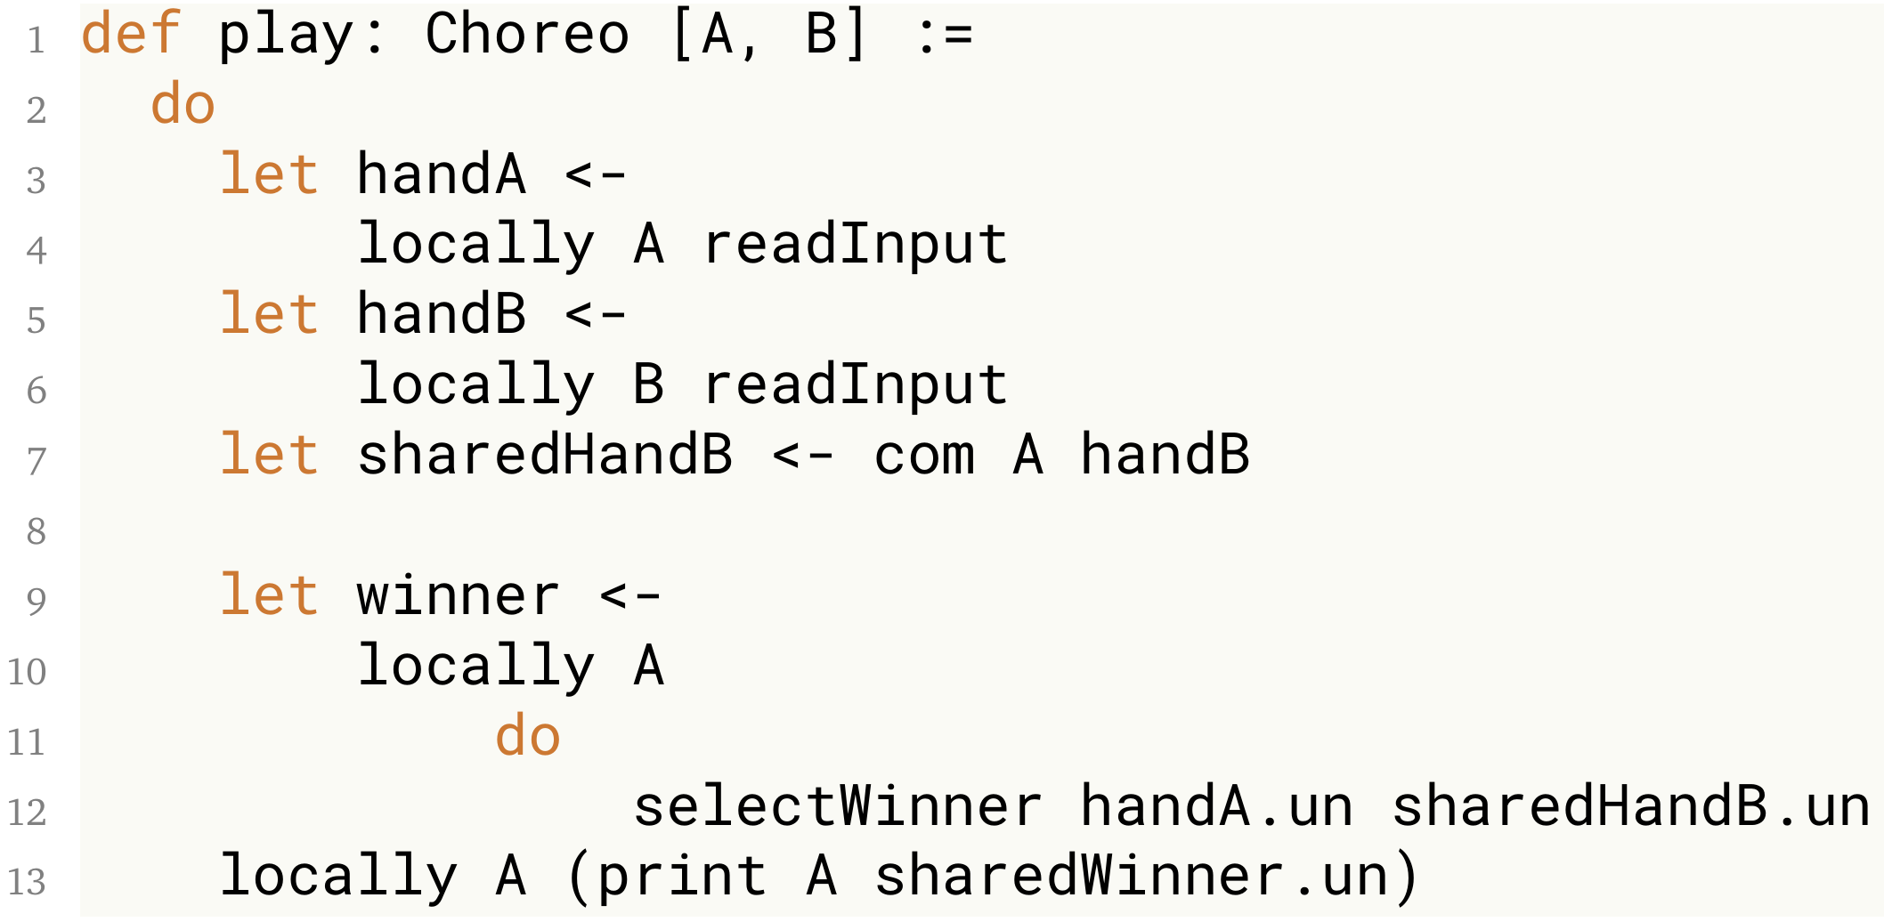
ChorLean: Rock Paper Scissors

Slide 10
Session Types
Not compatible
com send/recv
Viewpoint: global local

Slide 11
Goal: Extend ChorLean
  Exceptions

Slide 12
Exceptions
Multiple solutions inspected
Two-phase commit protocol
  Hard coded coordinator role
  What if coordinator fails?
Player 1
Coordinator
Player 2

Slide 13
Goal: Extend ChorLean
  Group chat application

Slide 14
Group chat
Trivial with Multitier Programming
  ScalaLoci
Impossible with ChorLean
  Possible solution: Advanced abstraction over peers
Differences:
  Topologies
  Distributed data structures
  First class choreographies
@A
@B
@B
@C

Slide 15
Goal: Extend ChorLean
  Find inspiration from other choreographic languages

Slide 16
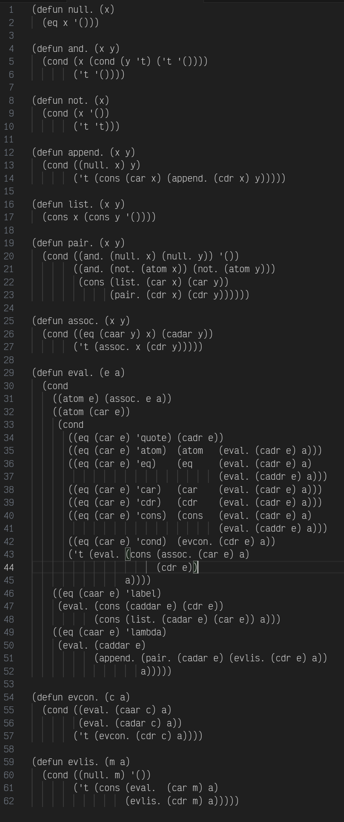
Lisp
Developed in 1960
  Compiler is 62 lines of code
Syntax: Linked lists
  Powerful macros
https://sep.turbifycdn.com/ty/cdn/paulgraham/jmc.lisp?t=1767460192&

Slide 17


Other Languages:
Written in Clojure
  A modern Lisp
  Dynamically typed
  Functional first
  Immutable data structures
Custom type checking with macros
  Custom error messages
  „Roles X is required here but you wrote Y“
  Breakpoint debugging and stack traces
Use usual language features without restrictions
https://raw.githubusercontent.com/lovrosdu/klor/master/klor.svg | https://clojure.org/images/clojure-logo-120b.png

Slide 18
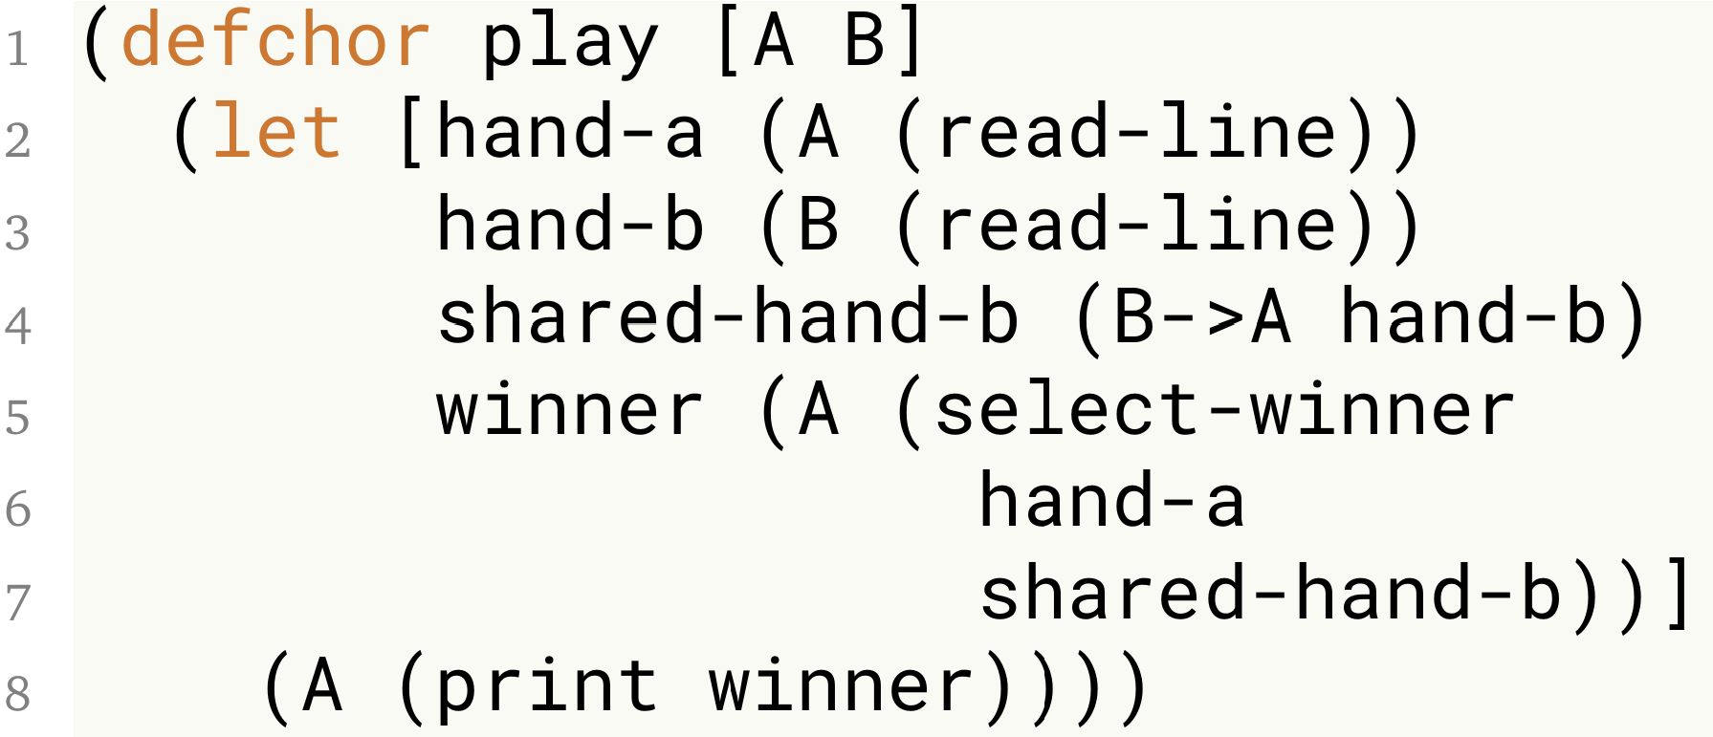
Other Languages:

Slide 19


Other Languages
MultiChor & HasChor
  Haskell
  Purely functional
  No dependent types
ChoRus
  Rust
  Not functional
  Mutation
https://raw.githubusercontent.com/lsd-ucsc/ChoRus/main/assets/ChoRus.png | https://raw.githubusercontent.com/gshen42/HasChor/main/haschor-logo.svg

Slide 20
Goal: Extend ChorLean
  Proof deadlock freedom

Slide 21

Proof Deadlock Freedom
Interaction Trees & Connectivity Graphs
  Data structures to represent programs
  Simplify proofs
  Written in Rocq (Coq)
  Simple example: 1500 lines of dense code

Slide 22
Proof Deadlock Freedom: λ^{χ}
Base for choreographic languages
  Unifies features and semantics
Lambda calculus
Simple set of rules
  Removed many rules from Chorλ
  Found obscure missing rules
Key insight: Neither strict nor lazy
  Semilenient

Slide 23
Proof Deadlock Freedom: λ^{χ}
Provides a full proof of deadlock freedom
But: No implementation

Slide 24
Goal: Mechanization of λ^{χ}
Future Work: Extend ChorLean
  Translate ChorLean to fit λ^{χ}
  Gain a „free“ proof of deadlock freedom

Slide 25
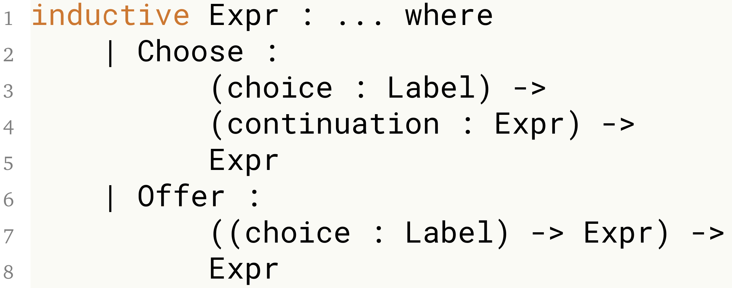
Mechanization of λ^{χ}
Show rps example instead

Slide 26
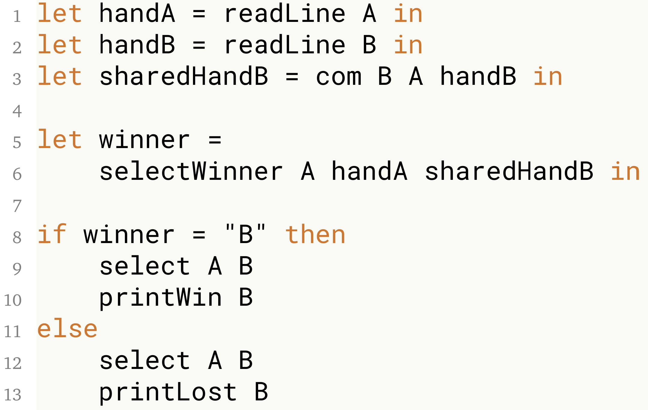
Mechanization of λ^{χ}

Slide 27
Future Work
Session Types
  Find use case for dependent types
  Combine with ChorLean
  Combine with multitier programming
Extend ChorLean
  Add better Exceptions
  Finish proof of deadlock freedom (e.g. c-graphs, λ^{χ})
  Implement group chat
  More inspiration from other languages
Compare choreographic with multitier
Finish mechanization of λ^{χ}
Improve other choreographic languages
  With knowledge from ChorLean

Slide 28
Conclusion
High complexity
Shifting goals
Implement Thiemann’s session types
Extend ChorLean
  Exceptions
  Group chat: Comparison with multitier programming
  Comparing with other choreographic languages
  Proving deadlock freedom
Mechanization of λ^{χ}

Slide 29
ChorLean Implementation
Point of reference
Show code
Explain roles

Slide 30
Dependent Types (Advantages)
Show Choreo definition
  Hint how dependent types work

Slide 31
MultiChor

Slide 32
ChoRus

