Slide 1





ISC 19 Tutorial: Getting Started with Containers on HPC
Carlos Eduardo Arango¹, Sameer Shende², Shane Canon³, Andrew J. Younge⁴
¹Sylabs Inc eduardo@sylabs.io | ²University of Oregon sameer@cs.uoregon.edu
³Lawrence Berkeley National Lab scanon@lbl.gov | ⁴Sandia National Labs ajyoung@sandia.gov

Slide 2
Outline
14:01 - 14:30 Introduction to Containers in HPC (Younge)
14:31 - 15:00 How to build your first Docker container (Canon)
15:00 - 15:30 How to deploy a container on a supercomputer (Canon)
15:30 - 16:00 -- Break --
16:00 - 16:30 How to build a Singularity container image (Arango)
16:30 - 17:00 Running Singularity on a supercomputer & adv features (Arango)
17:00 - 17:30 Running an HPC app on the E4S container (Shende)
17:30– 18:00 Success Stories and Summary (Canon)
Link: https://ecpcontainers.github.io/isc19-tutorial/

Slide 3
Introduction to Containers in HPC
Andrew Younge

Slide 4
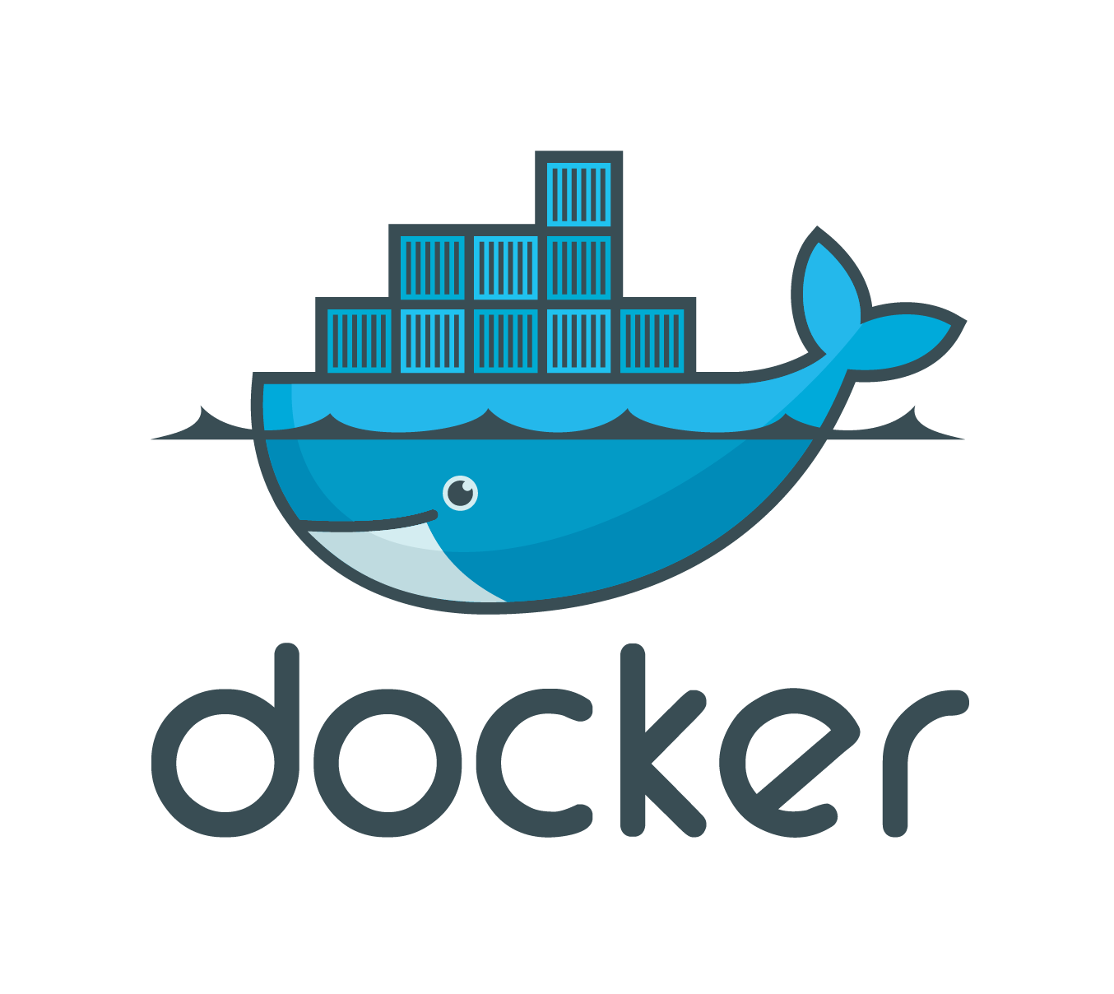
What are containers
A lightweight collection of executable software that encapsulates everything needed to run a single specific task
Minus the OS kernel
Based on Linux only
Processes and all user-level software is isolated
Creates a portable* software ecosystem
Think chroot on steroids
Docker most common tool today
Available on all major platforms
Widely used in industry
Integrated container registry via Dockerhub

Slide 5
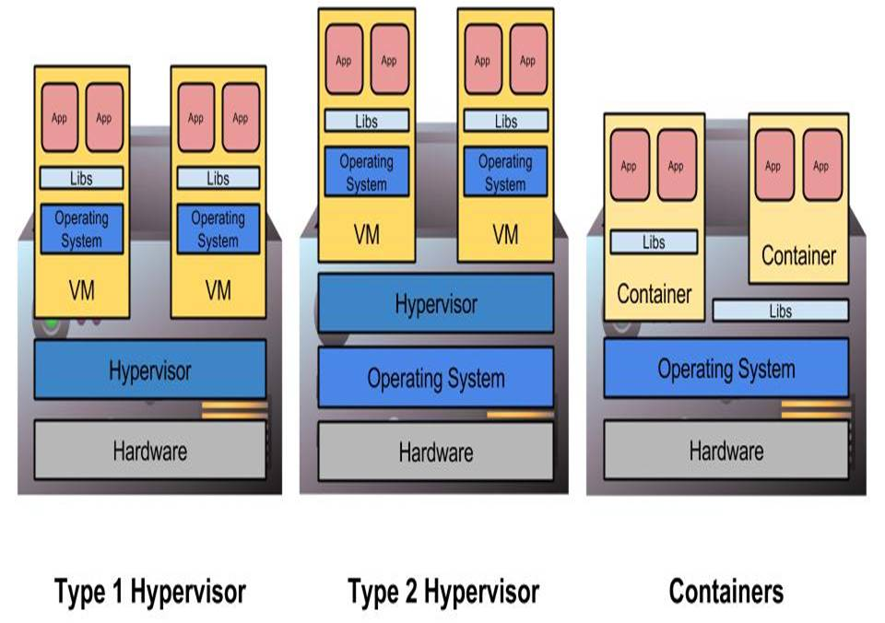
Hypervisors and Containers
Type 1 hypervisors insert layer below host OS
Type 2 hypervisors work as or within the host OS
Containers do not abstract hardware, instead provide “enhanced chroot” to create isolated environment
Location of abstraction can have impact on performance
All enable custom software stacks on existing hardware

Slide 6
Background
Abstracting hardware and software resources has had profound impact on computing
Virtual Machines to Cloud computing in the past decade
Early implementations limited by performance
HPC on clouds: FutureGrid, Magellan, Chameleon Cloud, Hobbes, etc
Some initial successes, but not always straightforward
OS-level virtualization a bit different
User level code packaged in container, can then be transported
Single OS kernel shared across containers and provides isolation
Cgroups traditionally multiplexes hardware resources
Performance is good, but OS flexibility is limited

Slide 7
Containers in Cloud Industry
Containers are used to create large-scale loosely coupled services
Each container runs just 1 user process – “micro-services”
3 httpd containers, 2 DBs, 1 logger, etc
Scaling achieved through load balancers and service provisioning
Jam many containers on hosts for increased system utilization
Helps with dev-ops issues
Same software environment for developing and deploying
Only images changes are pushed to production, not whole new image (CoW).
Develop on laptop, push to production servers
Interact with github similar to developer code bases
Upload images to ”hub” or “repository” whereby they can just be pulled and provisioned

Slide 8
Containers
Containers are gaining popularity for software management of distributed systems
Enable way for developers to specify software ecosystem
US DOE High Performance Computing (HPC) resources need to support emerging software stacks
Applicable to DevOps problems seen with large HPC codes today
Support new frameworks & cloud platform services
But HPC systems are very dissimilar from cloud infrastructure
MPI-based bulk synchronous parallel workloads are common
Scale-out to thousands of nodes
Performance is paramount
Notes:
How do we provide software ecosystem flexibility on extreme-scale supercomputing resources?

Slide 9
Container features in HPC
BYOE - Bring-Your-Own-Environment
Developers define the operating environment and system libraries in which their application runs.
Composability
Developers explicitly define how their software environment is composed of modular components as container images,
Enable reproducible environments that can potentially span different architectures.
Portability
Containers can be rebuilt, layered, or shared across multiple different computing systems
Potentially from laptops to clouds to advanced supercomputing resources.
Version Control Integration
Containers integrate with revision control systems like Git
Include not only build manifests but also with complete container images using container registries like Docker Hub.

Slide 10
Container features not wanted in HPC
Overhead
HPC applications cannot incur significant overhead from containers
Micro-Services
Micro-services container methodology does not apply to HPC workloads
1 application per node with multiple processes or threads per container
On-node Partitioning
On-node partitioning with cgroups is not necessary (yet?)
Root Operation
Containers allow root-level access control to users
In supercomputers this is unnecessary and a significant security risk for facilities
Commodity Networking
Containers and their network control mechanisms are built around commodity networking (TCP/IP)
Supercomputers utilize custom interconnects w/ OS kernel bypass operations

Slide 11



HPC Containers
Docker not good fit for running HPC workloads
Security issues
Can’t allow root on shared resources
Lack of HPC architecture support
No batch integration
Assumes local resources
Assumes commodity TCP/IP
Many different container options in HPC
Shifter Singularity Charliecloud …

Slide 12
Developing Container Vision
Support software dev and testing on laptops
Working builds that then can run on supercomputers
Dev time on supercomputers is expensive
May also leverage VM/binary translation
Let developers specify how to build the env AND app
Import and run container on target platform
Many containers, but can have different code “branches”
Not bound to vendor and sysadmin software
Focus on Interoperability
Provide containerized services coupled with simulations
Developing mechanisms to support services
Performance matters
Want to manage permutations of architectures and compilers
Ensure container implementations on HPC are performant
Keep features to support future complete workflows
Notes:
Caveat: you are your own helpdesk or support services

Slide 13
Container DevOps
Impractical for apps to use large-scale supercomputers for DevOps and/or testing
HPC resources have long batch queues
Dev time commonly delayed as a result
Create deployment portability with containers
Develop Docker containers on your laptop or workstation
Leverage Gitlab registry services
Separate networks maintain separate registries
Import to target deployment
Leverage local resource manager

Slide 14
This tutorial will show you:
How to build your first Docker container.
How to run a Docker container on a supercomputer with Shifter.
How to build your first Singularity container.
How to run a container on a supercomputer with Singularity.
And work with some Sylabs cloud features
How to use the Extreme-scale Scientific Software Stack (E4S) container image.
And a bit about Spack
And maybe some best practices and lessons learned.

Slide 15
Tutorial Link
https://ecpcontainers.github.io/isc19-tutorial/

Slide 16
CANOPIE HPC WORKSHOP Containers and New Orchestration Paradigms for Isolated Environments in HPC
https://canopie-hpc.nersc.gov/
Submission Deadline: September 2nd, 2019

Slide 17
Number | IP | Username | Password
1 | 34.214.92.245 | tutorial | HPCLinux12!
2 | 54.213.158.55 | tutorial | HPCLinux12!
3 | 52.36.223.133 | tutorial | HPCLinux12!
4 | 34.222.134.220 | tutorial | HPCLinux12!
5 | 52.32.19.184 | tutorial | HPCLinux12!
6 | 54.149.163.157 | tutorial | HPCLinux12!
7 | 54.185.253.100 | tutorial | HPCLinux12!
8 | 52.38.149.225 | tutorial | HPCLinux12!
9 | 34.216.223.223 | tutorial | HPCLinux12!
10 | 34.220.187.130 | tutorial | HPCLinux12!
11 | 52.12.80.43 | tutorial | HPCLinux12!
12 | 52.11.209.11 | tutorial | HPCLinux12!
13 | 34.215.208.182 | tutorial | HPCLinux12!
14 | 34.222.129.101 | tutorial | HPCLinux12!
15 | 34.213.69.137 | tutorial | HPCLinux12!
16 | 54.201.140.162 | tutorial | HPCLinux12!
17 | 54.200.17.194 | tutorial | HPCLinux12!
18 | 34.213.235.30 | tutorial | HPCLinux12!
19 | 34.211.225.174 | tutorial | HPCLinux12!
20 | 34.209.150.45 | tutorial | HPCLinux12!
Number | IP | Username | Password
21 | 54.184.113.47 | tutorial | HPCLinux12!
22 | 34.218.232.221 | tutorial | HPCLinux12!
23 | 34.217.105.148 | tutorial | HPCLinux12!
24 | 54.148.128.9 | tutorial | HPCLinux12!
25 | 54.201.33.248 | tutorial | HPCLinux12!
26 | 18.237.255.117 | tutorial | HPCLinux12!
27 | 34.217.180.124 | tutorial | HPCLinux12!
28 | 52.25.78.125 | tutorial | HPCLinux12!
29 | 54.187.155.155 | tutorial | HPCLinux12!
30 | 34.218.249.188 | tutorial | HPCLinux12!
31 | 34.219.144.68 | tutorial | HPCLinux12!
32 | 34.212.185.214 | tutorial | HPCLinux12!
33 | 54.202.195.99 | tutorial | HPCLinux12!
34 | 54.202.6.162 | tutorial | HPCLinux12!
35 | 18.236.176.142 | tutorial | HPCLinux12!
36 | 52.39.76.233 | tutorial | HPCLinux12!
37 | 18.237.253.123 | tutorial | HPCLinux12!
38 | 34.210.187.148 | tutorial | HPCLinux12!
39 | 34.208.254.73 | tutorial | HPCLinux12!
40 | 34.219.72.114 | tutorial | HPCLinux12!

Slide 18
Questions?
Next: learn how to work with your first container!

