Slide 1
Coexistence of Wi-Fi and Li-Fi Towards 5G: Concepts, Opportunities, and Challenges
Aranjay Rewanwar (20927312), Juhi Bachani (20979706)
Electrical and Computer Engineering Department, University of Waterloo

Slide 2
Index
Introduction
HetNets
Problems in current network
The Proposed Li-Fi and Wi-Fi HetNet
Li-Fi and Wi-Fi Together
Multiple Links and Aggregation
The Li-Fi Transceivers
Comparison of three systems
Hybrid Vs Aggregated system
Throughput Vs Distance
Throughput Vs Blockage Duration
Future of Li-Fi and Wi-Fi
Conclusion

Slide 3
Introduction
Watching HD streaming movies and videos, playing online games, and accessing cloud-based services are the key data-intensive activities for users now and in the future.
Due to which the demand for wireless voice and data services has increased.
Operators are struggling to meet this increased demand without compromising the quality of service.
Fifth Generation (5G) will not only be able to meet the need of increasing data rate but also provide low latency.

Slide 4
HetNets
Heterogeneous networks (HetNets) will play a key role in integrating a diversified spectrum to provide high quality-of-service (QoS).
In a HetNet, where RF microcells, RF-SCs, and O-SCs comprise a three-layer network, Li-Fi-enabled indoor luminaires (lights) can be depicted as optical SCs (OSCs) enabling increased coverage at user-occupied sites, and Li-Fi microcells that increase capacity by using the optical spectrum.

Slide 5
Problems in current network
The carrier sense multiple access with collision avoidance (CSMA/CA) allows only one link to be active in dense deployments, due to which the sustainable performance of Wi-Fi will be reduced.
Concurrent multiuser transmission is used in Wi-Fi but there are complexity limits with larger numbers of antennas.
Due to these complex issues and the increasing demand for Wi-Fi, scalability is limited and there is a rationale to consider other wireless media.

Slide 6
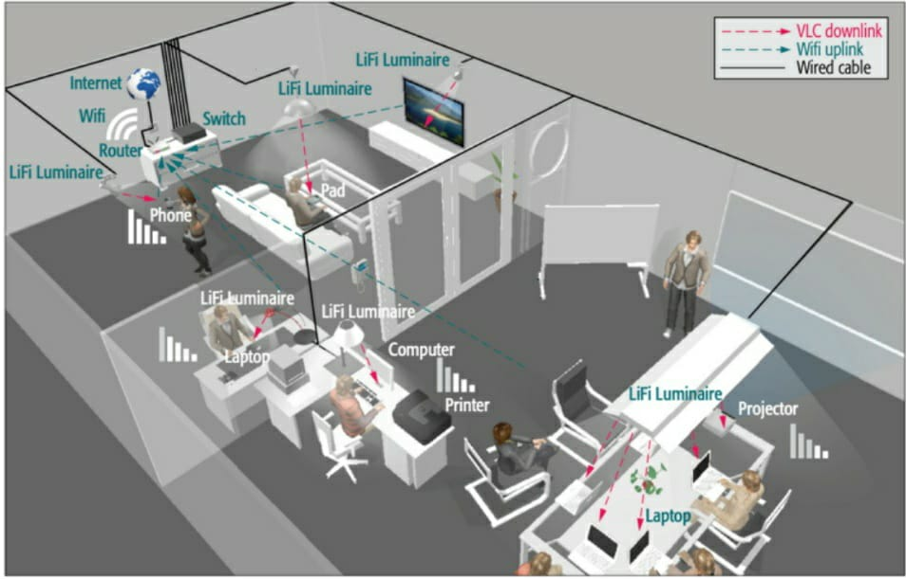
The proposed Li-Fi and Wi-Fi HetNet

Slide 7
Li-Fi and Wi-Fi Together
Due to increased indoor traffic, the performance of a single Wi-Fi AP or numerous Wi-Fi APs should be improved by offloading traffic to the most localized and directed Li-Fi.
The proposed Li-Fi & Wi-Fi system also has certain novel characteristics, such as improved O-SC security.
Li-Fi will serve as the downlink, which should free up Wi-Fi system capacity to accommodate any future traffic-uploading expansion.
The stationary user will get access to data by Li-Fi enabled luminaire.
Which reduces congestion of traffic and free up RF resources that can serve more users which are not in Li-Fi coverage area.

Slide 8
Multiple links and Aggregation
Multiple luminaires are present, and it is assumed that the transmitter knows every user device (UD) in the room's channel state information (CSI) but it cannot be error-free from a practical standpoint.
When high throughput is required, a user is connected to many optical channels.
When a user is hooked to a single luminaire (SISO configuration) or many luminaires simultaneously (MIMO configuration), there will be 3 Scenarios:
Single user is connected to a single luminaire.
Single user is served by multiple luminaires.
Multiple users connected to multiple luminaires.

Slide 9
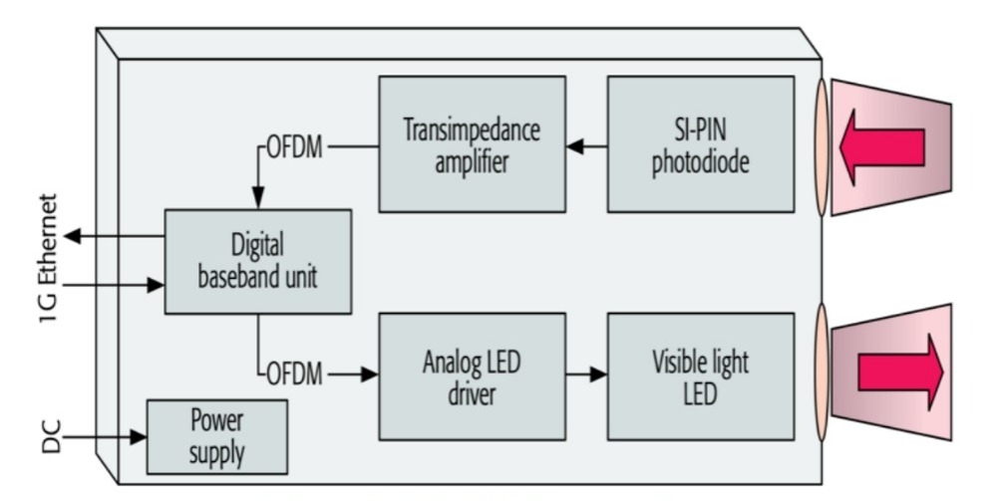
The Li-Fi Transceivers

Slide 10
The Li-Fi Transceivers
A large-area high-speed silicon PIN photodiode is employed in the receiver, along with a trans-impedance amplifier (TIA).
To concentrate the beam and enhance the receiving area, a plano-convex 1" lens is used by both the LED and the photodiode.
The digital baseband unit (BBU) converts Ethernet packets into DC-biased orthogonal frequency division multiplexing (OFDM) signals.
The BBU uses pilot-assisted channel estimation and frequency-domain equalization.
The received pilot sequence is used to determine the error vector magnitude (EVM), which is then sent back to the transmitter.
To ensure that no errors occur after forward error correction, the data rate is increased as much as possible.

Slide 11
Comparison of three systems
The Wi-Fi is solely used to connect to the Internet.
Hybrid system - uses Wi-Fi to connect to the Internet, but one of the users' downlinks is connected via a Li-Fi link. The unidirectional Li-Fi link is used in this system to supplement the traditional Wi-Fi downlink.
Aggregated system - one user is simultaneously connected to both Wi-Fi and Li-Fi. Both bi-directional Wi-Fi and Li-Fi links are completely employed to increase possible throughput and offer reliable network connectivity.

Slide 12
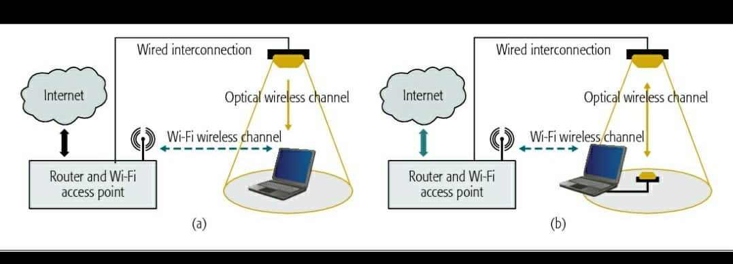
Hybrid Vs Aggregated system

Slide 13
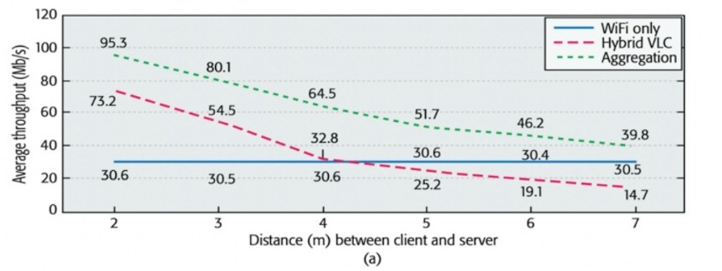
Throughput Vs. Distance

Slide 14
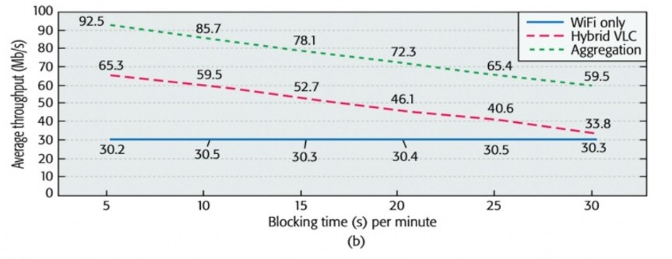
Throughput Vs. Blockage Duration

Slide 15
Future of Li-Fi & Wi-Fi
This survey opens several doors for field research on the existence of both Wi-Fi and Li-Fi.
Where Li-Fi gives an enhanced interior experience by delivering high data speeds and security, and Wi-Fi provides increased off-loading opportunities.
The integration of these two technologies produces an output that is needed in the field.
According to operators, 80 percent of mobile traffic happens indoors; thus, the combination of Li-Fi and Wi-Fi has a lot of promise in future HetNets, including next-generation (5G) mobile telecommunications systems

Slide 16
Conclusion
HetNets are useful in this situation because they provide additional wireless bandwidth at the required location, resulting in increased indoor connectivity.
Li-Fi has evolved into a ubiquitous system technology with unique networking capabilities for universal application, allowing a variety of device platforms to connect over the internet at high rates.
Both technologies together gives triple average throughput for a single user.

