Slide 1

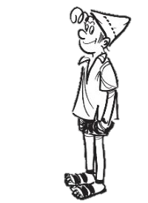
DO ISRAELIS DIFFER BY PERSONALITY?
Tamar Aranoff
14.9 11:10

Slide 2
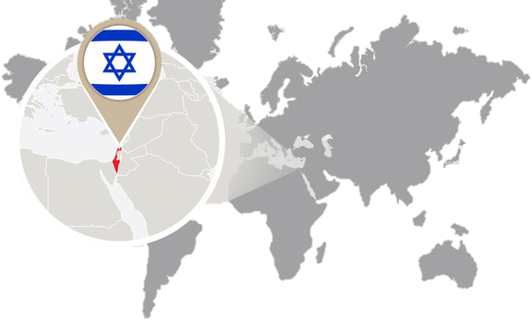

Who is the Israeli?

Slide 3

HOW TO MEASURE PERSONALITY?

Slide 4
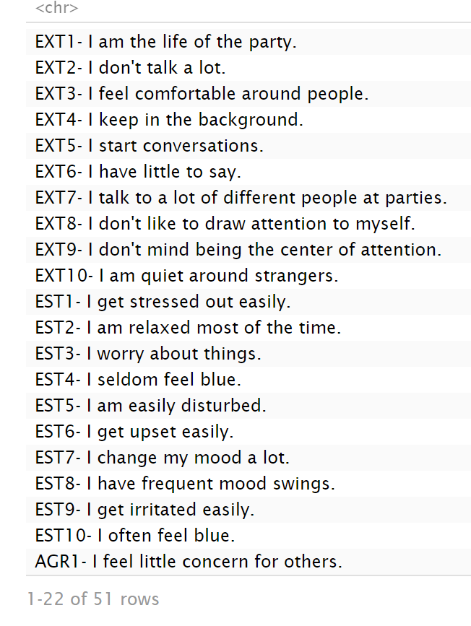
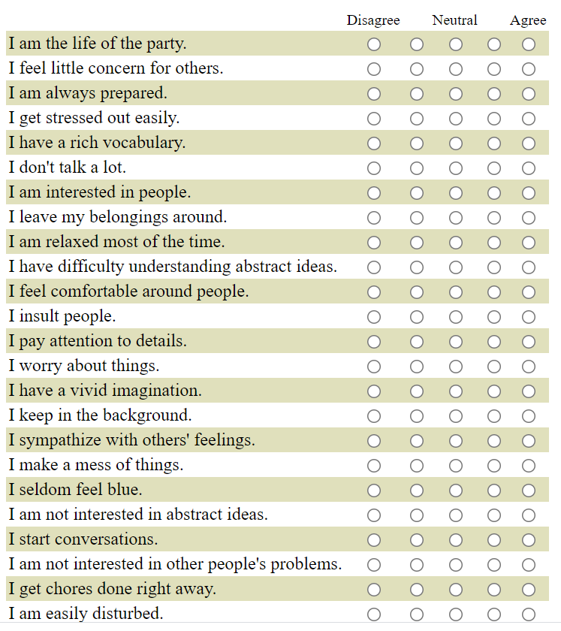
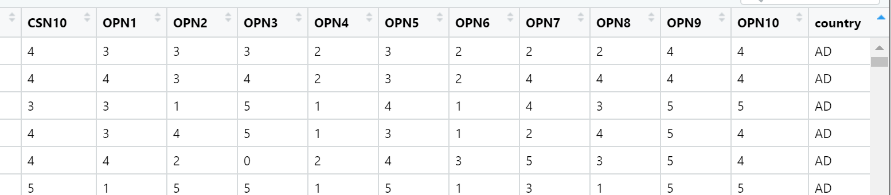
DATA

Slide 5
EXPLORATORY DATA ANALYSIS

Slide 6
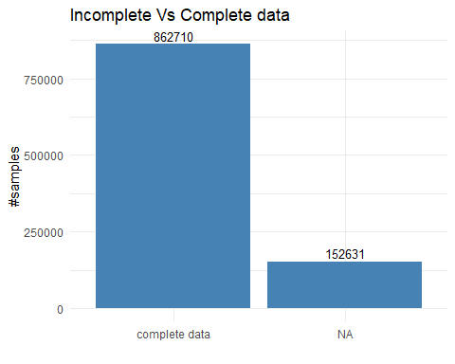
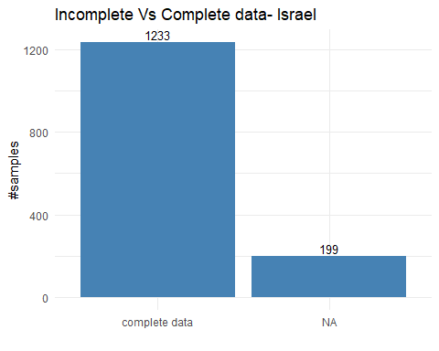
EXPLORATORY DATA ANALYSIS - Missing DATA
World
Israel

Slide 7
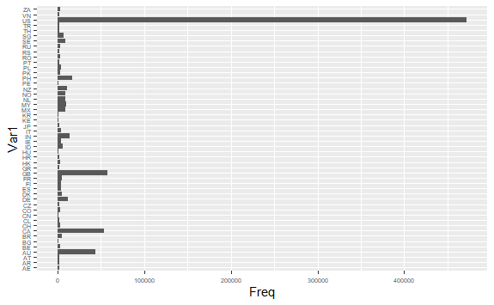
EXPLORATORY DATA ANALYSIS – World reflection

Slide 8
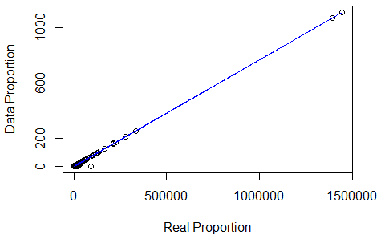
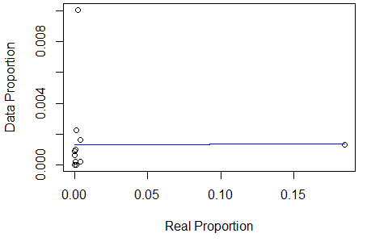
EXPLORATORY DATA ANALYSIS – World reflection

Slide 9
EXPLORATORY DATA ANALYSIS – Features
WHAT FEATURES?
First try- 50 likert scale answers
What type? Ordinal
EXT 1 | EXT 2 | EXT 3 | EXT 4 | EXT 5 | EXT 6 | EXT 7 | EXT 8 | EXT 9 | EXT 10 | EST 1 | EST 2 | EST 3 | EST 4 | EST 5 | EST 6 | EST 7 | EST 8 | EST 9 | EST 10 | AGR1 | AGR2 | AGR3 | AGR4 | AGR5 | AGR6 | AGR7 | AGR8 | AGR9 | AGR10 | CSN1 | CSN2 | CSN3 | CSN4 | CSN5 | CSN6 | CSN7 | CSN8 | CSN9 | CSN10 | OPN1 | OPN2 | OPN3 | OPN4 | OPN5 | OPN6 | OPN7 | OPN8 | OPN9 | OPN10
4 | 1 | 5 | 2 | 5 | 1 | 5 | 2 | 4 | 1 | 1 | 4 | 4 | 2 | 2 | 2 | 2 | 2 | 3 | 2 | 2 | 5 | 2 | 4 | 2 | 3 | 2 | 4 | 3 | 4 | 3 | 4 | 3 | 2 | 2 | 4 | 4 | 2 | 4 | 4 | 5 | 1 | 4 | 1 | 4 | 1 | 5 | 3 | 4 | 5
3 | 5 | 3 | 4 | 3 | 3 | 2 | 5 | 1 | 5 | 2 | 3 | 4 | 1 | 3 | 1 | 2 | 1 | 3 | 1 | 1 | 4 | 1 | 5 | 1 | 5 | 3 | 4 | 5 | 3 | 3 | 2 | 5 | 3 | 3 | 1 | 3 | 3 | 5 | 3 | 1 | 2 | 4 | 2 | 3 | 1 | 4 | 2 | 5 | 3
2 | 3 | 4 | 4 | 3 | 2 | 1 | 3 | 2 | 5 | 4 | 4 | 4 | 2 | 2 | 2 | 2 | 2 | 1 | 3 | 1 | 4 | 1 | 4 | 2 | 4 | 1 | 4 | 4 | 3 | 4 | 2 | 2 | 2 | 3 | 3 | 4 | 2 | 4 | 2 | 5 | 1 | 2 | 1 | 4 | 2 | 5 | 3 | 4 | 4
2 | 2 | 2 | 3 | 4 | 2 | 2 | 4 | 1 | 4 | 3 | 3 | 3 | 2 | 3 | 2 | 2 | 2 | 4 | 3 | 2 | 4 | 3 | 4 | 2 | 4 | 2 | 4 | 3 | 4 | 2 | 4 | 4 | 4 | 1 | 2 | 2 | 3 | 1 | 4 | 4 | 2 | 5 | 2 | 3 | 1 | 4 | 4 | 3 | 3
3 | 3 | 3 | 3 | 5 | 3 | 3 | 5 | 3 | 4 | 1 | 5 | 5 | 3 | 1 | 1 | 1 | 1 | 3 | 2 | 1 | 5 | 1 | 5 | 1 | 3 | 1 | 5 | 5 | 3 | 5 | 1 | 5 | 1 | 3 | 1 | 5 | 1 | 5 | 5 | 5 | 1 | 5 | 1 | 5 | 1 | 5 | 3 | 5 | 5
3 | 3 | 4 | 2 | 4 | 2 | 2 | 3 | 3 | 4 | 3 | 4 | 3 | 2 | 2 | 1 | 2 | 1 | 2 | 2 | 2 | 3 | 1 | 4 | 2 | 3 | 2 | 3 | 4 | 4 | 3 | 2 | 4 | 1 | 3 | 2 | 4 | 3 | 4 | 3 | 5 | 1 | 5 | 1 | 3 | 1 | 5 | 4 | 5 | 2
4 | 3 | 4 | 3 | 3 | 3 | 5 | 3 | 4 | 3 | 2 | 4 | 4 | 2 | 4 | 2 | 2 | 2 | 4 | 4 | 1 | 2 | 1 | 5 | 3 | 5 | 3 | 4 | 4 | 5 | 3 | 2 | 4 | 2 | 1 | 4 | 4 | 2 | 2 | 5 | 5 | 2 | 4 | 3 | 4 | 1 | 5 | 5 | 4 | 4
3 | 1 | 5 | 2 | 5 | 2 | 5 | 2 | 3 | 2 | 2 | 4 | 2 | 4 | 2 | 1 | 2 | 1 | 1 | 1 | 2 | 5 | 2 | 4 | 3 | 2 | 2 | 4 | 4 | 4 | 5 | 1 | 5 | 1 | 4 | 2 | 3 | 2 | 5 | 5 | 4 | 1 | 3 | 1 | 5 | 1 | 4 | 3 | 4 | 5
2 | 2 | 3 | 3 | 4 | 2 | 2 | 2 | 4 | 4 | 3 | 4 | 4 | 1 | 2 | 2 | 3 | 2 | 3 | 4 | 1 | 5 | 1 | 5 | 1 | 3 | 1 | 4 | 4 | 4 | 3 | 3 | 4 | 0 | 3 | 4 | 1 | 2 | 1 | 4 | 4 | 1 | 5 | 1 | 4 | 1 | 5 | 2 | 5 | 5
1 | 5 | 3 | 5 | 2 | 3 | 2 | 4 | 5 | 4 | 3 | 3 | 3 | 3 | 4 | 3 | 3 | 3 | 3 | 3 | 5 | 3 | 5 | 1 | 5 | 3 | 4 | 2 | 3 | 2 | 2 | 5 | 1 | 5 | 1 | 4 | 3 | 4 | 2 | 2 | 3 | 1 | 3 | 1 | 3 | 3 | 4 | 3 | 3 | 3
3 | 3 | 2 | 3 | 3 | 2 | 4 | 3 | 3 | 5 | 4 | 3 | 4 | 1 | 2 | 3 | 5 | 4 | 4 | 5 | 2 | 5 | 3 | 4 | 2 | 3 | 1 | 3 | 4 | 2 | 1 | 5 | 5 | 5 | 1 | 5 | 3 | 1 | 1 | 5 | 5 | 1 | 5 | 1 | 5 | 1 | 5 | 5 | 5 | 5
3 | 1 | 5 | 3 | 5 | 1 | 5 | 5 | 5 | 3 | 5 | 1 | 3 | 1 | 5 | 5 | 5 | 5 | 5 | 3 | 2 | 5 | 5 | 3 | 3 | 5 | 3 | 5 | 5 | 5 | 5 | 5 | 5 | 3 | 5 | 5 | 5 | 3 | 3 | 5 | 4 | 1 | 5 | 1 | 5 | 3 | 1 | 5 | 5 | 5
4 | 1 | 5 | 4 | 5 | 1 | 4 | 1 | 5 | 2 | 1 | 5 | 1 | 2 | 1 | 1 | 5 | 4 | 1 | 5 | 1 | 5 | 2 | 5 | 1 | 4 | 1 | 5 | 5 | 5 | 2 | 4 | 5 | 4 | 2 | 3 | 1 | 4 | 1 | 2 | 5 | 1 | 5 | 1 | 4 | 1 | 5 | 5 | 5 | 5
1 | 5 | 1 | 5 | 1 | 5 | 1 | 5 | 1 | 5 | 5 | 1 | 5 | 1 | 4 | 5 | 3 | 3 | 4 | 5 | 2 | 2 | 2 | 3 | 3 | 3 | 3 | 0 | 3 | 1 | 3 | 2 | 5 | 3 | 4 | 1 | 5 | 3 | 4 | 3 | 5 | 1 | 4 | 1 | 2 | 2 | 4 | 5 | 5 | 3
1 | 5 | 2 | 5 | 1 | 4 | 1 | 2 | 2 | 5 | 4 | 3 | 5 | 1 | 4 | 4 | 4 | 2 | 4 | 5 | 2 | 5 | 4 | 5 | 1 | 5 | 2 | 4 | 5 | 5 | 4 | 4 | 2 | 4 | 2 | 3 | 4 | 1 | 4 | 5 | 5 | 4 | 5 | 5 | 4 | 1 | 4 | 4 | 5 | 5
2 | 1 | 3 | 4 | 4 | 3 | 5 | 3 | 3 | 5 | 4 | 2 | 3 | 3 | 3 | 4 | 3 | 3 | 5 | 5 | 5 | 5 | 5 | 5 | 2 | 3 | 3 | 3 | 4 | 5 | 3 | 3 | 4 | 4 | 4 | 2 | 3 | 3 | 4 | 5 | 5 | 2 | 5 | 3 | 4 | 1 | 3 | 3 | 5 | 5
Extraversion | Neuroticism | Agreeableness | Conscientiousness | Openness
31 | 45 | 43 | 17 | 41
31 | 33 | 21 | 37 | 43
27 | 32 | 23 | 47 | 30
28 | 18 | 33 | 24 | 29
43 | 40 | 12 | 34 | 31
26 | 26 | 38 | 25 | 33
39 | 29 | 41 | 19 | 45
31 | 45 | 43 | 17 | 41
1 | 5 | 2 | 5 | 5
3 | 4 | 3 | 3 | 3
1 | 5 | 5 | 5 | 5
3 | 1 | 5 | 5 | 5
1 | 5 | 5 | 5 | 5
2 | 4 | 5 | 5 | 3
Openness
Conscientiousness
Agreeableness
Neuroticism
Extraversion

Slide 10
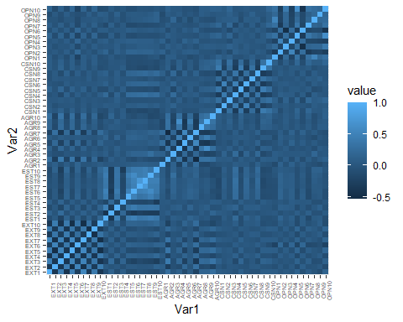
EXPLORATORY DATA ANALYSIS – Feature relationships

Slide 11
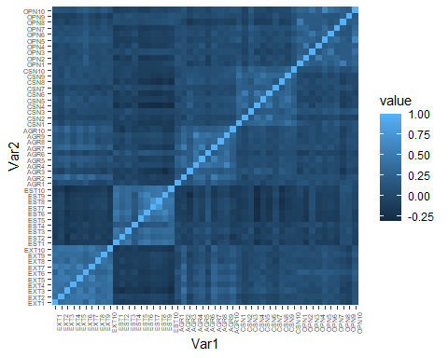
EXPLORATORY DATA ANALYSIS – Feature relationships

Slide 12
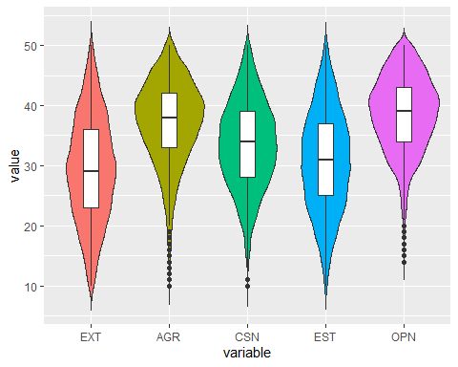
EXPLORATORY DATA ANALYSIS – Features relationships

Slide 13
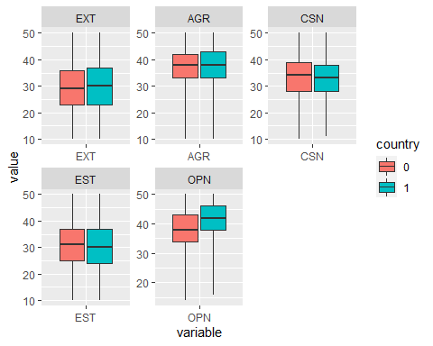
EXPLORATORY DATA ANALYSIS – Features relationships

Slide 14
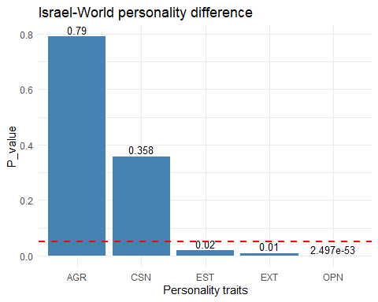
EXPLORATORY DATA ANALYSIS – Features relationships

Slide 15
INFERENCE

Slide 16
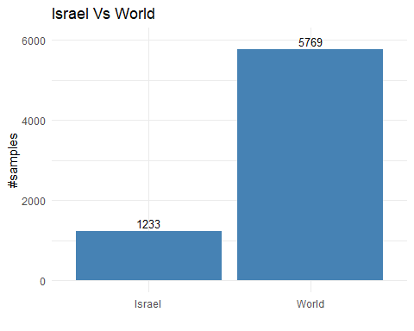
Inference- Balancing DATA

Slide 17
Inference- Balancing DATA
Balancing Methods:
UNDERSAMPLING
OVERSAMPLING
BOTH
ROSE

Slide 18
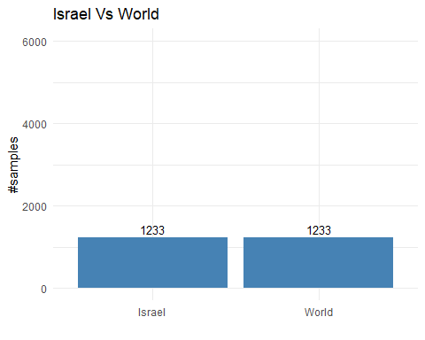
Inference- Balancing DATA
Balancing Methods:
UNDERSAMPLING

Slide 19
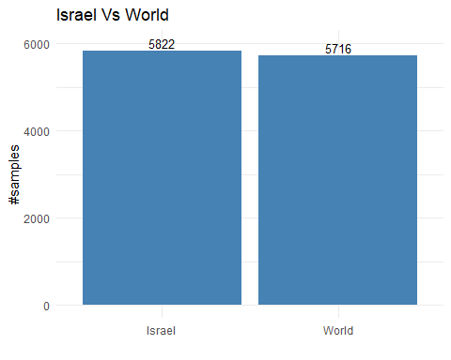
Inference- Balancing DATA
Balancing Methods:
OVERSAMPLING

Slide 20
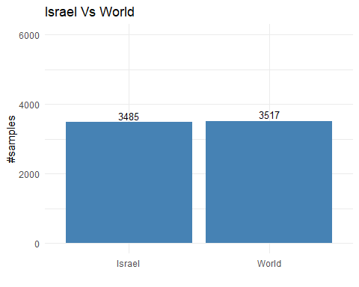
Inference- Balancing DATA
Balancing Methods:
BOTH

Slide 21
Inference- Balancing DATA
Balancing Methods:
ROSE

Slide 22
Inference- Choosing model
LOGISTIC REGRESSION
Binary Classification
Regression- Explainable
WHAT FEATURES?
First try- 50 features
What type? Ordinal- considered as continues

Slide 23
Inference- 50 features
OVERSAMPLING
TEST
TRAIN
TRAIN MODEL
5-fold cross-validation
MCR
UNDERSAMPLING
TEST
TRAIN
TRAIN MODEL
0.2033
5-fold cross-validation
0.2058
BOTH
TEST
TRAIN
TRAIN MODEL
5-fold cross-validation
0.2079
ROSE
TEST
TRAIN
TRAIN MODEL
5-fold cross-validation
0.2203

Slide 24
Inference- 50 features & OVERSAMPLING
summary(logistic_model_over)
## ## Call: ## glm(formula = country ~ ., family = binomial(), data = train_over) ## ## Deviance Residuals: ## Min 1Q Median 3Q Max ## -2.379 -0.995 0.442 0.974 2.772 ## ## Coefficients: ## Estimate Std. Error z value Pr(>|z|) ## (Intercept) 2.52591 0.36327 6.95 0.0000000000036 *** ## EXT1 -0.24435 0.02547 -9.59 < 0.0000000000000002 *** ## EXT2 0.01868 0.02525 0.74 0.45947 ## EXT3 0.03842 0.02841 1.35 0.17625 ## EXT4 -0.15855 0.02704 -5.86 0.0000000045410 *** ## EXT5 -0.03566 0.02802 -1.27 0.20315 ## EXT6 -0.32500 0.02569 -12.65 < 0.0000000000000002 *** ## EXT7 -0.05560 0.02520 -2.21 0.02737 * ## EXT8 0.13040 0.02368 5.51 0.0000000364742 *** ## EXT9 0.00179 0.02323 0.08 0.93848 ## EXT10 -0.12970 0.02502 -5.18 0.0000002179438 *** ## EST1 0.08830 0.02455 3.60 0.00032 *** ## EST2 0.07172 0.02404 2.98 0.00285 ** ## EST3 0.00376 0.02640 0.14 0.88661 ## EST4 -0.06019 0.02097 -2.87 0.00410 ** ## EST5 0.03864 0.02294 1.68 0.09211 . ## EST6 0.06199 0.02776 2.23 0.02555 * ## EST7 0.05357 0.02987 1.79 0.07286 . ## EST8 -0.18519 0.03019 -6.13 0.0000000008576 *** ## EST9 -0.10562 0.02601 -4.06 0.0000490412812 *** ## EST10 0.06837 0.02489 2.75 0.00601 ** ## AGR1 -0.10061 0.01943 -5.18 0.0000002227866 *** ## AGR2 -0.03164 0.02786 -1.14 0.25609 ## AGR3 0.04761 0.02262 2.10 0.03533 * ## AGR4 0.07188 0.03274 2.20 0.02813 * ## AGR5 -0.02596 0.02715 -0.96 0.33899 ## AGR6 -0.07271 0.02399 -3.03 0.00244 ** ## AGR7 -0.13636 0.02985 -4.57 0.0000049085864 *** ## AGR8 -0.07088 0.02561 -2.77 0.00565 ** ## AGR9 -0.03316 0.02880 -1.15 0.24961 ## AGR10 -0.12256 0.02649 -4.63 0.0000037324397 *** ## CSN1 -0.03040 0.02525 -1.20 0.22862 ## CSN2 -0.04535 0.02096 -2.16 0.03052 * ## CSN3 -0.01313 0.02529 -0.52 0.60360 ## CSN4 -0.01594 0.02534 -0.63 0.52944 ## CSN5 -0.16009 0.02315 -6.92 0.0000000000047 *** ## CSN6 -0.03281 0.02222 -1.48 0.13978 ## CSN7 0.12198 0.02332 5.23 0.0000001683921 *** ## CSN8 0.09433 0.02428 3.89 0.00010 *** ## CSN9 -0.01796 0.02337 -0.77 0.44214 ## CSN10 -0.06166 0.02612 -2.36 0.01825 * ## OPN1 0.37417 0.02820 13.27 < 0.0000000000000002 *** ## OPN2 -0.28337 0.02853 -9.93 < 0.0000000000000002 *** ## OPN3 -0.11465 0.02950 -3.89 0.00010 *** ## OPN4 0.10617 0.02697 3.94 0.0000827380109 *** ## OPN5 0.06057 0.03479 1.74 0.08170 . ## OPN6 -0.00752 0.02904 -0.26 0.79567 ## OPN7 -0.05697 0.03138 -1.82 0.06948 . ## OPN8 0.13589 0.02372 5.73 0.0000000100652 *** ## OPN9 0.02586 0.02693 0.96 0.33677 ## OPN10 0.01115 0.03503 0.32 0.75021 ## --- ## Signif. codes: 0 '***' 0.001 '**' 0.01 '*' 0.05 '.' 0.1 ' ' 1 ## ## (Dispersion parameter for binomial family taken to be 1) ## ## Null deviance: 12796 on 9230 degrees of freedom ## Residual deviance: 10839 on 9180 degrees of freedom ## AIC: 10941 ## ## Number of Fisher Scoring iterations: 4
summary(logistic_model_over)
## ## Call: ## glm(formula = country ~ ., family = binomial(), data = train_over) ## ## Deviance Residuals: ## Min 1Q Median 3Q Max ## -2.379 -0.995 0.442 0.974 2.772 ## ## Coefficients: ## Estimate Std. Error z value Pr(>|z|) ## (Intercept) 2.52591 0.36327 6.95 0.0000000000036 *** ## EXT1 -0.24435 0.02547 -9.59 < 0.0000000000000002 *** ## EXT2 0.01868 0.02525 0.74 0.45947 ## EXT3 0.03842 0.02841 1.35 0.17625 ## EXT4 -0.15855 0.02704 -5.86 0.0000000045410 *** ## EXT5 -0.03566 0.02802 -1.27 0.20315 ## EXT6 -0.32500 0.02569 -12.65 < 0.0000000000000002 *** ## EXT7 -0.05560 0.02520 -2.21 0.02737 * ## EXT8 0.13040 0.02368 5.51 0.0000000364742 *** ## EXT9 0.00179 0.02323 0.08 0.93848 ## EXT10 -0.12970 0.02502 -5.18 0.0000002179438 *** ## EST1 0.08830 0.02455 3.60 0.00032 *** ## EST2 0.07172 0.02404 2.98 0.00285 ** ## EST3 0.00376 0.02640 0.14 0.88661 ## EST4 -0.06019 0.02097 -2.87 0.00410 ** ## EST5 0.03864 0.02294 1.68 0.09211 . ## EST6 0.06199 0.02776 2.23 0.02555 * ## EST7 0.05357 0.02987 1.79 0.07286 . ## EST8 -0.18519 0.03019 -6.13 0.0000000008576 *** ## EST9 -0.10562 0.02601 -4.06 0.0000490412812 *** ## EST10 0.06837 0.02489 2.75 0.00601 ** ## AGR1 -0.10061 0.01943 -5.18 0.0000002227866 *** ## AGR2 -0.03164 0.02786 -1.14 0.25609 ## AGR3 0.04761 0.02262 2.10 0.03533 * ## AGR4 0.07188 0.03274 2.20 0.02813 * ## AGR5 -0.02596 0.02715 -0.96 0.33899 ## AGR6 -0.07271 0.02399 -3.03 0.00244 ** ## AGR7 -0.13636 0.02985 -4.57 0.0000049085864 *** ## AGR8 -0.07088 0.02561 -2.77 0.00565 ** ## AGR9 -0.03316 0.02880 -1.15 0.24961 ## AGR10 -0.12256 0.02649 -4.63 0.0000037324397 *** ## CSN1 -0.03040 0.02525 -1.20 0.22862 ## CSN2 -0.04535 0.02096 -2.16 0.03052 * ## CSN3 -0.01313 0.02529 -0.52 0.60360 ## CSN4 -0.01594 0.02534 -0.63 0.52944 ## CSN5 -0.16009 0.02315 -6.92 0.0000000000047 *** ## CSN6 -0.03281 0.02222 -1.48 0.13978 ## CSN7 0.12198 0.02332 5.23 0.0000001683921 *** ## CSN8 0.09433 0.02428 3.89 0.00010 *** ## CSN9 -0.01796 0.02337 -0.77 0.44214 ## CSN10 -0.06166 0.02612 -2.36 0.01825 * ## OPN1 0.37417 0.02820 13.27 < 0.0000000000000002 *** ## OPN2 -0.28337 0.02853 -9.93 < 0.0000000000000002 *** ## OPN3 -0.11465 0.02950 -3.89 0.00010 *** ## OPN4 0.10617 0.02697 3.94 0.0000827380109 *** ## OPN5 0.06057 0.03479 1.74 0.08170 . ## OPN6 -0.00752 0.02904 -0.26 0.79567 ## OPN7 -0.05697 0.03138 -1.82 0.06948 . ## OPN8 0.13589 0.02372 5.73 0.0000000100652 *** ## OPN9 0.02586 0.02693 0.96 0.33677 ## OPN10 0.01115 0.03503 0.32 0.75021 ## --- ## Signif. codes: 0 '***' 0.001 '**' 0.01 '*' 0.05 '.' 0.1 ' ' 1 ## ## (Dispersion parameter for binomial family taken to be 1) ## ## Null deviance: 12796 on 9230 degrees of freedom ## Residual deviance: 10839 on 9180 degrees of freedom ## AIC: 10941 ## ## Number of Fisher Scoring iterations: 4

Slide 25
Inference- 50 features & OVERSAMPLING
REDUCING NUMBER OF COEFFICIENTS WITH stepAIC( )
MCR = 0.2029 < 0.2033
step$coefficients
## (Intercept) EXT1 EXT4 EXT6 EXT7 EXT8 ## 2.35483 -0.24760 -0.15853 -0.31919 -0.06352 0.13254 ## EXT10 EST1 EST2 EST4 EST5 EST6 ## -0.12134 0.08644 0.07307 -0.06100 0.03805 0.05958 ## EST7 EST8 EST9 EST10 AGR1 AGR3 ## 0.05627 -0.18840 -0.10691 0.06893 -0.10333 0.04245 ## AGR4 AGR6 AGR7 AGR8 AGR10 CSN2 ## 0.05474 -0.07414 -0.13182 -0.07123 -0.12470 -0.04698 ## CSN5 CSN6 CSN7 CSN8 CSN10 OPN1 ## -0.17159 -0.03197 0.11597 0.10009 -0.06879 0.37564 ## OPN2 OPN3 OPN4 OPN5 OPN7 OPN8 ## -0.28885 -0.11513 0.10032 0.06442 -0.05908 0.13410

Slide 26
Inference- second model
WHAT FEATURES?
5 traits- Sum of 10 answers
What type? Considered as continues
Extraversion | Neuroticism | Agreeableness | Conscientiousness | Openness
31 | 45 | 43 | 17 | 41
31 | 33 | 21 | 37 | 43
27 | 32 | 23 | 47 | 30
28 | 18 | 33 | 24 | 29
43 | 40 | 12 | 34 | 31
26 | 26 | 38 | 25 | 33
39 | 29 | 41 | 19 | 45
31 | 45 | 43 | 17 | 41
1 | 5 | 2 | 5 | 5
3 | 4 | 3 | 3 | 3
1 | 5 | 5 | 5 | 5
3 | 1 | 5 | 5 | 5
1 | 5 | 5 | 5 | 5
2 | 4 | 5 | 5 | 3

Slide 27
Inference- 5 features
OVERSAMPLING
TEST
TRAIN
TRAIN MODEL
5-fold cross-validation
MCR
UNDERSAMPLING
TEST
TRAIN
TRAIN MODEL
0.2336
5-fold cross-validation
0.2341
BOTH
TEST
TRAIN
TRAIN MODEL
5-fold cross-validation
0.2348
ROSE
TEST
TRAIN
TRAIN MODEL
5-fold cross-validation
0.2381

Slide 28
Inference- 5 features & oversampling
summary(logistic_five_over)
## ## Call: ## glm(formula = country ~ ., family = binomial(), data = five_train_over) ## ## ## Coefficients: ## Estimate Std. Error z value Pr(>|z|) ## (Intercept) -2.740377 0.225031 -12.18 < 0.0000000000000002 *** ## EXT 0.001209 0.002691 0.45 0.65 ## AGR 0.000413 0.003268 0.13 0.90 ## CSN -0.012810 0.003119 -4.11 0.000040 *** ## EST -0.010599 0.002679 -3.96 0.000076 *** ## OPN 0.086817 0.003767 23.05 < 0.0000000000000002 ***

Slide 29
Inference- third model
WHAT FEATURES?
10 features- Sum of positive (5) + Sum of negative (5) statements
What type? Still considered continues
EXT 1 | EXT 2 | EXT 3 | EXT 4 | EXT 5 | EXT 6 | EXT 7 | EXT 8 | EXT 9 | EXT 10 | EST 1 | EST 2 | EST 3 | EST 4 | EST 5 | EST 6 | EST 7 | EST 8 | EST 9 | EST 10 | AGR1 | AGR2 | AGR3 | AGR4 | AGR5 | AGR6 | AGR7 | AGR8 | AGR9 | AGR10 | CSN1 | CSN2 | CSN3 | CSN4 | CSN5 | CSN6 | CSN7 | CSN8 | CSN9 | CSN10 | OPN1 | OPN2 | OPN3 | OPN4 | OPN5 | OPN6 | OPN7 | OPN8 | OPN9 | OPN10
4 | 1 | 5 | 2 | 5 | 1 | 5 | 2 | 4 | 1 | 1 | 4 | 4 | 2 | 2 | 2 | 2 | 2 | 3 | 2 | 2 | 5 | 2 | 4 | 2 | 3 | 2 | 4 | 3 | 4 | 3 | 4 | 3 | 2 | 2 | 4 | 4 | 2 | 4 | 4 | 5 | 1 | 4 | 1 | 4 | 1 | 5 | 3 | 4 | 5
3 | 5 | 3 | 4 | 3 | 3 | 2 | 5 | 1 | 5 | 2 | 3 | 4 | 1 | 3 | 1 | 2 | 1 | 3 | 1 | 1 | 4 | 1 | 5 | 1 | 5 | 3 | 4 | 5 | 3 | 3 | 2 | 5 | 3 | 3 | 1 | 3 | 3 | 5 | 3 | 1 | 2 | 4 | 2 | 3 | 1 | 4 | 2 | 5 | 3
2 | 3 | 4 | 4 | 3 | 2 | 1 | 3 | 2 | 5 | 4 | 4 | 4 | 2 | 2 | 2 | 2 | 2 | 1 | 3 | 1 | 4 | 1 | 4 | 2 | 4 | 1 | 4 | 4 | 3 | 4 | 2 | 2 | 2 | 3 | 3 | 4 | 2 | 4 | 2 | 5 | 1 | 2 | 1 | 4 | 2 | 5 | 3 | 4 | 4
2 | 2 | 2 | 3 | 4 | 2 | 2 | 4 | 1 | 4 | 3 | 3 | 3 | 2 | 3 | 2 | 2 | 2 | 4 | 3 | 2 | 4 | 3 | 4 | 2 | 4 | 2 | 4 | 3 | 4 | 2 | 4 | 4 | 4 | 1 | 2 | 2 | 3 | 1 | 4 | 4 | 2 | 5 | 2 | 3 | 1 | 4 | 4 | 3 | 3
3 | 3 | 3 | 3 | 5 | 3 | 3 | 5 | 3 | 4 | 1 | 5 | 5 | 3 | 1 | 1 | 1 | 1 | 3 | 2 | 1 | 5 | 1 | 5 | 1 | 3 | 1 | 5 | 5 | 3 | 5 | 1 | 5 | 1 | 3 | 1 | 5 | 1 | 5 | 5 | 5 | 1 | 5 | 1 | 5 | 1 | 5 | 3 | 5 | 5
3 | 3 | 4 | 2 | 4 | 2 | 2 | 3 | 3 | 4 | 3 | 4 | 3 | 2 | 2 | 1 | 2 | 1 | 2 | 2 | 2 | 3 | 1 | 4 | 2 | 3 | 2 | 3 | 4 | 4 | 3 | 2 | 4 | 1 | 3 | 2 | 4 | 3 | 4 | 3 | 5 | 1 | 5 | 1 | 3 | 1 | 5 | 4 | 5 | 2
4 | 3 | 4 | 3 | 3 | 3 | 5 | 3 | 4 | 3 | 2 | 4 | 4 | 2 | 4 | 2 | 2 | 2 | 4 | 4 | 1 | 2 | 1 | 5 | 3 | 5 | 3 | 4 | 4 | 5 | 3 | 2 | 4 | 2 | 1 | 4 | 4 | 2 | 2 | 5 | 5 | 2 | 4 | 3 | 4 | 1 | 5 | 5 | 4 | 4
3 | 1 | 5 | 2 | 5 | 2 | 5 | 2 | 3 | 2 | 2 | 4 | 2 | 4 | 2 | 1 | 2 | 1 | 1 | 1 | 2 | 5 | 2 | 4 | 3 | 2 | 2 | 4 | 4 | 4 | 5 | 1 | 5 | 1 | 4 | 2 | 3 | 2 | 5 | 5 | 4 | 1 | 3 | 1 | 5 | 1 | 4 | 3 | 4 | 5
2 | 2 | 3 | 3 | 4 | 2 | 2 | 2 | 4 | 4 | 3 | 4 | 4 | 1 | 2 | 2 | 3 | 2 | 3 | 4 | 1 | 5 | 1 | 5 | 1 | 3 | 1 | 4 | 4 | 4 | 3 | 3 | 4 | 0 | 3 | 4 | 1 | 2 | 1 | 4 | 4 | 1 | 5 | 1 | 4 | 1 | 5 | 2 | 5 | 5
1 | 5 | 3 | 5 | 2 | 3 | 2 | 4 | 5 | 4 | 3 | 3 | 3 | 3 | 4 | 3 | 3 | 3 | 3 | 3 | 5 | 3 | 5 | 1 | 5 | 3 | 4 | 2 | 3 | 2 | 2 | 5 | 1 | 5 | 1 | 4 | 3 | 4 | 2 | 2 | 3 | 1 | 3 | 1 | 3 | 3 | 4 | 3 | 3 | 3
3 | 3 | 2 | 3 | 3 | 2 | 4 | 3 | 3 | 5 | 4 | 3 | 4 | 1 | 2 | 3 | 5 | 4 | 4 | 5 | 2 | 5 | 3 | 4 | 2 | 3 | 1 | 3 | 4 | 2 | 1 | 5 | 5 | 5 | 1 | 5 | 3 | 1 | 1 | 5 | 5 | 1 | 5 | 1 | 5 | 1 | 5 | 5 | 5 | 5
3 | 1 | 5 | 3 | 5 | 1 | 5 | 5 | 5 | 3 | 5 | 1 | 3 | 1 | 5 | 5 | 5 | 5 | 5 | 3 | 2 | 5 | 5 | 3 | 3 | 5 | 3 | 5 | 5 | 5 | 5 | 5 | 5 | 3 | 5 | 5 | 5 | 3 | 3 | 5 | 4 | 1 | 5 | 1 | 5 | 3 | 1 | 5 | 5 | 5
4 | 1 | 5 | 4 | 5 | 1 | 4 | 1 | 5 | 2 | 1 | 5 | 1 | 2 | 1 | 1 | 5 | 4 | 1 | 5 | 1 | 5 | 2 | 5 | 1 | 4 | 1 | 5 | 5 | 5 | 2 | 4 | 5 | 4 | 2 | 3 | 1 | 4 | 1 | 2 | 5 | 1 | 5 | 1 | 4 | 1 | 5 | 5 | 5 | 5
1 | 5 | 1 | 5 | 1 | 5 | 1 | 5 | 1 | 5 | 5 | 1 | 5 | 1 | 4 | 5 | 3 | 3 | 4 | 5 | 2 | 2 | 2 | 3 | 3 | 3 | 3 | 0 | 3 | 1 | 3 | 2 | 5 | 3 | 4 | 1 | 5 | 3 | 4 | 3 | 5 | 1 | 4 | 1 | 2 | 2 | 4 | 5 | 5 | 3
1 | 5 | 2 | 5 | 1 | 4 | 1 | 2 | 2 | 5 | 4 | 3 | 5 | 1 | 4 | 4 | 4 | 2 | 4 | 5 | 2 | 5 | 4 | 5 | 1 | 5 | 2 | 4 | 5 | 5 | 4 | 4 | 2 | 4 | 2 | 3 | 4 | 1 | 4 | 5 | 5 | 4 | 5 | 5 | 4 | 1 | 4 | 4 | 5 | 5
2 | 1 | 3 | 4 | 4 | 3 | 5 | 3 | 3 | 5 | 4 | 2 | 3 | 3 | 3 | 4 | 3 | 3 | 5 | 5 | 5 | 5 | 5 | 5 | 2 | 3 | 3 | 3 | 4 | 5 | 3 | 3 | 4 | 4 | 4 | 2 | 3 | 3 | 4 | 5 | 5 | 2 | 5 | 3 | 4 | 1 | 3 | 3 | 5 | 5
EXT_neg | EXT_pos | EST_neg | EST_pos | AGR_neg | AGR_pos | CSN_neg | CSN_pos | OPN_neg | OPN_pos
31 | 27 | 45 | 3 | 43 | 30 | 17 | 17 | 41 | 18
31 | 30 | 33 | 2 | 21 | 20 | 37 | 30 | 43 | 33
27 | 25 | 32 | 4 | 23 | 9 | 47 | 24 | 30 | 22
28 | 16 | 18 | 5 | 33 | 16 | 24 | 25 | 29 | 30
43 | 10 | 40 | 10 | 12 | 13 | 34 | 5 | 31 | 7
26 | 5 | 26 | 13 | 38 | 6 | 25 | 25 | 33 | 15
39 | 4 | 29 | 25 | 41 | 21 | 19 | 13 | 45 | 13
31 | 10 | 45 | 25 | 43 | 23 | 17 | 15 | 41 | 10
1 |  | 5 |  | 2 |  | 5
3 |  | 4 |  | 3 |  | 3 |  | 3
1 |  | 5 |  | 5 |  | 5 |  | 5
3 |  | 1 |  | 5 |  | 5 |  | 5
1 |  | 5 |  | 5 |  | 5 |  | 5
2 |  | 4 |  | 5 |  | 5 |  | 3
Openness
Conscientiousness
Agreeableness
Neuroticism
Extraversion

Slide 30
Inference- 10 features
OVERSAMPLING
TEST
TRAIN
TRAIN MODEL
5-fold cross-validation
MCR
UNDERSAMPLING
TEST
TRAIN
TRAIN MODEL
0.2243
5-fold cross-validation
0.2207
BOTH
TEST
TRAIN
TRAIN MODEL
5-fold cross-validation
0.2239
ROSE
TEST
TRAIN
TRAIN MODEL
5-fold cross-validation
0.2300

Slide 31
Inference- Comparing models
50 FEATURES
OVERSAMPLING
MCR=0.2033
BEST MODELS
5 FEATURES
OVERSAMPLING
MCR=0.2336
10 FEATURES
UNDERSAMPLING
MCR=0.2207

Slide 32
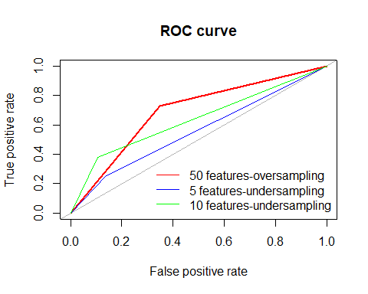
Inference- Comparing models
AUC
50 features | 0.69
5 features | 0.56
10 features | 0.64

Slide 33
Inference- 10 FEATURE MODEL RESULTS
summary(logistic_ten_under)
## ## Call: ## glm(formula = country ~ ., family = binomial(), data = ten_train_under) ## ## Coefficients: ## Estimate Std. Error z value Pr(>|z|) ## (Intercept) -2.76653 0.50803 -5.45 0.0000000516416614 *** ## EXT_pos -0.09329 0.01675 -5.57 0.0000000257829085 *** ## AGR_pos -0.07074 0.01538 -4.60 0.0000042125466514 *** ## CSN_pos -0.02862 0.01388 -2.06 0.039 * ## EST_pos -0.01609 0.00854 -1.89 0.059 . ## OPN_pos 0.11000 0.01384 7.95 0.0000000000000019 *** ## EXT_neg 0.09580 0.01654 5.79 0.0000000069691312 *** ## AGR_neg 0.10009 0.01962 5.10 0.0000003367507459 *** ## CSN_neg 0.00812 0.01649 0.49 0.623 ## EST_neg 0.02942 0.03048 0.97 0.334 ## OPN_neg 0.04187 0.02540 1.65 0.099 .

Slide 34
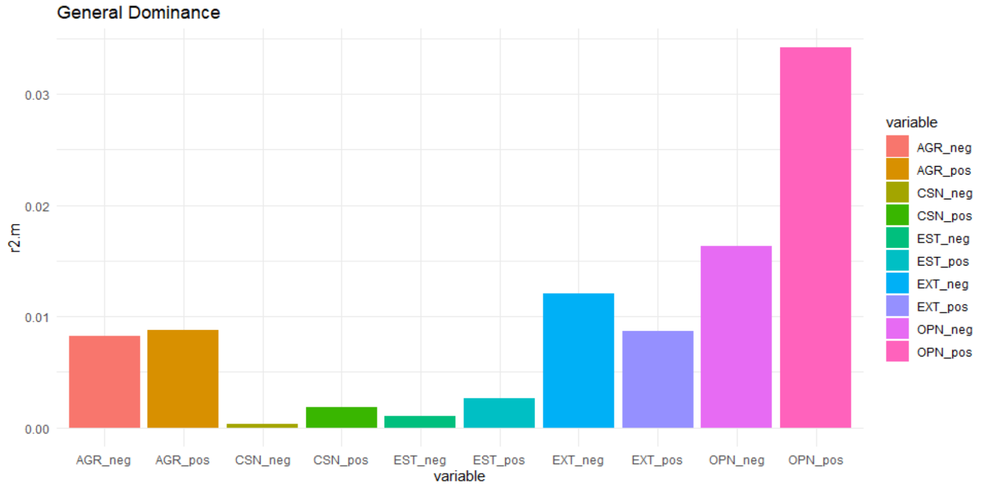
Inference- 10 FEATURE MODEL RESULTS

Slide 35
CONCLUSION
Results suggest: openness and introversion are dominant in Israelis
Models yielded low accuracy
Israelis are not different?
Humans can’t be categorized?
Models can be improved
Trying other models
Trying other personality assessment methods

