Slide 1

Presentation on “Go Fit”
Submitted To Submitted by Harjot Tiwana Aranshu Bansal
1702573

Slide 2
Abstract
The project ‘Go-Fit’ is a java-based application whose motivation came in lockdown period when the entire GYM Industry suffered heavily due to covid-19 pandemic. This struck me with the idea of making this java application as the people who worked in GYM basically lost their livelihood. What this application does is enable gym owners and trainers to generate a revenue by providing paid services to the customer.
Customer is provided an in-build chat service by which he can directly get in touch with the assigned trainer regarding his queries and can provide feedback to the owner of the gym.
Administrator is provided with rights to controls and manage the activities of customer and the trainer
Trainer is provided with the list of all the customers assigned to him and also provide with a in build chat service to interaction and answered queries of the customer

Slide 3
Introduction
We have designed an application in the era of a pandemic (Covid-19), called as 'Go Fit'. As we know in this difficult time it is safe to stay home, so this application is specially designed for the ones who love to be physically fit and active. People are not able to attend the gym physically, this service will help giving them the pleasure to feel the experience of a gym at home, they could simply enroll and enjoy all the services. Now coming on to the interface of an application.
We mainly have 3 components- The Administrator, Customer and a Trainer.
Administrator handles all the admin work Coming on to Customer, there are two types of consumers, consumers with basic plan and consumers with premium plan. Basic and premium plans have their own different cost Trainer is another component, trainer could see the data of a consumer, could check the regularity of a client in classes and could check their exercise schedules

Slide 4
Objectives of Project
The project ‘Go-Fit’ is a java-based application which is developed using concept of advance java like java swing and the database used for back-end connectivity is my sql. whose motivation came in lockdown period when the entire GYM Industry suffered heavily due to covid-19 pandemic. This struck me with the idea of making this java application as the people who worked in GYM basically lost their livelihood. What this application does is enable gym owners and trainers to generate a revenue by providing paid services to the customer.
The Overall objective of this application is to help gym owner and trainer to raise some kind of revenue and also help the customer to retain their fitness at ease of their home this application removes the barrier and enable customer to virtually connect with his trainer for any kind of query on the other hand helps administrator to manage customer and trainer data in a proper and organized manner also enable him to do more work in short time stamp

Slide 5
Motivation
For this project motivation came in lockdown period when the entire GYM Industry suffered heavily due to covid-19 pandemic. This struck me with the idea of making this java application as the people who worked in GYM basically lost their livelihood. What this application does is enable gym owners and trainers to generate a revenue by providing paid services to the customer.
The Overall objective of this application is to help gym owner and trainer to raise some kind of revenue and also help the customer to retain their fitness at ease of their home this application removes the barrier and enable customer to virtually connect with his trainer for any kind of query on the other hand helps administrator to manage customer and trainer data in a proper and organized manner also enable him to do more work in short time stamp
Technology is rapidly changing different business model but fitness industries is in its initial phase of this transformation. Technology can not only increase the fitness industrial review and it can also help us to expand the fitness industries reach to remote areas as this application remove the barrier of distance

Slide 6
Methodology
Model used for application development is v-model
Java Technology is both a programming language and a platform. With most programming languages, you either compile or interpret a program so that you can run it on your computer. The Java programming language is unusual in that a program is both compiled and interpreted. With the compiler, first you translate a program into an intermediate language called Java byte codes the platform-independent codes interpreted by the interpreter on the Java platform. The interpreter parses and runs each Java byte code instruction on the computer. Compilation happens just once; interpretation occurs each time the program is executed. The following figure illustrates how this works.
Java SwingsSwing API is a set of extensible GUI Components to ease the developer's life to create JAVA based Front End/GUI Applications. It is built on top of AWT API and acts as a replacement of AWT API, since it has almost every control corresponding to AWT controls. Swing component follows a Model-View-Controller architecture to fulfil the following criteria.

Slide 7
Methodology
Java AWT Abstract Window Toolkit which is an API to develop GUI or window-based applications in java. Java AWT components are platform-dependent i.e., components are displayed according to the view of operating system. AWT is heavyweight i.e., its components are using the resources of OS. The java.awt package provides classes for AWT api such as TextField, Label, TextArea, RadioButton, CheckBox, Choice, List etc.
My SQL is the world's most popular open source relational database and Amazon RDS makes it easy to set up, operate, and scale MySQL deployments in the cloud. With Amazon RDS, you can deploy scalable MySQL servers in minutes with cost-efficient and resizable hardware capacity.

Slide 8
Project Design Phases
Phase 1: System/Information Engineering and Modeling
In this, the information of the project was gathered to meet the requirements. As software is always of a large system (or business), work begins by establishing requirements for all system elements and then allocating some subset of these requirements to software. This system view is essential when software must interface with other elements such as hardware, people and other resources
Phase 2: Software Requirement Analysis
This is also known as feasibility study. In this phase, the development team visits the customer and studies their system. They investigate the need for possible software automation in the given system. By the end of the feasibility study, the team furnishes a document that holds the different specific recommendations for the candidate system.

Slide 9
Project Design Phases
Phase 3: System Analysis and Design
In this phase, the software development process, the software's overall structure and its nuances are defined. In terms of the client/server technology, the number of tiers needed for the package architecture, the database design, the data structure design etc are all defined in this phase. A software development model is created. Analysis and Design are very crucial in the whole development cycle.
Phase 4: Code generation
The code is written in Java. The design must be translated into a machine-readable form. The code generation step performs this task. If the design is performed in a detailed manner, code generation can be accomplished without much complication. . Different high level programming languages like C, C++, Pascal, and Java are used for coding. With respect to the type of application, the right programming language is chosen.

Slide 10
Project Design Phases
Phase 5:Testing
Different tests were performed to check the proper functioning of Branush Hub. Different test users were added to check the authenticity and proper functioning of the code. Several error cases were also tested and were corrected if any error was found. Once the code is generated, the software program testing begins. Different testing methodologies are available to unravel the bugs that were committed during the previous phases.
Phase 6: Maintenance
Software will definitely undergo change once it is delivered to the customer. There are many reasons for the change. Change could happen because of some unexpected input values into the system. In addition, the changes in the system could directly affect the software operations. The software should be developed to accommodate changes that could happen during the post implementation period.

Slide 11
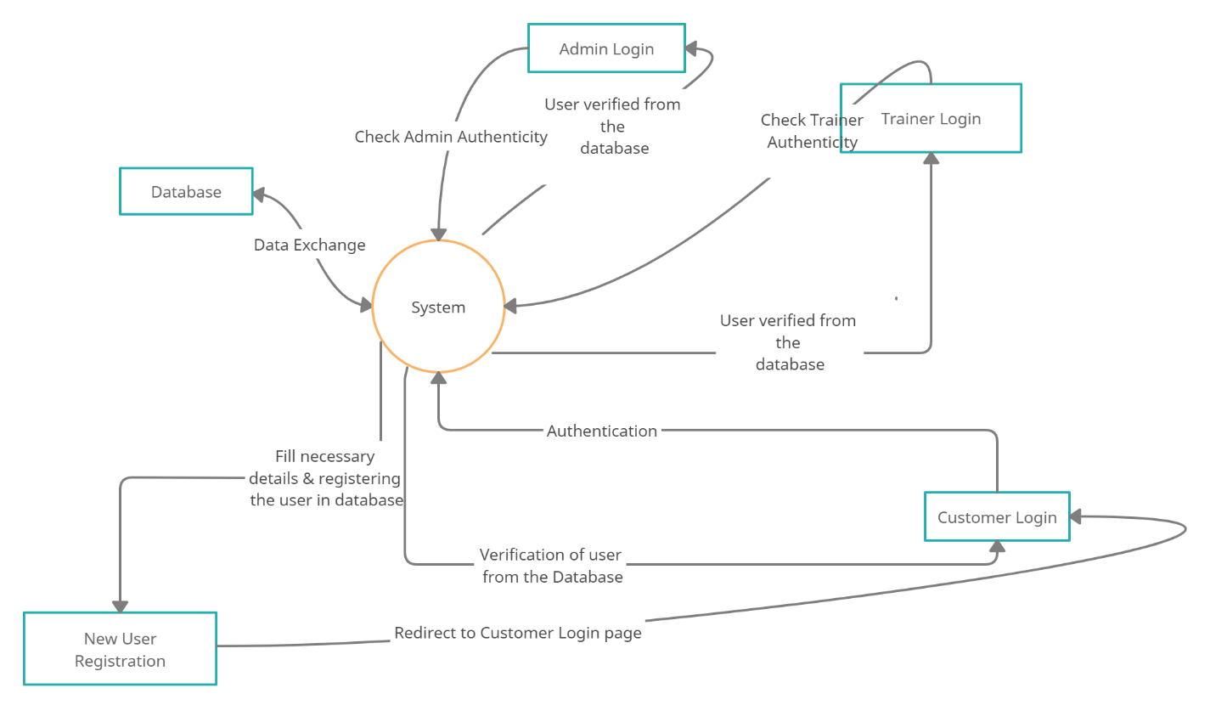
DFD (Data Flow Diagram)

Slide 12
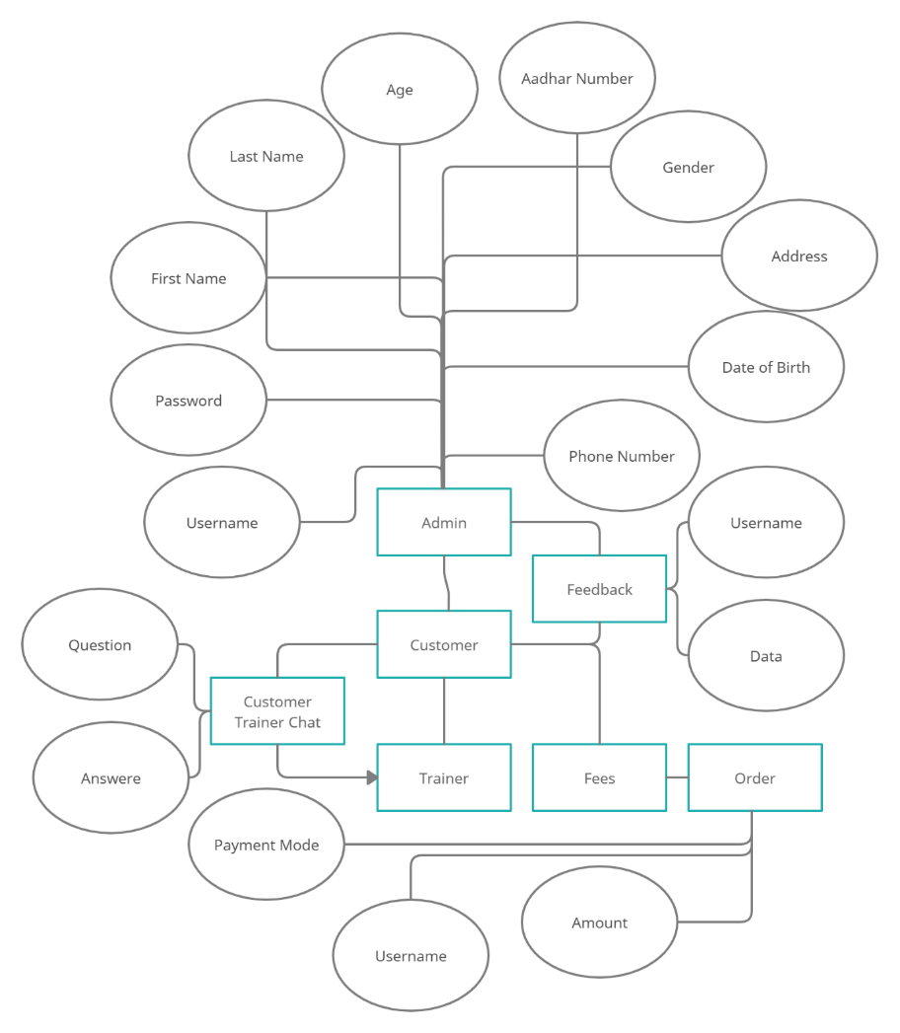
Entity Relationship Diagram

Slide 13
CONCLUSIONS
The project 'Go Fit' mainly help gym's which are small and medium sized. This application helps to enable the gym owners to generate revenue and further offers an online platform for their business model.
In today's world, technology is very useful in general, it helps us to increase business of gym owners, decrease the competition, be unique in the market, increase the revenue, and also this model is very customer friendly, easy to adapt and very effective.
The interface is really easy to use and a trainer directly links the customers with each other,
trainer also take care of various tie-ups

Slide 14
References
www.google.com
www.javatpoint.com
https://stackoverflow.com/
https://www.w3schools.com/
https://fontawesome.com/
https://www.heropatterns.com/
https://www.youtube.com/

Slide 15
Thank You
Queries?

