Slide 1


Slide 2




HA for DSC (?)
Web-Requests use cases
Paweł Jarosz
@PaweJarosz4 | www.paweljarosz.wordpress.com

Slide 3
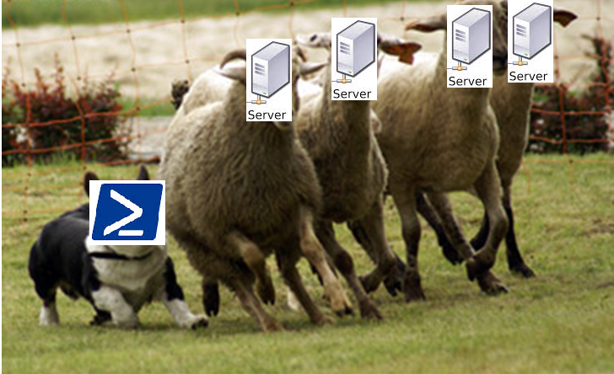
A quick recall
Origins of DSC
What DSC HTTPS Pull Server
and why it is the best option?
How to configure DSC Pull Server and clients
DSC for Linux
Script to build DSC on core
HA for DSC using ARR (?)

Slide 4
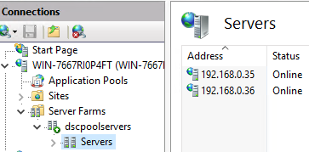
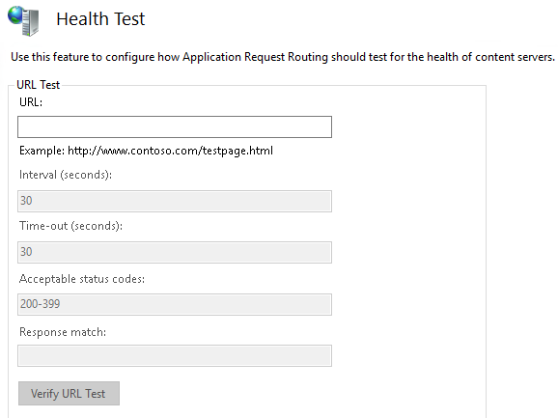
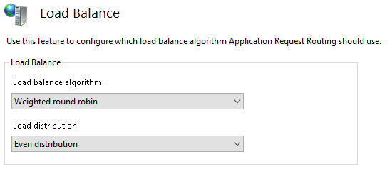
About Applicaiton Request Routing (ARR)

Slide 5
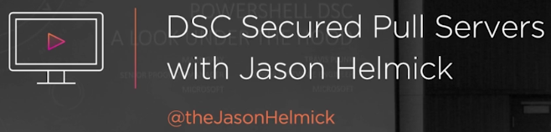
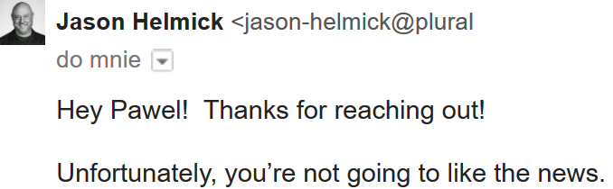
So what about a secure and well tailored DSC on Windows Core with HA?

Slide 6

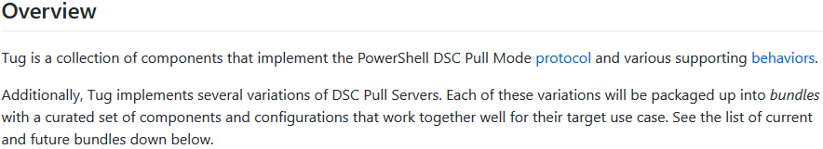
TUG
https://github.com/PowerShellOrg/tug

Slide 7

Do websites have useful info?

Slide 8

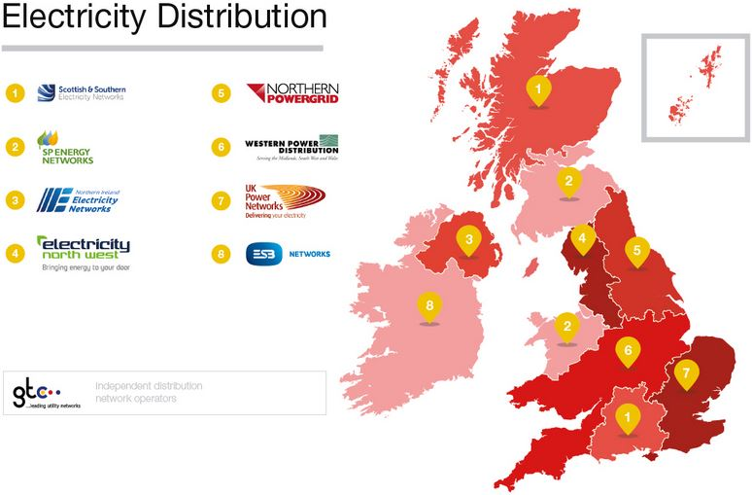
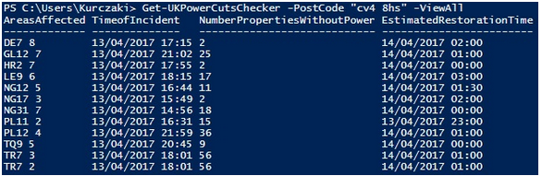
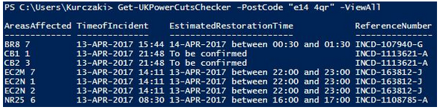

Check for a power outage… REMOTELY
Module presented here works so far for “Western Power Distribution”, “UK Power Networks” and “Scottish And Southern Power Networks”.
To install it and start testing simply run:
Install-Module UKPowerCutChecker

Slide 9

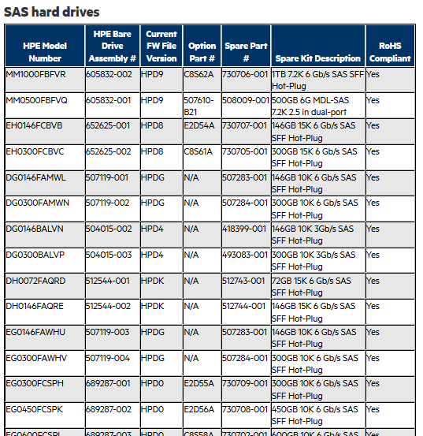
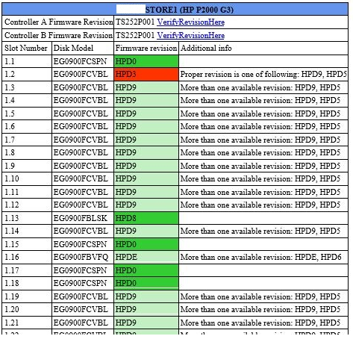
Get Information about firmware updates

Slide 10
Aaaaaand…

Slide 11

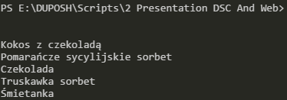
…configure an Ice Cream Alert!
$Website = invoke-Webrequest https://www.facebook.com/LodyZKrzyckiej/
$Posts = $Website.ParsedHtml.body.getElementsByClassName("text_exposed_root")
ForEach ($Post in $Posts) {
$Smaki = @()
If($Post.innerHTML -match "🍦.*🍦.*🍦"){
$P = $Post.innerHTML -split("🍦")
ForEach ($s in $P){
if ($s -match "</SPAN></SPAN>" -and $s -notmatch "<P>"){
$Smak = $s.split('<BR>')[4]
$Smaki += $Smak
}
}
break;
}
}
$Smaki

Slide 12
When it all started
PowerShell v3 introduced
Invoke-WebRequest
Invoke-RestMethod
Going through the elements
PowerShellCookBook
Show-Object

Slide 13
WebRequest vs RestMethod?
Almost same – RestMethod return more structured data (understands JSON), ergo? Quicker!

Slide 14
Obstacles? Many! First – JavaScript.
If ($IeExperience) {
$ie = new-object -ComObject "InternetExplorer.Application"
$ie.navigate($WebSite)
while($ie.busy) {Start-Sleep 1}
$doc = $ie.Document.body
$tables = @($doc.getElementsByTagName('TABLE'))
} else {
$WebRequest = Invoke-WebRequest $WebSite
$tables = @($WebRequest.ParsedHtml.getElementsByTagName("TABLE"))
}

Slide 15
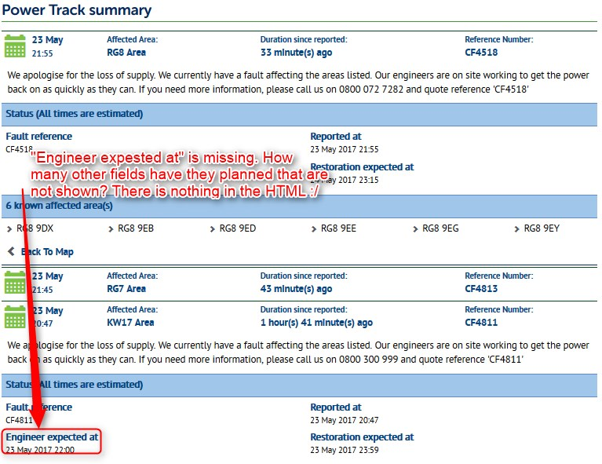

Aaaand JavaScript again.

Slide 16
Inspirations
TUG - Open-source, cross-platform Pull/Reporting Server for PowerShell DSC
https://github.com/PowerShellOrg/tug
Jeffrey Snover and Done Jones – PowerShell unplugged:
https://channel9.msdn.com/events/Ignite/2016/BRK3142
PowerShell Facebook module
https://facebookpsmodule.codeplex.com/
https://www.youtube.com/watch?v=divETm--UEc

Slide 17
Questions? I hope not…

Slide 18





pawel.jarosz@gmail.com
@PaweJarosz4
linkedin.com/in/paweljarosz2/
paweljarosz.wordpress.com
github.com/zaicnupagadi

