Slide 1


Slide 2




PowerShell Functions
Tomek Dąbrowski
DomBros
dombros@gmail.com
@Dom_Bros
dombrosblog.wordpress.com

Slide 3
Agenda:
Function – where to start
Function Advanced
Pester tests - TDD, BDD
Test and Automate

Slide 4
Functions - Short story
Best practises
Synopsis
Naming
Parameters
Parameter validation
WhatIf, PsCmdlet
ConfirmImpact, PsCmdlet
Splatting
Pipeline
Error handling
Try, Catch, Finally
PSBoundParameters
Module
Class
Output
Pester

Slide 5

Pester, testy - Test Driven Development (TDD), Bahavior Development Driven (BDD)
function Show-Hello {param ([String]$From) "Hello from $From"}
Describe -Name 'Show-Hello' -Fixture {
Context -Name 'Running with arguments' -Fixture {
It -Name 'returns standard phrase' -Test {
Show-Hello -From 'Venus' | Should Be 'Hello from Venus' }}}
Notes:
https://github.com/pester/Pester

Slide 6
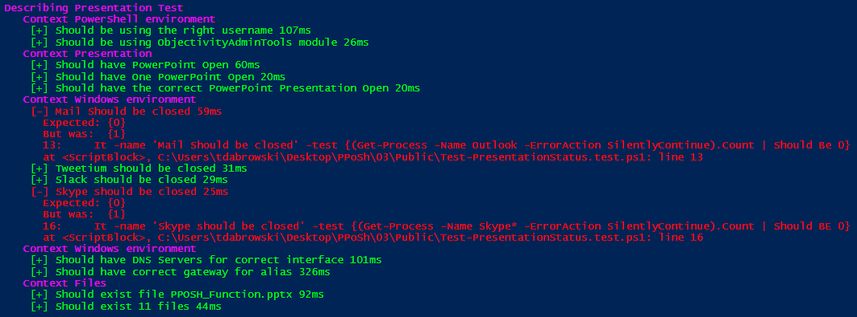
Pester your presentation
Notes:
https://github.com/pester/Pester

Slide 7

Test… Test everything Test your backup

Slide 8
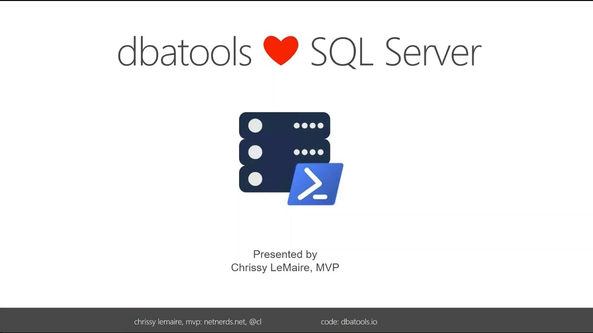

Slide 9
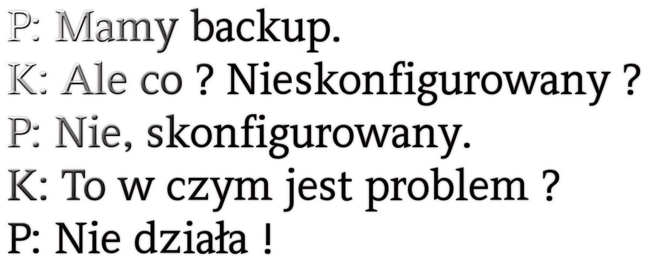

Slide 10

Screenwriter: Tomasz Dabrowski Leading actor: Veeam
Notes:
https://cooltext.com/Logo-Design-Slab

Slide 11
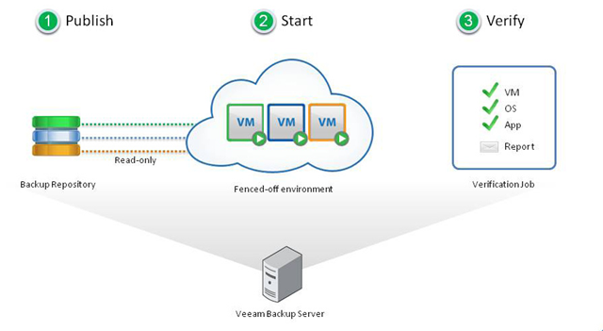
Veeam SureBackup Job
Notes:
SureBackup in Veeam is a great solution. With it, you can take any backup and then run automated tests against each protected VM. By powering on the VM in a virtual lab, isolated from the original VM in production, you can first of all be sure that the virtual machine can be powered on when needed from a backup, but you can also configure SureBackup to tests different things like vmware tools heartbeat (and again, it would mean the OS is up and the services are running, as VMware tools is one of those services), network ping (so you can verify the network stack is up), and you can also run scripts of any kind against the applications. I’ve seen customers doing amazing things like a sql query that goes into a MS SQL database and retrieves a table, so they can be sure that the database is up nd running, it’s answering on the correct port, accepts the user used into the script, and return the correct data.

Slide 12
Veeam SureBackup Job
Virtual Machines
Veeam Virtual Lab
Virtual Host
Application group
Sure Job
Veeam Backup
Veeam Virtual Lab

Slide 13
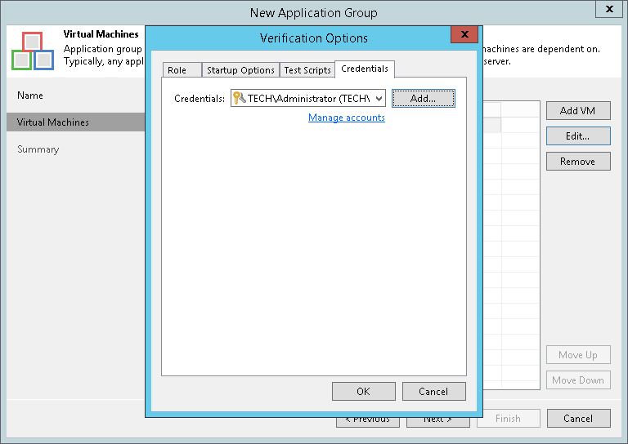
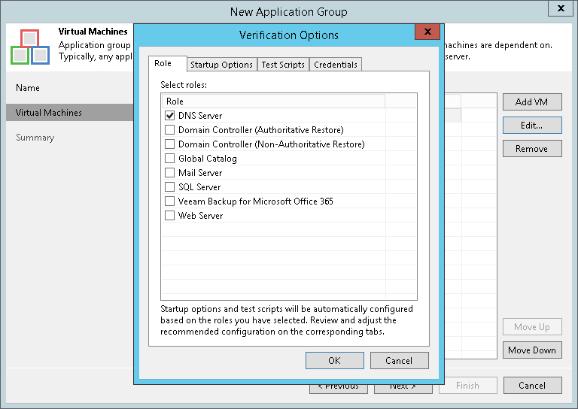
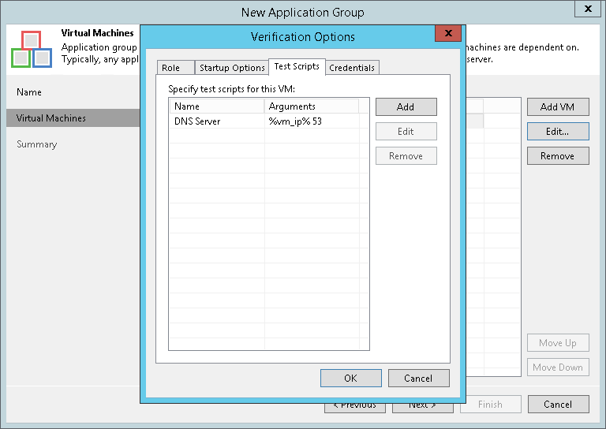
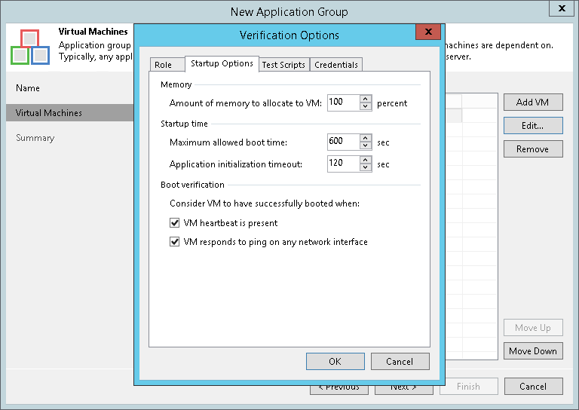
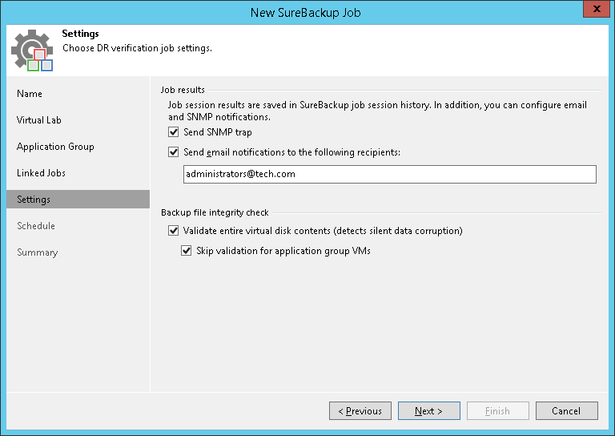
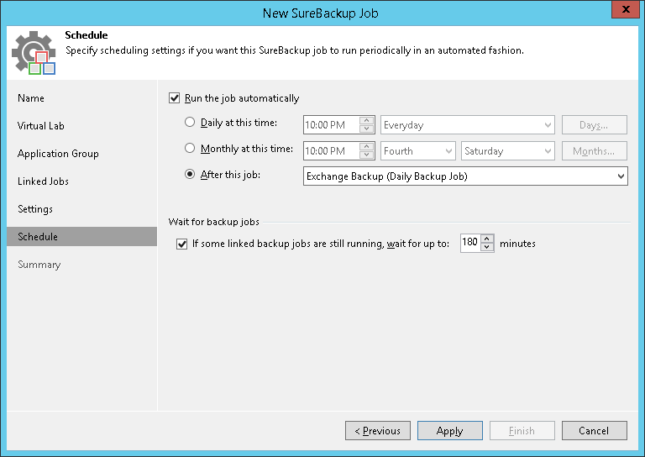
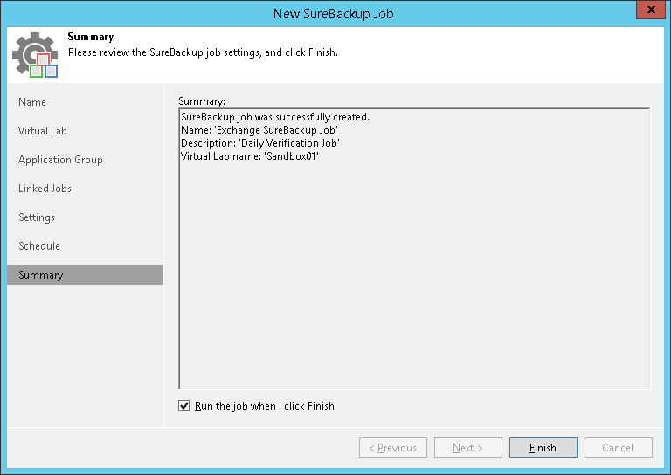
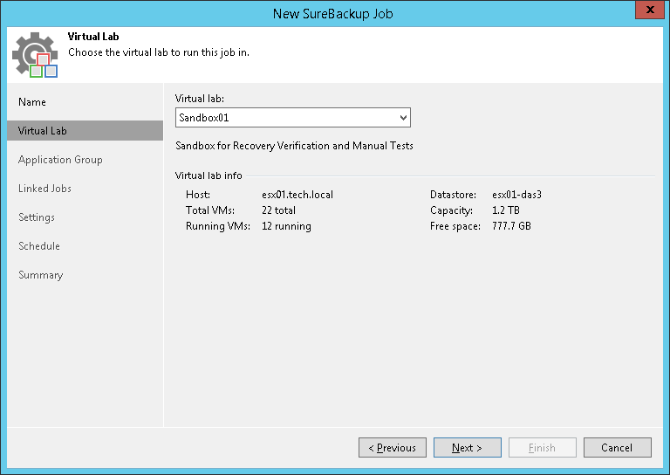
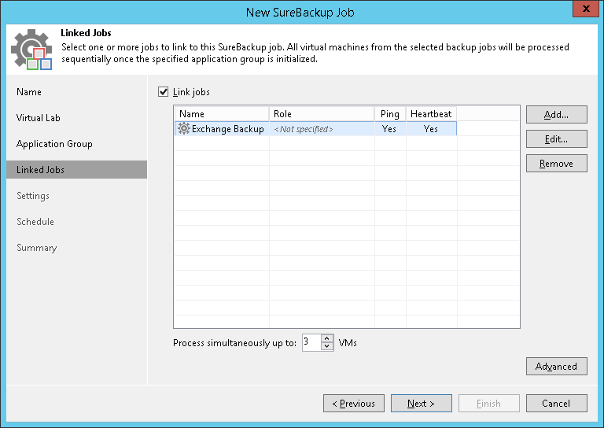
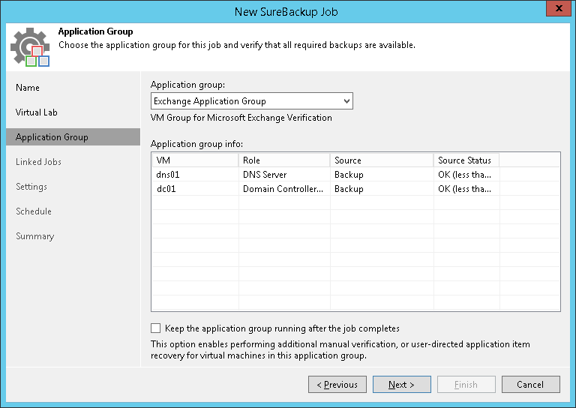
Veeam SureBackup Job

Slide 14
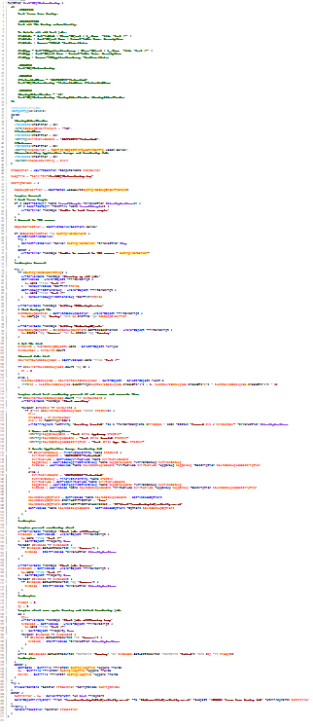
Veeam SureBackup Job

Slide 15
Veeam SureBackup Job
Get VM from backup
Create Application group for VM
Create SureBackup Job for Application group
Run SurebBackup Job
Send Report
Check if VM has AppGroup and SubeJob

Slide 16
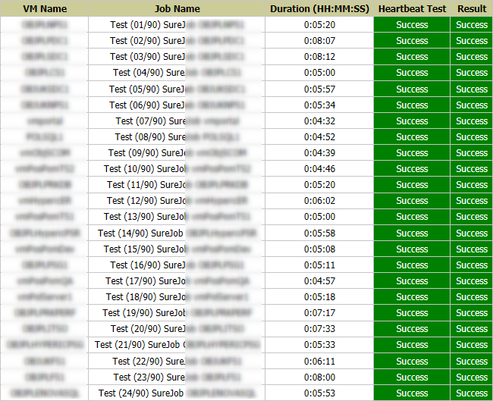
Veeam SureBackup Job

Slide 17
Veeam SureBackup Job
1 VM -> 7 minutes
(24h)
1440 / 7 = 205 VM
5 hosts * 200 = 1000 VMs in SureJobs

Slide 18


