Slide 1


Slide 2




Windows Update managing for „resourcefull" ;) (no-SCCM, annoyed by WSUS)
Tomek Dąbrowski
DomBros
dombros@gmail.com
@Dom_Bros
dombrosblog.wordpress.com

Slide 3
Agenda:
Why PowerShell
SystemUpdate - PowerShell module under the hood
Pros and cons
PowerShell code

Slide 4
The hard way…
WSUS
https://www.reddit.com/r/sysadmin/comments/5axzg7/general_consensus_is_that_wsus_sucks_what
http://www.adamtheautomator.com/use-powershell-to-make-wsus-suck-less
SCCM
https://www.microsoft.com/en-us/cloud-platform/system-center-pricing
PowerShell remote – error:
0x800706ba (Firewall)
0x80070002 (known and comon Windows Update error)
0x80070005 (Access Denied)

Slide 5
The hard way…
WUInstall software: (https://www.wuinstall.com/)
> 250 machines 790 USD
> 500 machines 1290 USD
PSWindowsUpdate - Michał Gajda
No cross-domian
No schedule
No depenedcy
No reports

Slide 6
Functions:
Private:
Add-SUDatabaseSystemUpdate
Add-SUDatabaseSystemUpdateStatus
Set-SUCurrentConfigurationSettingVariable
PSWindowsUpdate (Michał Gajda):
Invoke-WUInstall
Update-WUModule

Slide 7
Functions public:
Add-SUIPAddressToReceiveConnector
Add-SUScheduleSystemUpdate
Convert-SUStringToDate
Get-SUContentLogFile
Get-SUContentLogFileInRealTime
Get-SUCredential
Get-SUScheduledSystemUpdateReport
Get-SUVMHost
Get-SUVMSnapshot
Get-SystemUpdateStatus
Initialize-SUSystemUpdate
Remove-SUOldConnection
Remove-SUVMSnapshot
Send-SUCheckEmail
Send-SUEndEmail
Send-SUInformationEmail
Set-SUComputerStatus
Set-SUConnection
Set-SUConnectionDB
Set-SUReScheduledSystemUpdate
Set-SUScheduledTaskToStartAtStartup
Start-SUActionSystemUpdate
Start-SUInstallSystemUpdate
Test-SUClusterStorageFreeSpace
Test-SUIsVirtualMachine
Test-SUPendingReboot
Test-SUScheduledTaskStatus
Update-SUComputerInformationInDataBase

Slide 8
Operator:

Slide 9
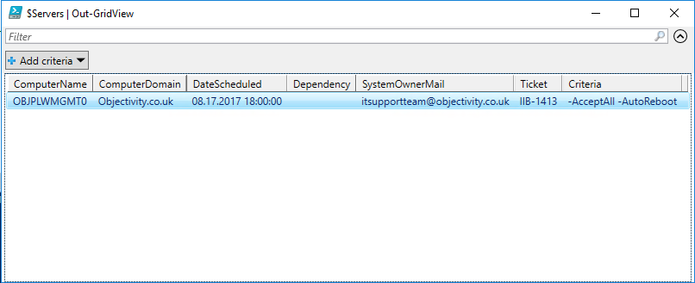
Data file:

Slide 10
Schedule Task:

Slide 11
Schedule Task:

Slide 14
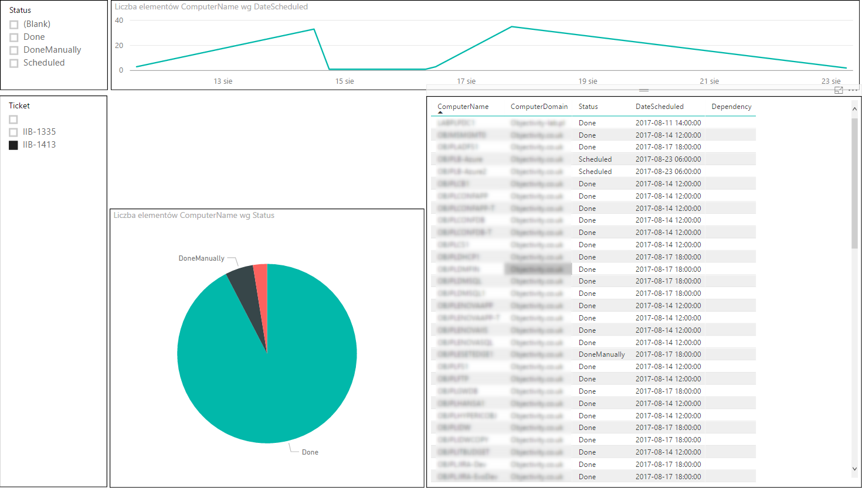
Update progres report:

Slide 15
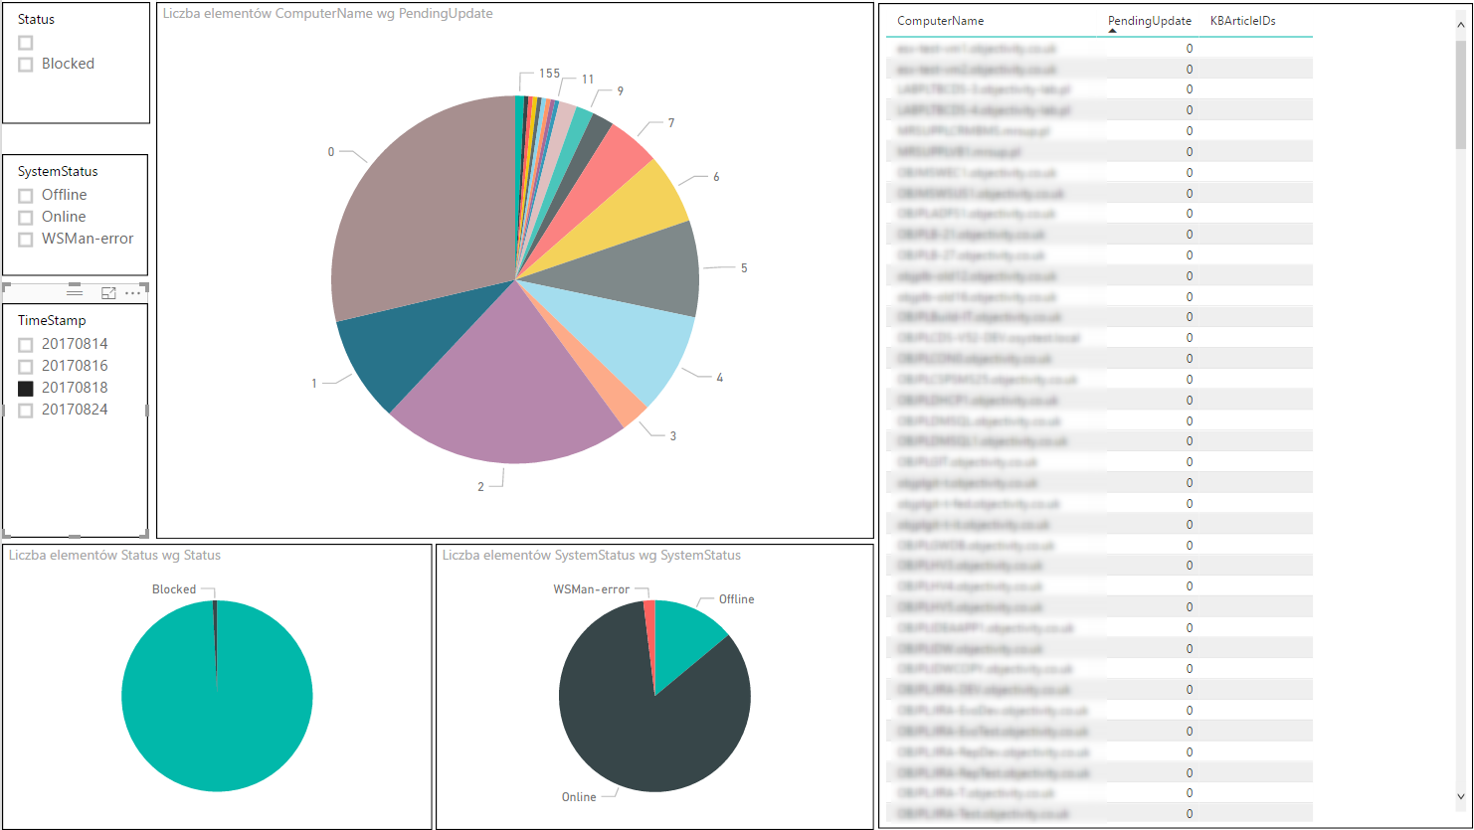
Status update report:

Slide 16


