Slide 1


Slide 2




Pester – SysAdmins weapon
Mateusz Czerniawski
Arcontar
mczerniawski@arcon.net.pl
@Arcontar
arconnetblog.wordpress.com

Slide 3
Agenda:
Pester – what’s the fuzz about and why should I care
Reusable Code – why to complicate
OVF – what’s in it for me
Enough of this – show me some code (demo time)

Slide 4
Pester – „the new black”
https://github.com/pester/Pester - PowerShell BDD style testing framework
http://www.powershellmagazine.com/2014/03/12/get-started-with-pester-powershell-unit-testing-framework/ - PowerShell unit testing framework (year 2014)
https://blogs.technet.microsoft.com/heyscriptingguy/2015/12/14/what-is-pester-and-why-should-i-care/ (year 2015)
https://leanpub.com/pesterbook/c/4ti1DbCOBQux (25-06-2017)

Slide 5
Real Life examples
DBATools - https://sqldbawithabeard.com/tag/pester/
DSC - https://pwrshell.net/create-your-first-pester-script-to-test-a-dsc-resource/

Slide 6
Real Life examples
AD Accounts:
$SamaccountName = 'mczerniawski'
$computername = 'nbmczerniawski'
$Scripts = 'C:\AdminTools\Temporary\LocalAdministrator'
Import-Module (Join-path $Scripts -ChildPath 'Validate-LocalAdminCheck.ps1')
$pesterFile = Join-Path $Scripts -ChildPath 'Pester_Validate-LocalAdminCheck.ps1’
Validate-LocalAdminCheck -samaccountname $SamaccountName -PesterTestFile $pesterFile -ComputerName $computername

Slide 7
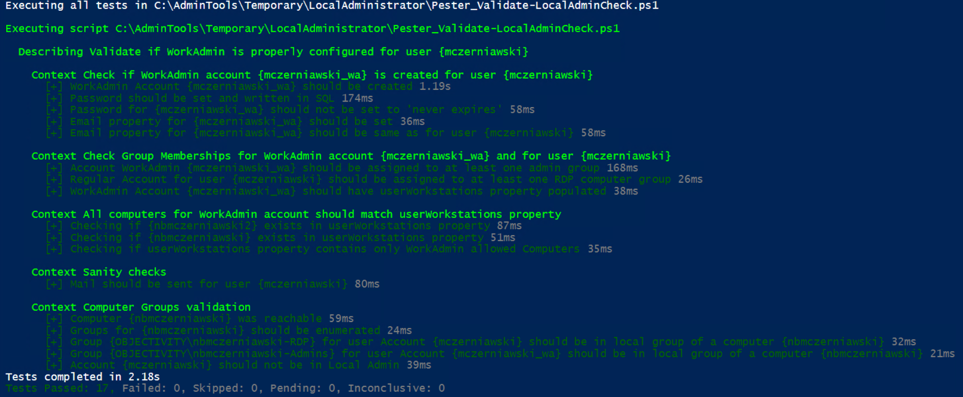
Real Life examples

Slide 8
Pester – powered by community
Format-Pester https://github.com/equelin/Format-Pester
PSCribo - https://github.com/iainbrighton/PScribo
ReportUnit - https://mcpmag.com/articles/2016/12/01/create-a-simple-pester-test-report.aspx
Nunit output – integration with CI tools - https://github.com/pester/Pester/wiki/Showing-Test-Results-in-CI-(TeamCity,-AppVeyor)
http://www.dexterposh.com/2015/06/powershell-pester-jenkins-ci.html
PoshSpec - expand the Pester DSL to test infrastructure - https://github.com/Ticketmaster/poshspec
OVF - https://github.com/PowerShell/Operation-Validation-Framework

Slide 9
Configuration as a Code

Slide 10
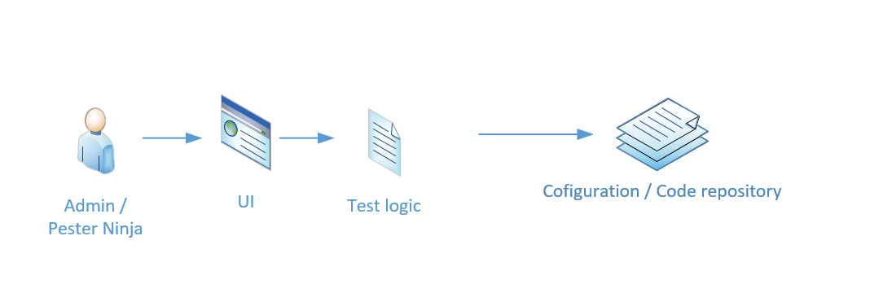
Test logic as a Code

Slide 11
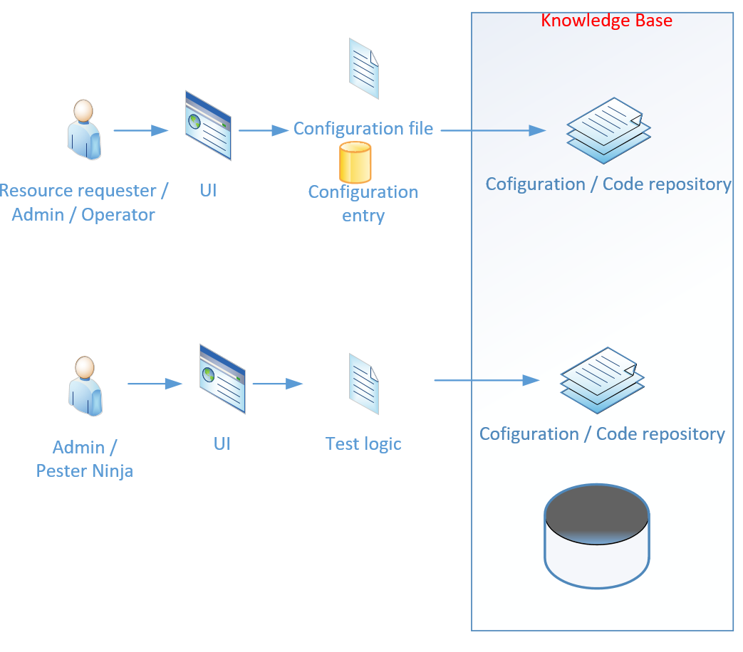
The True Power

Slide 12
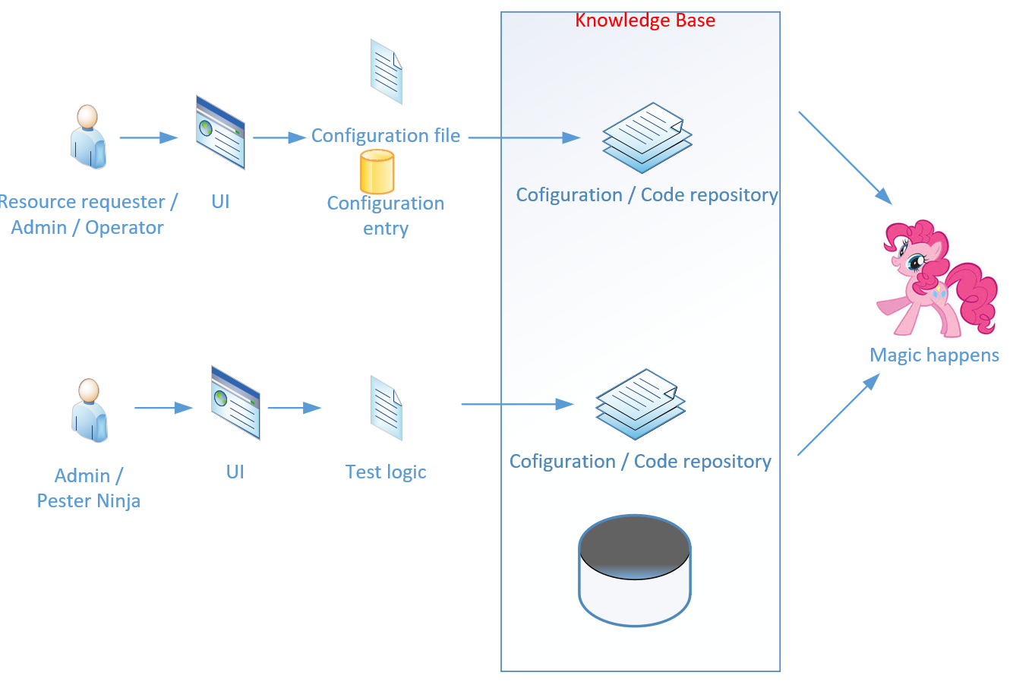
Friendship is Magic

Slide 13
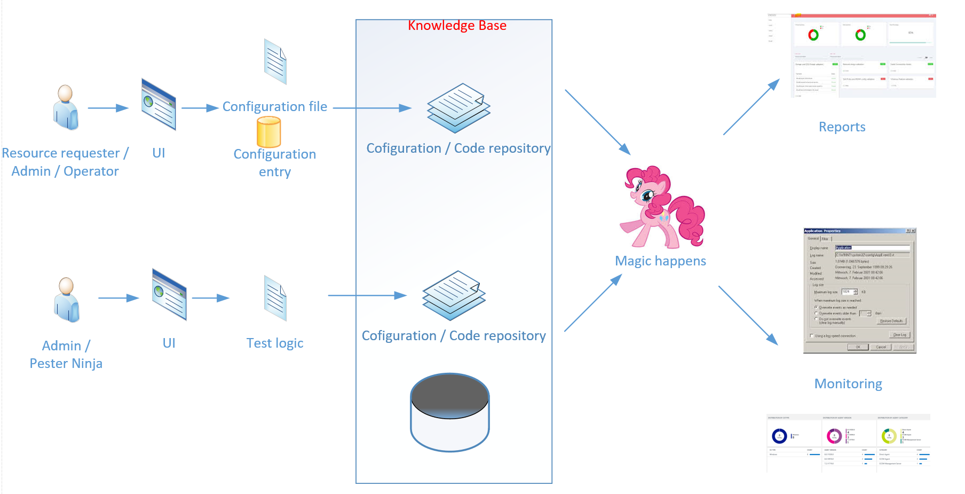
Dashboards Time

Slide 14
Concept
PowerShell Module:
Tests, Configurations, Credentials
Helper Functions: Invoke Tests, Write Output
„Agent” server
Monitoring:
Consume EventLogs - OMS
Reports:
Combine Nunit XML files

Slide 15
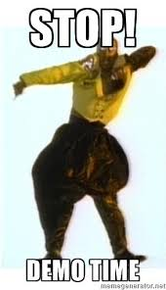
Demo Time

Slide 16
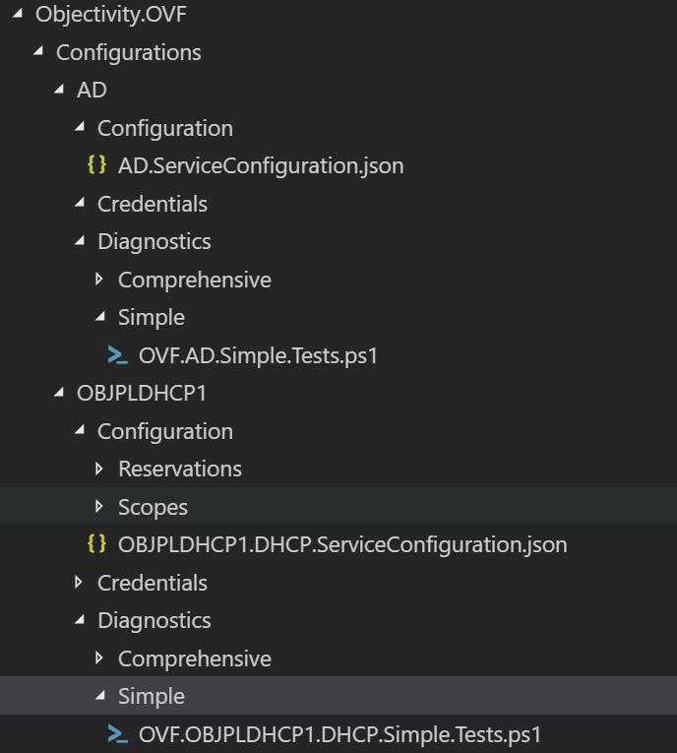
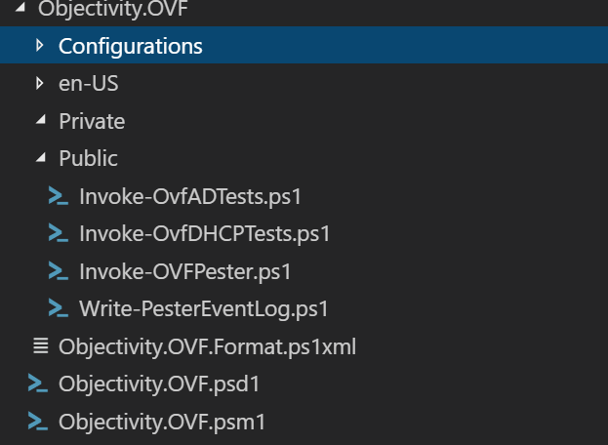
Summary

Slide 17
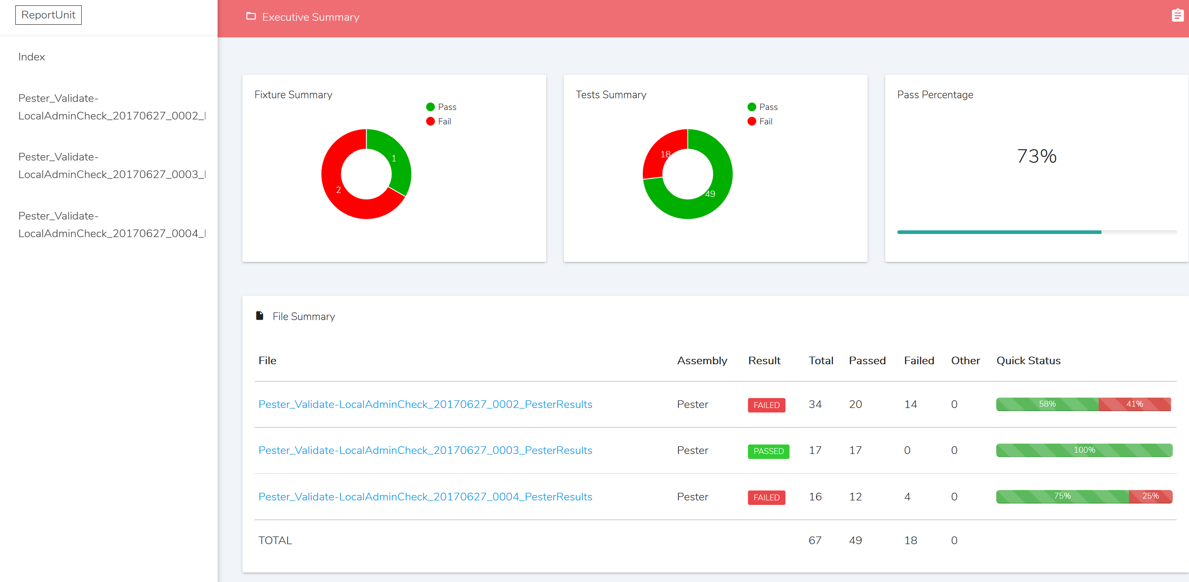
Summary

Slide 18
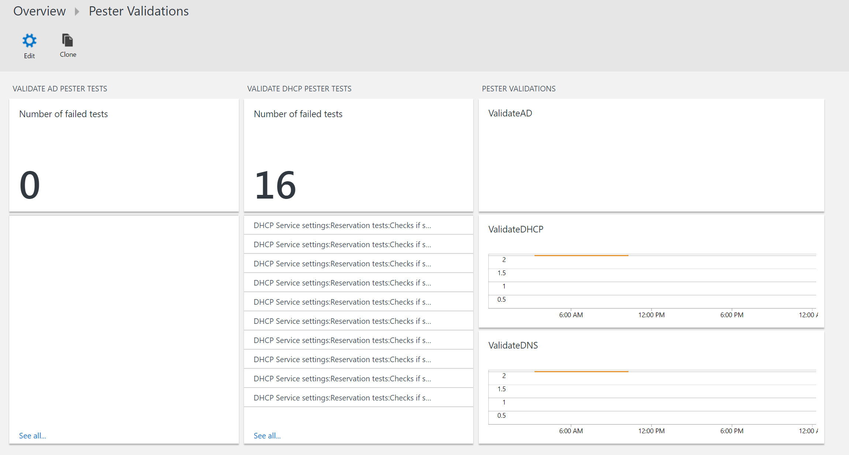
Summary

Slide 19
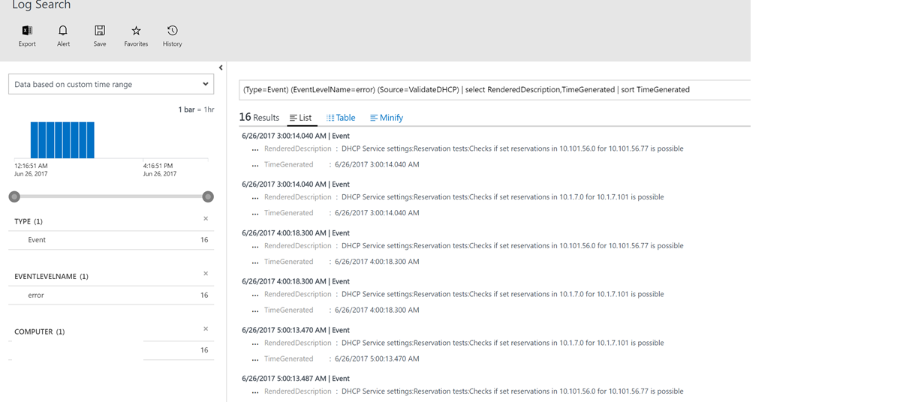
Summary

Slide 20

Questions

