Slide 1


Slide 2




HyperV 2016, S2D, PowerShell
Mateusz Czerniawski
Arcontar
mczerniawski@arcon.net.pl
@Arcontar
arconnetblog.wordpress.com

Slide 3
PPoSh #1 HomeLab:
Azure Dev/Test Lab
Lability – VirtualEngine
GUI – clicky click
PowerShell

Slide 4
PPoSh #1 Architecture

Slide 5
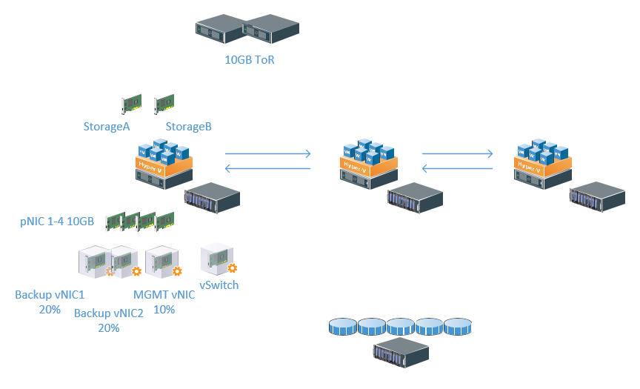
S2D Architecture

Slide 6
The Concept
Configuration as a Code (.json)
– configuration, validation, documentation
Deployment as a Code (.ps1)
repeatable, automated, error-free process
Validation and auditable environment (Pester, OMS)
- Configuration drift, treshold violations

Slide 7
Workbench
Windows 10/2016 – operator’s console (WMF 5.1)
Install-Module PPoShTools -MinimumVersion 1.0.8
Install-Module PPoShHyperV – soon to be released

Slide 8
PowerShell (PPoSh #1)
Prepare VM Templates – Gold Images (5.Run-PrepareVMTemplates.ps1)
Prepare VMs configuration files (6. Run-PrepareVM.ps1)
Deploy VMs from configuration files (7.Run-CreateVMs.ps1)

Slide 9

Demo Time

