Slide 1


Slide 2




PowerShell Functions
Tomek Dąbrowski
DomBros
dombros@gmail.com
@Dom_Bros
dombrosblog.wordpress.com

Slide 3
Agenda:
Scripts vs Functions vs Modules
Function - best practices
Splatting
Error handling
Logging
Module
Pester tests - TDD, BDD
Function Advanced

Slide 4
1. Script vs Function vs Module
Script
is a collection of commands which are executed 1 by 1
Cmdlet
is a compiled .NET code
Function
is a small script, function lets you do a repeatable task
Module
is set of related Windows PowerShell functionalities (functions, scripts, assemblies)
Internal commands
These are cmdlets.
External commands
Are other programs that exist outside of PowerShell (ping.exe)
Notes:
Script A script is a collection of commands which are executed. For example, you may have a script which gather a list of running processes on your PC or another PC, and then it may have a function which does something with that data or you might also run some other commands. So think of it as a sequence of commands being run without having to run the commands 1 by 1 yourself. Cmdlet A cmdlet is .NET code which performs a specific task without you having to write it out yourself. For example instead of just typing Get-Process and using it's nifty switches, you could use the below code and work with it yourself to get the various output you want. [System.Diagnostics.Process]::GetProcesses() Function A function lets you do a repeatable task or a whole bunch of tasks without having to type it out over and over (think of a function as maybe a small script? :p). So rather than have 10/1, 10/2, 10/5, etc you could have a function which you fed the numbers to divide 10 by do you don't have to type it out over and over. Internal commands These are cmdlets. External commands Are other programs that exist outside of PowerShell. For example ping.exe.
https://www.experts-exchange.com/questions/26311104/PowerShell-CMDLETS-vs-Scripts-Vs-Functions.html

Slide 5
Script
$ComputerName = 'NBTDABROWSKI'
$Class = 'Win32_Bios'
Get-WmiObject -ComputerName $ComputerName -Class $Class
Notes:
Script A script is a collection (one or hundred) of commands which are executed.

Slide 6
Function
function Get-WinOrCimData {
<#
.Synopsis
Short description
.DESCRIPTION
Long description
.EXAMPLE
Example of how to use this cmdlet
#>
[CmdletBinding(SupportsShouldProcess)]
param
(
[String]
$ComputerName,
[String]
$Class = 'Win32_Bios'
)
Get-WmiObject -ComputerName $ComputerName -Class $Class
}
Notes:
Function Function sometimes can has more lines then script so why care.
Function is script wrapped additionally with help section, parameter section and with other switches and options.
Help shows how function works, how function use.
Parameter definitione can really simplify things (because of defining type, validation)

Slide 7
2. Function, best practices
A function should do one thing, and do it well.
Use Singular Parameter and Function Names
Use simple but meaningful variable names. (e.g. $ServiceName or $Counter, and not $s and $c).
Use Pascal case for parameter names and functions - capitalize the first letter of verb and all terms used in the noun. For example, “Clear-ItemProperty”.
Notes:
https://blogs.technet.microsoft.com/pstips/2014/06/17/powershell-scripting-best-practices/

Slide 8

2. Function, best practices
Use standard parameter naming (e.g. ComputerName and not Machine or Server), and set them a default value
(e.g. $ComputerName = $ENV:ComputerName).
(Get-Command -ParameterName Computer).Count
(Get-Command -ParameterName ComputerName).Count
Notes:
https://blogs.technet.microsoft.com/pstips/2014/06/17/powershell-scripting-best-practices/

Slide 9
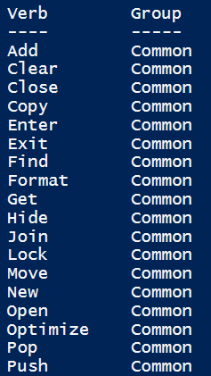
3. Function naming (Verb-Noun)
Use the Verb-Noun naming convention
Get-Verb

Slide 10
3. Function naming (Verb-Noun)
New vs. Set
New - create a new resource. Set verb is used to modify an existing resource
Invoke vs. Start
Invoke - perform synchronous operation. Start - begin asynchronous operation, such as starting a process.
Ping vs. Test
Use the Test verb.

Slide 11
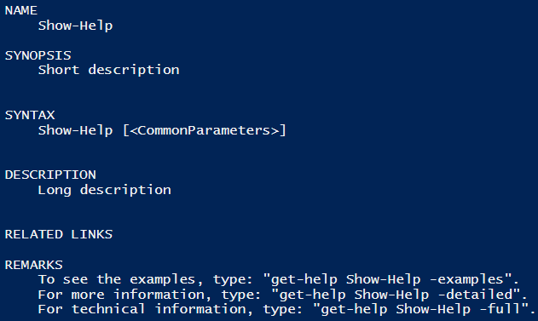
4. Synopsis – function help
The minimum items are Synopsis, Description, and Example.
Function Show-Help
{
<#
.Synopsis
Short description
.DESCRIPTION
Long description
.EXAMPLE
Example of how to use this cmdlet
#>
param()
}
Get-help Show-Help
Notes:
Help - why „waste” time writing it
Because in half a year even you will not know what you meant
For others who will take your functions, so they can find out what it is for and how it works
In the world, and even in our office, there are more and more function every day
Our module has over 200 functions
You are not working alone

Slide 12
5. Parameter defining (types, validation, sets, etc.)
Function Show-Help
{
[CmdletBinding(ConfirmImpact = 'High')]
param(
# ComputerName
[String]$ComputerName
)
if ($PSCmdlet.ShouldProcess($ComputerName)) {
Write-Host -Object "Test computer $ComputerName"
}
}
Show-Help -ComputerName 'OBJPLRESTART'
Notes:
http://windowsitpro.com/blog/advanced-functions-part-2-shouldprocess-your-script-cmdlets
Using this [CmdletBinding(ConfirmImpact = 'High’)] function will stop here ”if ($PSCmdlet.ShouldProcess($ComputerName))” and ask to confirm the operation

Slide 13
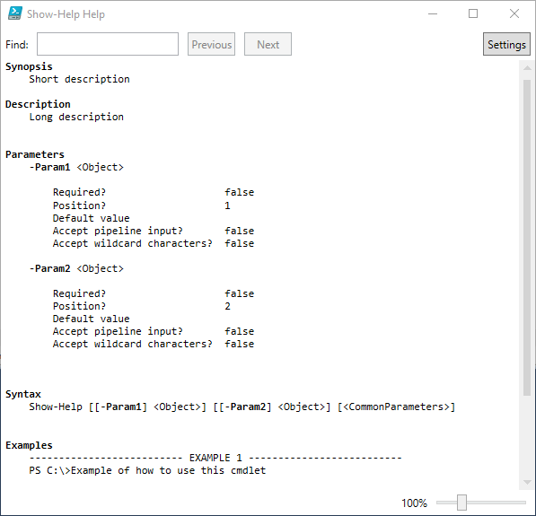
5. Parameter defining (types, validation, sets, etc.)
Function Show-Help
{
<#
.Synopsis
Short description
.DESCRIPTION
Long description
.EXAMPLE
Example of how to use this cmdlet
#>
param($Param1, $Param2)
}
Get-help Show-Help -ShowWindow
Notes:
Parameter definition
Shortest way param($Param1, $Param2)

Slide 14
5. Parameter defining (types, validation, sets, etc.)
Function Show-Help
{
<#
.Synopsis
Short description
.DESCRIPTION
Long description
.EXAMPLE
Example of how to use this cmdlet
#>
param($Param1, $Param2)
}
Get-help Show-Help -ShowWindow
Notes:
Parameter definition
Shortest way param($Param1, $Param2)
But please don’t go that way

Slide 15
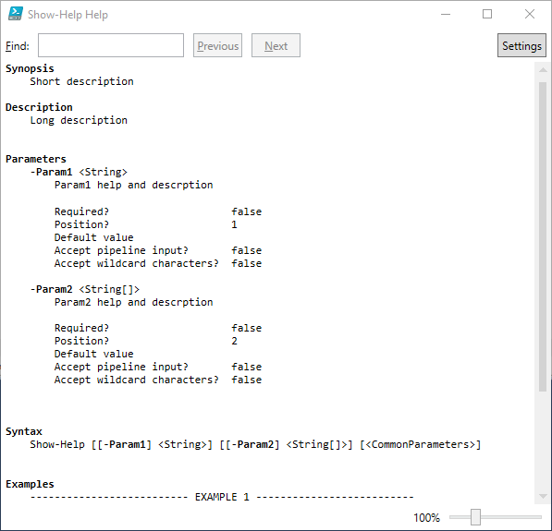
5. Parameter defining (types, validation, sets, etc.)
Function Show-Help
{
<#
.Synopsis
Short description
.DESCRIPTION
Long description
.EXAMPLE
Example of how to use this cmdlet
#>
param(
# Param1 help and descrption
[String]
$Param1,
# Param2 help and descrption
[String[]]
$Param2)
}
Get-help Show-Help -ShowWindow
Notes:
Parameter definition
Now Paramters have help, have type, and can have many more

Slide 16
5. Parameter defining (types, validation, sets, etc.)
Param
(
# Param1 help description
[Parameter(Mandatory=$true, ValueFromPipeline=$true, ValueFromPipelineByPropertyName=$true, ValueFromRemainingArguments=$false, Position=0, ParameterSetName='Parameter Set 1')]
[ValidateNotNull()]
[ValidateNotNullOrEmpty()]
[ValidateCount(0,5)]
[ValidateSet('sun', 'moon', 'earth')]
[Alias('p1')]
$Param1,
Notes:
This is „the many more”

Slide 17
5. Parameter and variable defining
[int] ${32-bit signed integer}
[string] ${Fixed-length string of Unicode characters}
[PSCredential]$Credential
[array] ${Array of values}
[hashtable] ${Hashtable object (similar to a Dictionary object)}
[xml] ${Xmldocument object}
Notes:
Most common variable types

Slide 18
5. Parameter validation
Param (
[ValidateSet('Tom','Kris','Jane')]
[String]$Name,
[ValidateRange(21,65)]
[Int]$Age,
[ValidateLenght(100,255)]
[String]$Text,
[ValidateCount(0,5)]
[String[]]$List,
[ValidateScript({Test-Path $_ -PathType 'Container'})]
[string]$Path,
[ValidatePattern('[A-Z]*[-]\d*')]
[string]$Ticket
)
Notes:
Parameter Validation
It’s simplify PowerShell scripts and functions
https://learn-powershell.net/2014/02/04/using-powershell-parameter-validation-to-make-your-day-easier/

Slide 19
6. WhatIf, PsCmdlet (automatic variable)
function Show-WhatIf
{
[CmdletBinding(SupportsShouldProcess = $true)]
Param
(
# Computer Param help description
[String]$Computer
)
if ($pscmdlet.ShouldProcess('Target', 'Operation'))
{
}
if($pscmdlet.ShouldProcess($Computer,’Delete'))
{
Write-Host -Object "Deleting $Computer ..." -ForegroundColor Red
}
}
Notes:
https://4sysops.com/archives/the-powershell-whatif-parameter/

Slide 20
6. WhatIf, PsCmdlet (automatic variable)
Show-WhatIf -WhatIf

Slide 21
7. no Splatting
Get-WinOrCimData -ComputerName 'OBJPLRESTART' -Credential (Get-Credential) -Class 'Win32_QuickFixEngineering' -WhatIf:$True -Verbose:$True -Confirm:$True -ErrorAction SilentlyContinue -ErrorVariable $ErrorVar
Notes:
Hard to read
Hard to see mistakes

Slide 22
7. Splatting
$Params = @{
Class = 'Win32_QuickFixEngineering'
ComputerName = 'OBJPLRESTART'
Credential = (Get-Credential)
WhatIf = $False
Verbose = $True
}
$ErrorHandle = @{
ErrorAction = 'SilentlyContinue'
ErrorVariable = $ErrorVar
}
Get-WinOrCimData @Params @ErrorHandle -Debug
Notes:
https://technet.microsoft.com/en-us/library/gg675931.aspx

Slide 23

8. Pipeline
function Test-Pipeline
{
[CmdletBinding(PositionalBinding = $false)]
Param
(
# Param1 help description
[Parameter(ValueFromPipeline = $true)]
$ComputerName
)
Begin { Write-Host 'Create temporary files' }
Process { $ComputerName }
End { Write-Host 'Clean up temporary files' }
}
$ComputerName = 'OBJPLRESTART','NBTDABROWSKI'
$ComputerName | Test-Pipeline
Notes:
https://beatcracker.wordpress.com/2017/02/04/visualizing-powershell-pipeline/

Slide 24
9. StrictMode
Set-StrictMode -Version Latest
# Prevents use of variables that have not been initialized
# Cannot call non-existent properties on objects
# Disallows calling a function like a method, for example, Do-Something(1 2)
# Prohibits creating variables without a name
Notes:
https://blogs.technet.microsoft.com/heyscriptingguy/2014/12/03/enforce-better-script-practices-by-using-set-strictmode/

Slide 25
10. Error handling
Essentially, in PowerShell we have two types of errors:
- terminating
- non-terminating
$ErrorActionPreference = "Stop"
$ErrorActionPreference = "Continue"
$ErrorActionPreference = "SilentlyContinue"
Notes:
A non-terminating error is one that Windows PowerShell can recover from, and it can continue doing things.
A terminating error is one that means "it is over, and Windows PowerShell can’t do anything else."
http://powershell-guru.com/dont-do-that-17-silent-errors-with-erroractionpreference-silentlycontinue/
https://blogs.technet.microsoft.com/heyscriptingguy/2015/09/15/error-handling-two-types-of-errors/

Slide 26
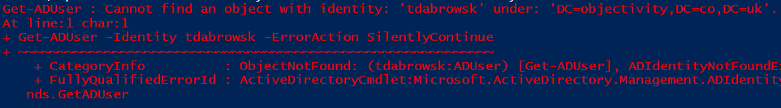
10. Error handling
Get-ADUser -Identity tdabrowsk
Notes:
In our module $ErrorActionPreference is set to "Stop„, because of that now we have an error

Slide 27
10. Error handling
Get-ADUser -Identity tdabrowsk -ErrorAction SilentlyContinue
Notes:
In our module $ErrorActionPreference is set to "Stop„, because of that now we have an error
There is still an error even if -ErrorAction is set to SilentlyContinue

Slide 28

10. Error handling
$OldValue = $ErrorActionPreference
$ErrorActionPreference = 'SilentlyContinue'
Get-ADUser -Identity tdabrowsk
$ErrorActionPreference = $OldValue
Notes:
When we set $ErrorActionPreference to "SilentlyContinue„, then error go silent

Slide 29
10. Error handling
$ErrorActionPreference = "SilentlyContinue"
Get-ADUser -Identity tdabrowsk -ErrorVariable ErrorFromADUser
$ErrorFromADUser

Slide 30

11. Try, Catch, Finally
Try{ Get-ADUser -Identity tdabrowsk }
Notes:
It works with F8
Error is traped in Try block
https://www.vexasoft.com/blogs/powershell/7255220-powershell-tutorial-try-catch-finally-and-error-handling-in-powershell

Slide 31
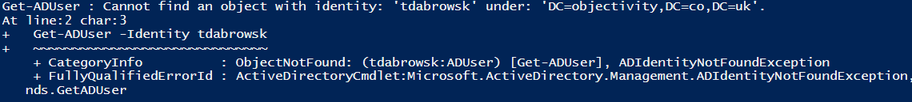
11. Try, Catch, Finally
Try {
Get-ADUser -Identity tdabrowsk
}
Catch {
$_
}
Notes:
We can pass through error using $_ to catch block

Slide 32
11. Try, Catch, Finally
Try{
Get-ADUser -Identity tdabrowsk
}
Catch [Microsoft.ActiveDirectory.Management.ADIdentityNotFoundException]{
Write-Host 'Error trapped. Unknown user.' -ForegroundColor Yellow
}
Catch {
Write-Host 'Other error:' -ForegroundColor Yellow
$_
}
Notes:
We can have many catch blocks depending on exceptions in this case exception name [Microsoft.ActiveDirectory.Management.ADIdentityNotFoundException]

Slide 33

11. Try, Catch, Finally
Try {
Get-ADUser -Identity tdabrowsk
}
Catch [Microsoft.ActiveDirectory.Management.ADIdentityNotFoundException]{
Write-Host 'Error trapped. Unknow user.' -ForegroundColor Yellow
}
Catch {
Write-Host 'Other error:' -ForegroundColor Yellow
$_
}
Finally {
Write-Host 'Cleaning up ...' -ForegroundColor Green
}
Notes:
And finally we can have finally block which is perform always

Slide 34
12. Operation Logging
Write-Verbose, Write-Output, Write-Host
Write-Log
Add-ChangeLog
SQL
“Turn on PowerShell Transcription” GPO allows you to log the input and output of PowerShell commands into text-based transcript files.

Slide 35
13. PSBoundParameters (automatic variable)
function Get-WinOrCimData {
[CmdletBinding(SupportsShouldProcess)]
param( [String]$ComputerName, [PSCredential]$Credential, [String]$Class )
Begin {
if( -not $PSBoundParameters.ContainsKey('Class') ) {
$Class = 'Win32_QuickFixEngineering'
Write-Host -Object "Setting default Class: $Class" -ForegroundColor Gray
$PSBoundParameters.Add('Class',$Class)
}
$WhatIf = $PSBoundParameters['WhatIf']
$Verbose = $PSBoundParameters['Verbose']
$null = $PSBoundParameters.Remove('Verbose') = $PSBoundParameters.Remove('Debuge') = $PSBoundParameters.Remove('WhatIf')
}
Process {
$DataWinCim = Get-WmiObject @PSBoundParameters
Notes:
http://tommymaynard.com/quick-learn-the-psboundparameters-automatic-variable-2016/

Slide 36
14. Pester, testy - Test Driven Development (TDD), Bahavior Development Driven (BDD)
function Show-Hello {
param ([String]$From)
"Hello from $From"
}
Context -Name 'Running with arguments' -Fixture {
It -Name 'returns standard phrase' -Test {
Show-Hello -From 'Venus' | Should Be 'Hello from Venus’
}
}
Notes:
https://github.com/pester/Pester

Slide 37
15. Module
#region read all files
. 'C:\Users\tdabrowski\Desktop\PPoSh\02\PPoShDemo.psm1'
# export function
Export-ModuleMember -Function Get-ComputerInformation
#endregion
Notes:
The simplest way
Create file with extension .psm1
Inside this file load file with function using DOT
At the end use Export-ModuleMember
And that’s it
http://www.tomsitpro.com/articles/powershell-modules,2-846.html
Dot-Sourcing
https://mcpmag.com/articles/2017/02/02/exploring-dot-sourcing-in-powershell.aspx

Slide 38
15. Module
#region read all files
$Functions = @(Get-ChildItem -Recurse -Path $PSScriptRoot\*.ps1 | Where-Object { $_ -notmatch '\.Examples.ps1' })
foreach ($import in $Functions) {
. $import.fullname
}
# export functions (all or selected)
Export-ModuleMember -Function Show-Hello
#endregion
Notes:
Create file with extension .psm1
Using Get-ChildItem get all ps1 files
Load all files using Dot-Sourcing
Export functions

Slide 39
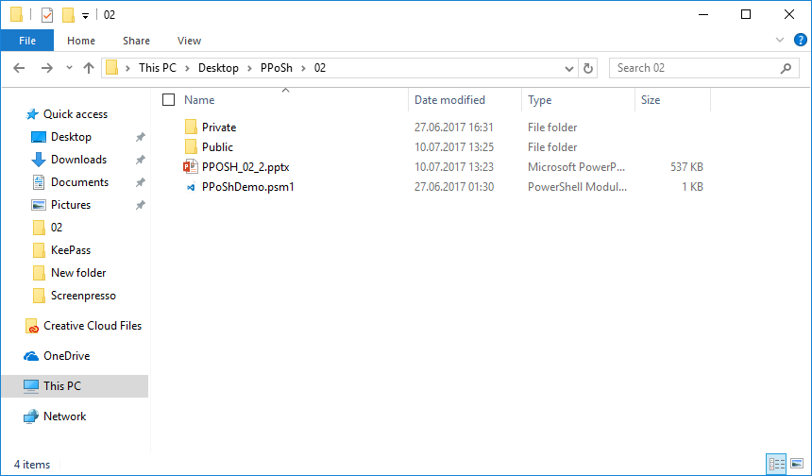
15. Module
Notes:
It loook like this

Slide 40
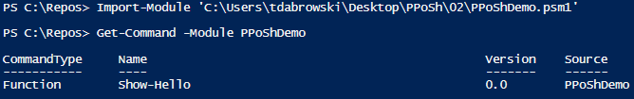
15. Module

Slide 41
Function output
Class ComputerInformation {
[String]$OperatingSystem
[String]$Manufacturer
[String]$Model
[String]$SerialNumber
[String]$CPU
[String]$RAM
[String]$HDDCapacity
[String]$HDDFreeSpace
[String]$UserLoggedIn
[String]$LastReboot
}
Notes:
Class definition
https://blogs.technet.microsoft.com/heyscriptingguy/2015/09/01/powershell-5-create-simple-class/

Slide 42
Function output
$ComputerInformation = New-Object -TypeName ComputerInformation
$ComputerInformation.OperatingSystem = $OSData.caption + ', Service Pack: ' + $OSData.ServicePackMajorVersion
$ComputerInformation.Manufacturer = $SystemData.Manufacturer
$ComputerInformation.Model = $SystemData.Model
$ComputerInformation.SerialNumber = $BiosData.SerialNumber
$ComputerInformation.CPU = $CPUData.Name
$ComputerInformation.RAM = '{0:N0} GB' -f ($SystemData.TotalPhysicalMemory/1GB)
$ComputerInformation.HDDCapacity = '{0:N0} GB' -f ($HDDData.Size/1GB)
$ComputerInformation.HDDFreeSpace = '{0:P0}' -f ($HDDData.FreeSpace/$HDDData.Size) + ' ({0:N0} GB)' -f ($HDDData.FreeSpace/1GB)
$ComputerInformation.UserLoggedIn = $SystemData.UserName
$ComputerInformation.LastReboot = $OSData.LastBootUpTime

Slide 43
Function output
# define an array containing the properties you are interested in
$DefaultProperties = @('OperatingSystem', 'SerialNumber')
# create a new object of type PSPropertySet using the previously created array
# this object will be called DefaultDisplayPropertySet
$DefaultDisplay = New-Object System.Management.Automation.PSPropertySet -ArgumentList ('DefaultDisplayPropertySet', [string[]]$DefaultProperties)
# create a PSStandardMembers object with the previously created DefaultDisplayPropertySet object
$PSStandardMembers = [System.Management.Automation.PSMemberInfo[]]@($DefaultDisplay)
# add this object as a property to our object
$ComputerInformation | Add-Member MemberSet PSStandardMembers $PSStandardMembers
Notes:
Create default display properties
https://learn-powershell.net/2013/08/03/quick-hits-set-the-default-property-display-in-powershell-on-custom-objects/

Slide 44
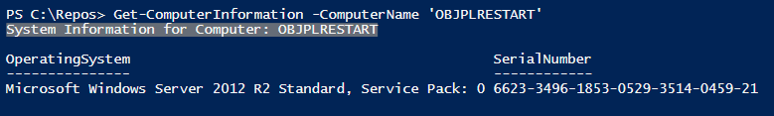
Function output

Slide 45
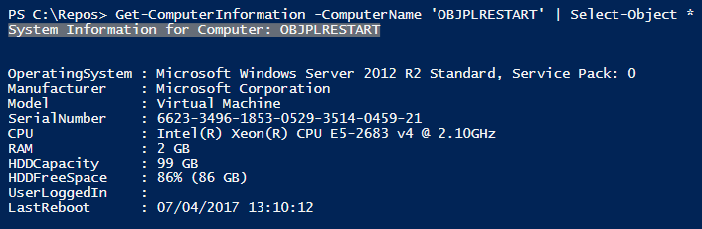
Function output

Slide 46
Other Win_32 classes
Get-WmiObject -Class Win32_Desktop
Get-WmiObject -Class Win32_Processor
Get-WmiObject -Class Win32_LogicalDisk
Get-WmiObject -Class Win32_LogonSession
Get-WmiObject -Class Win32_ComputerSystem
Get-WmiObject -Class Win32_OperatingSystem
Get-WmiObject -Class Win32_QuickFixEngineering

