Slide 1

AI in India
Kapili hostel

Slide 2
Problem: Soil property prediction
Farming and agriculture sector is the backbone of Indian economy.
The success of the crop depends a lot on the type of soil that is used for cultivating the crop.
If we're able to predict some of the important properties of the soil, such as the amount of nutrients, its water retention capacity, resistance to water erosion, etc., then we can help the farmers in giving an idea of the kind of crops that would be beneficial for them to grow on the given land.
Prediction of soil properties helps in planning sustainable agricultural intensification and also natural resource management.

Slide 3
Dataset
We have obtained the dataset from the Kaggle's Africa Soil Property Prediction Challenge, which we can easily extrapolate to the Indian scenario.
The dataset consists of 1158 examples.
There are 5 target variables: SOC(Soil Organic Carbon), pH(pH value), Ca(Mehlich-3 extractable Calcium), P(Mehlich-3 extractable Phosphorus) and Sand(Sand Content).
There are 3578 mid infrared absorbance measurements, labelled from m7497.96 to m599.76, and also a categorical variable 'Depth', indicating the depth of the soil sample, which takes either the value 'Topsoil' or 'Subsoil'.
There are also 15 other measurements that are taken from remote sensening data sources, for each example.

Slide 4
Data processing
From the 3578 mid infrared absorbance measurements, it was suggested to remove the CO2 band, that is, from m2379.76 to m2352.76, which was done.
The categorial variable 'Depth' was One Hot Encoded, and in place of that, 2 variables 'Depth_Topsoil' and 'Depth_Subsoil' were introduced, which take values either 0 or 1.
As there was too many features for a given example, different techniques were used to reduce the dimensionality of the dataset. Applying PCA, we could see that only 10-15 features were of importance. But PCA wasn't used as it drastically reduced the number of features, and also because the model with PCA wasn't that accurate.
Next, we calculated the standard deviation and the variance of the data. It was seen that many features had variance less than 0.02, which was quite low, and hence, they wouldn't be of much importance in deciding the final prediction. Hence, keeping a threshold of sqrt(0.02)=0.1414, all the features with standard deviation below 0.1414 were removed.

Slide 5


Removing CO2 band
OneHot Encoding
Removing data with low variance

Slide 6

Model selection & Hyperparameter tuning
We used 5 different Support Vector Regressors to predict the 5 target variables, i.e. Ca, P, pH, SOC and Sand.
As the number of features are large, we used Support Vector Regression, as they can deal with huge number of features easily.
Also, we used SVR because it is usually tends to be resistant to overfitting even in cases like this, I.e. small dataset with many features.
As the number of features were large, we used a linear kernel in the SVR, for all the regressors, and we also set different values of C for the regressors.
For finding the error, we have used MCRMSE(Mean Columnwise Root Mean Squared Error), I.e.

Slide 7
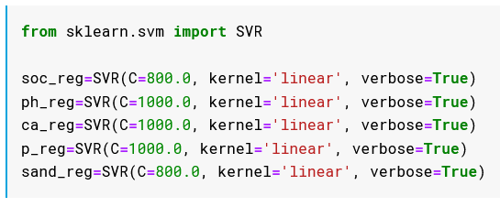
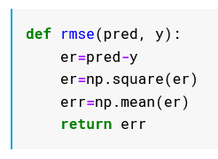
Support Vector Regressors for the target variables
Root Mean Squared Error

Slide 8
Training and validation error
The training error:
Ca=0.96, P=1.30, pH=1.02, SOC=1.45, Sand=0.72
The testing error:
Ca=1.68, P=2.54, pH=1.37, SOC=1.34, Sand=1.47

Slide 9
THANK YOU

