Slide 1
Memory: The unreliable narrator in our head

Slide 2
What we cover
Introduction
False memory and Science behind it
Causes/Factors
Treatment
Real world Implications
Case Study

Slide 3
Introduction
Definition
Importance
Types

Slide 4
introduction
Memory is the cognitive process by which we encode, store and retrieve information and experiences from our past.
Memory is crucial for learning, forming relationships, and navigating daily lives. It helps us retain knowledge, make decisions, and building identities.
Types of Memory:
Sensory Memory
Short-Term Memory
Long-Term Memory

Slide 5

FALSE MEMORY​
What they are
Characteristics
Examples

Slide 6
FALSE MEMORY
Memories that are people believe to be true but are actually distorted or fabricated. These memories can be either completely imagined or altered versions of real events.
Characteristics:
Believability
Persistence
Example: Mandela Effect

Slide 7
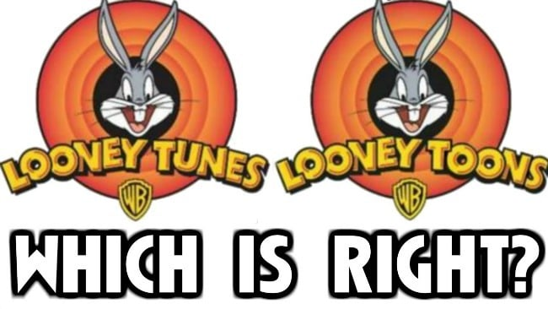

Slide 8
CAUSES/FACTORS

Slide 9
​CAUSES/FACTORS
Misinformation Effect: Incorrect information after an event can alter recollection.
Source Misattribution: Confusing the source of memories, mixing real events with imagined or suggested details.
Imagination Inflation: Vividly imagining an event can increase confidence that it actually occurred.
Emotional Factors: Strong emotions or stress can distort memory accuracy.
Memory Reconstruction: Memory is a reconstructive process and can change with each recall.
Suggestibility: Exposure to leading or suggestive questions can create false memories.

Slide 10
TREATMENT

Slide 11
treatment
• Awareness: Recognizing that false memories are a natural occurrence.
• Verification: Double-checking facts before relying on a memory.
• Cognitive Therapy: Techniques to improve memory accuracy.
• Mindfulness and Stress Reduction: Reducing factors that contribute to memory errors.

Slide 12
Real world implications

Slide 13
REAL WORLD IMPLICATIONS
Eyewitness Testimony: False memories can lead to unreliable testimonies and wrongful convictions.
Personal and Social Identity: Misremembered events can alter self-identity and strain relationships.
Educational and Professional Settings: False memories can affect learning and decision-making.

Slide 14
Case study

Slide 15
The ramona false memory case
• Gary Ramona was a vice president for worldwide marketing of Robert Mondavi Winery and was married to Stephanie Ramona, has a daughter Holly Ramona, a student.
• Holly had experienced bulimia and depression and sought treatment through Marche Isabella, a counselor, told Holly and Stephanie that bulimia was caused by sexual abuse in 60–70% of her patients. Western Medical chief of psychiatry Richard Rose also treated Holly Ramona. Holly agreed to take sodium amytal, administered by Rose.
• Holly Ramona confronted her father of raping her from the time when she was 5 – 8. Gary's wife Stephanie divorced him, and he lost his family and job.
• In Napa County Superior Court, Gary Ramona, sued Western Medical, Rose, and Isabella. Lenore Terr, an advocate of recovered memories, cross-examined on whether Holly Ramona's flashbacks of abuse were accurate. During the trial, Harrison Pope stated that bulimia was not influenced by one being sexually assaulted as a child.

Slide 16
THANK YOU

