Slide 1

MBEYA UNIVERSITY OF SCIENCE AND TECHNOLOGY COLLEGE OF SCIENCE AND TECHNICAL EDUCATION
DEPARTMENT OF NATURAL SCIENCES
COURSE NAME: ADVANCED PHYSICS – I
COURSE CODE: NS 6141
SEMESTER: I
ACADEMIC YEAR: 2024/2025
NAME OF FACILITATOR: ALENI FELIX RUDOVICK
CONTACT: +255622187682
ROOM: 107 COSTE

Slide 2

Mode of assessment
Two tests 30%
Test I:
Test II:
At End of${ 1}^{st}$ Semester Examination (60%)

Slide 3
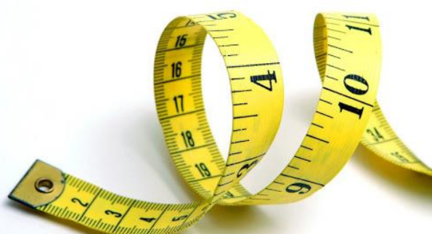
UNITS & DIMENSIONS

Slide 4
Learning objective
After going through this chapter, you should be able to;
Understand physical quantities, fundamental and derived
Describe different systems of units
Define dimensions and formulate dimensional formulae
Write dimensional equations and apply these to verify various formulations

Slide 5
Cont...
DEFINITION OF PHYSICS AND PHYSICAL QUANTITIES
Physics: Physics is the branch of science, which deals with the study of nature and properties of matter and energy.
The subject matter of physics includes heat, light, sound, electricity, magnetism and the structure of atoms.
For designing a law of physics, a scientific method is followed which includes the verifications with experiments.
The physics, attempts are made to measure the quantities with the best accuracy, therefore Physics can also be defined as science of measurement
Applied Physics is the application of the Physics to help human beings and solving their problem, it is usually considered as a bridge or a connection between Physics & Engineering

Slide 6
Cont...
Physical Quantities is a physical property of a material or system that can be quantified by measurement
Also, all Physical quantities are expressed in terms of laws of physics
For example; Length, Time, Distance, Speed, Mass, Force etc.

Slide 7
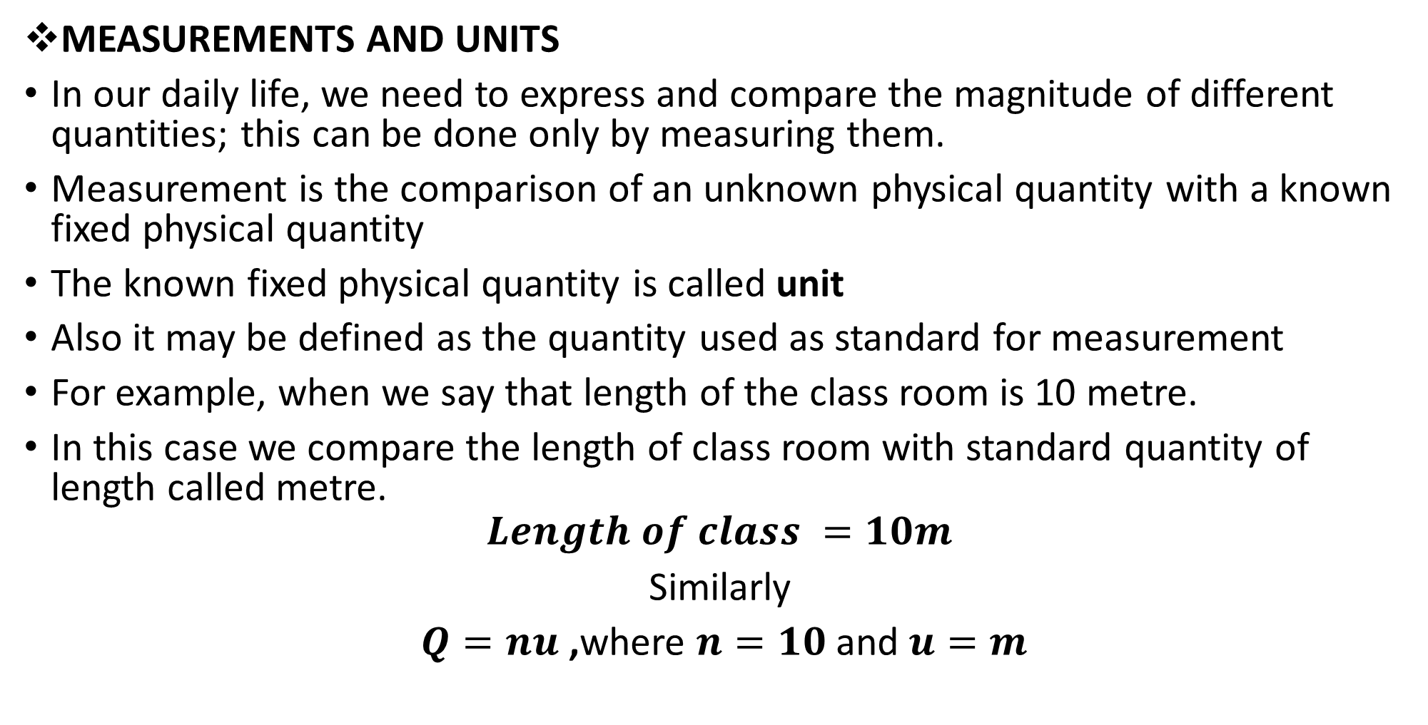
Cont...
MEASUREMENTS AND UNITS
In our daily life, we need to express and compare the magnitude of different quantities; this can be done only by measuring them.
Measurement is the comparison of an unknown physical quantity with a known fixed physical quantity
The known fixed physical quantity is called unit
Also it may be defined as the quantity used as standard for measurement
For example, when we say that length of the class room is 10 metre.
In this case we compare the length of class room with standard quantity of length called metre.
$$Length of class =10m$$
Similarly
$Q=nu$ ,where $n=10$and $u=m$

Slide 8
Cont...
A unit selected for measuring a physical quantity should have the following properties
It should be well defined i.e. its concept should be clear
It should not change with the change in physical condition like pressure, stress, etc
It should not change with place or time
It should be internationally accepted

Slide 9
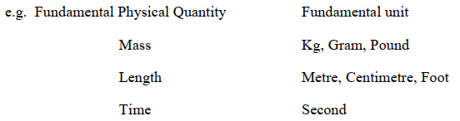
Cont...
Classification of Physical quantities and units
Physical quantities and their units can be classified into two categories that are
Fundamental Quantity
The quantity which is independent of other physical quantities.
In mechanics, mass, length, and time are called fundamental quantities.
Units of these fundamental physical quantities are called Fundamental units

Slide 10
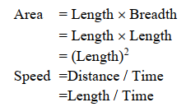
Cont...
Derived quantities
Are the quantities that can be expressed in terms of fundamental quantities are called derived quantities
They are expressed through mathematical operations of fundamental physical quantities (multiplication, Division, etc..)
For example, area, volume, velocity, acceleration, force
The units for derived quantities are called Derived Units.
Consider

Slide 11
System of Units
For measurement of physical quantity the following system of units are commonly used
C.G.S system
In this system, the unit of length is centimeter, the unit of mass in grams, the unit of time in second
F.P.S system
In this system, the unit of length is a foot, the unit of mass is a pound and the unit of time is a second
M.K.S
In this system, the unit of length is metre, the unit of mass is kg and the unit of time is second
S.I System
This system is an improved and extended version of the M.K.S system of units.
It is called the international system of units.

Slide 12
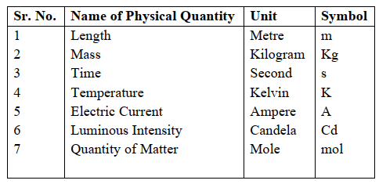
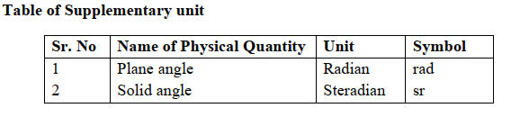
Cont...
With the development of science & technology, the three fundamental quantities like mass, length & time were not sufficient as many other quantities like electric current, heat etc. were introduced.
Therefore, more fundamental units in addition to the units of mass, length and time are required.
Thus, the MKS system was modified with the addition of four other fundamental quantities and two supplementary quantities as shown below

Slide 13
Cont...
Advantage of S.I. system
It is a coherent system of units i.e. the derived units of physical quantities are easily obtained by multiplication or division of fundamental units.
It is a rational system of units i.e. it uses only one unit for one physical quantity. E.g. It uses Joule (J) as the unit for all types of energies (heat, light, mechanical).
It is a metric system of units, i.e., its multiples and submultiples can be expressed to a power of 10.

Slide 14
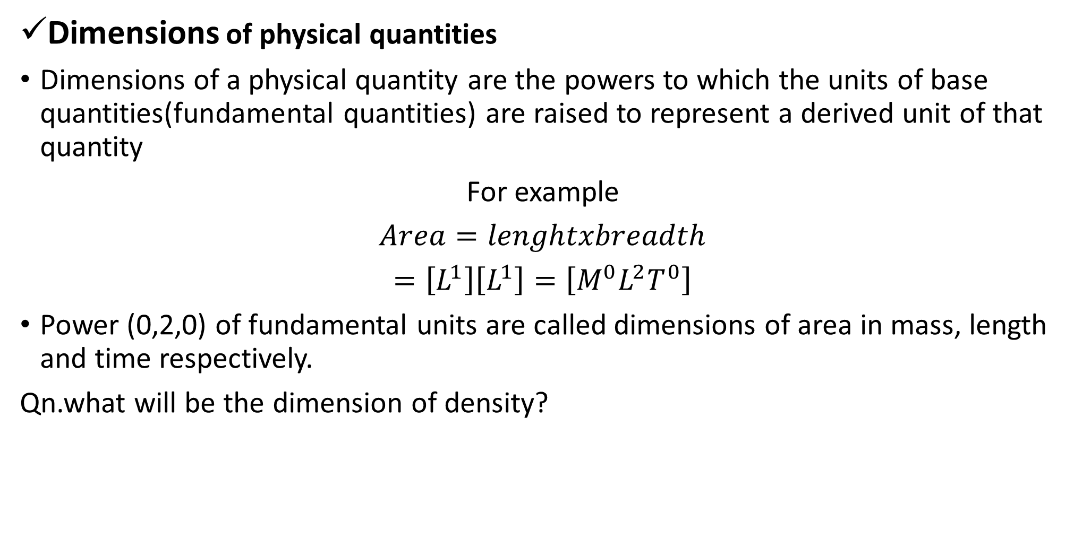
Cont..
Dimensions of physical quantities
Dimensions of a physical quantity are the powers to which the units of base quantities(fundamental quantities) are raised to represent a derived unit of that quantity
For example
$Area=lenghtxbreadth$
$=\left[L^{1}\right]\left[L^{1}\right]=\left[M^{0}L^{2}T^{0}\right]$
Power (0,2,0) of fundamental units are called dimensions of area in mass, length and time respectively.
Qn.what will be the dimension of density?

Slide 15
Cont...
Based on dimension, we can classify quantities into four categories
(a) Dimensional variables
Are physical quantities, which possess dimensions and have variable values
Examples of dimensional variables are length, velocity, and acceleration
(b) Dimensionless variables
Are physical quantities that have no dimensions, but have variable values
Examples of dimensionless variables are specific gravity(R.D), strain, refractive index
(c) Dimensional Constant
Are physical quantities that possess dimensions and have constant values
Examples of the dimensional constant are Gravitational constant, Planck’s constant

Slide 16
Cont.…
(d) Dimensionless Constant
Are physical quantities which have constant values and also have no dimensions are called dimensionless constants
Examples of dimensionless constants are π, e, numbers (whole numbers, fractions, negative value ), etc.

Slide 17
Examples
Derive the dimensional formula of the following Quantity and write down their dimensions
Density
Power
Co-efficient of viscosity
Angle
Explain which of the following pair of physical quantities have the same dimensions
Work &Power
Stress & Pressure
Momentum &Impulse

Slide 18
DIMENSIONAL EQUATIONS and FORMULA
The expression that shows how and which of the fundamental units are required to represent the unit of a physical quantity is called the Dimensional formula
It must contain the dimensions of all three fundamental physical quantities
Example:[M⁰LT⁻²] is the dimensional formula of acceleration
When the dimensional formula of a physical quantity is expressed in the form of an equation, such an equation is known as the dimensional equation
A careful examination of the dimensions of various quantities involved in a physical relation is called dimensional analysis.
The analysis of the dimensions of a physical quantity is of great help to us in a number of ways as discussed under the uses of dimensional equations.

Slide 19
PRINCIPLE OF HOMOGENEITY OF DIMENSIONS
It states that “the dimensions of all the terms on both sides of an equation must be the same”
According to the principle of homogeneity, the comparison, addition & subtraction of all physical quantities is possible only if they are of the same nature i.e., they have the same dimensions
If the power of M, L and T on two sides of the given equation are same, then the physical equation is correct otherwise not.
Therefore, this principle is very helpful to check the correctness of a physical equation
Example in the physical expression v² = u² + 2as
The dimensions of v², u² and 2as are the same and equal to [L²T⁻²]

Slide 20
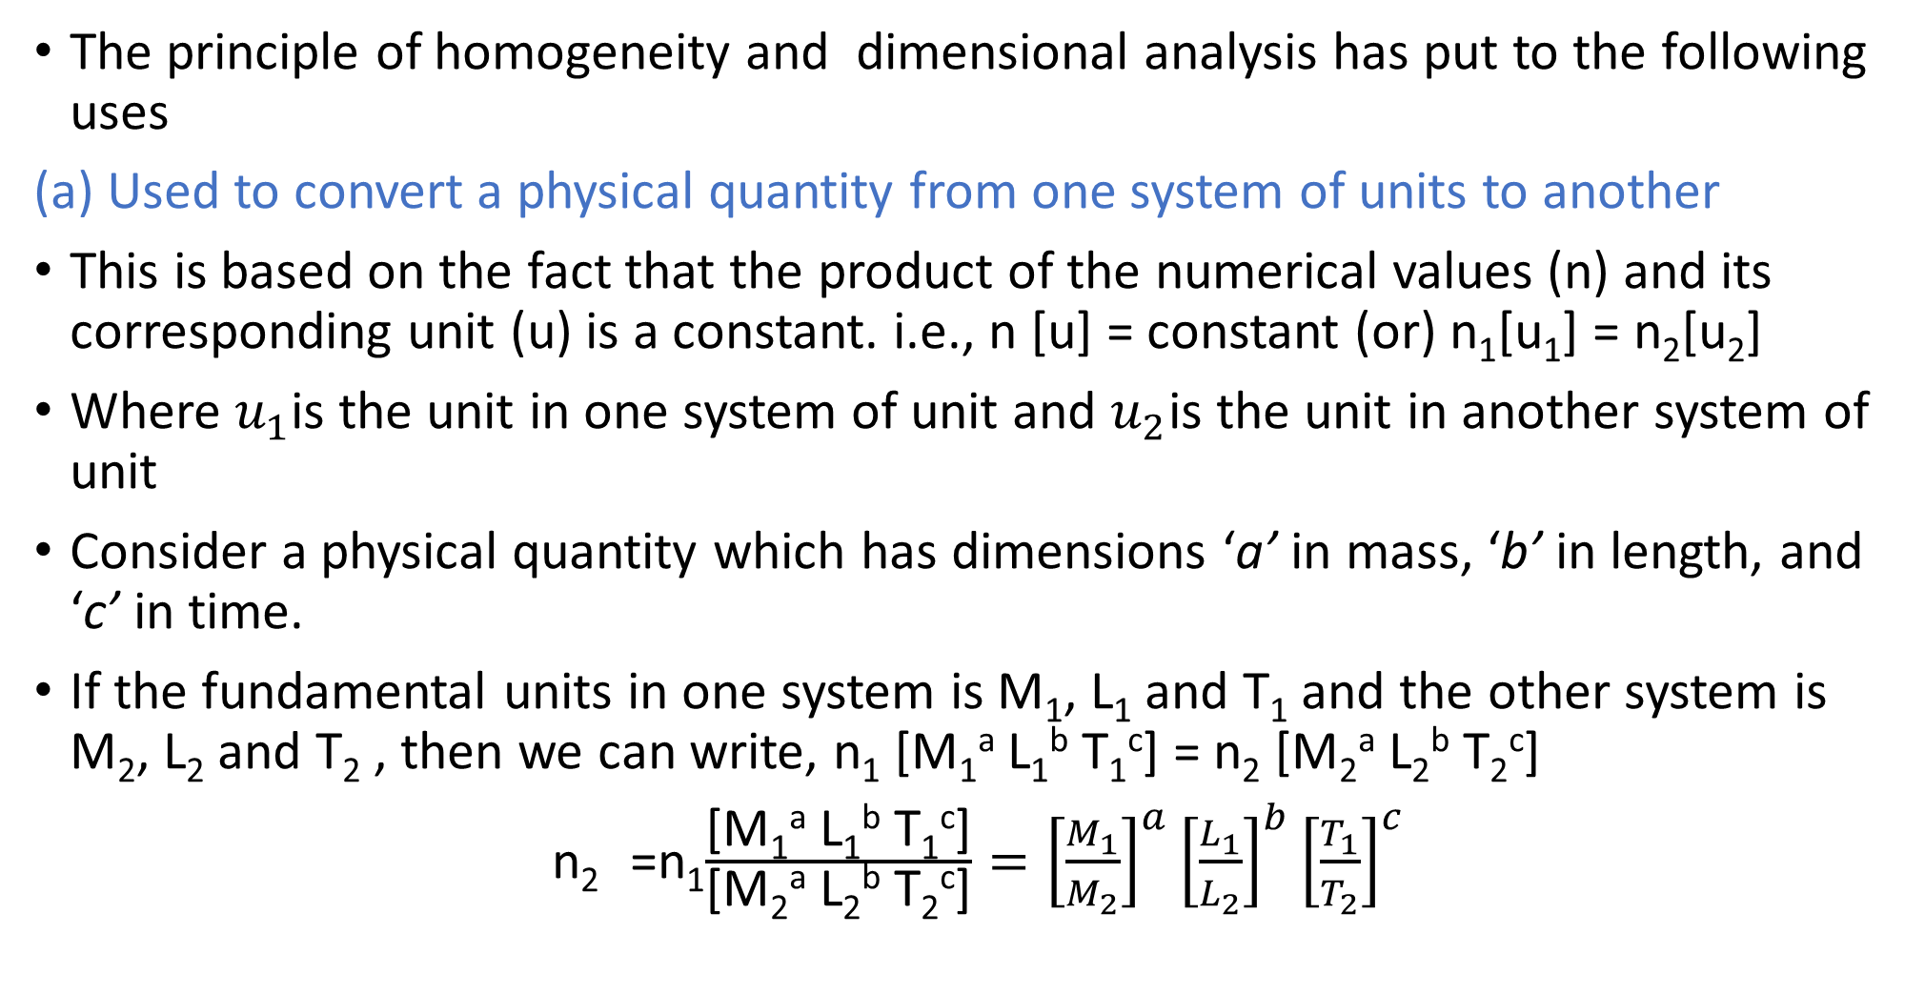
APPLICATIONS OF DIMENSIONAL EQUATIONS
The principle of homogeneity and dimensional analysis has put to the following uses
(a) Used to convert a physical quantity from one system of units to another
This is based on the fact that the product of the numerical values (n) and its corresponding unit (u) is a constant. i.e., n [u] = constant (or) n₁[u₁] = n₂[u₂]
Where $u_{1}$is the unit in one system of unit and $u_{2}$is the unit in another system of unit
Consider a physical quantity which has dimensions ‘a’ in mass, ‘b’ in length, and ‘c’ in time.
If the fundamental units in one system is M₁, L₁ and T₁ and the other system is M₂, L₂ and T₂ , then we can write, n₁ [M₁ª L₁^{b} T₁^{c}] = n₂ [M₂ª L₂^{b} T₂^{c}]
n₂ =n₁$\frac{\text{[}\text{M}\text{1}\text{a} \text{L}\text{1}\text{b} \text{T}\text{1}\text{c}\text{]}}{\text{[}\text{M}\text{2}\text{a} \text{L}\text{2}\text{b} \text{T}\text{2}\text{c}\text{]}}={\left[\frac{M_{1}}{M_{2}}\right]}^{a}{\left[\frac{L_{1}}{L_{2}}\right]}^{b}{\left[\frac{T_{1}}{T_{2}}\right]}^{c}$

Slide 21
Cont.….
(b)Used to check if any relation is dimensionally correct
Consider the first equation of motion
v = u + at
Apply dimensional formula on both sides
[LT⁻¹] = [LT⁻¹] + [LT⁻²] [T]
From the fact that units of the same dimension can be added, this is dimensionally correct, because the dimension of LHS is equal to that of RHS
(c)Used to establish relations among various physical quantities
If the physical quantity Q depends upon the quantities Q₁, Q₂ and Q₃
Therefore Q is proportional to Q₁, Q₂ and Q₃
[LT⁻¹] = [LT⁻¹] + [LT⁻¹]

Slide 22

Cont.…
Then, $Q α Q1a Q2b Q3c$removing proportionality sign introduce proportionality constant k
$$Q = k Q1a Q2b Q3c$$
Where k is a dimensionless constant
$$[Q] = K [Q1]a [Q2]b [Q3]C$$
If the dimensional formula of Q ,Q₁, Q₂ and Q₃ are substituted, then relationship can be obtained

Slide 23
Cont.…
Limitations of Dimensional analysis
This method gives no information about the dimensionless constants in the formula
This method cannot decide whether the given quantity is a vector or a scalar
This method is not suitable to derive relations involving trigonometric, exponential and logarithmic functions
It cannot be applied to an equation involving more than three physical quantities
It can only check on whether a physical relation is dimensionally correct but not the correctness of the relation
Eg. Using dimensional analysis, s = Ut + 1/3 at² is dimensionally correct whereas the correct relation is s = Ut + 1/2 at²

Slide 24
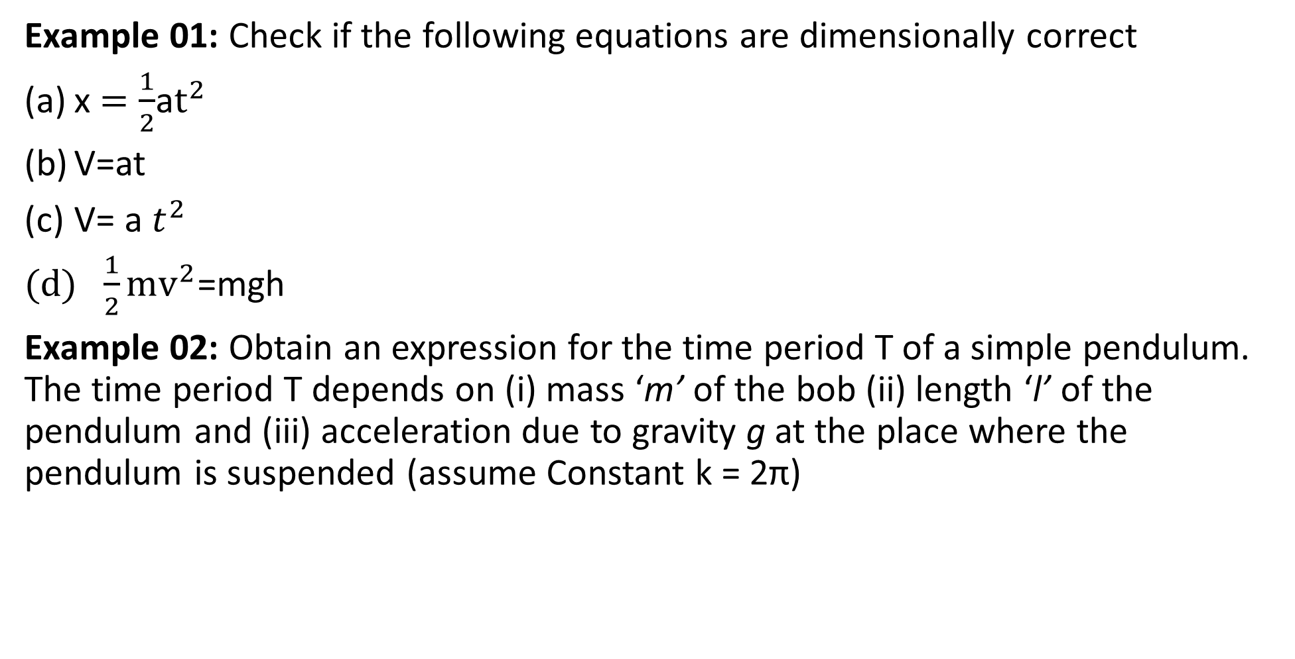
Solved Example Problems
Example 01: Check if the following equations are dimensionally correct
x $=\frac{1}{2}$a$t^{2}$
V=at
V= a $t^{2}$
$\frac{1}{2}mv^{2}$=mgh
Example 02: Obtain an expression for the time period T of a simple pendulum. The time period T depends on (i) mass ‘m’ of the bob (ii) length ‘l’ of the pendulum and (iii) acceleration due to gravity g at the place where the pendulum is suspended (assume Constant k = 2π)

Slide 25
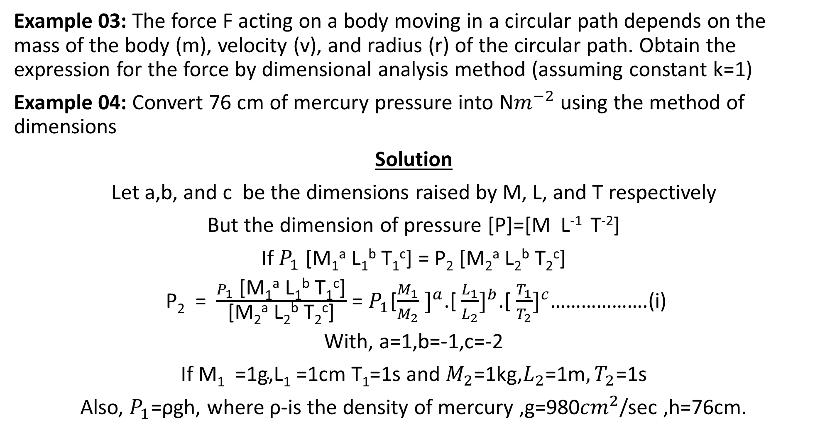
Cont.…
Example 03: The force F acting on a body moving in a circular path depends on the mass of the body (m), velocity (v), and radius (r) of the circular path. Obtain the expression for the force by dimensional analysis method (assuming constant k=1)
Example 04: Convert 76 cm of mercury pressure into N$m^{−2}$ using the method of dimensions
Solution
Let a,b, and c be the dimensions raised by M, L, and T respectively
But the dimension of pressure [P]=[M L⁻¹ T⁻²]
If $P_{1}$ [M₁ª L₁^{b} T₁^{c}] = P₂ [M₂ª L₂^{b} T₂^{c}]
P₂ = $\frac{P_{1}\text{ [}\text{M}\text{1}\text{a} \text{L}\text{1}\text{b} \text{T}\text{1}\text{c}\text{]}}{\text{[}\text{M}\text{2}\text{a} \text{L}\text{2}\text{b} \text{T}\text{2}\text{c}\text{]}}$ = $P_{1}$[${\frac{M_{1}}{M_{2}} ]}^{a}$.[ ${\frac{L_{1}}{L_{2}}]}^{b}$.[ ${\frac{T_{1}}{T_{2}}]}^{c}$……………….(i)
With, a=1,b=-1,c=-2
If $\text{M}\text{1} \text{ =1}\text{g}\text{,}\text{L}\text{1} \text{=1}\text{cm} \text{T}\text{1}$=1s and $M_{2}\text{=1}\text{kg}\text{,}L_{2}\text{=1}\text{m}{,T}_{2}$=1s
Also, $P_{1}$=ρgh, where ρ-is the density of mercury ,g=980${cm}^{2}$/sec ,h=76cm.

Slide 26
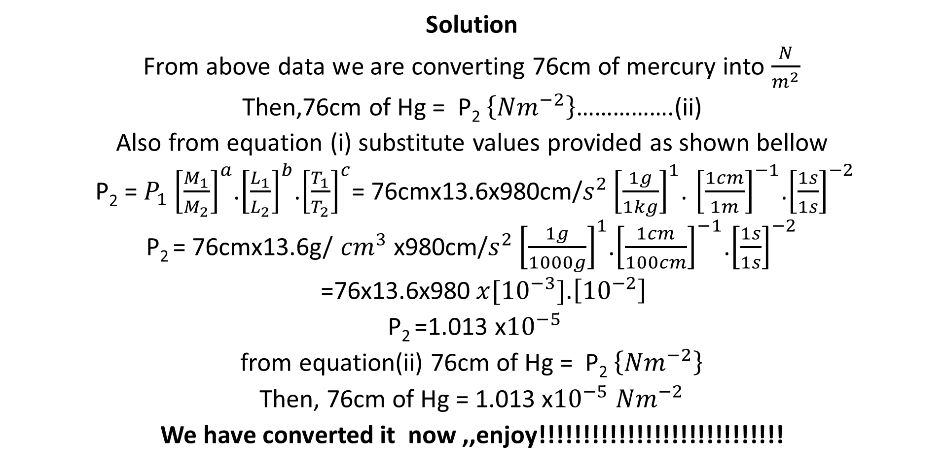
Cont.…
Solution
From above data we are converting 76cm of mercury into $\frac{N}{m^{2}}$
Then,76cm of Hg = P₂ $\left\{{Nm}^{−2}\right\}$…………….(ii)
Also from equation (i) substitute values provided as shown bellow
P₂ = $P_{1}{\left[\frac{M_{1}}{M_{2}}\right]}^{a}$.${\left[\frac{L_{1}}{L_{2}}\right]}^{b}$.${\left[\frac{T_{1}}{T_{2}}\right]}^{c}$= 76cmx13.6x980cm/$s^{2}{\left[\frac{1g}{1kg}\right]}^{1}$. ${\left[\frac{1cm}{1m}\right]}^{−1}$.${\left[\frac{1s}{1s}\right]}^{−2}$
P₂ = 76cmx13.6g/ ${cm}^{3}$x980cm/$s^{2}{\left[\frac{1g}{1000g}\right]}^{1}$.${\left[\frac{1cm}{100cm}\right]}^{−1}$.${\left[\frac{1s}{1s}\right]}^{−2}$
=76x13.6x980$x{[10}^{−3}]$.$\left[{10}^{−2}\right]$
P₂ =1.013 x${10}^{−5}$
from equation(ii) 76cm of Hg = P₂ $\left\{{Nm}^{−2}\right\}$
Then, 76cm of Hg = 1.013 x${10}^{−5}$ ${Nm}^{−2}$
We have converted it now ,,enjoy!!!!!!!!!!!!!!!!!!!!!!!!!!!!

Slide 27
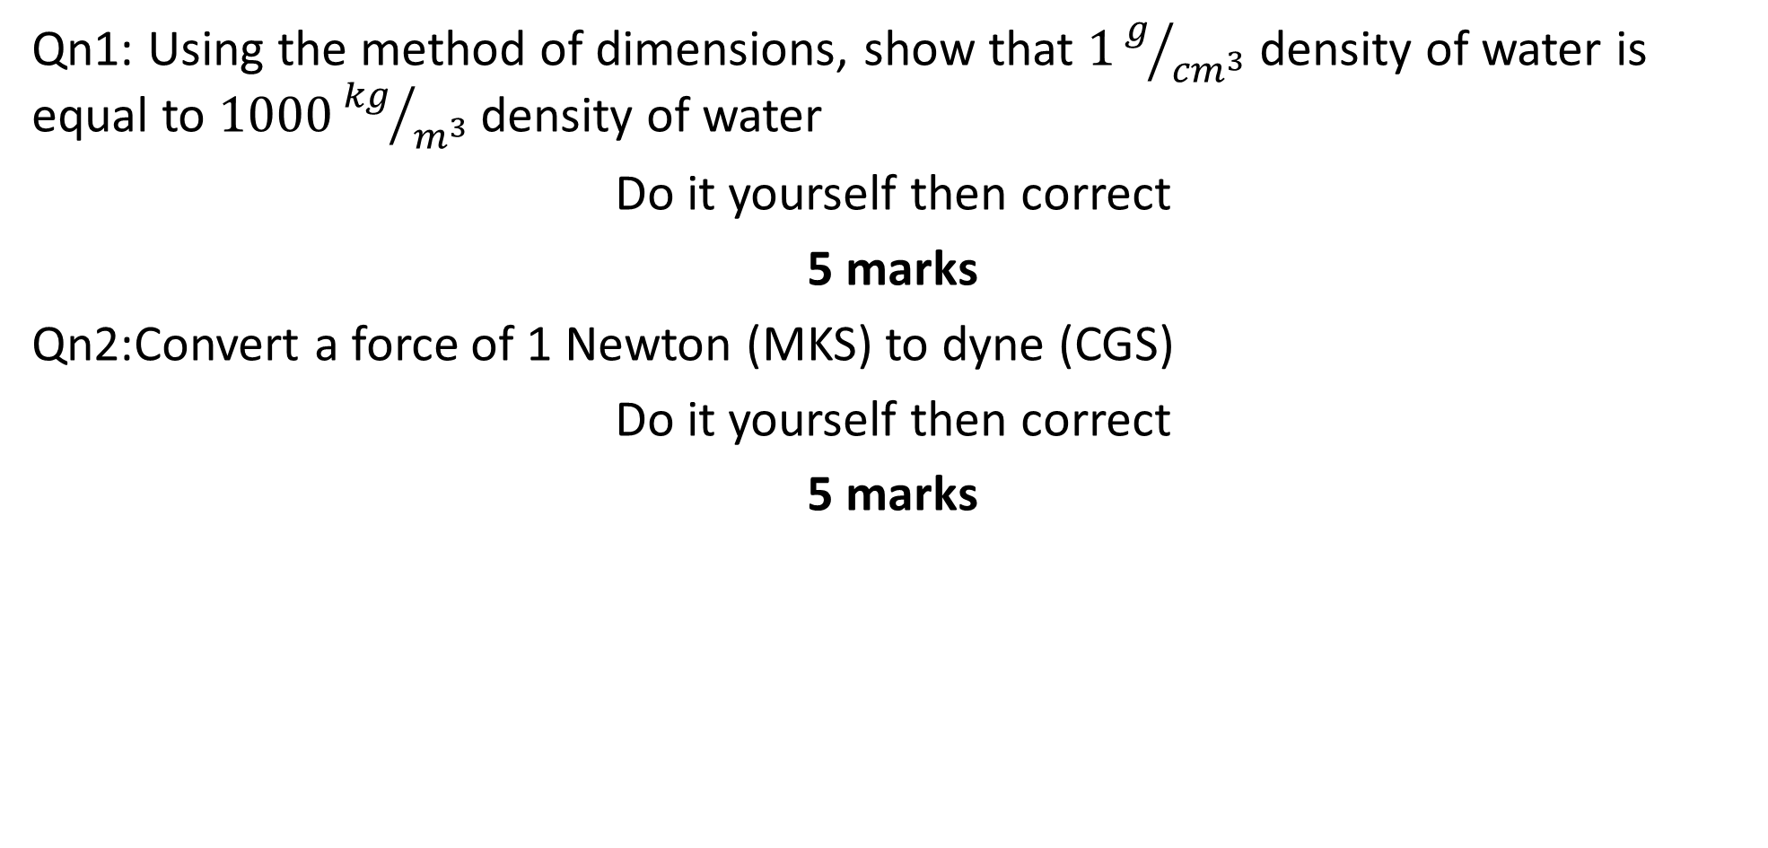
Quiz
Qn1: Using the method of dimensions, show that $1g/{{cm}^{3}}$ density of water is equal to $1000{kg}/{m^{3}}$density of water
Do it yourself then correct
5 marks
Qn2:Convert a force of 1 Newton (MKS) to dyne (CGS)
Do it yourself then correct
5 marks

Slide 28
Errors in measurement
Measurements of physical quantities are always subjected to some errors.
These errors may originate from various sources, mainly from measuring devices, the environment, an observer taking the measurements, and mathematical computations.
Errors are uncertainties in measurements.
Therefore, measured values will always deviate from exact values.
The difference between the exact value and the measured value constitutes an error of measurement.
The word error should not be confused with a mistake which is simply doing something incorrectly or carelessly.
In this part we are going to see the types, sources, and how to determine errors in the measurement of physical quantities

Slide 29
Cont...
Types and sources of errors
Errors of measurement can be grouped as follows
Gross error
This class of errors is generally the fault of the person using the instruments such as incorrect reading of instruments, incorrect recording of experimental data or data incorrect use of instruments.
Although complete eliminating of gross errors is probably impossible, one should try to avoid them.
The following actions may be necessary to reduce the effects of gross errors.
(a) Great care should be taken in reading and recording the data
(b) Two or more readings should be taken by different experimenters
Systematic error
These are errors caused by instruments
It can be further divided into the following categories

Slide 30
Cont...
Instrumental Error
These errors arise due to the following main reasons
Due to inherent shortcomings in the instruments (may be caused by the construction, calibration, or operation of mechanical structure in the instruments).
Due to misuse of the instruments. For example, these may be caused by failure to adjust zero of the instruments.
Due to the loading effect of the instruments.
Note
These errors can be eliminated or at least reduced by using the following methods:
The procedure of measurements must be carefully planned.
Correction factors should be applied after detection of these errors.
Re-calibration the instrument carefully
Use the instrument intelligently

Slide 31
Cont...
Observational Errors
These errors may be caused by the following reasons
Due to the types of instrument display, whether it is analog or digital.
Due to parallax (eye should be directly in line with the measurement point).
Note
These errors can be eliminated completely by using digital display instruments
Environmental Errors
These are the types of errors that occur due to external conditions of the measuring device such as the area, surrounding the instrument.
These conditions may be caused by changes in pressure, humidity, dust, vibration, or external magnetic or electrostatic fields.
These errors can be eliminated or reduced by using corrective measure as explained bellow

Slide 32
Cont...
Keep the condition as constant as possible.
Use an instrument/equipment which is immune (whose external condition to it is negligible) to these effects.
Employ a technique that eliminates these disturbances from the external environment
Random error
These are the types of errors whose causes are unpredictable
That is its causes have no systematic pattern
They keep varying the magnitude and direction of measurement
The causes of these errors may be due to the change in experimental conditions such as pressure, humidity, wind, and dust
The best way of minimizing random error is to repeat the experiment several times and then find the arithmetic mean of measured data

Slide 33
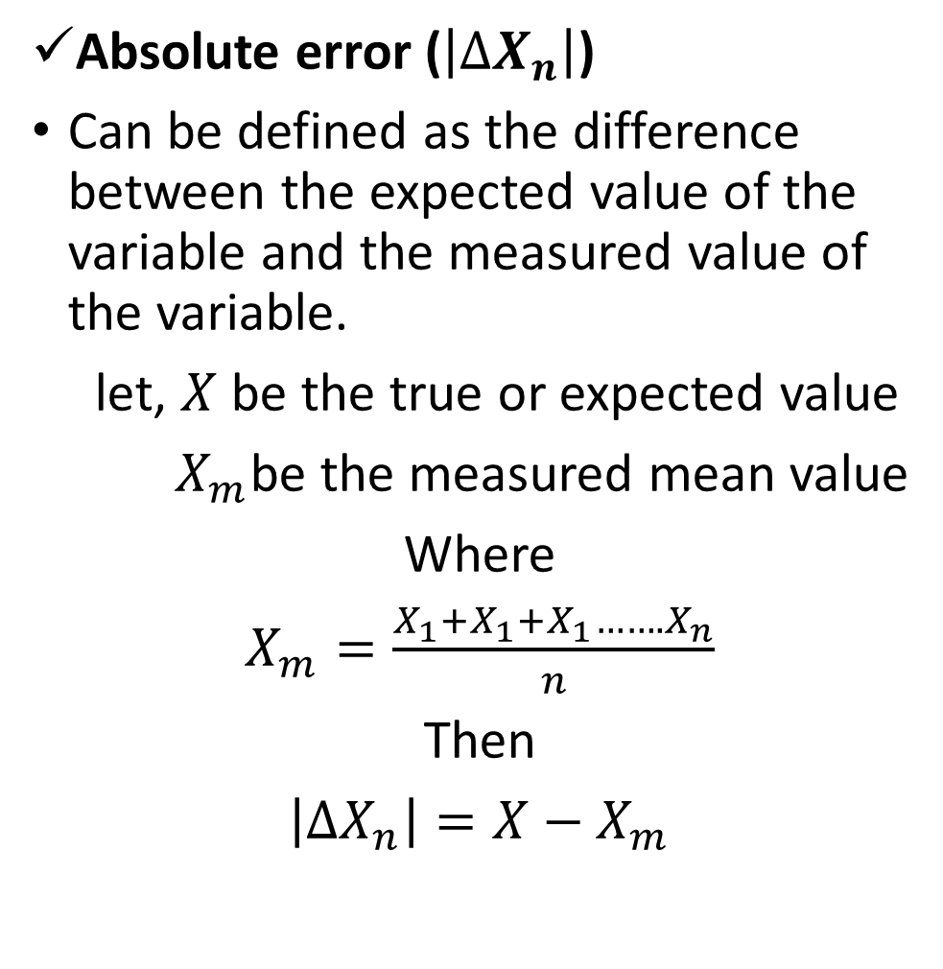
Cont...
Determination of errors in measurement
Any measured quantities are always subjected to errors
Because of the uncertainties that are involved in measurement, it’s very important to make an analysis and find the magnitude of the error for further interpretation of measured data
In understanding the analysis and finding errors involved there are some common terminologies used as follows
Absolute error ($\left|{∆X}_{n}\right|$)
Can be defined as the difference between the expected value of the variable and the measured value of the variable.
let, $X$ be the true or expected value
$X_{m}$be the measured mean value
Where
$X_{m}=\frac{X_{1}+X_{1}+X_{1}…….X_{n}}{n}$
Then
$\left|{∆X}_{n}\right|=X−X_{m}$

Slide 34
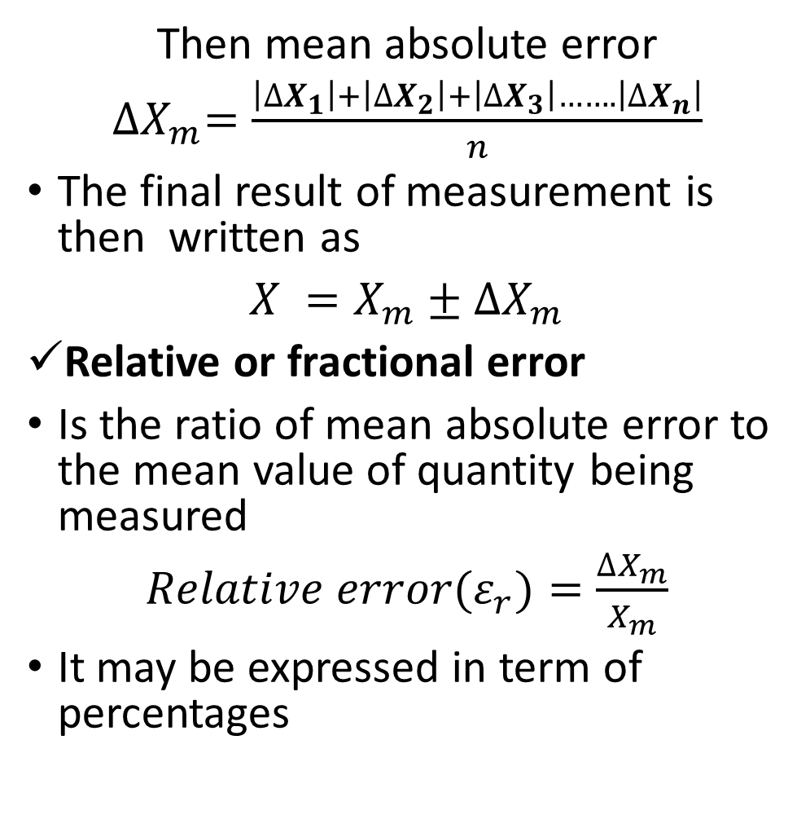
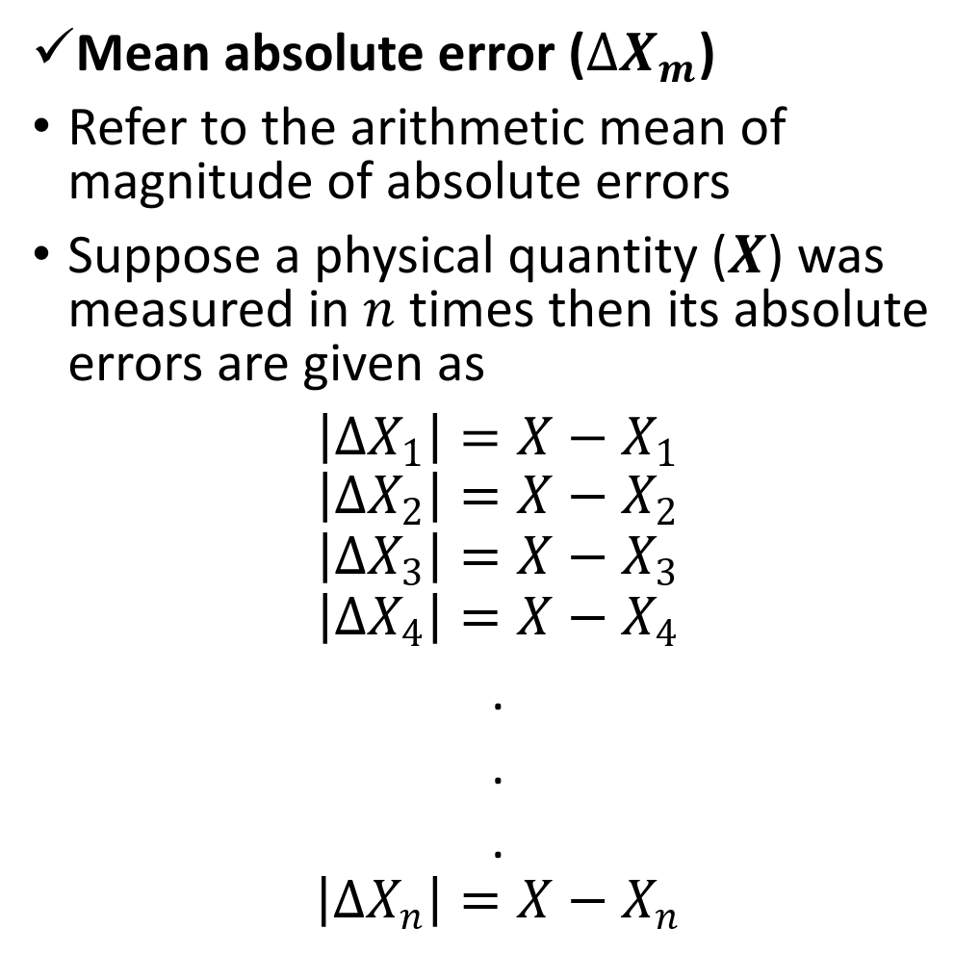
Cont...
Then mean absolute error
${∆X}_{m}=\frac{\left|{∆X}_{1}\right|+\left|{∆X}_{2}\right|+\left|{∆X}_{3}\right|…….\left|{∆X}_{n}\right|}{n}$
The final result of measurement is then written as
$X =X_{m}±{∆X}_{m}$
Relative or fractional error
Is the ratio of mean absolute error to the mean value of quantity being measured
$Relative error{(ε}_{r})=\frac{{∆X}_{m}}{X_{m}}$
It may be expressed in term of percentages
Mean absolute error (${∆X}_{m}$)
Refer to the arithmetic mean of magnitude of absolute errors
Suppose a physical quantity ($X$) was measured in $n$ times then its absolute errors are given as
$\left|{∆X}_{1}\right|=X−X_{1}$
$$\left|{∆X}_{2}\right|=X−X_{2}$$
$$\left|{∆X}_{3}\right|=X−X_{3}$$
$$\left|{∆X}_{4}\right|=X−X_{4}$$
.
.
.
$$\left|{∆X}_{n}\right|=X−X_{n}$$

Slide 35
Cont...
Relative error is an indication how good a measurement compared to the measured size of an object
It compare a measurement to an exact value
Example: The expected value of the voltage across a resistor is 50V; however, measurement yields a value of 49V. Calculate
The absolute error
The percent of error
Example: A food weighs exactly 36.5grams.When weighed on faulty scale it weighs 38grams,Calculate
a)What is percentage error in measurement of faulty scale
b)If another sample of food weighs 14grams on the same defective scale, what is the weight of food in gram ?

Slide 36
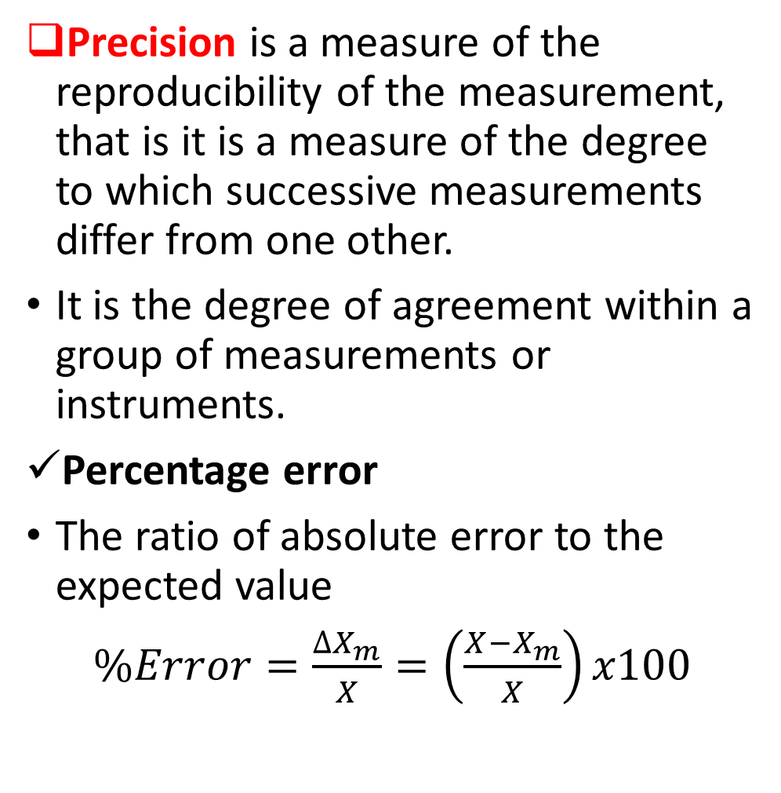
Cont...
Accuracy and Precision
Accuracy is a closeness with which the instrument reading approaches the true value of the variable under measurement.
It is the degree to which instrument reading match the true or accepted values.
It indicates the ability of instrument to indicate the true value of the quantity.
Accuracy refers to how closely the measured value of a quantity corresponds to its “true” value.
Precision is a measure of the reproducibility of the measurement, that is it is a measure of the degree to which successive measurements differ from one other.
It is the degree of agreement within a group of measurements or instruments.
Percentage error
The ratio of absolute error to the expected value
$\%Error=\frac{{∆X}_{m}}{X}=\left(\frac{{X−X}_{m}}{X}\right)x100$

Slide 37
Cont...
What are the different type of the errors in the field of measurements?
What is the measurement of the error
Explain the cause of Gross error?
Explain the cause of Systematic error?
Explain the following by suitable example (i) Gross Errors (ii) Systematic Errors (iii) Random Errors
Explain the causes of random error?
7.List the various steps to minimize errors.
8.What is the accuracy?
9.What is the Precision?
10.Explain the difference illustrate it between accuracy and precision
11.What are the different type of errors in the measurement and how will you minimize these errors?
12.What do you mean by accuracy in instrument? Differentiate it with term Precision.

Slide 38
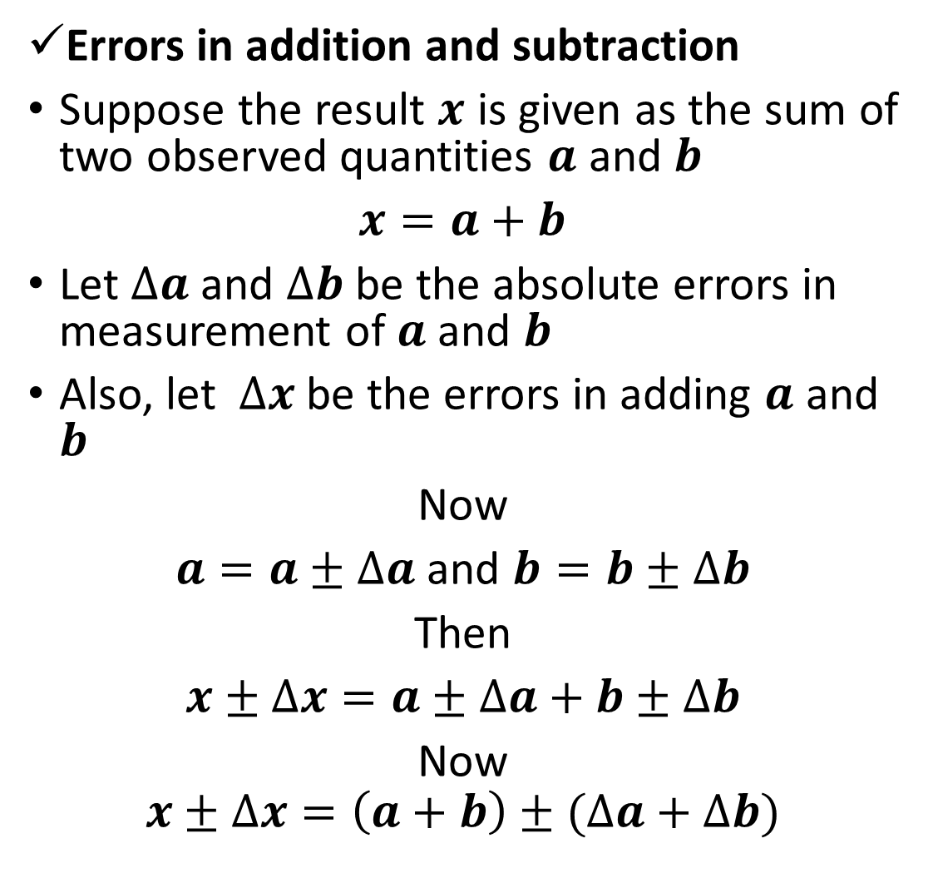
Propagation of Errors
In any scientific experiment it involve series of measurement
Each measurement is associated with some errors
In order to calculate the final results, we need to perform mathematical operation like addition, subtraction, multiplication, etc.. On these measurements
Therefore, we need to calculate the maximum permissible error in different mathematical operation
Errors in addition and subtraction
Suppose the result $x$ is given as the sum of two observed quantities $a$ and $b$
$x=a+b$
Let $∆a$ and $∆b$ be the absolute errors in measurement of $a$ and $b$
Also, let $∆x$ be the errors in adding $a$ and $b$
Now
$a=a±∆a$ and $b=b±∆b$
Then
$x±∆x=a±∆a+b±∆b$
Now
$$x±∆x=\left(a+b\right)±(∆a+∆b)$$

Slide 39
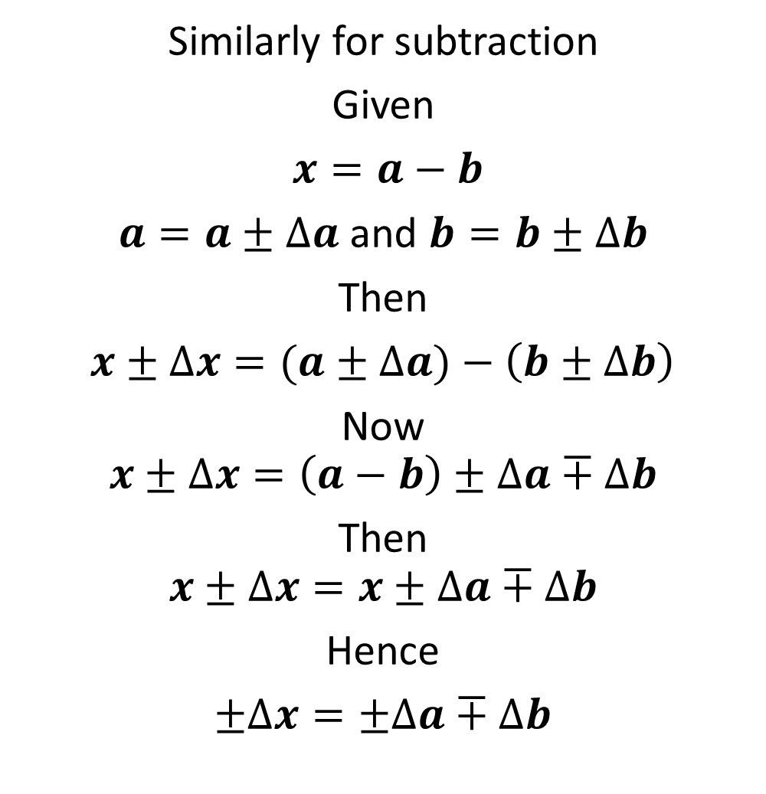
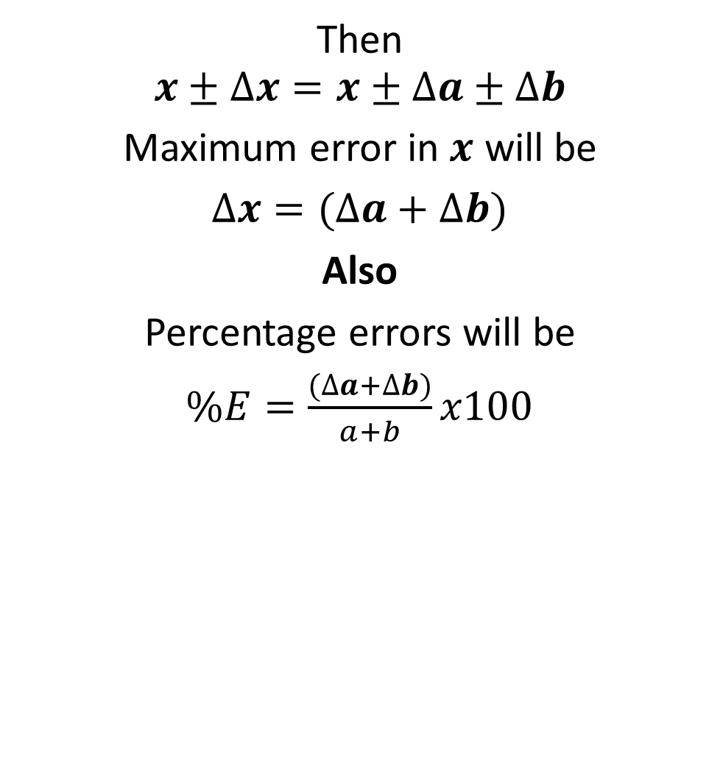
Cont...
Then
$$x±∆x=x±∆a±∆b$$
Maximum error in $x$ will be
$∆x=(∆a+∆b)$
Also
Percentage errors will be
$\%E=\frac{(∆a+∆b)}{a+b}x100$
Similarly for subtraction
Given
$x=a−b$
$a=a±∆a$ and $b=b±∆b$
Then
$x±∆x=(a±∆a)−\left(b±∆b\right)$
Now
$$x±∆x=\left(a−b\right)±∆a∓∆b$$
Then
$$x±∆x=x±∆a∓∆b$$
Hence
$±∆x=±∆a∓∆b$

Slide 40
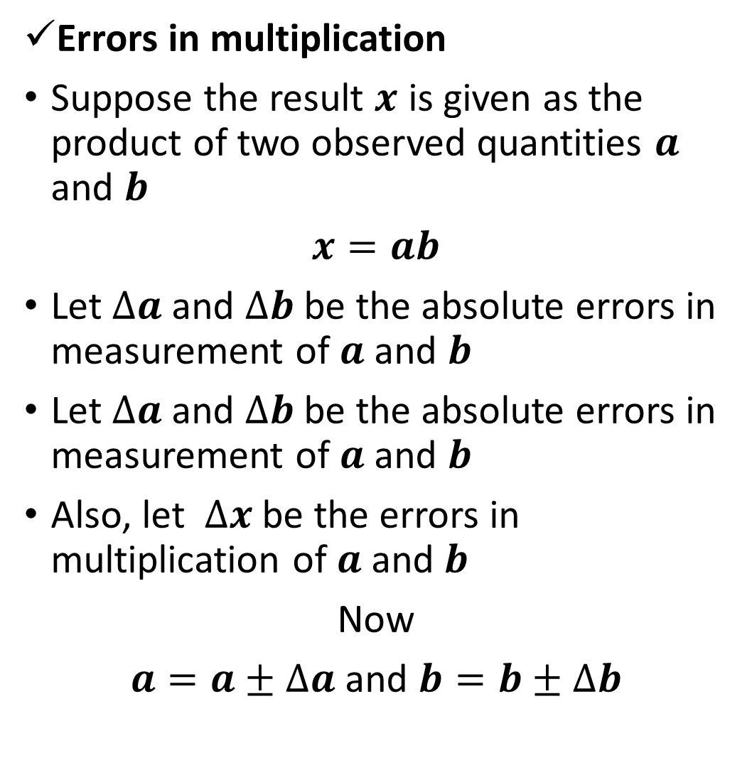
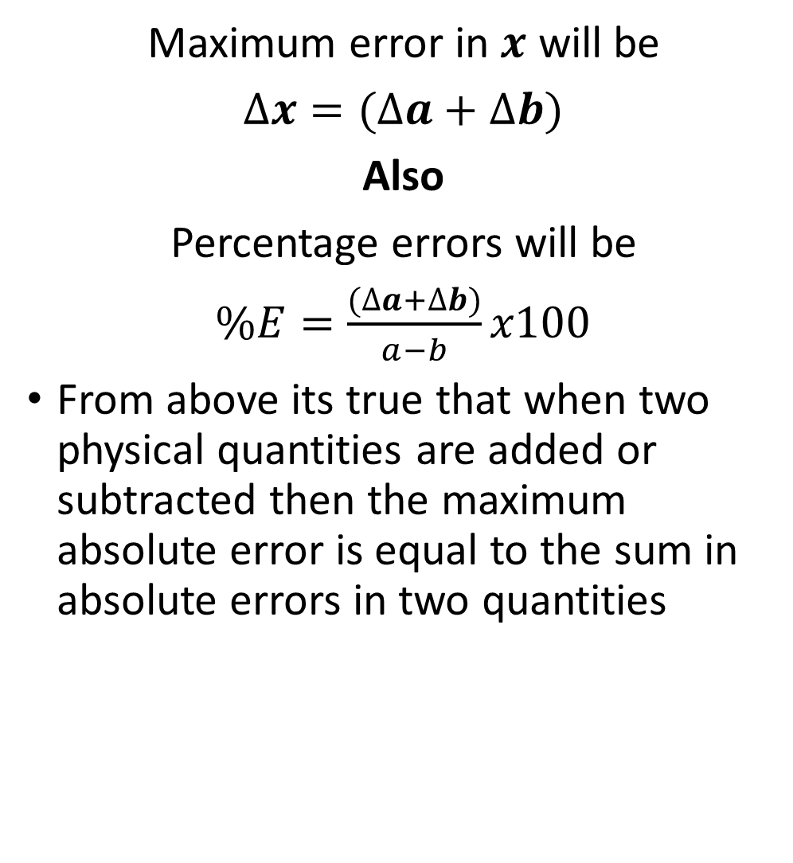
Cont...
Maximum error in $x$ will be
$∆x=(∆a+∆b)$
Also
Percentage errors will be
$\%E=\frac{(∆a+∆b)}{a−b}x100$
From above its true that when two physical quantities are added or subtracted then the maximum absolute error is equal to the sum in absolute errors in two quantities
Errors in multiplication
Suppose the result $x$ is given as the product of two observed quantities $a$ and $b$
$x=ab$
Let $∆a$ and $∆b$ be the absolute errors in measurement of $a$ and $b$
Let $∆a$ and $∆b$ be the absolute errors in measurement of $a$ and $b$
Also, let $∆x$ be the errors in multiplication of $a$ and $b$
Now
$a=a±∆a$ and $b=b±∆b$

Slide 41
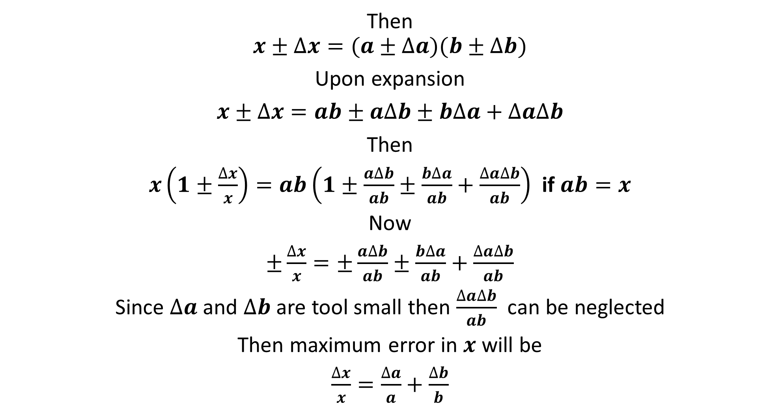
Cont...
Then
$$x±∆x=(a±∆a)(b±∆b)$$
Upon expansion
$x±∆x=ab±a∆b±b∆a+∆a∆b$
Then
$x\left(1±\frac{∆x}{x}\right)=ab\left(1±\frac{a∆b}{ab}±\frac{b∆a}{ab}+\frac{∆a∆b}{ab}\right)$ if $ab=x$
Now
$±\frac{∆x}{x}=±\frac{a∆b}{ab}±\frac{b∆a}{ab}+\frac{∆a∆b}{ab}$
Since $∆a$ and $∆b$ are tool small then $\frac{∆a∆b}{ab}$ can be neglected
Then maximum error in $x$ will be
$\frac{∆x}{x}=\frac{∆a}{a}+\frac{∆b}{b}$

Slide 42
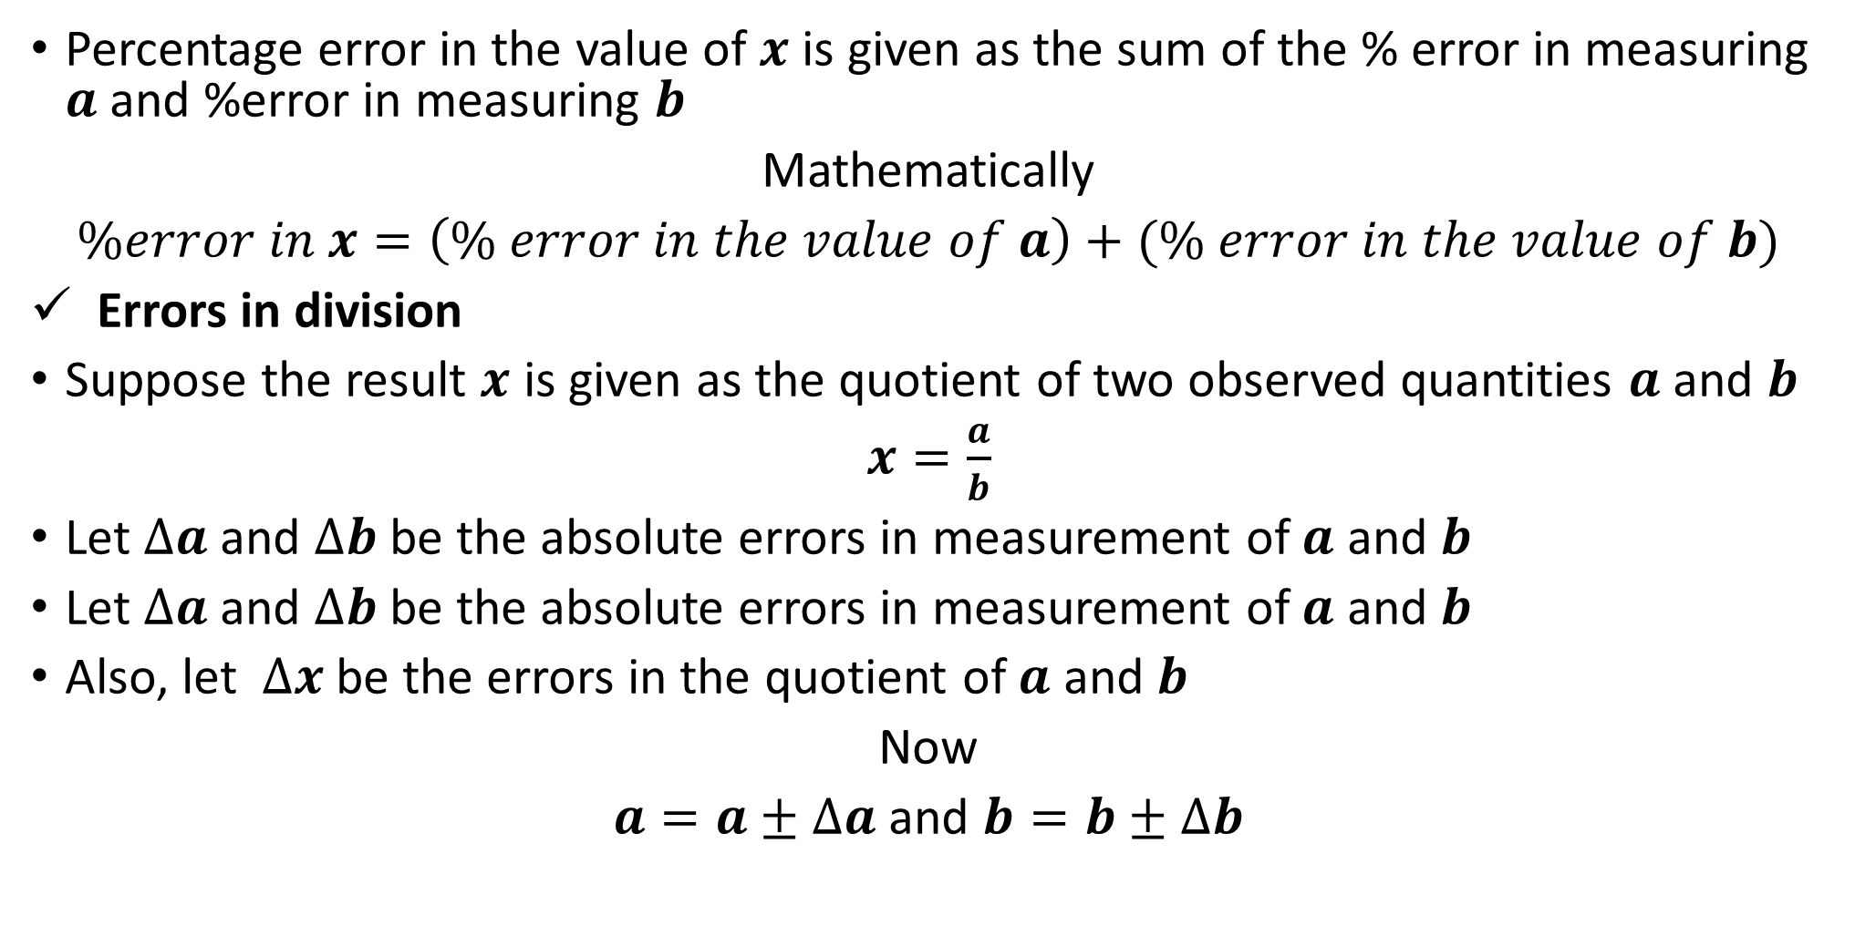
Cont...
Percentage error in the value of $x$ is given as the sum of the % error in measuring $a$ and %error in measuring $b$
Mathematically
$\%error in x=\left(\% error in the value of a\right)+(\% error in the value of b)$
Errors in division
Suppose the result $x$ is given as the quotient of two observed quantities $a$ and $b$
$x=\frac{a}{b}$
Let $∆a$ and $∆b$ be the absolute errors in measurement of $a$ and $b$
Let $∆a$ and $∆b$ be the absolute errors in measurement of $a$ and $b$
Also, let $∆x$ be the errors in the quotient of $a$ and $b$
Now
$a=a±∆a$ and $b=b±∆b$

Slide 43

Cont...
$x±∆x=\frac{a±∆a}{b±∆b}$
Then
$x\left(1±\frac{∆x}{x}\right)=\frac{a\left(1±\frac{∆a}{a}\right)}{b\left(1±\frac{∆b}{b}\right)}$ since $x=\frac{a}{b}$
Now
$\left(1±\frac{∆x}{x}\right)=\frac{\left(1±\frac{∆a}{a}\right)}{\left(1±\frac{∆b}{b}\right)}=\left(1±\frac{∆a}{a}\right){\left(1±\frac{∆b}{b}\right)}^{−1}$
If
${(1+x)}^{m}=1+mx+\frac{m(m−1) }{2}x^{2}+…$
Then
${\left(1±\frac{∆b}{b}\right)}^{−1}=\left(1∓\frac{∆b}{b}\right)$
Now
$\left(1±\frac{∆x}{x}\right)=\left(1±\frac{∆a}{a}\right)\left(1∓\frac{∆b}{b}\right)$

Slide 44
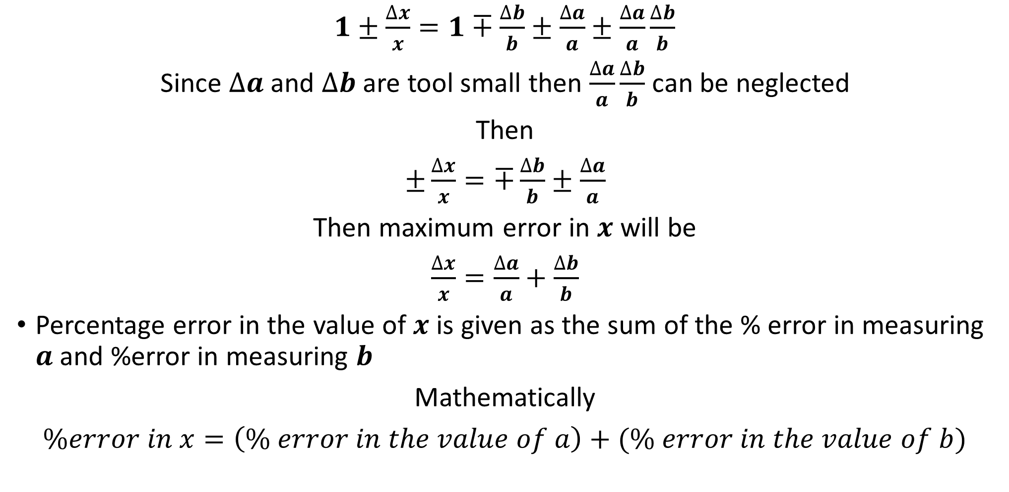
Cont...
$1±\frac{∆x}{x}=1∓\frac{∆b}{b}±\frac{∆a}{a}±\frac{∆a}{a}\frac{∆b}{b}$
Since $∆a$ and $∆b$ are tool small then $\frac{∆a}{a}\frac{∆b}{b}$ can be neglected
Then
$±\frac{∆x}{x}=∓\frac{∆b}{b}±\frac{∆a}{a}$
Then maximum error in $x$ will be
$\frac{∆x}{x}=\frac{∆a}{a}+\frac{∆b}{b}$
Percentage error in the value of $x$ is given as the sum of the % error in measuring $a$ and %error in measuring $b$
Mathematically
$\%error in x=\left(\% error in the value of a\right)+(\% error in the value of b)$

Slide 45
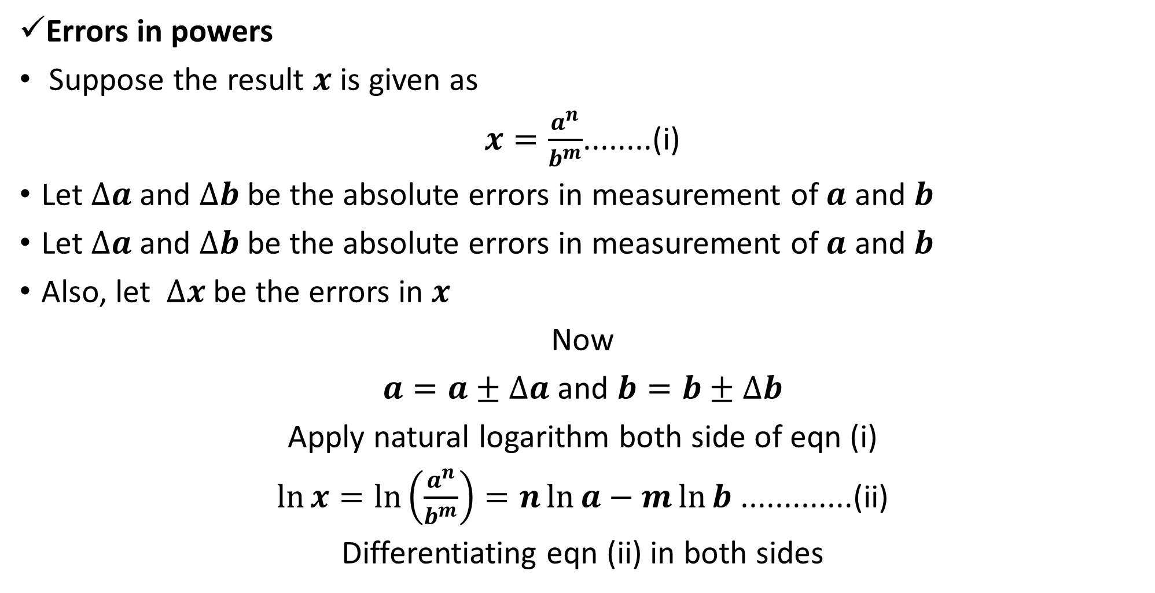
Cont...
Errors in powers
Suppose the result $x$ is given as
$x=\frac{a^{n}}{b^{m}}$........(i)
Let $∆a$ and $∆b$ be the absolute errors in measurement of $a$ and $b$
Let $∆a$ and $∆b$ be the absolute errors in measurement of $a$ and $b$
Also, let $∆x$ be the errors in $x$
Now
$a=a±∆a$ and $b=b±∆b$
Apply natural logarithm both side of eqn (i)
$\ln{x}=\ln\left(\frac{a^{n}}{b^{m}}\right)=n\ln{a}−m\ln{b}$ .............(ii)
Differentiating eqn (ii) in both sides

Slide 46
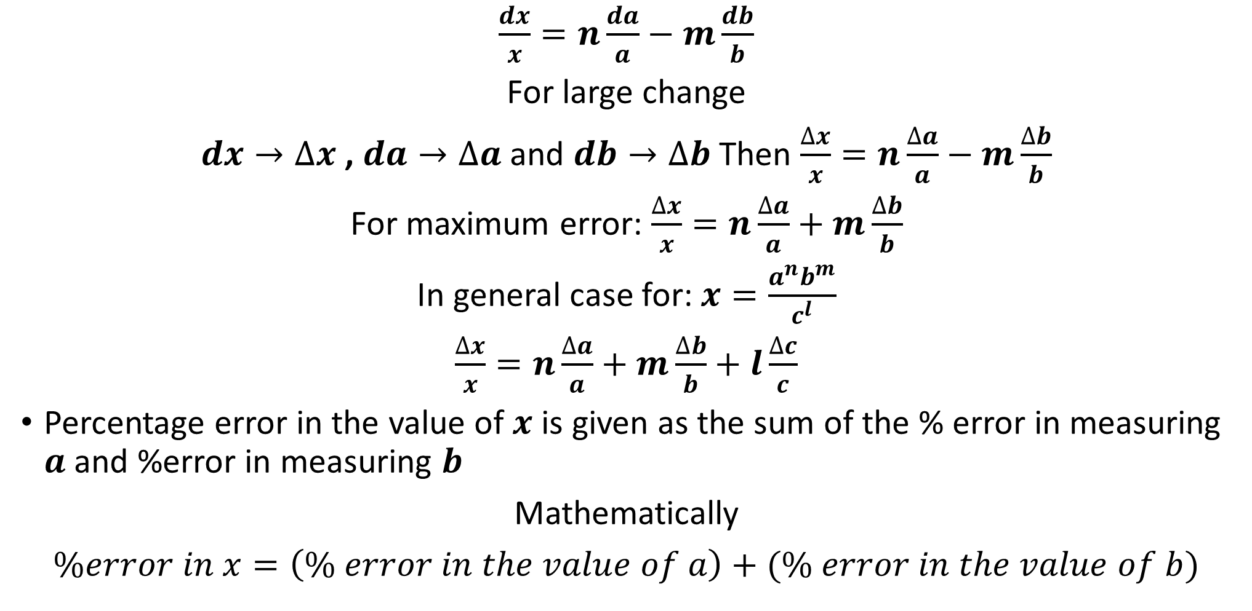
Cont...
$\frac{dx}{x}=n\frac{da}{a}−m\frac{db}{b}$
For large change
$dx→∆x$ , $da→∆a$ and $db→∆b$ Then $\frac{∆x}{x}=n\frac{∆a}{a}−m\frac{∆b}{b}$
For maximum error: $\frac{∆x}{x}=n\frac{∆a}{a}+m\frac{∆b}{b}$
In general case for: $x=\frac{a^{n}b^{m}}{c^{l}}$
$\frac{∆x}{x}=n\frac{∆a}{a}+m\frac{∆b}{b}+l\frac{∆c}{c}$
Percentage error in the value of $x$ is given as the sum of the % error in measuring $a$ and %error in measuring $b$
Mathematically
$\%error in x=\left(\% error in the value of a\right)+(\% error in the value of b)$

Slide 47
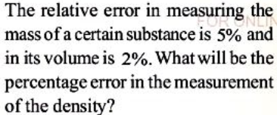
Cont...

Slide 48
QN: The force acting on the object of mass,$m$travelling at velocity $v$ in a circle of radius $r$ is given $F=\frac{mv^{2}}{r}$ .The measurements are recorded as
$m=3.5kg±0.1kg;v=20m/s±1m/s;r=12.5m±0.5m$
Find the maximum possible (a)Fractional error (b)%error in the measurement of the force (c)How will you record the reading
END

Slide 49
END

