Slide 1


Slide 2
Problem
From observing the dietary habits of our college peers, we noticed that health is an area being neglected, and that many students have uneducated and uninterested views on nutrition. Ultimately, it is their choice, but we feel more could be done to help them.

Slide 3
Solution
Through gathering research, our aim was to collect ideas and recommendations in order to facilitate the diet of students. Development of an effective and tailored application aiming to improve a healthier option of eating behaviours in university students was our goal.

Slide 4
Step3

Slide 5



You can access the web application from anywhere, using your tablet or smartphone.
Technologies used
Tested in several mobile devices and smartphone emulators
JQuery Mobile for the front end
PHP for the back end
MySQL for database

Slide 6
Marketing & Sales
Planning to publish it on Search Engines
Creating Social Network Pages
This Service Will not require payment to Register
Spaces for Announcements(in future)

Slide 7
Competition

Slide 8
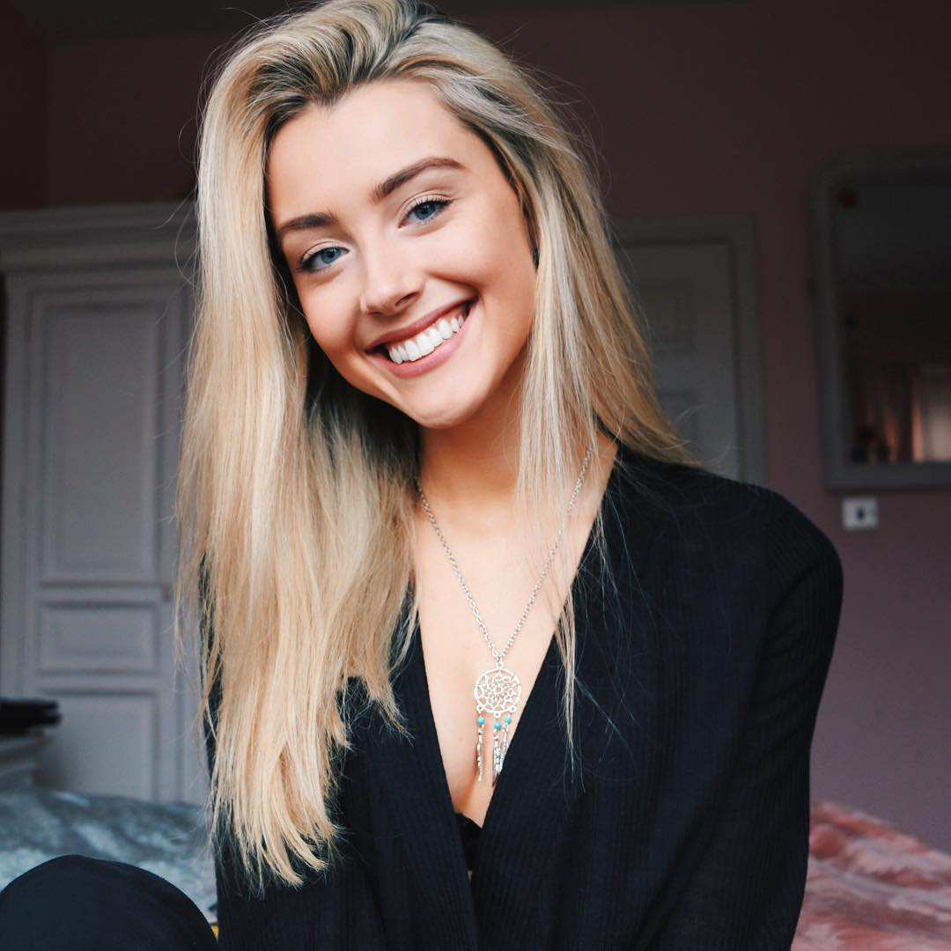
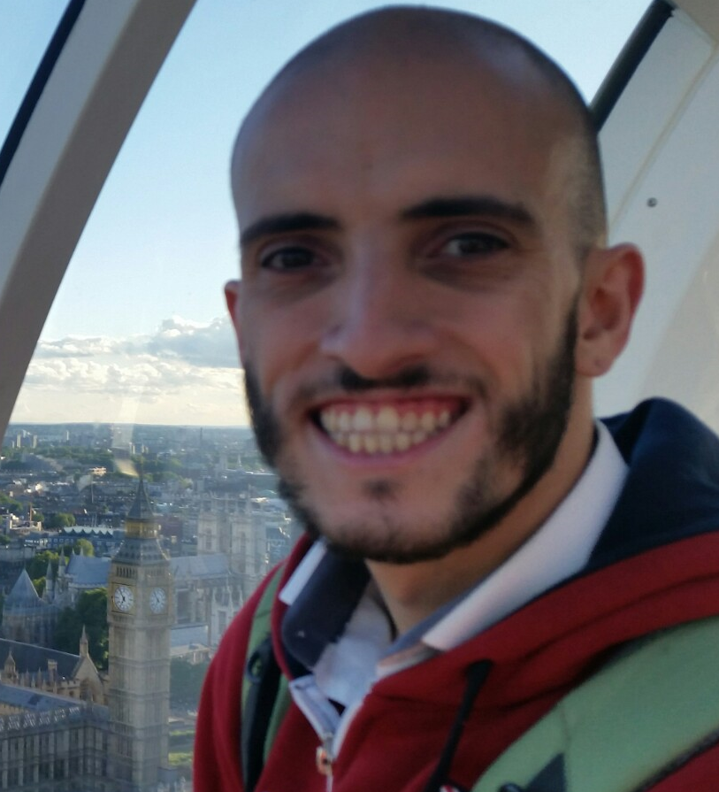
Team
Krystal
Krystal is passionate about creating, designing and producing her own ideas. She is currently employed as a web designer and helped with the research and design of Zingy.
Douglas
Matheus
Matheus, Brazilian, IT professional since 2008. Joined to this group in the end of last semester, to help the group in the programming side

Slide 9
Projections to the future
Use PhoneGap to wrap the current application and host on Google / Apple stores.
Work on a better looking desktop browser version of the web application.
Migrate to a private domain. Better control, professional looking URL and email accounts.
Reach more people! Localize for other languages.

Slide 10










Status & Timeline
The Code is still being developed
Web/Mobile Service planned to be given in the next 3/4 months
Decided to Create a Web/Mobile Service
13/1/2016
`Research about Market and Technologies Available to Build The Project
10/10/2016
Academic Research
Development Finished
7/11/2016
31/8/2017
Prototype Development
Start Tests Processes
12/11/2016
1/9/2017
Tests Finished
Databases Planning
Preparing and Setting the Documentation
1/10/2017
14/12/2016
6/3/2017
First Sketches
Development Began
Documentation Finished
Zingy Published Online
17/11/2016
10/1/2017
30/4/2017
2/10/2017
out
dez
fev
abr
jun
ago
out
2017
Hoje

Slide 11
Call to Action & Summary
“Become a Chef. Eat whatever you want, with whatever you have”
Zingy is walking to it’s debuting date, and in few months the service will be available for everyone.
We have a good feeling and a believe that this project will inovate the market with the new “Research recipes mode”, and making everybody happy eating helthy.

Slide 12


