Slide 1
CS301 Algorithms
Shortest Common Superstring
Aras BOZKURT
Buse ÇARIK
Deren Ege TURAN
Mücahit Umut ONAT

Slide 2
OUTLINE
Problem Description
Algorithm Description
Algorithm Analysis
Experimental Analysis
Testing
Discussion
References

Slide 3
Problem Description
Shortest Common Superstring
The shortest common superstring problem (SCS) is in a given collection of input strings, finding the shortest possible string that contains all strings in the set as a substring.
To express formally, Let’s first define the terms of superstring and common superstring of a set of strings.
Superstring: Given a string S over an alphabet ∑, a superstring S’ of S to be any string S’=w₀ x₁w₁x₂w₂...x_{k}w_{k} over ∑ such that S=x₁x₂...x_{k} and each w_{i} ∈ ∑*

Slide 4
Problem Description
A common superstring of a collection of strings R={r₁,r₂,...,r_{m} } is a string S over the alphabet ∑ such that S is the superstring of each string r_{i} in the set R.
Shortest Common Superstring:
Given an alphabet ∑, positive integer k, and a finite set of strings R={r₁,r₂,...,r_{m} } from the alphabet ∑*, if present, the shortest common superstring of R of length less than or equal to k.
Applications of SCS are data compression and genome assembly.

Slide 5
Shortest Common Superstring Problem Description
In this project, instead of a finite alphabet, strings are composed of the binary alphabet. Hence, our problem is stated as below;
For a finite set R={r₁,r₂,...,r_{m} } of binary strings (sequence of 0 and 1), is there a binary string w of length at most positive integer k such that every string in R is a substring of w i.e. for each r in R, w can be decomposed as w=w₀rw₁ where w₀, w₁ are (possibly empty) binary strings?

Slide 6
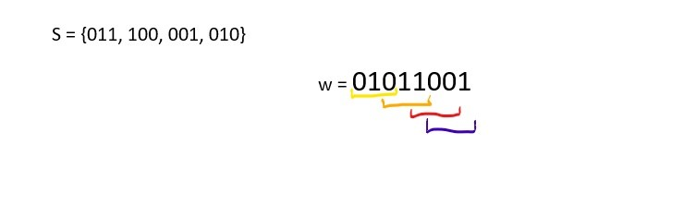
Basic Definition of Problem
For the set of S, the aim is to find a string w such that every string from set S must be generated from w.
As in the example below;

Slide 7
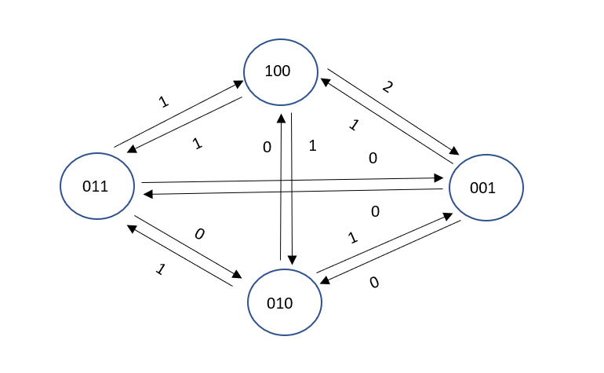
About Problem
SCS is an NP-complete problem
It is a reduction of Maximum Asymmetric Traveling Salesman problem
The figure on the left shows the representation of an SCS instance in the Traveler Salesman format by reduction.

Slide 8
Algorithm Description
The Shortest Common Superstring problem is an NP-Complete problem for array size larger than 2. Since it is running time is O(n! + mn²), instead using brute force method, we used a heuristic solution to solve it in polynomial time, which is a greedy approach. It finds ½ approximation for SCS problem.
What greedy algorithm does is to select the most optimal choice for that instance as it attempts to find overall optimal solution for the entire problem. Unfortunately for some cases it does not lead to the optimal solution.

Slide 9
Algorithm Description
The simple implementation of the algorithm as follows:
First, from the given finite string set R, which consist of binary strings, Eliminate_Substr function checks and if necessary eliminate the strings in order to regulate the list as the algorithm would work more accurately. The determination process of this function is ; if any pairs exists on the list ( r₁,r₂ ∈ R) such that one of the is the substring of another (r₁ ⊆ r₂); the algorithm removes that (r₁) substring from the list.
Then it calculates the sum of all string lengths on the remaining list. This number indicates if there were no overlap between any of the strings, this would be the length of resulted shortest superstring.

Slide 10
Algorithm Description
3) To solve the rest of SCSS problem, it is reduced to a graph for simplicity. First all strings are transformed to nodes. Then the directed edges are drawn for all the possibilities. To load the weights to the edges, all permutations of 2 of the list are extracted. The purpose of this operation is to compute overlap character count pairwise for both sides (r₁r₂ and r₂r₁). Then concatenate the pairs with the least possible total length. To make this happen, the suffix of the first string and the prefix of the second string are matched with the longest length possible. This length is weight of one edge. It is placed on an edge which originated from the beginning string in the concatenation and ends with the ending string in the concatenation. When this process is repeated for all permutations by 2. All edges of the created graph are acquired. Finally just remove the edges with 0 length. At the end with this edges, this problem can be solved same as MaxATSP.

Slide 11
Algorithm Description
4) By sending edges that are found in the previous step to the greedy algorithm (SCSS function) this article based on, a common superstring for R will be found. Ideally it is supposed to be the shortest, but since greedy algorithm does not always guaranteed to produce the optimal solution, it is only hoped to be the shortest superstring. The summary of SCSS function is to take the highest weighted edge in the edges, combine the nodes according to that directed edge and re-form the edges list by the choice of that step. Repeats this method until no edges is remained. It means all possible compositions are made. The formed path/paths total weight/s will be calculated and returned.

Slide 12
Algorithm Description
5) SCSS function will return number of length that the total weight of the graph’s path solved by MaxATSM problem with greedy algorithm. This number is the number of characters which are overlapped in our solution for shortest common superstring.
6) Finally, when the total overlapped character count(calculated at step 5) is subtracted from Total Strings length (calculated at step 2), the result will give the length of the shortest common superstring of the strings ∈ R.
7) Lastly, since it is a decision problem the result found above is compared with the given k value as an input. if k is equal or larger, then the algorithm returns true, otherwise false.

Slide 13
Algorithm Description
def Check(Str_Set,k):
Eliminate_Substr(Str_Set) #STEP 1
Total_Len = 0
for st in Strings: #STEP 2
Total_Len += len(st)
E = FindAllOverlaps(Strings) #STEP 3
SCSS_len = Total_Len - SCSS(E) #STEP 4 , 5 , 6
if k >= SCSS_len: return True #STEP 7
else: return False

Slide 14
Algorithm Analysis
Greedy algorithm on shortest common superstring problem is a heuristic solution and it does not always gives the most optimal solution. On the other hand it solves the problem in polynomial time in the exchange of accuracy. Running Time: O(n³ + mn²)
To check the accuracy of greedy approach, the results should be compared with brute force method which basically just concatenates every possible permutation of the given string set back to back while compersion them by their overlapped suffix-prefix pairs. After checking every scenario, returns the exact shortest common superstring.
Running Time: O(n! + nm)

Slide 15
Algorithm Analysis
Bluem et al.(1994) proved that the solution of greedy method can not be larger than the exact solution multiplied by 4. Also more recently, Kaplan et al.(2005) proved that the length of string produced by GREEDY is in fact within a factor of 3.5 from the optimal string. Although Blum et al. and many others conjectured that the approximation guarantee of GREEDY is 2, no one could actually manage to narrow the gap regarding the approximation guarantee of GREEDY.

Slide 16
Algorithm Analysis
There are also a lot of other approximation algorithms are developed in years. As this is an optimization problem, it is measured by 2 different aspects; The compression indicates the difference between the length of the superstring and the sum of lengths of the given strings. On the other hand superstring indicates the length of the resulting string. So far the best obtained upper bound results for the problem are; ¾ for compression measure by Paluch et. al. (2014) and 2+11/23 for the superstring length measure by Mucha et. al.(2013).

Slide 17
Algorithm Analysis
def Compress2strings(ind,edges): #Complexity of this func is O(n^2) since the len
a = edges[ind][0] #of edges might be at most n^2 for worst case
b = edges[ind][1]
i = len(edges)-1
while i != -1:
if edges[i][0] == a: del edges[i] #Remove edges start with a
elif edges[i][1] == b: del edges[i] #Remove edges end with b
elif edges[i][0] == b: #Edges which which b goes are now goes from X
if edges[i][1] == a: del edges[i]
else: edges[i][0] = a
i = i-1 #Edges which goes to a, now goes to this new X
return

Slide 18
Algorithm Analysis
def overlap(a,b): #return length of longest suffix of a which matches prefix of b
start = 0 #Complexity of this func is O(m) where m is max string length
while True: of the array
start = a.find(b[0],start)
if start == -1: return 0
if b.startswith(a[start:]): return len(a)-start
start += 1
def FindAllOverlaps(Set): #Complexity of this func is O(mn^2)
Edges= []
for a,b in permutations(range(len(Set)),2): #O(n^2)
W = overlap(Set[a],Set[b]) #O(m)
if W > 0: Edges.append([a,b,W])
return Edges

Slide 19
Algorithm Analysis
def SCSS(Edges): #Greedy Algorithm for finding shortest common superstring
Total_Path_Weight = 0 #Complexity of this func is O(n^3) = O(n)*(O(n^2)+O(n^2))
while (len(Edges) != 0): #O(n)
maxWeight = 0
index = -1
for E in range (len(Edges)): #Find Longest Weight & its index #O(n^2)
if Edges[E][2] > maxWeight:
maxWeight = Edges[E][2]
index = E
Total_Path_Weight += maxWeight
Compress2strings(index,Edges) #O(n^2)
return Total_Path_Weight

Slide 20
Algorithm Analysis
def Eliminate_Substr(SS): #Complexity of this func is O(m*n^2)
i=0
while i != len(SS): #O(n)
t = i+1
while t != len(SS): #O(n)
if(SS[t] in SS[i]): del SS[t] #O(m)
elif(SS[i] in SS[t]):
del SS[i]
i -= 1
break
else: t += 1
i += 1
return

Slide 21
Algorithm Analysis
Overall
Running
Time:
O(n^3 + mn^2)
n => our array size
m => the max length of string within this array.
def Check(Str_Set,k):
Eliminate_Substr(Str_Set) #Eliminate substrings on the Set #O(mn^2)
Total_Len = 0
for st in Strings: #O(n)
Total_Len += len(st)
E = FindAllOverlaps(Strings) #O(mn^2)
SCSS_len = Total_Len - SCSS(E) #O(n^3)
if k >= SCSS_len:
return True
return False

Slide 22
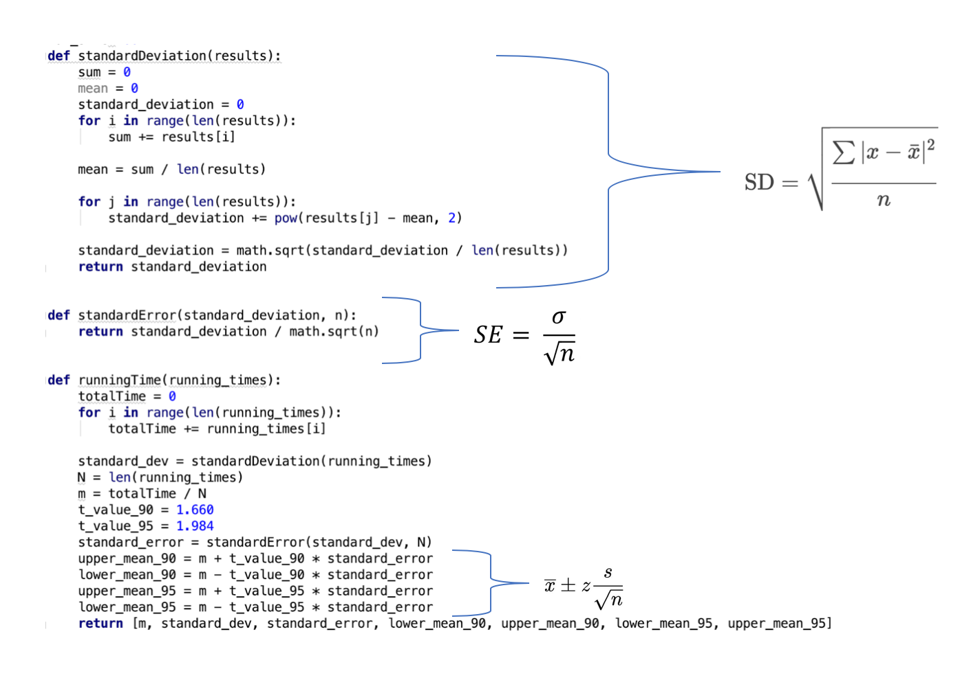
Experimental Analysis
Running Time
The statistics code used in the running time comparison are as follows:
The t values are selected as 1.660 for 90% confidence interval and 1.984 for 95% confidence interval since after 100 samples t values are approximately the same. By using this function, the true mean will be in the given intervals with given confidence levels.

Slide 23
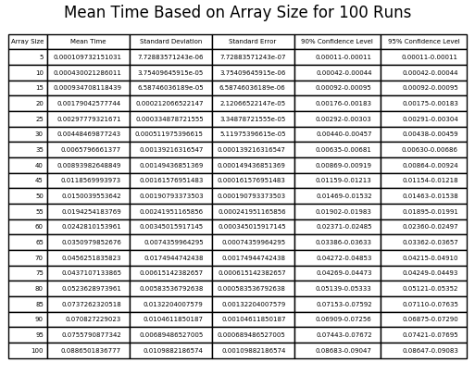
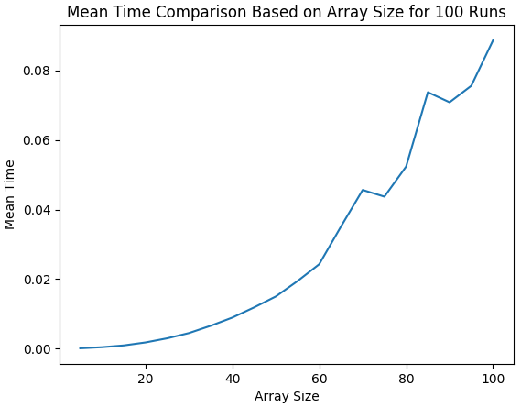
Experimental Analysis
Running Time
Running Time vs Array Size
In these experiments there are 100, 300, and 500 runs for each of the array size incrementation in the range [5,100] with increment size = 5. All strings had 10 as their length. Random strings are created for every run.

Slide 24
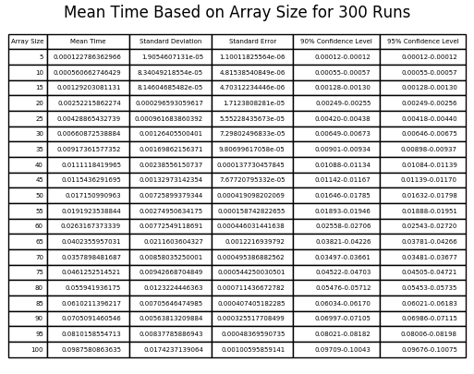
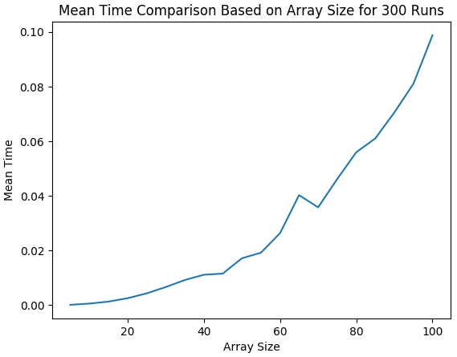
Experimental Analysis
Running Time
Running Time vs Array Size

Slide 25
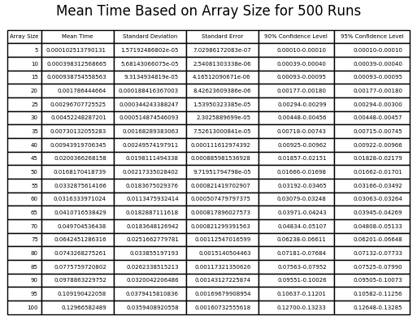
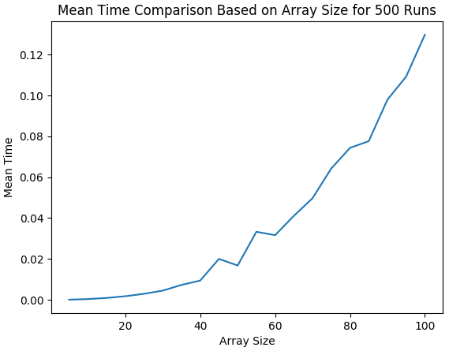
Experimental Analysis
Running Time
Running Time vs Array Size
In general, incrementing the input array size with fixed input string lengths (10) increased the running time polynomially.

Slide 26
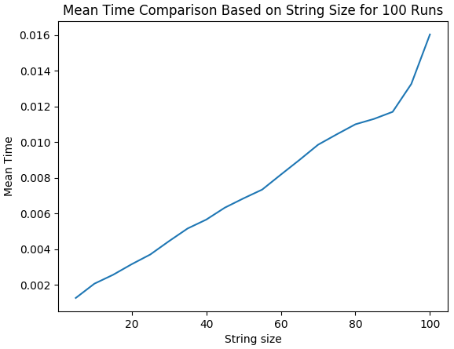
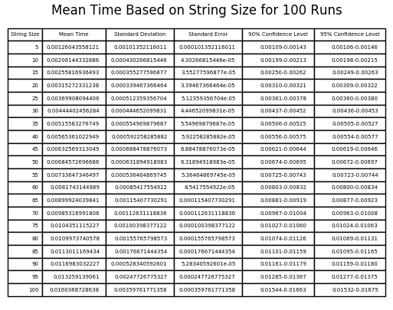
Experimental Analysis
Running Time
b. Running Time vs String Length
In these experiments there are 100, 300, and 500 runs for each of the string size incrementation in the range [5,100] with increment size = 5. All arrays contained 20 strings. Random strings are created for every run.

Slide 27
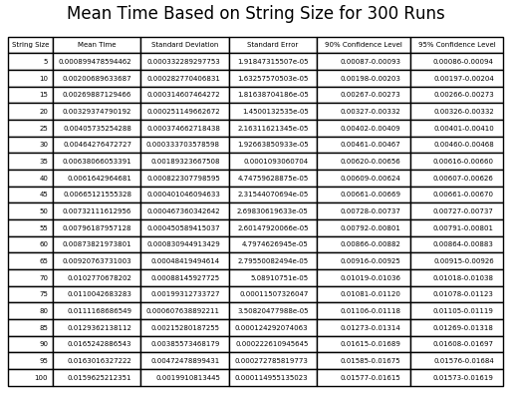
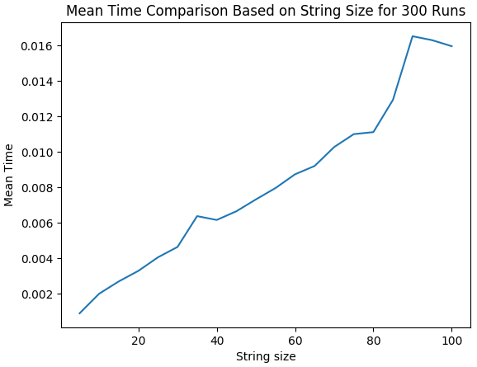
Experimental Analysis
Running Time
b. Running Time vs String Length

Slide 28
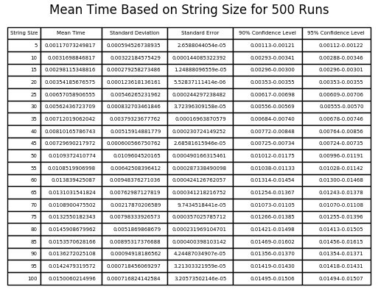
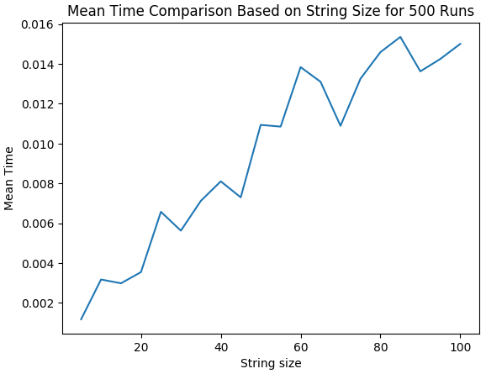
Experimental Analysis
Running Time
b. Running Time vs String Length
In general, incrementing the input string length with fixed input array size (20) increased the running time.

Slide 29
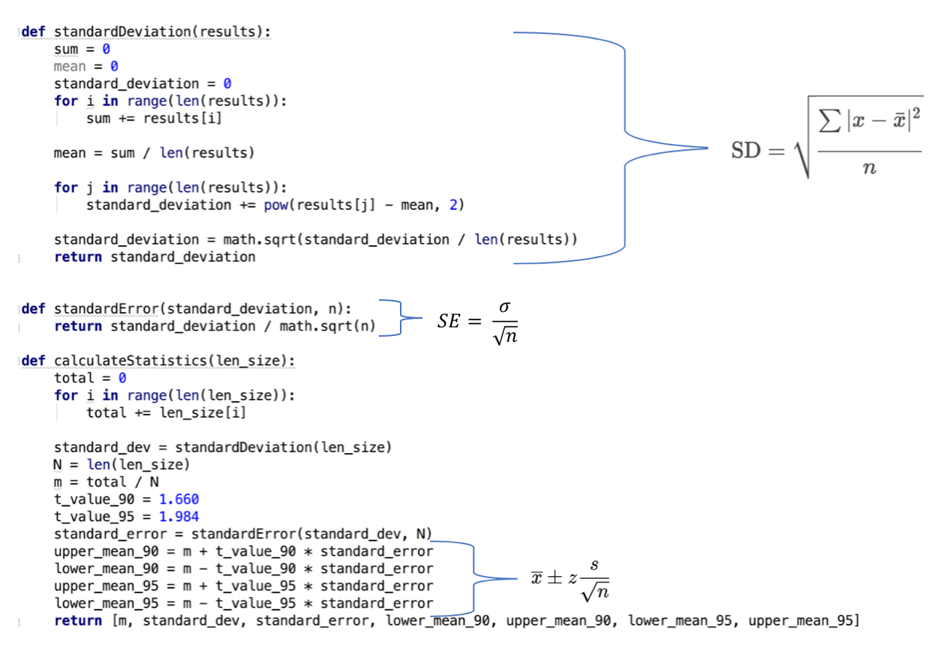
Experimental Analysis
2. Determining Successful Superstring Size for k
The statistics code used in the superstring length comparisons are as follows:
The t values are selected as 1.660 for 90% confidence interval and 1.984 for 95% confidence interval since after 100 samples t values are approximately the same. By using this function, the true mean will be in the given intervals with given confidence levels.

Slide 30
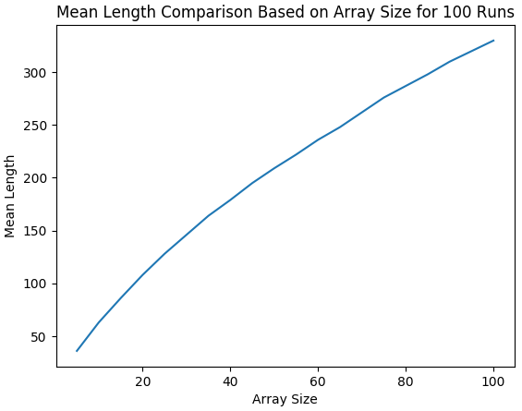
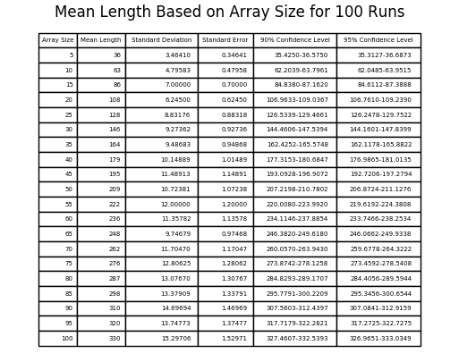
Experimental Analysis
2. Determining Successful Superstring Size for k
The Mean Length vs Array Size
Every experiment ran 100, 300, and 500 times for each of the array size incrementation in the range [5,100] with increment size = 5. All arrays contained 10 as input string length. Random strings are created for every run.

Slide 31
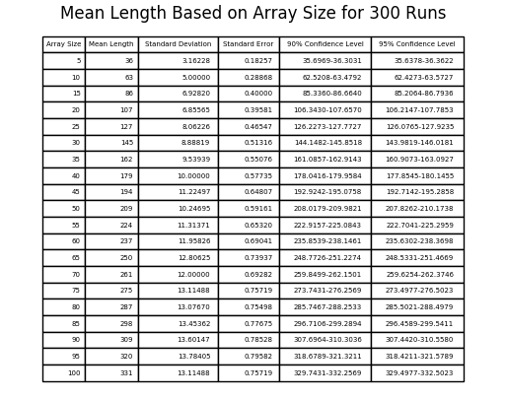
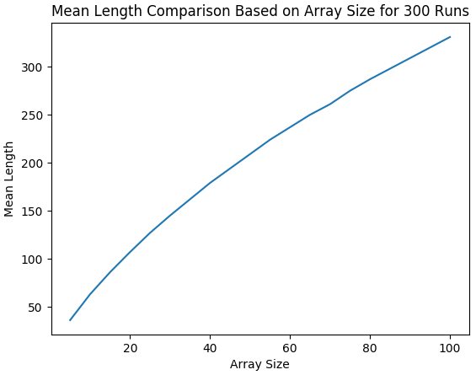
Experimental Analysis
2. Determining Successful Superstring Size for k
The Mean Length vs Array Size

Slide 32
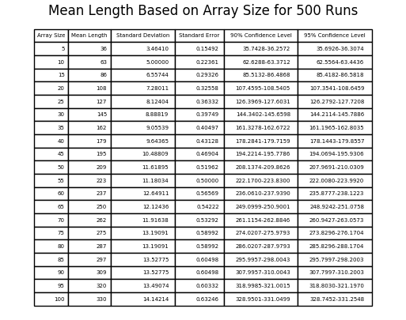

Experimental Analysis
2. Determining Successful Superstring Size for k
The Mean Length vs Array Size
In general, incrementing the input array size with fixed input string lengths (10) increased the mean length of superstring. If the k is chosen as the mean superstring length or higher, the algorithm will successfully computes the shortest common superstring with size less than k.

Slide 33
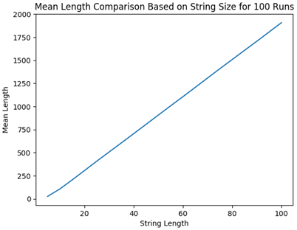
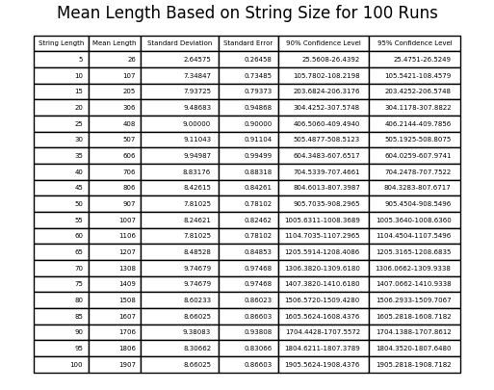
Experimental Analysis
2. Determining Successful Superstring Size for k
b. The Mean Length vs String Length
Every experiment ran 100, 300, and 500 times for each of the input string length incrementation in the range [5,100] with increment size = 5. All arrays contained 20 strings. Random strings are created for every run.

Slide 34


Experimental Analysis
2. Determining Successful Superstring Size for k
b. The Mean Length vs String Length

Slide 35
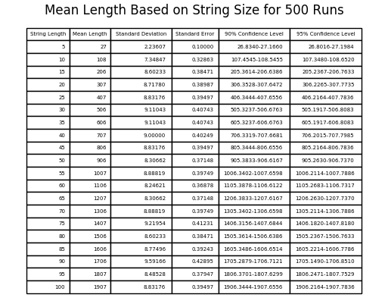

Experimental Analysis
2. Determining Successful Superstring Size for k
b. The Mean Length vs String Length
In general, incrementing the input string length with fixed array size (20) increased the mean length of superstring. If the k is chosen as the mean superstring length or higher, the algorithm will successfully computes the shortest common superstring with size less than k.

Slide 36
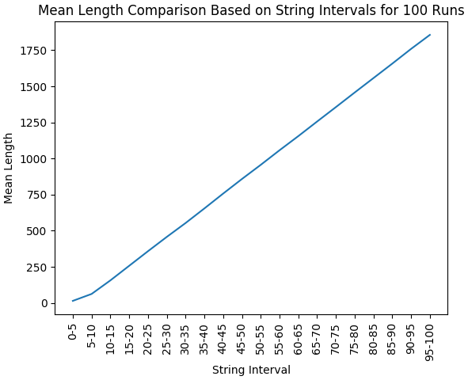
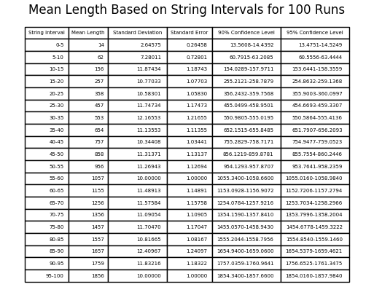
Experimental Analysis
3. Determining Successful Superstring Size for k with Array Size = 20 and Changing String Length Intervals
For determining expected superstring size for random strings with random lengths in a fixed size array are considered for 100, 300, and 500 runs. In these cases array sizes were fixed at 20.

Slide 37

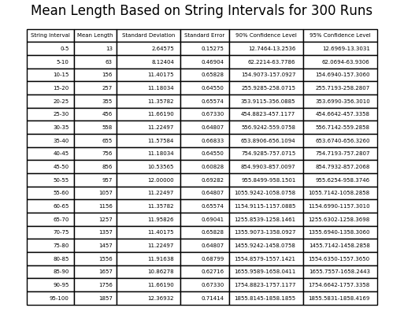
Experimental Analysis
3. Determining Successful Superstring Size for k with Array Size = 20 and Changing String Length Intervals

Slide 38
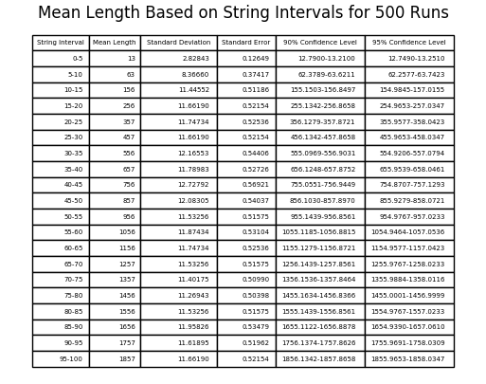

Experimental Analysis
3. Determining Successful Superstring Size for k with Array Size = 20 and Changing String Length Intervals
When the string size is chosen between intervals instead of fixed size, the mean of superstring varies between upper and lower bound of the interval.

Slide 39
Testing
For testing Black Box Testing technique is used.
Random number of strings
Random string lengths
Number of strings are equal to 0
String lengths are equal to 0
All strings are the same.

Slide 40
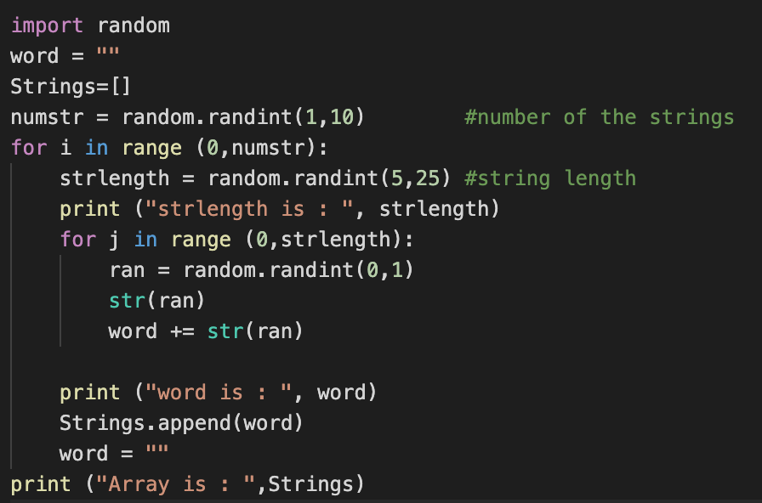
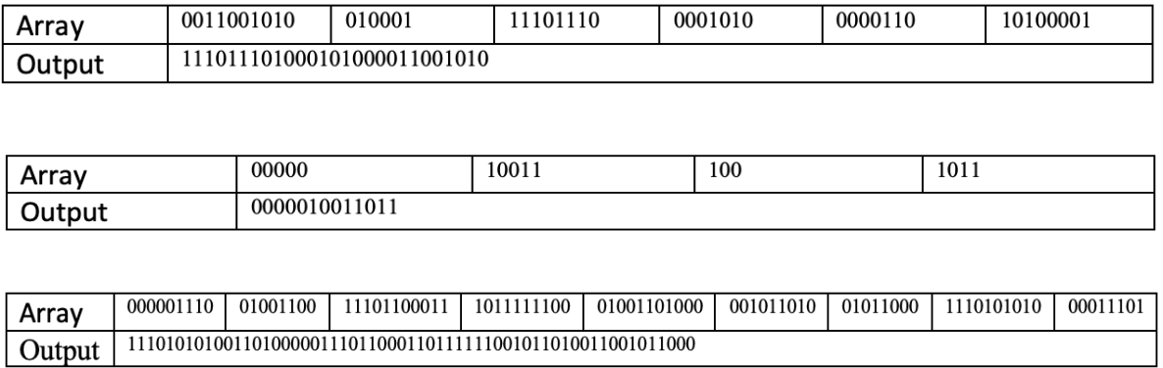
Testing
Random number of strings and string lengths are determined by function below.

Slide 41
Testing
Case 1 : Number of strings are equal to 0
Case 2 : String lengths are equal to 0
Case 3 : All strings are the same

Slide 42
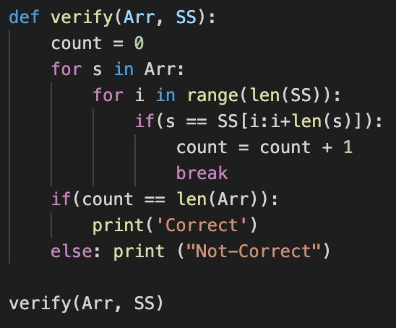
Testing
Verify function proves that, all elements of the array are the subset of the output string.

Slide 43
Discussion
As a result, SCS problem is an NP-complete problem that is reduced from Maximum Asymmetric Traveling Salesman problem.
Since the problem is NP-complete, an efficient algorithm for as a solution to this problem does not exist. There are heuristic algorithms that do not give a guarantee to find the correct answer, however, they work reasonably faster than the brute-force solution.
Greedy approach is one of the heuristic algorithms but it does not always give the shortest superstring.
If the array size or the string size is increased, in general, algorithm’s running time is increased.
For the successful results of the algorithm, the value of k should be chosen regarding the mean superstring length such as found in the second part of the experiments which is approximately linearly increasing.
When the string size is chosen between intervals instead of fixed size, the mean of superstring varies between upper and lower bound of the interval.

Slide 44
References
[1] A. Blum, T. Jiang, M. Li, J. Tromp, and M. Yannakakis, “Linear approximation of shortest superstrings,” Journal of the ACM, vol. 41, no. 4, pp. 630–647, Jan. 1994.
[2] K.J. Räihä and E. Ukkonen. The shortest common supersequence problem over binary alphabet is NP-complete. Theoretical Computer Science, 16:187–198, 1981.
[3] L. Bulteau, F. Hüffner, C. Komusiewicz, R. Niedermeier. Multivariate Algorithmics for NP-Hard String Problems. Institut für Softwaretechnik und Theoretische Informatik, TU Berlin, Germany.

