Slide 1
World-Class CAD / PLM Integration
Chip Depew
VP, Product Management
I-Cubed
Aras 2007 User Conference

Slide 2
ICubed: Deep CAD and PLM Integration Expertise
CAD Integration Technology Supplier to Tier 1 PLM Vendors for a Decade
Support the CAD Systems Your Customers Are Asking For
  SolidWorks
  Inventor
  Unigraphics NX
  Catia V5
  AutoCAD
  SolidEdge
  Microstation
  ME10

Slide 3
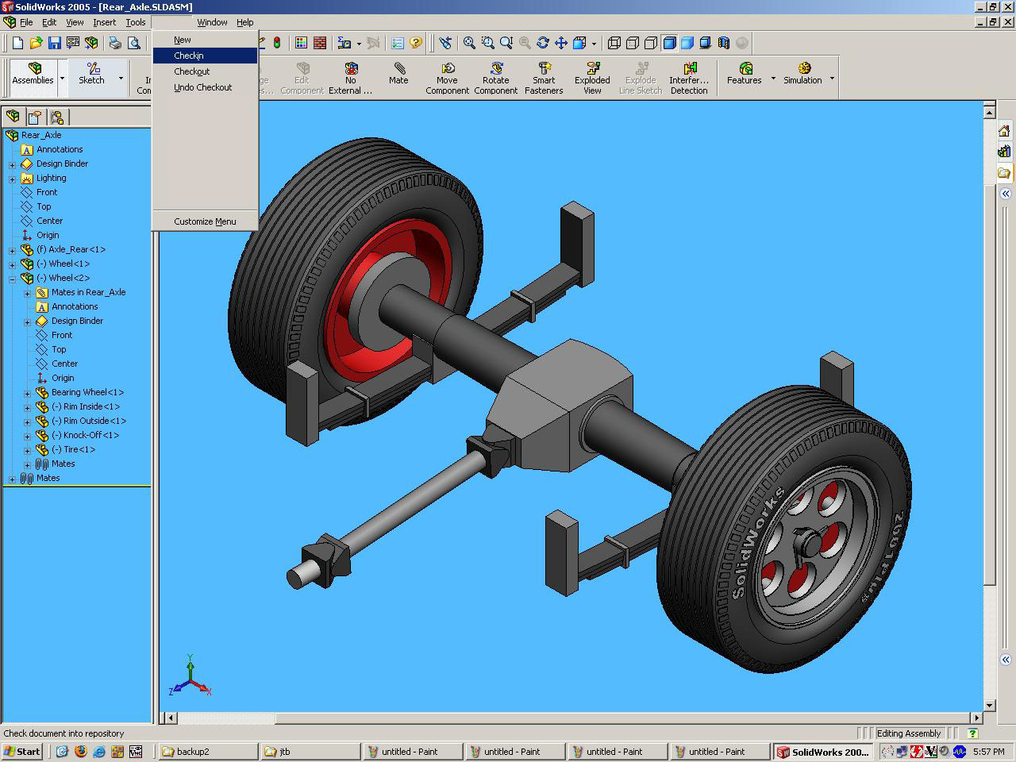
Checkin: Tight Integration with CAD Tool
User Initiates Checkin Within Solidworks

Slide 4
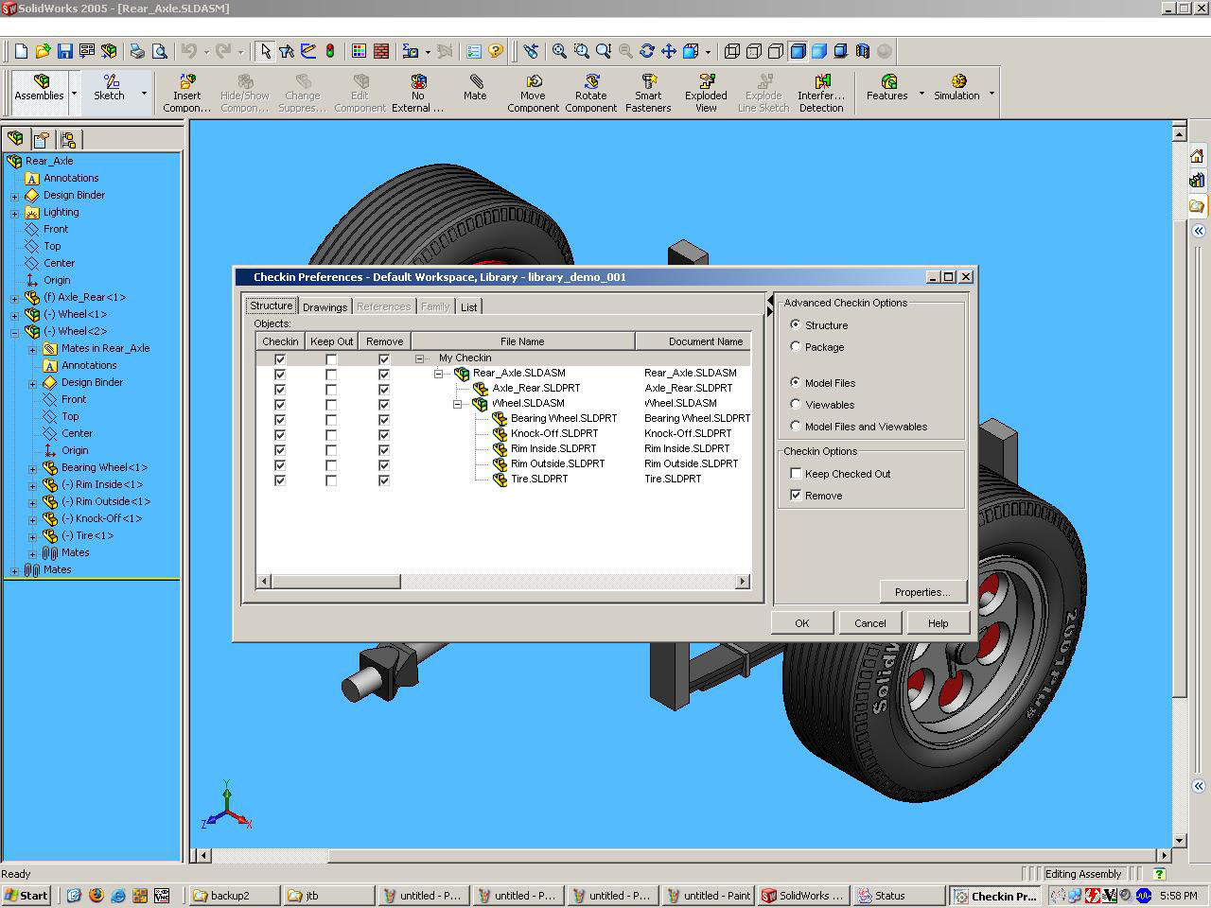
Integration Extracted Structure Identical to CAD Tool
Fine-tune Checkin Options Prior to Committing Transaction
Keep Checked Out
Remove from Local Filesystem
All Files in Structure Checked In Initially
Files May Be Selectively Checked in Thereafter

Slide 5
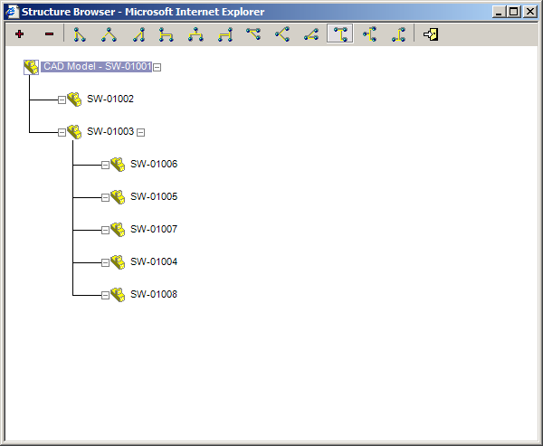
CAD Structure Duplicated in Innovator
Displaying All Files and Dependencies for the CAD Model

Slide 6
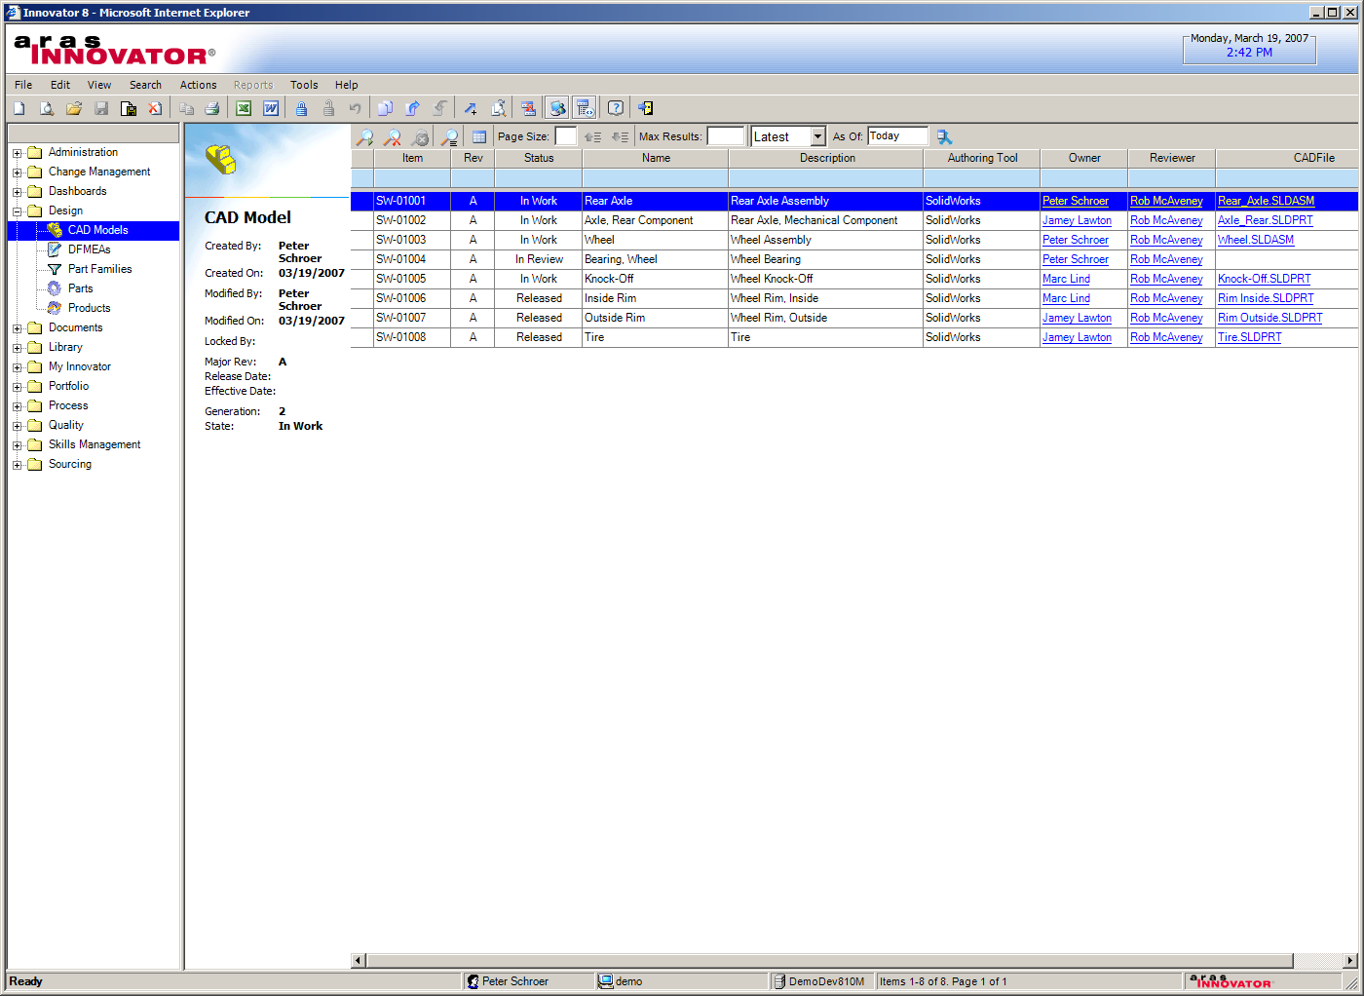
Innovator Main Search Grid
Displaying all CAD Models in Vault

Slide 7
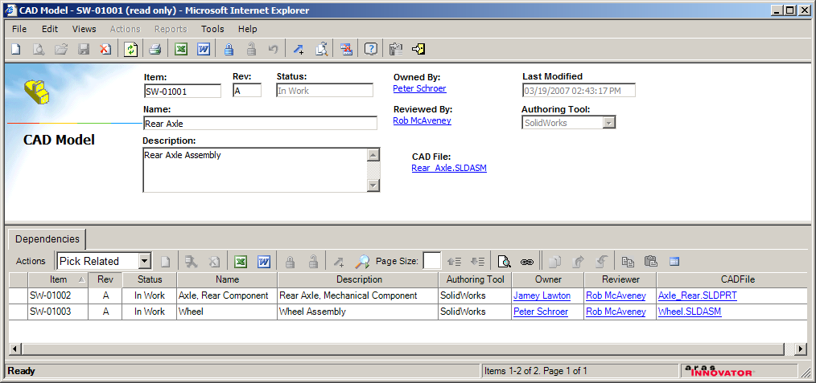
CAD Model Form
Displaying Attributes and Single-Level CAD Dependencies

Slide 8
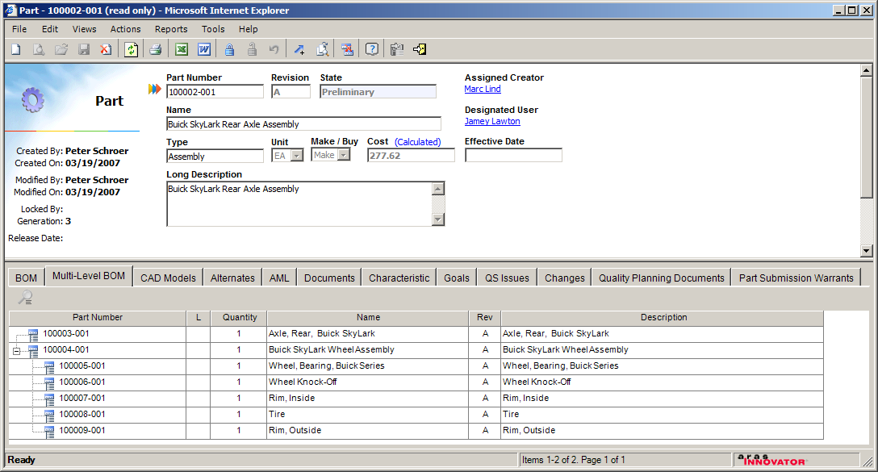
Part Form
Displaying Part Master Attributes and Multi-Level BOM Tab

Slide 9
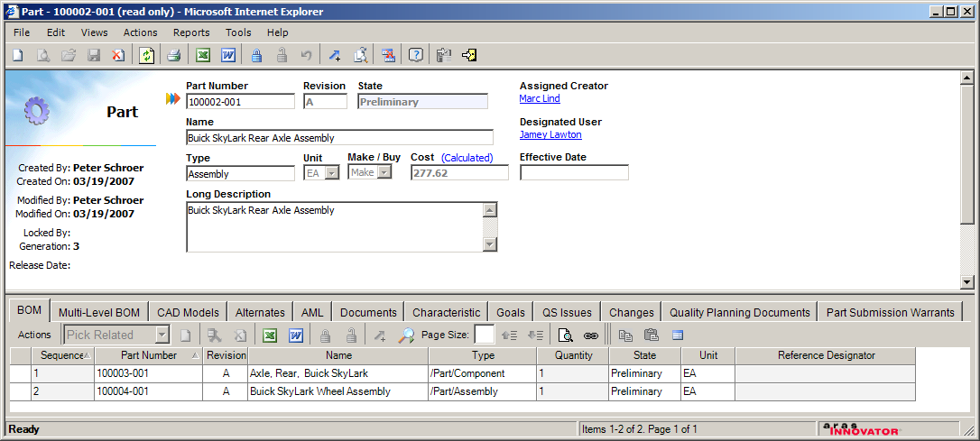
Part Form
Displaying Part Master Attributes and BOM Tab

Slide 10
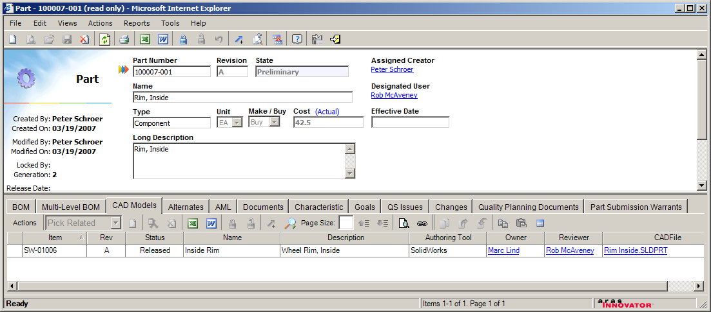
Part Form
Displaying Part Master Attributes and CAD Model Relationship Tab

Slide 11
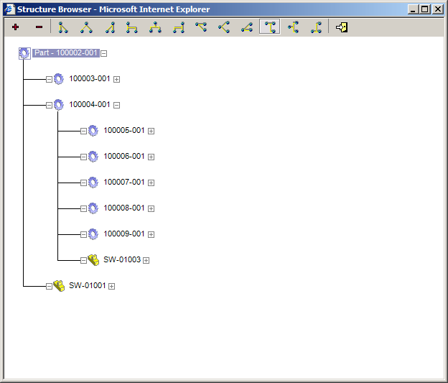
Structure Browser
Displaying the multi-level BOM for the Part

Slide 12
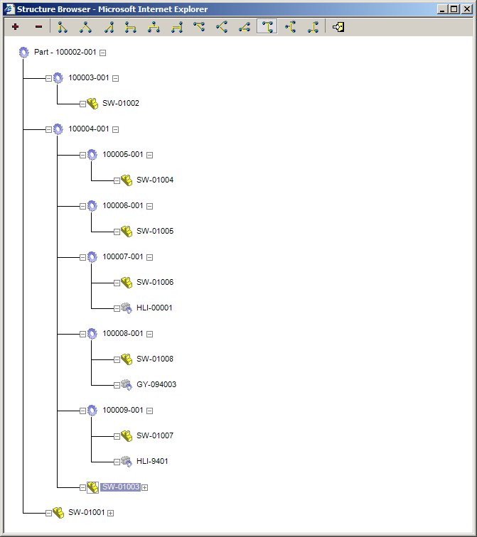
Structure Browser
Displaying all BOM and CAD Dependencies and Relationships

Slide 13
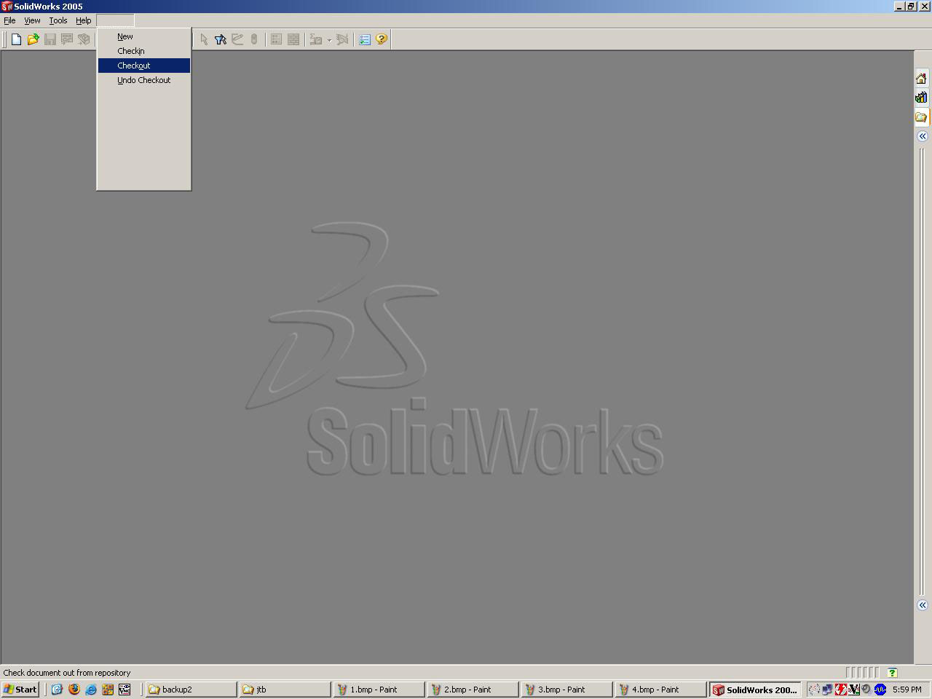
Checkout: Tight Integration with CAD Tool
User Initiates Checkout Within Solidworks

Slide 14
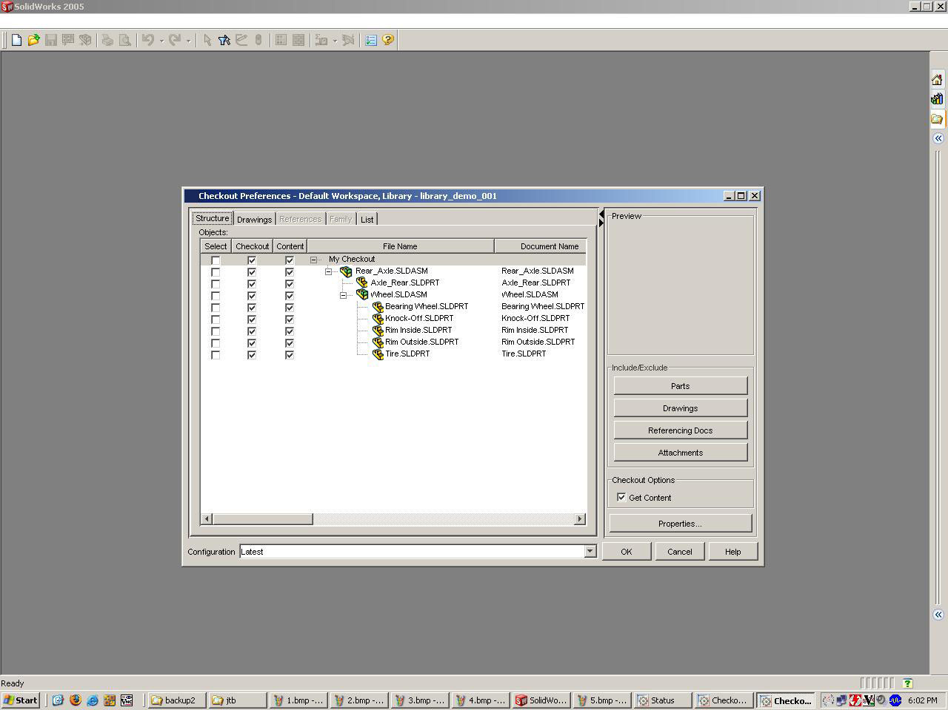
CAD Structure Extracted from Innovator
Select Files For Checkout
Files Not Requiring Changes May Be Downloaded Without Checking Them Out

Slide 15
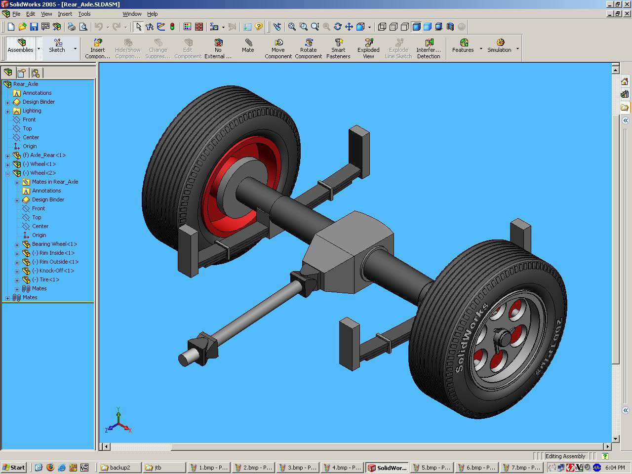
Completed Checkout
Files Downloaded and Loaded Into CAD Session
Checked-out Files Locked in Vault and Set as Read-Write on Local Filesystem
Downloaded Files Not Locked in Vault and Set as Read-Only on Local Filesystem

