Slide 1
Aras Innovator M-BOM Model
Why model the M-BOM?
  There will be different views of the product structure between Engineering and Mfg, due to the manufacturing processes.
  Will need multiple M-BOM views because there will be different manufacturing processes for the same part depending on the Plant and Work Centers used.
What differences between E-BOM and M-BOM?
  Manufacturing uses phantom parts that do not exist in the Engineering structure
    Phantoms are Mfg created pseudo sub-assemblies. They are inserted into the product structure so that manufacturing can plan and build partially completed sub-assemblies and store these in inventory.
  Engineering adds structure hierarchy to organize their modeling of products, while Manufacturing may view the entire parts list as a flat, single level pick list.
  Manufacturing may need to restructure the assembly-component relationships, for example to place certain parts into Kits for field assembly rather than completing the assembly during the Mfg process. Or to move parts that are structured under one sub-assembly by Engineering, to a higher level sub-assembly to match the manufacturing process.,
  MBOM Quantities may be higher to account for yield and scrap losses

Slide 2
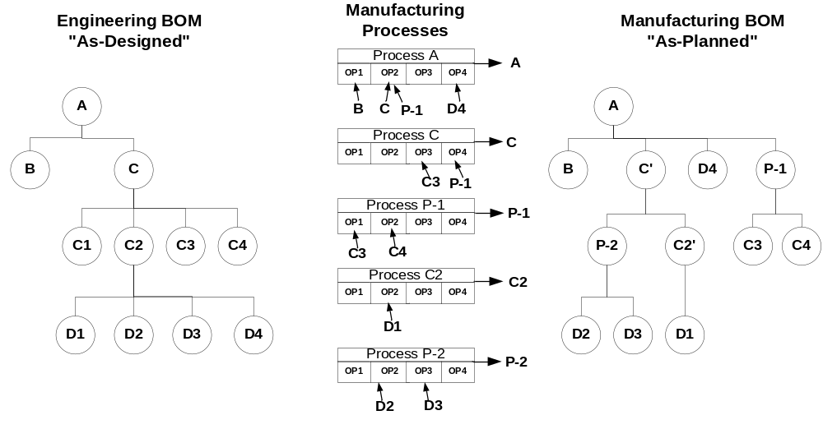
Mapping E-BOM to M-BOM
Using the Process Planner (“router”)
Each Process Planner produces a single Part and consumes zero or more other Parts
Phantoms
Re-structuring

Slide 3
Part Form
Adding a Tab on Part itemType to display and edit the M-BOM
This is a view of one or more Process Planners. A pull-down list
on the toolbar selects which Plant M-BOM should be displayed.
A 2nd pull-down enables Operation display or just rollups for the PP.
Pick-Related used to select a PP. New used to create one.
Mfg BOM
Action Clone Delete lock/unlock Process {Plant list} Operation {show/hide}
Operation Part Description Quantity Reference Designator
Grid control with Toolbar in frame
Create New M-BOM – create and attach a new process planner. Default to One Operation.
Clone - copy a process planner as baseline for a new Plant
Edit functions – add Operations
– edit Operations. Add/delete/change parts
Report: Full-Deep MBOM Report (for each part, re-explode M-BOM through Process Planners
Report: EBOM vs MBOM Compare Report, one-level and full explosion

Slide 4
M-BOM Tab -- Implemented as relationshipType with null related_id
RelationshipType View to Form
Add an Operation Part relationship with Quantity and Reference_Designator properties.
M-BOM is a Package with dependencies on PE and QP
Client loads Form (includes grid & toolbar layout) into RelationshipsGrid.html for the Tab
Client gets Part-id from Form, and sends to a server method
Server Method queries for all PP for this part and returns a structure
  PP -> Operation -> Part
Client queries returned structured for Process Planners
  Update the ToolBar pull-down to list the Process-Planner-Plant combinations found
Display the Operations and Parts for the 1st Process Planner on the pull-down list.
Client UI allows new Process Planners to be created or attached from Tab
PP must be locked (manually or auto) before edits to Operations and Parts
Question: Should the Part Item be locked to allow M-BOM editing? {NO}
Question: Should this tab be viewing only, and edits made in another window (the Process Planner)? This would simplify dealing with the dirty DOM on a Tab on the Part item.
EBOM / MBOM Compare should align around Ref Designator
Some Sub-Assy are discarded in EBOM-MBOM. Need a Flag so not always reviewed.

Slide 5
To Define
Multi-level editor for EBOM using tree-grid in separate window – launch from Toolbar
Copy from EBOM to MBOM, all parts into Operation #10, or Drag-and-Drop from EBOM into MBOM Router, with color coding to show which parts are assigned.
Traceability from EBOM to MBOM by rel-id so that ECO changes can be automatically propogated
Create Tab on PP named ManufBom - use CGRID for hierarchy (similar to PFD, but with Parts per operation displayed)

Slide 6
Phantom Part = an engineering planned part number that exists in production only very briefly as a separate component (it is immediately assembled into a parent assembly). For example, a measured piece of insulation cut from a reel. The bulk material has a part number. The measured piece of insulation cut from the reel has a part number (with a specification from Engineering). The cut piece is never stored in Inventory. It is created and consumed (into the next higher parent assembly) immediately on the production floor.
Synthetic Part = a manufacturing created sub-assembly number used to build and temporarily store a partially completed assembly, or to store a sub-assembly not recognized in the Engineering BOM. The Synthetic parts may be placed in a stockroom and used later to complete the engineering defined assembly. Synthetics ‘disappear’ at the end of a production process.

Slide 7
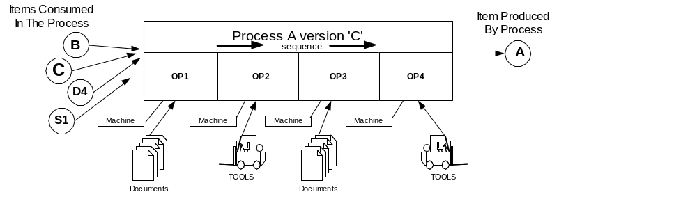
PPS - Process Flow
(Routings)

