Slide 1
Variant Community Solution
Preliminary Release for Aras 11

Slide 2

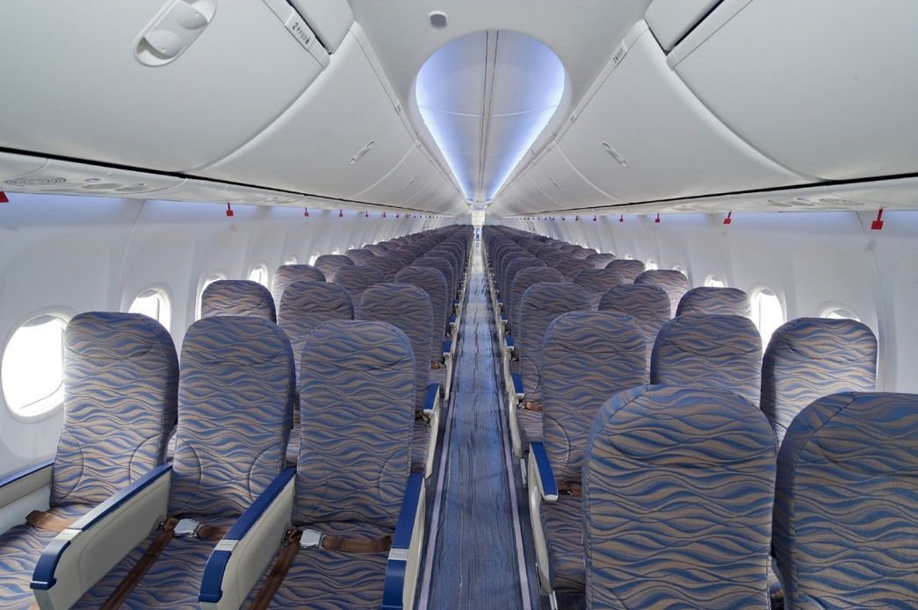
Selecting Aircraft & Choosing Configurations
...
L Exit
R Standard
Configuration Challenge
In a standard Boeing 737-900 there are at least 10 different seat configurations
L Standard
R Front
L Front

Slide 3
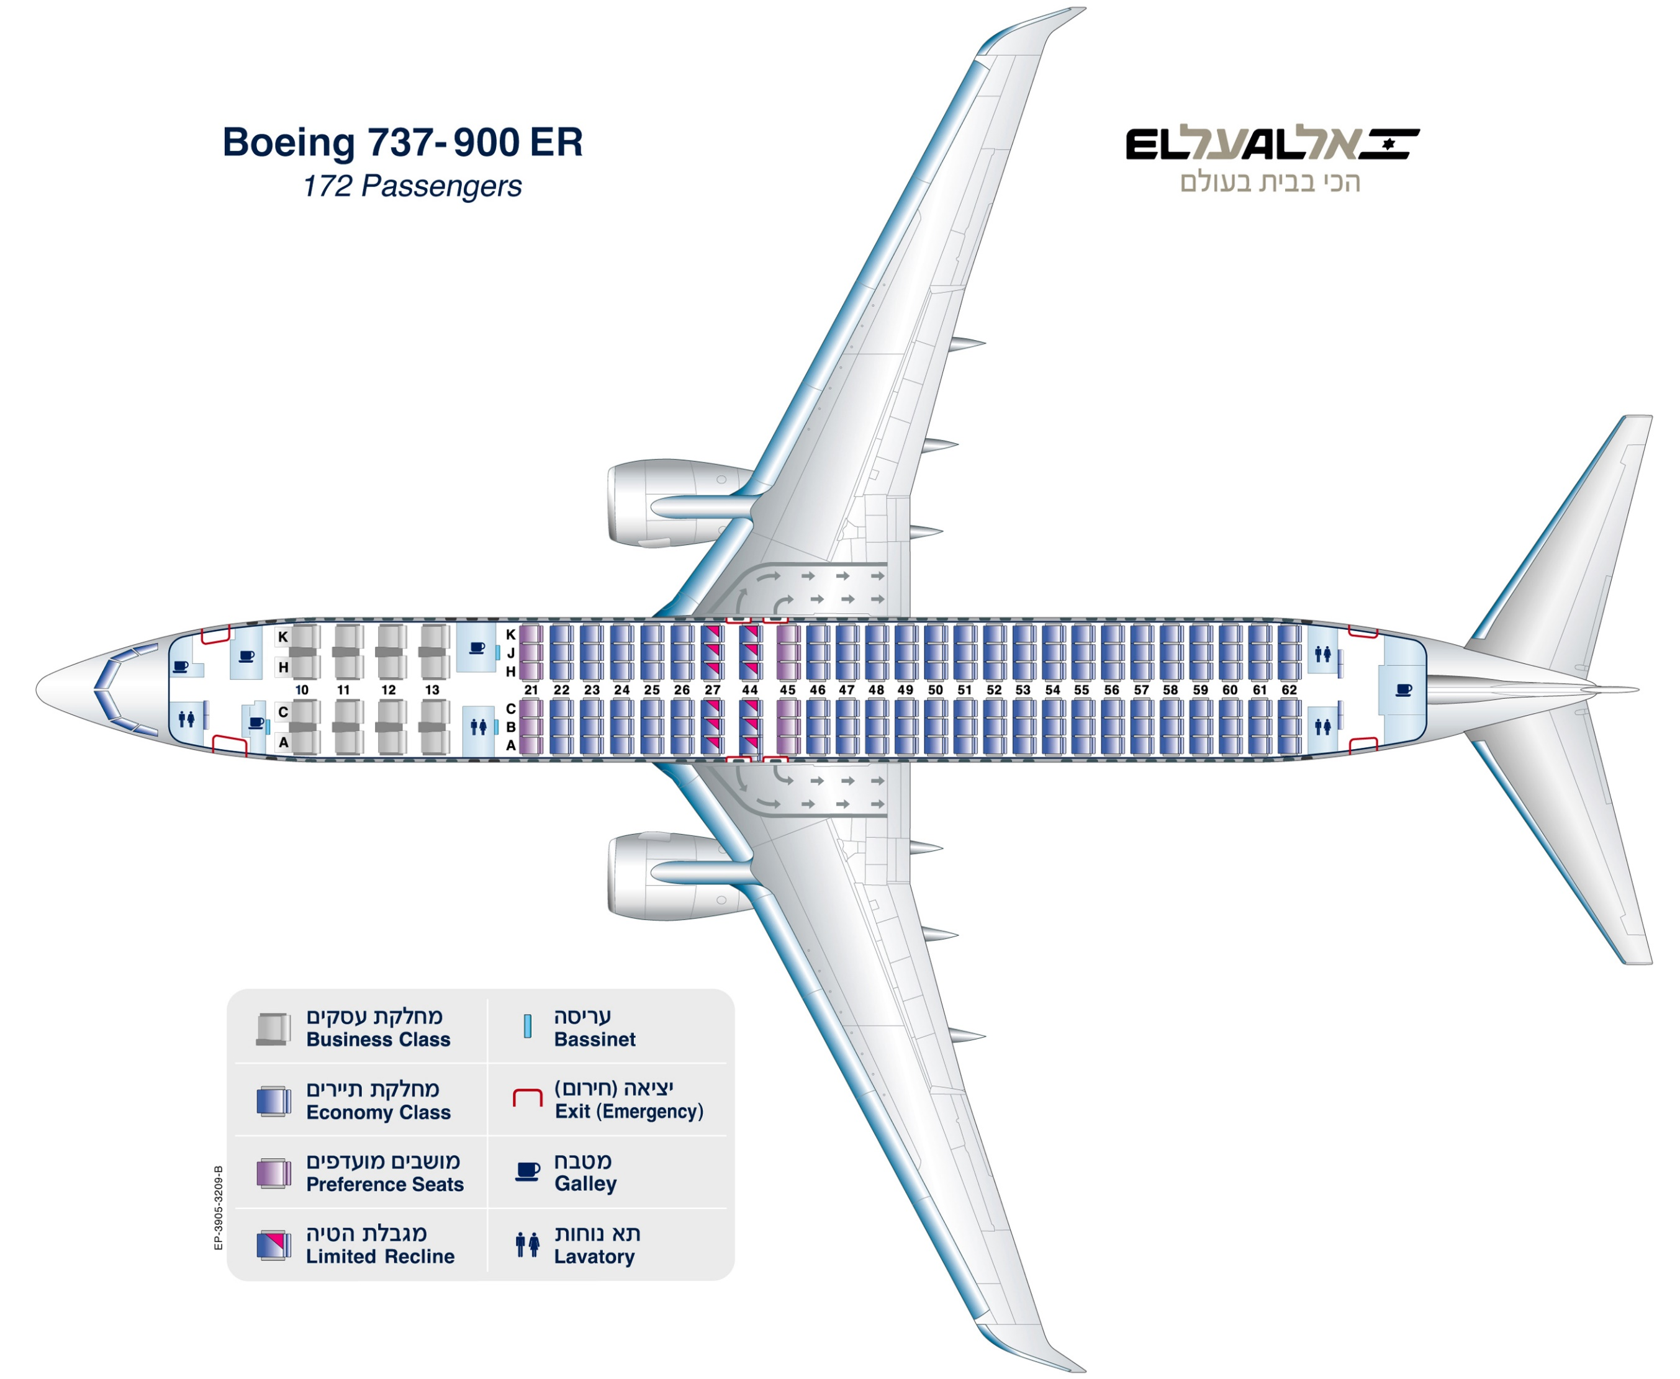
737-900 Example
Example Location Variants
Left & Right
Front
Pre-Exit
Exit
Standard
Aft
Example Options
AC Power
USB Power
Video
Std. Phone
Phone w/ Game Control
Front
PreExit
Exit
Std
Aft

Slide 4
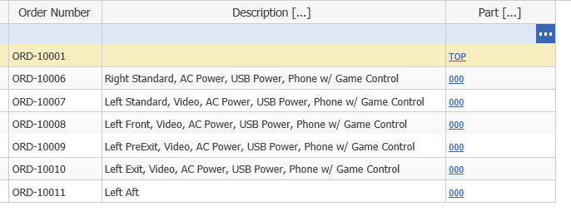
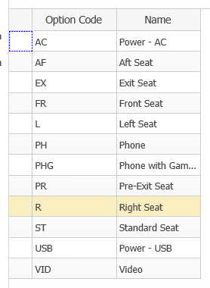
737-900 Example
Orders
Option Codes
ORD-10006
Side = Right
Frame = Front
AC Power = Yes
USB Power = Yes
Video = Yes
Phone = Combo
Select Options
Generate Orders
Front
PreExit
Exit
Std
Aft
ORD-10008
Side = Left
Seat = Front
AC Power = Yes
USB Power = Yes
Video = Yes
Phone = Combo
ORD-10009
Side = Left
Seat = PreExit
AC Power = Yes
USB Power = Yes
Video = Yes
Phone = Combo
ORD-10010
Side = Left
Seat = Exit
AC Power = Yes
USB Power = Yes
Video = Yes
Phone = Combo
ORD-10007
Side = Left
Seat = Standard
AC Power = Yes
USB Power = Yes
Video = Yes
Phone = Combo
ORD-10011
Side = Left
Seat = Aft
AC Power = No
USB Power = No
Video = No
Phone = No

Slide 5
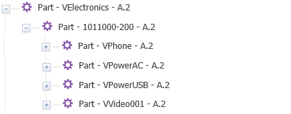
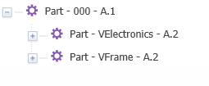
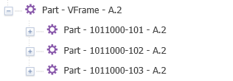
Variant Structure
Electronics Variant Options
Standard Chassis
Seat Base part with variant placeholders
Second
Level
Variants
Frame Variant Options
Left Std
Right Std
Left Short

Slide 6
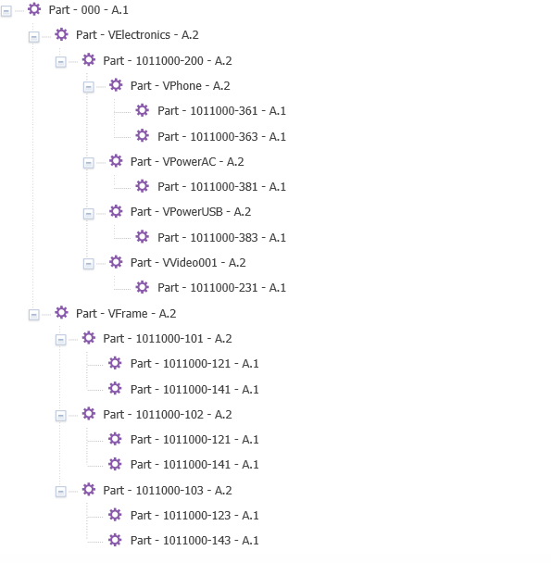
Selection Rules
Frame Selections
MUST Pick two Options
Electronics Selections
Not Required – Pick any Options
Left AND (Standard OR Exit OR PreExit)
ANY Electronics Selections
Phone
Right AND (Standard OR Exit OR PreExit)
Combo Phone
AC Power
Left AND (Front OR Aft)
USB Power
Video

Slide 7
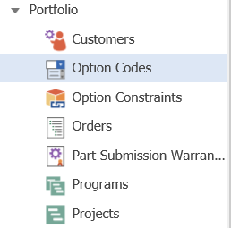
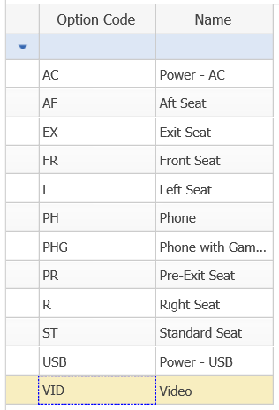
Option Codes
Codes to be used in Boolean expressions
Can be any length, but shorter is better
Alphanumeric characters only
Name field for human-readable description

Slide 8
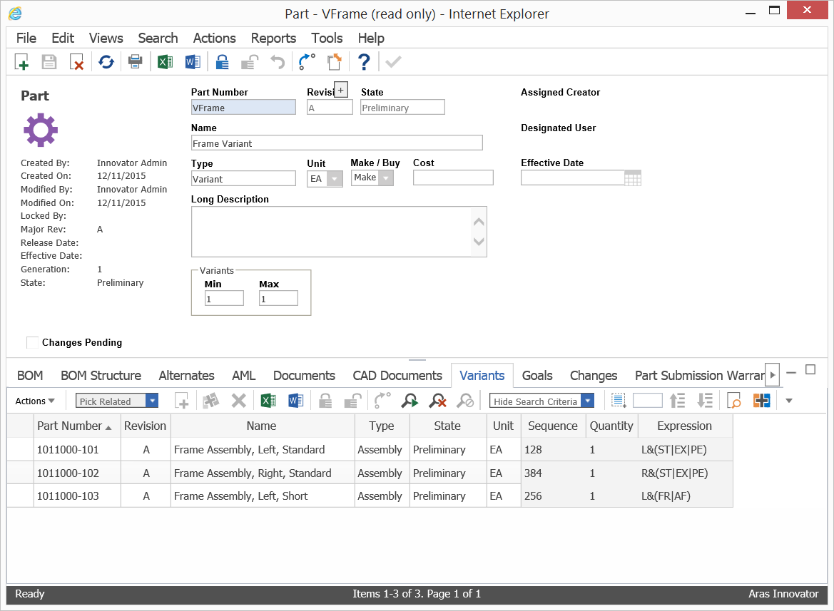
Variant Expressions
Boolean Expressions using Option Codes
Supports ANDs (&), ORs (|) and NOTs (!)
Group with parentheses
Evaluate Expressions in descending order
Return between variant_min and variant_max results

Slide 9
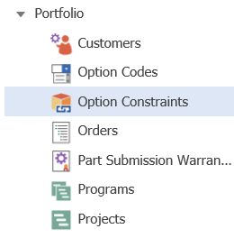
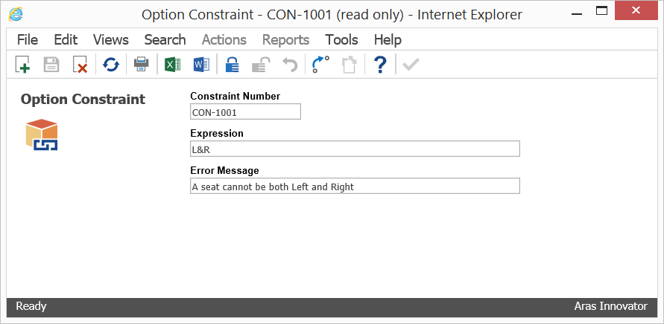
Option Constraints
Boolean Expressions using Option Codes
Supports ANDs (&), ORs (|) and NOTs (!)
Group with parentheses
If the Constraint resolves to True, return the error message

Slide 10
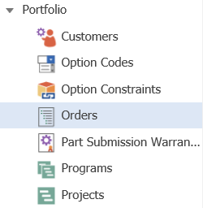
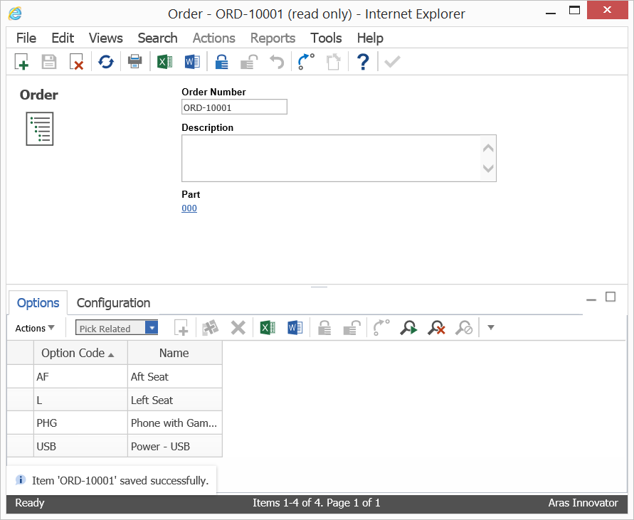
Order Creation
Select top level assembly
Includes Variants in its BOM
Select desired Options
Error on Save if:
Constraint is violated (e.g. both L and R options selected)
Variant minimums are not met by the options selected (e.g. neither L nor R selected)

Slide 11
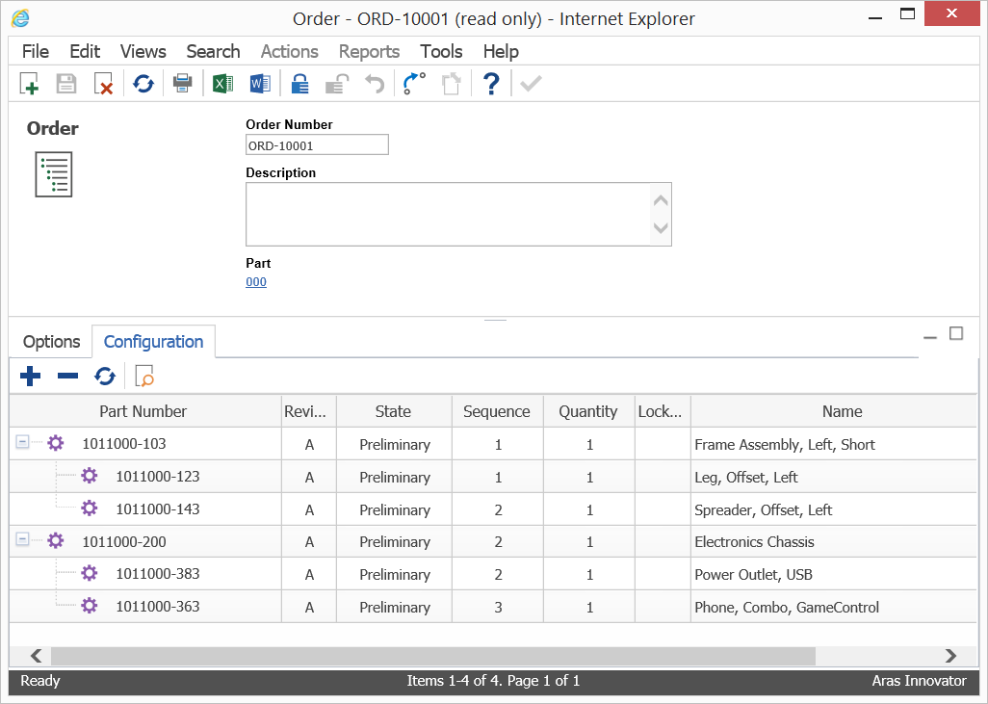
Order Configuration
“Order BOM” to be used in downstream systems (ERP)
Variant Parts removed from the structure and replaced with real part numbers (from the Variants tab, based on expressions)
Multi-level variants supported

