Slide 1
KEYLOGGER AND SECURITY
CAPSTONE PROJECT
Presented By:
S.ARASAKUMAR
JAYARAJ ANNAPACKIAM CSI COLLEGE OF ENGINEERING
B.TECH/INFORMATION TECHNOLGY

Slide 2
OUTLINE
Problem Statement (Should not include solution)
Proposed System/Solution
Key logger code
Key logger Run & Output
System Development Approach (Technology Used)
Algorithm & Deployment
Result (Output Image)
Conclusion
Future Scope
References

Slide 3
Problem Statement
In today's digital age, where cyber security threats loom large, one
of the significant concerns is the proliferation of key loggers,
stealthy software tools designed to monitor and record keystrokes
on a user's computer without their knowledge. Key loggers pose a
severe threat to individuals and organizations as they can capture
sensitive information such as passwords, credit card details, and
other personal data, leading to identity theft, financial loss, and
privacy breaches . project problem statement for key logger

Slide 4
Proposed Solution
The proposed system to compact the threat key loggers in today’s age , several solutions can be implemented. The solution will consist of the following components:
Use Antivirus Software:
Employ reputable antivirus software with key logger detection capabilities.
Regular Updates:
Keep all software ,including OS and applications, up to date to patch vulnerabilities exploited by key loggers.
Firewalls and IDS:
Utilize firewalls and Instruction Detection Systems to monitor and block suspicious network activity.
Virtual Keyboards:
Encourage the use of virtual keyboards for sensitive activities to avoid physical keystroke capture.
User Education:
Train users about key loggers risks and best practices to mitigate them.
Multi –Factor Authentication:
Implement MFA to add an extra layer of security beyond passwords.
Encryption:
Encrypt sensitive data to render intercepted keystrokes useless.

Slide 5

KEY LOGGER CODE

Slide 6
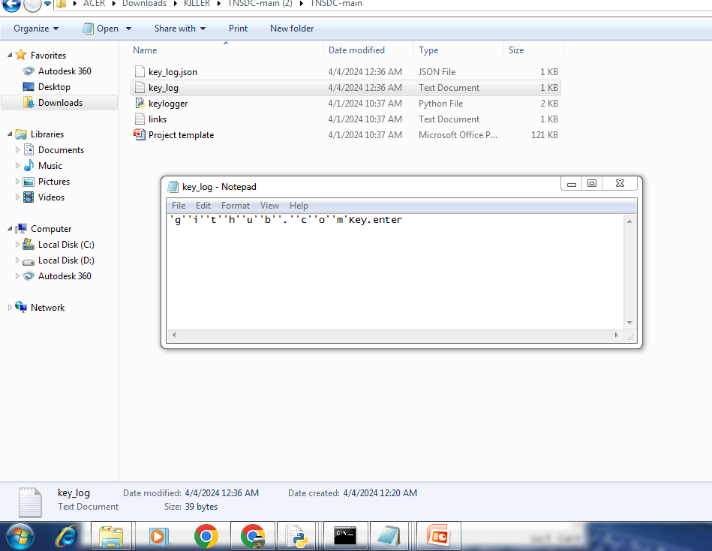
KeY LOGGER RUNS & OUTPUT

Slide 7
System Approach
The "System Approach" section outlines the overall strategy and methodology for proliferation of key loggers in today’s digital age involves multiple interconnected strategies. Here's a suggested structure for this section:
Prevention Measure
Detection and Monitoring
Response and Mitigations
User Awareness and Training

Slide 8
Algorithm & Deployment
Certainly here’s an algorithm and deployment plan to address the proliferation of key loggers:
Detection Algorithm:
Scan for known key logger signatures using antivirus software.
Check network traffic for anomalies that may indicate communication with a remote key logger server.
Response Algorithm:
Quarantine the affected system to prevent further spread of the key logger.
Disable or remove the key logger software and associated files.
Configuration and Testing:
Configure antivirus software and IDS/IPS systems to detect and respond to key logger threats.
Conduct through testing of detection and response mechanisms to ensure they are effective and efficient.
Implementation:
Roll out the deployment of antivirus software and IDS/IPS systems across all devices and network structure.
Monitoring systems logs and network traffic for signs of key logger activity and respond promptly to detect threads.

Slide 9
Result
Present the results of the proliferation of key loggers , Increased awareness among users organizations about the threat posed by key loggers . Overall improvement in cyber security re silence proliferation and readiness to combat key logger proliferation in the digital age.

Slide 10
Conclusion
Summarizing the importance of safeguarding against key loggers and the critical role of cyber security in protecting sensitive data.

Slide 11
Future scope
The further scope of addressing the proliferation of key loggers in today’s digital age involves innovative approaches and technologies to enhance cyber security . In cyber security automation , develop automated response mechanisms to rapidly detect and mitigate key logger.

Slide 12
References
Websites of cyber security organizations and companies often publish articles , reports and whitepapers on various cyber threats , including key loggers like, Symantec , McAfee , Kasperskys .

Slide 13
THANK YOU

