Slide 1
Opening a Café in North York, Toronto
IBM Capstone Project: Applied Data Science Capstone
By Sayed Aresh Beheshti-Shirazi
January 2021

Slide 2
The goal is to determine which neighborhood of North York Borough of Toronto provides better prospect for a Café business.
Main Goal

Slide 3
Analyze different neighborhoods of North York Borough to determine what kind of business are there.
Avoid neighborhoods with high number of café.
Select the neighborhood that has the lowest number of café businesses.
Analytic approach

Slide 4
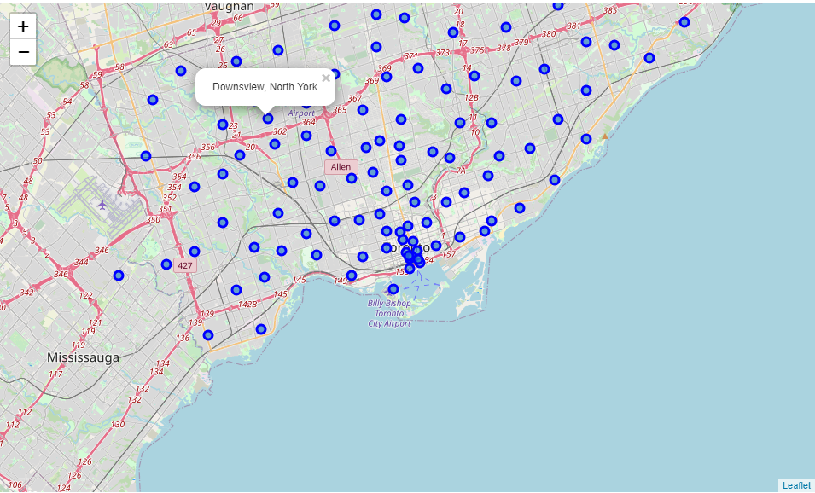
Map Of Toronto with it’s Boroughs and Neighborhoods
Area 630.29 km²
Population 2.93 Million
Districts 6
Neighborhoods 140

Slide 5
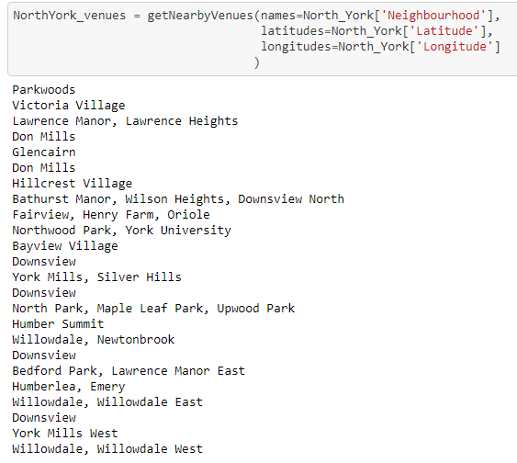
List of Neighborhoods of North York

Slide 6
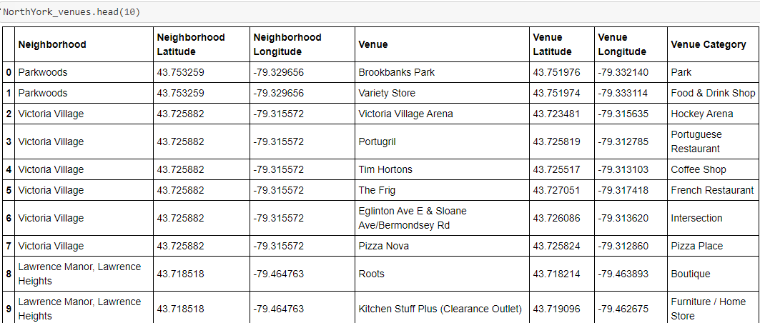
List of Different Venues in North York Borough

Slide 7
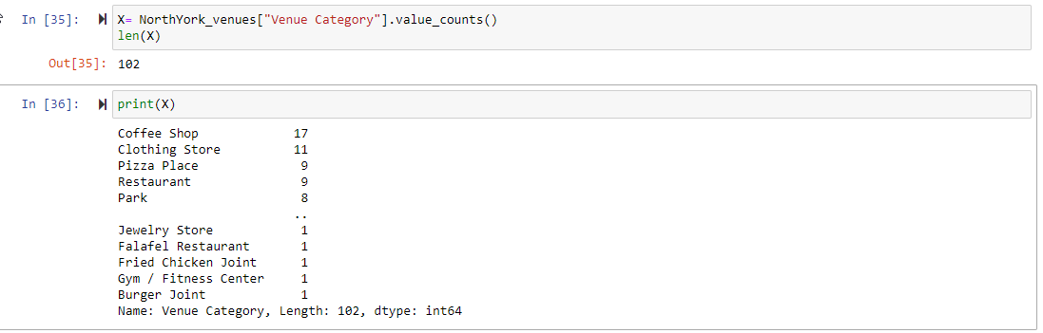
List of Different Venues in North York Borough
There are 243 venues or business in North York Borough’s different neighborhoods.
There are 102 different kind of businesses such as Clothing Store, Bakery, Restaurant, etc/

Slide 8
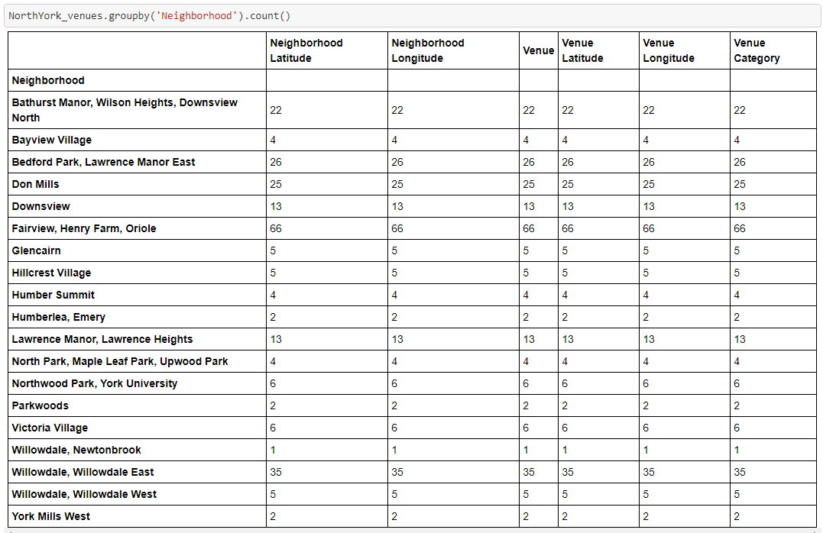
Number of Business/Venues Per Neighborhood

Slide 9
Finding the Most Common Venues
Next, we are finding a most common venues in different neighborhoods of North York
We are finding the 10th most common venue in each neighborhood
We will select a neighborhood that Café is the 10th most common venue, which means obviously, there is a need for a café in that neighborhoods.

Slide 10
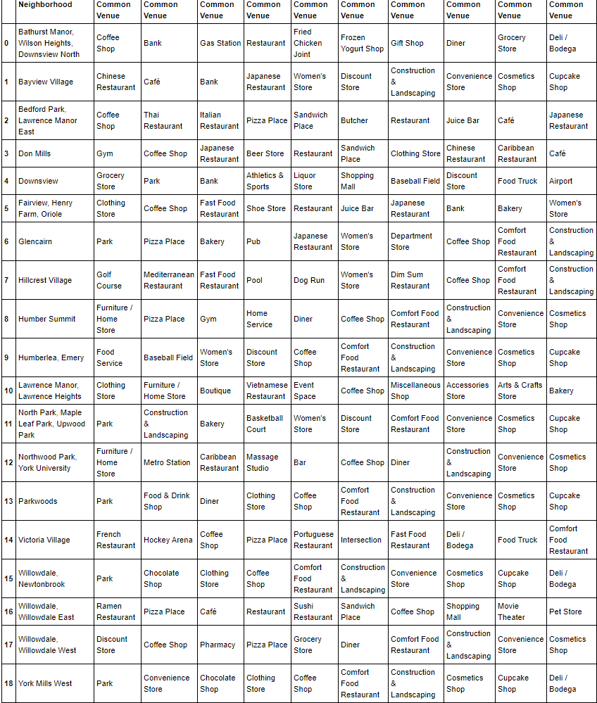
10th Most common Venues

Slide 11
Conclusion
Conclusion is that in Don Mills Neighborhood of Noth York Cafe's are the 10 most common business, therefore there is a shortage of Cafes and it is a good Neighborhood to open a Cafe

Slide 12


Data sources
Foursquare API
https://ru.foursquare.com/
Wikipedia
https://wikipedia.com

