Slide 1


Unix for Bioinformatics
Computational Biology Division
University of Cape Town
arash.iranzadeh@uct.ac.za

Slide 2
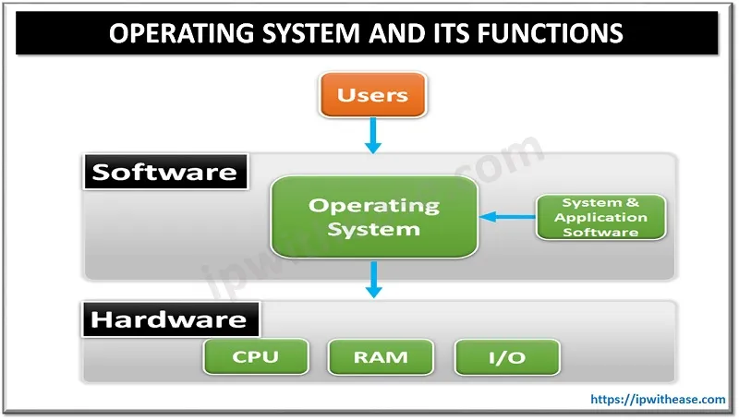
Operating System (OS)
Operating system (OS) is a program that manages computer hardware and software and lets the user interact with the computer.
Examples: Windows and Unix
Notes:
Operating system is the computer manager, our language is different from the computer language , os actually helps the computer understand what we want it to do.

Slide 3

What is Unix?
Unix is the standard OS on most large computer systems in scientific research, in the same way that Microsoft Windows is the dominant operating system on Desktop PCs.
Unix offers a graphical user interface that look different from the Windows interface but with the same functionality.
Unix is a multi-user multi-task operating system which allows dozens of people to run programs on the same computer at the same time. This is why it is the preferred for large-scale computing.
UNIX Introduction | High Performance Computing (iastate.edu)

Slide 4
Unix structure
Unix architecture has four layers:
Kernel: The heart of the OS that directly communicate with the hardware and controls the computer performance.
Shell: The interface between user and kernel, a command interpreter that can receive commands from users, translate, and send them to the computer.
Bioinformaticians need to learn the shell commands (the main objective of this course)!
User Apps
Shell
Kernel
Hardware

Slide 5
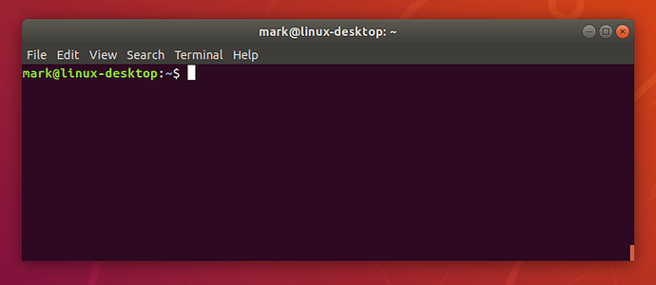
Linux Terminal is similar to Command Prompt on Windows system.
The Linux shell, also referred as terminal, console, command line, or prompt, is an interface between users and OS to run shell programs and analyse data.
The shell language is called “sh” or “bash”. Bash is actually the improved subset of sh.
https://ubuntu.com/tutorials/command-line-for-beginners#3-opening-a-terminal
Notes:
Command promt understands DOS language but Linux terminal understand shell language.

Slide 6

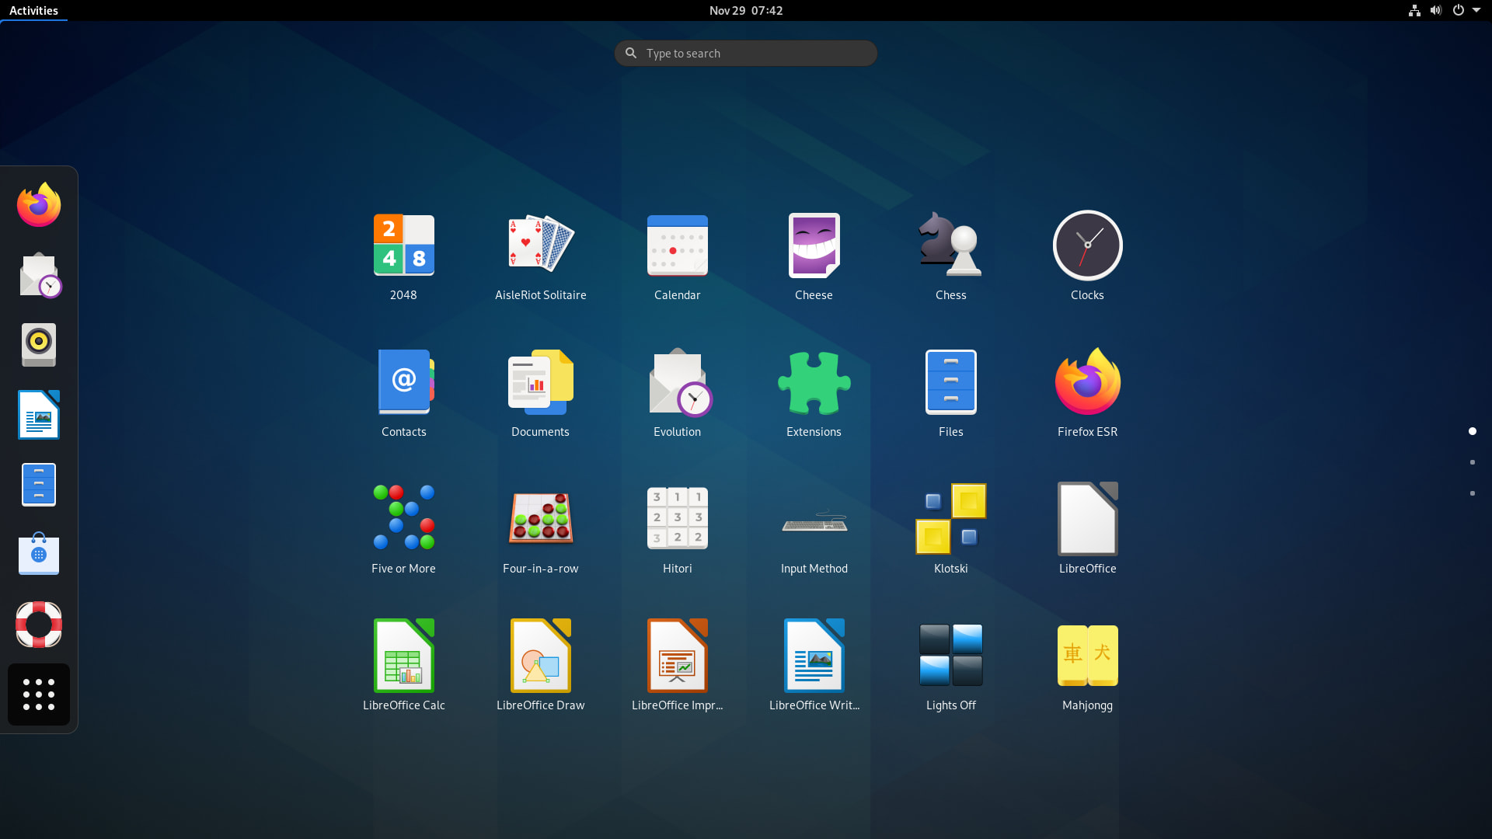
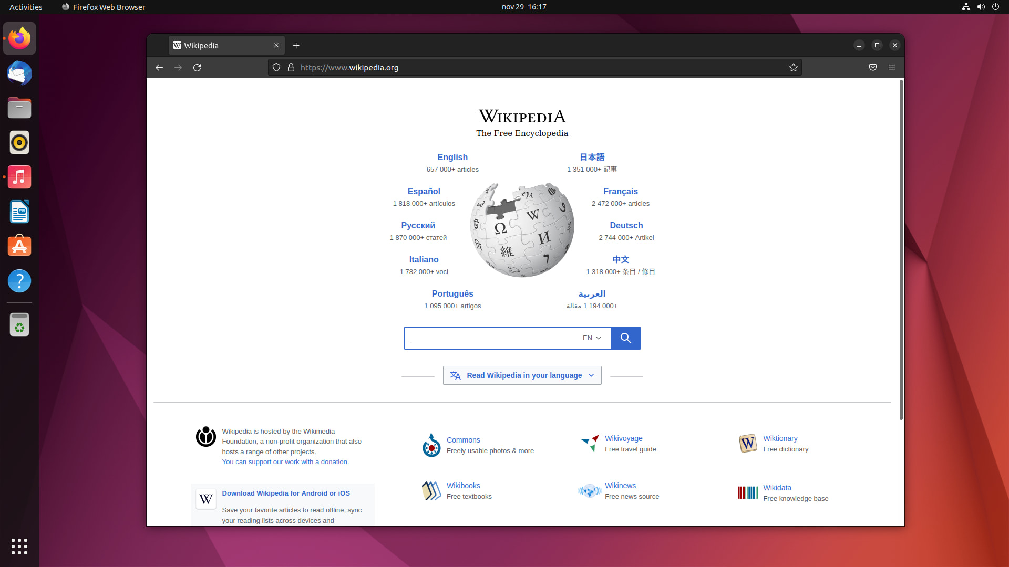
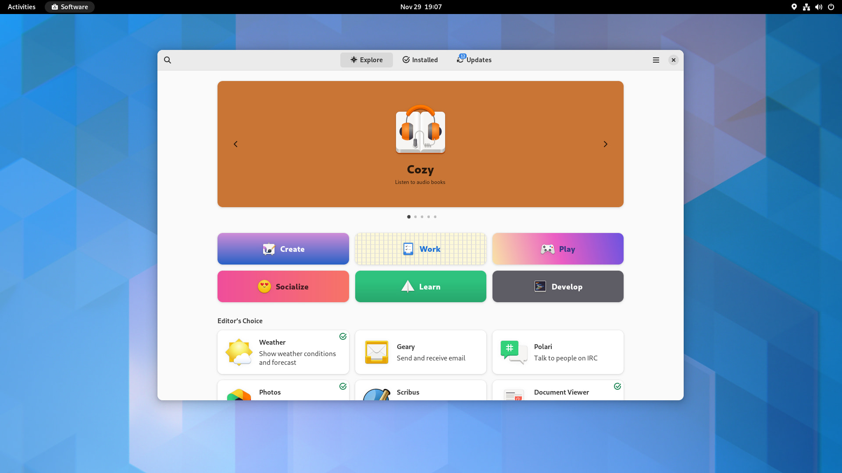



Unix distributions
There are several Unix distributions, both free and commercial:
Solaris
Mac OS
Linux distributions (Debian, Ubuntu, and Fedora):
https://www.getgnulinux.org/en/switch_to_linux/choose_a_distribution
Notes:
It is similar to Microsoft Windows, but it is entirely free. The accurate name is GNU/Linux but "Linux" is used more often.

Slide 7


Ubuntu https://ubuntu.com/
A Unix-like open-source OS! Many bioinformatics tools are freely available and can be easily installed on Ubuntu through the Advance Package Tool (APT) interface.
Ubuntu is released every six months, with long-term support (LTS) releases every two years.
The latest versions by June 2023 is Ubuntu 22.04.2 LTS (Jammy Jellyfish) with five years of free security and maintenance updates, guaranteed until April 2027.

Slide 8
Why Unix for bioinformatics?
Most of the Unix-like OS are free!
In computational biology we deal with large text files (e.g., sequencing data). Unix is suitable for working with such files with several commands.
Unix contains hundreds of commands that can be combine to investigate the content of the huge text file. Therefore, creating a biological analysis pipeline in Linux can be done.
To work with advance pipeline management frameworks such as Nexflow, knowing the Unix commands are useful.
Linux has become the de facto standard for HPC and supercomputing.
Stability and Reliability: Linux is known for its stability, which is crucial for systems that need to run for extended periods without crashing. HPC jobs can run for hours, days, or even weeks.
Security: The open-source nature means that security vulnerabilities are often found and patched quickly by a global community of developers.
Scalability: Linux is highly scalable and can efficiently manage thousands of nodes and millions of processor cores.
Notes:
Mention some bioinformatics tools available in ubunu

Slide 9
Install Ubuntu in Windows 10
Go to “Setting”.
Click “Turn Windows features on and off”.
Tick “Windows Subsystem for Linux” -> click “Ok”.
Click the “Restart now”.
Go to “Start Button -> Microsoft Store”.
Click “Run Linux on Windows”.
Choose “Ubuntu” -> Click the “Get” button.
Click the “Launch” button.
Wait for system to finish installing, then create username and password.

Slide 10
Install Ubuntu in Windows 10 (Cont..)
After installing Ubuntu run the following commands in the command prompt window to update all ubuntu packages:
sudo apt-get update
sudo apt-get upgrade
sudo apt-get dist-upgrade
To access the Linux terminal, select Ubuntu from start menu.

Slide 11

Basic Unix
To learn any programming language, we must read and type codes at the same time and check how they work in the shell console! :)

Slide 12

Type of variables in the Unix operating system
System defined variables:
Defined by the Unix operating system during its installation. They are defined in capital letters, for example BASH, PATH, HOME, …
echo $BASH (this command prints the BASH variable value that is the address of bash in the system).
echo $PATH (this command prints the PATH variable values referring to of the locations where the executable programs exist, different locations are separated by a colon symbol :).
User-defined variables:
Defined by the user. No rules for these variable declaration, but better to use lower case for their declaration.
To see the full list of variables, type echo $, then press tab twice!

Slide 13
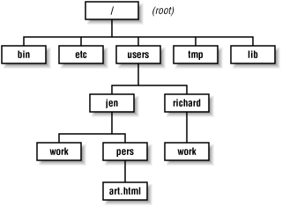
Unix Directory Structure Directories are the Unix equivalent of Folders in Windows and Mac. They are organized in hierarchy and each directory can have sub-directories (child directories). There is a parent-child relationship between directories that is depicted by a forward slash sign (/). The name before the slash is parent and after the slash is child: Example: users/richard The parent of all directories in Unix is called “root directory” and is shown by forward slash (/) without any name before it.
https://docstore.mik.ua/orelly/web2/wdesign/ch04_02.htm

Slide 14
Pathnames in Unix
The pathname for each file or directory is defined based on the parent-child relationship between directories.
The pathname of a file or directory is defined as the path of directories that should be travelled to get to where you want to go.
Two pathnames can be defined for each file or directory in Unix:
The absolute pathname: The path from root to the destination. It always starts with a forward slash sign (/).
The relative pathname: The relative pathname that points to a file or directory is defined relative to the current working directory.
Notes:
Explain module commands in hpc

Slide 15

Pathname in Unix (example)
If the current working directory is richard. What are the absolute and relative pathnames for the two directories “work”?
The absolute pathname (
/users/richard/work
/users/jen/work
The relative pathname:
./work
../jen/work
Please note that that a single full stops (.) refers to the current directory and
the two full stops (..) refers to the parent directory (see the next slide).
To show the absolute path of a file or directory use this command:
$realpath fileName
https://docstore.mik.ua/orelly/web2/wdesign/ch04_02.htm

Slide 16
The summary of path delimiters in Unix
~ (starting directory or home directory)
. (current directory)
.. (parent directory)
/ (root directory)
Notes:
Here u

Slide 17
Variable in Unix
Variables are the most fundamental concept in any programming languages. A variable refers to a memory location where a piece of information is stored (letter, number, etc.). Variables are declared using equal sign (=):
N=1 (N is variable name, and 1 is its value)
Variable rules in Unix:
The variable name is case sensitive.
Quotes (“ or ‘) are not required for the string declaration: x=David (correct).
The variable value can be alphanumeric or contain underscore signs (_).
The variable should be prefixed with a dollar sign ($) when it is read or printed (do not add $ when you declare a variable).
N=1
printf $N or echo $N ====> 1
printf N or echo N ====> N
There should not be a whitespace between the variable name and its value and the equal sign (=):
N=1 (correct)
N= 1 (wrong)
N
1

Slide 18
Unix commands
There are hundreds of commands that the Unix terminal can run. Each command is a program that tells the computer to do something. Commands are case sensitive and have the following prototype:
command –option argumnet1 argument 2 … argument
Example:
grep –f George fileName
In this example the grep command searches for word “George” in the file with name “fileName”. To get further information about each Unix command type:
command --help (e.g., grep --help)
man command (e.g., man grep), this gives a detailed information about the command.

Slide 19
Unix commands (basic)
echo and printf are used to print:
echo hello world
printf “hello world\n”
pwd: print working directory, displays the path to the current directory.
cd: changes current directory to another, it allows you to move up or down in the directory hierarchy:
cd targetDirectory
cd .
cd ~
cd ..
Notes:
Nextflow is …
Because the workflow management systems like nextflow, come with a number of advantages over a simple batch scripting, the most important one is that with nextflow, the parallelization effectively comes for free, it implicitly implements a high level of parallelization, which is quite scalable so that you can apply it on your computer, or a high performance cluster, or a cloud computing server by changing only a configuration option in your nextflow script.
It is designed around the idea that the Linux platform is the lingua franca of data science. Linux provides many simple but powerful command-line and scripting tools that, when chained together, facilitate complex data manipulations.

Slide 20
Unix commands (making files or directories)
ls: lists the contents of the directory (directories and files are listed in different colors).
ls -help: displays the manual page.
ls /path/to/directory: display the content of the directory that the path points to, if path is not provided, the ls command list the content of the current director.
ls -l: shows the detailed content of the directory.
ls -a -l: shows hidden files and detailed content.
ls -alh: shows size of the files, hidden files and detailed content.
ls ~: displayes the content of the home directory
ls ..
Notes:
Nextflow is …
Because the workflow management systems like nextflow, come with a number of advantages over a simple batch scripting, the most important one is that with nextflow, the parallelization effectively comes for free, it implicitly implements a high level of parallelization, which is quite scalable so that you can apply it on your computer, or a high performance cluster, or a cloud computing server by changing only a configuration option in your nextflow script.
It is designed around the idea that the Linux platform is the lingua franca of data science. Linux provides many simple but powerful command-line and scripting tools that, when chained together, facilitate complex data manipulations.

Slide 21
File permissions in Unix
Files and directories have a set of permissions that restrict what can be done with them:
r: permission to read from a file or directory.
w: permission to modify a file or directory.
x: permission to execute a file, indicates that the file is executable and contains codes that can be run.
After running the command “ls -l ”, we will see every file or directory has three set of permissions:
Character 1 indicates whether the entry is a file or directory (‘-’ for files file and ‘d’ for directories).
Characters 2,3,4 refer to what the owner of a file can do.
Characters 5,6,7 refer to what a member of a Unix group can do.
Characters 8,9,10 refer to what a everyone else can do.
Notes:
Nextflow is …
Because the workflow management systems like nextflow, come with a number of advantages over a simple batch scripting, the most important one is that with nextflow, the parallelization effectively comes for free, it implicitly implements a high level of parallelization, which is quite scalable so that you can apply it on your computer, or a high performance cluster, or a cloud computing server by changing only a configuration option in your nextflow script.
It is designed around the idea that the Linux platform is the lingua franca of data science. Linux provides many simple but powerful command-line and scripting tools that, when chained together, facilitate complex data manipulations.

Slide 22
File permission
The first character identifies the type of the entry that is being listed. The dash symbol refers to file. The letter d means the entry is a directory.
 | r | w | x | r | w | x | r | w | x
 | 1 | 2 | 3 | 4 | 5 | 6 | 7 | 8 | 9
Owner permission
Group permission
Permission for others
Example: -rwxr-xr-- ➔
The entry is a file (not a directory).
The owner has reading, modifying, and executing permission.
Member of the group can read and execute the file.
Others can only read the file.
Notes:
Nextflow is …
Because the workflow management systems like nextflow, come with a number of advantages over a simple batch scripting, the most important one is that with nextflow, the parallelization effectively comes for free, it implicitly implements a high level of parallelization, which is quite scalable so that you can apply it on your computer, or a high performance cluster, or a cloud computing server by changing only a configuration option in your nextflow script.
It is designed around the idea that the Linux platform is the lingua franca of data science. Linux provides many simple but powerful command-line and scripting tools that, when chained together, facilitate complex data manipulations.

Slide 23
File permission
Admin can use chmod command to alter the permission.
The prototype of the chmod command: chmod (ugoa) +/- fileName
The letters “ugoa” controls which users' access to the file will be changed:
The owner (u), group members (g), other users not in the group (o), and all users (a).
The plus sign (+) grants the permission wile the minus sign (-) remove the permission.
Example: There is a file named “test.txt” and the ls -l outputs the below:
ls -l test.txt ➔ -rw-r--r--
To give the execution permission to the owner:
chmod u+x test.txt ➔ ls -l test.txt ➔ -rwxr--r--
Remove reading permission from other members:
chmod o-r test.txt ➔ ls -l test.txt ➔ -rwxr-----
Grant modifying permission to all:
chmod a+w test.txt ➔ ls –l test.txt ➔ -rwxrw--w-
Notes:
Nextflow is …
Because the workflow management systems like nextflow, come with a number of advantages over a simple batch scripting, the most important one is that with nextflow, the parallelization effectively comes for free, it implicitly implements a high level of parallelization, which is quite scalable so that you can apply it on your computer, or a high performance cluster, or a cloud computing server by changing only a configuration option in your nextflow script.
It is designed around the idea that the Linux platform is the lingua franca of data science. Linux provides many simple but powerful command-line and scripting tools that, when chained together, facilitate complex data manipulations.

Slide 24
Making files and directories
There are several ways to create file, for instance:
Using cat command:
cat > filename (if fileName exists, this command will overwrite the content of the filename, if you want to keep the content of the fileName, use cat >> filename, which add the new content at the end of the filename).
Type the file content
Press ctrl d
Please not that the cat command is also used to read a file (see slide 28).
Using nano command:
nano filename
Type the file content
Press ctrl x, press y, press enter
mkdir: creates a new directories in the path provided, if the path is not given it will create a directory in the current working directory:
mkdir path/to/directoryName
mkdir train1 train2 (it creates two directories train1 and train2 in the current directory).
Notes:
cat > text1.txt
cat > text2.txt
Because the workflow management systems like nextflow, come with a number of advantages over a simple batch scripting, the most important one is that with nextflow, the parallelization effectively comes for free, it implicitly implements a high level of parallelization, which is quite scalable so that you can apply it on your computer, or a high performance cluster, or a cloud computing server by changing only a configuration option in your nextflow script.
It is designed around the idea that the Linux platform is the lingua franca of data science. Linux provides many simple but powerful command-line and scripting tools that, when chained together, facilitate complex data manipulations.

Slide 25
Copying and moving
Command cp copies files:
cp fileName1 fileName2 (works like copy/paste, it copies the content of fileName1 to fileName2, if fileName2 does not exist, this command will create it, otherwise, the cp command overwrites the content of fileName2). fileName2 can be created in other directories if the path is provided:
cp fileName1 /path/to/fileName2
Command mv moves files:
mv fileName1 fileName2 (the mv command works like cut/paste, if the path for fileName1 and fileName2 is the same, the mv command renames fileName1).
Commands cp and mv also work on the directories similar to the files:
cp directory1 directory2
mv directory1 directory2
Notes:
Nextflow is …
Because the workflow management systems like nextflow, come with a number of advantages over a simple batch scripting, the most important one is that with nextflow, the parallelization effectively comes for free, it implicitly implements a high level of parallelization, which is quite scalable so that you can apply it on your computer, or a high performance cluster, or a cloud computing server by changing only a configuration option in your nextflow script.
It is designed around the idea that the Linux platform is the lingua franca of data science. Linux provides many simple but powerful command-line and scripting tools that, when chained together, facilitate complex data manipulations.

Slide 26
Removing files and directories
rm command removes the files and directories permanently (can not be restored, be careful).
To delete files, rm command is used.
rm filename
To delete directories, there are two options:
Delete files inside the directory, then delete the empty directory
rm directoryName/* (the asterisk symbol means everything here)
rmdir directoryName (note: the rmdir only works on the empty directory)
Delete the directory with its content recursively (this option is the better solution to remove a directory):
rm -r directoryName (-r means recursively)
rm -i -r directoryName (-i caosues the system to ask for your confirmation before deleting).
Notes:
Nextflow is …
Because the workflow management systems like nextflow, come with a number of advantages over a simple batch scripting, the most important one is that with nextflow, the parallelization effectively comes for free, it implicitly implements a high level of parallelization, which is quite scalable so that you can apply it on your computer, or a high performance cluster, or a cloud computing server by changing only a configuration option in your nextflow script.
It is designed around the idea that the Linux platform is the lingua franca of data science. Linux provides many simple but powerful command-line and scripting tools that, when chained together, facilitate complex data manipulations.

Slide 27
Finding a file
The command “find” searches for files and directories within the hierarchy that starts at the path specified. It recursively searches and descends the directory hierarchy for a specified name.
Exmple:
find . -name test* (searching based on the name of the entries in the current directory denoted by the dot sign “.”. The asterisk sign “*” is a special character in Unix and means zero or more characters, this command finds all files whose names start with text in the current directories and all subdirectories).
find . -type d (searching based on the type of the entries in the current directory. In this command d after -type means directory. This command reports all directories and their children in the current directory).
Notes:
Nextflow is …
Because the workflow management systems like nextflow, come with a number of advantages over a simple batch scripting, the most important one is that with nextflow, the parallelization effectively comes for free, it implicitly implements a high level of parallelization, which is quite scalable so that you can apply it on your computer, or a high performance cluster, or a cloud computing server by changing only a configuration option in your nextflow script.
It is designed around the idea that the Linux platform is the lingua franca of data science. Linux provides many simple but powerful command-line and scripting tools that, when chained together, facilitate complex data manipulations.

Slide 28
Looking inside the files
There are several Linux commands to look at the contents of a file:
less and more: displays the contents of a file one screen at a time.
less filename
more fileName
head: displays the first n lines of the file (default is 10).
head -n 15 fileName (also try head fileName)
tail: displays the last n lines of a file.
tail -n 2 fileName
cat: throws the entire contents of the file.
cat filename
cat -n filename (prints the line numbers)
cat fileName1 fileName2 (concatenates and displays the content of file1 and file2).
Notes:
Nextflow is …
Because the workflow management systems like nextflow, come with a number of advantages over a simple batch scripting, the most important one is that with nextflow, the parallelization effectively comes for free, it implicitly implements a high level of parallelization, which is quite scalable so that you can apply it on your computer, or a high performance cluster, or a cloud computing server by changing only a configuration option in your nextflow script.
It is designed around the idea that the Linux platform is the lingua franca of data science. Linux provides many simple but powerful command-line and scripting tools that, when chained together, facilitate complex data manipulations.

Slide 29
Counting - wc
The command wc counts lines, words, and characters in a file:
wc fileName (reports the number of lines, words, and characters in fileName).
wc -l fileName (reports the number of lines in fileName).
Another way to count the number of lines in fileName:
cat filename | wc –l
The pipe symbol in the above command pipes the output of the command on the left into the input of the command on the right.
The pipe symbol
Notes:
Nextflow is …
Because the workflow management systems like nextflow, come with a number of advantages over a simple batch scripting, the most important one is that with nextflow, the parallelization effectively comes for free, it implicitly implements a high level of parallelization, which is quite scalable so that you can apply it on your computer, or a high performance cluster, or a cloud computing server by changing only a configuration option in your nextflow script.
It is designed around the idea that the Linux platform is the lingua franca of data science. Linux provides many simple but powerful command-line and scripting tools that, when chained together, facilitate complex data manipulations.

Slide 30
Saving the output of a command
So far, we have been running commands and outputting the results into the terminal. To redirect the output of any command into a file, the greater sign “>” is used:
cat fileName1 fileName2 > fileName3
head –n 15 filename > filename
The output of the command on the left would be saved into the file on the right. This allows the user to save the results of an analysis into a file.
Notes:
Nextflow is …
Because the workflow management systems like nextflow, come with a number of advantages over a simple batch scripting, the most important one is that with nextflow, the parallelization effectively comes for free, it implicitly implements a high level of parallelization, which is quite scalable so that you can apply it on your computer, or a high performance cluster, or a cloud computing server by changing only a configuration option in your nextflow script.
It is designed around the idea that the Linux platform is the lingua franca of data science. Linux provides many simple but powerful command-line and scripting tools that, when chained together, facilitate complex data manipulations.

Slide 31
Sorting values - sort
The sort command lets you sort the contents of the input:
sort filename
sort -r filename (the r option reverses the result of comparison)
The sort command by default sorts numbers according to their leftmost digits based on a one-by-one comparison, it means it considers 2 greater than 11 because the first digit of 2 is greater than the first digit of the 11, to resolve this issue the n option should be supplies:
sort –n fileName
To sort a file based on a column, the k option is used:
sort -k 2 fileName (sort the files based on the values in column 2, don’t forget to supply n option if you want to sort numbers).
Notes:
Nextflow is …
Because the workflow management systems like nextflow, come with a number of advantages over a simple batch scripting, the most important one is that with nextflow, the parallelization effectively comes for free, it implicitly implements a high level of parallelization, which is quite scalable so that you can apply it on your computer, or a high performance cluster, or a cloud computing server by changing only a configuration option in your nextflow script.
It is designed around the idea that the Linux platform is the lingua franca of data science. Linux provides many simple but powerful command-line and scripting tools that, when chained together, facilitate complex data manipulations.

Slide 32
Finding unique values - uniq
The uniq command extract unique lines from the input.
The input of the uniq commands must be sorted, therefore, uniq is often combined with the sort command:
sort filename | uniq
sort filename | uniq -c prefix lines by the number of occurrences
sort filename | uniq -D ➔ print all duplicate lines
sort filename | uniq -d ➔ only print duplicate lines, one for each group
Notes:
Nextflow is …
Because the workflow management systems like nextflow, come with a number of advantages over a simple batch scripting, the most important one is that with nextflow, the parallelization effectively comes for free, it implicitly implements a high level of parallelization, which is quite scalable so that you can apply it on your computer, or a high performance cluster, or a cloud computing server by changing only a configuration option in your nextflow script.
It is designed around the idea that the Linux platform is the lingua franca of data science. Linux provides many simple but powerful command-line and scripting tools that, when chained together, facilitate complex data manipulations.

Slide 33
Searching inside files - grep
A common task in computational biology is to extract information from large files.
The grep, standing for “Globally search for a Regular Expression and Print”, is one the most powerful command in Unix that can search for a pattern in large files.
The grep command in combination with other commands provides efficient and powerful way to explore the output of computational pipelines.
grep pattern fileName (search for pattern in filename)
grep pattern fileName1 fileName2 (search for pattern in multiple files)
grep -i pattern fileName (ignore case distinctions in pattern)
grep -w pattern fileName (match only whole words, look for exact matches)
grep -v pattern filename (select non-matching lines)
grep -n pattern fileName (print line number with output lines)
grep -c pattern fileName (print only a count of selected lines containing the pattern)
grep -f fileName1 fileName2 (take patterns from a file, in this case the patterns are taken from fileName1)
Notes:
Nextflow is …
Because the workflow management systems like nextflow, come with a number of advantages over a simple batch scripting, the most important one is that with nextflow, the parallelization effectively comes for free, it implicitly implements a high level of parallelization, which is quite scalable so that you can apply it on your computer, or a high performance cluster, or a cloud computing server by changing only a configuration option in your nextflow script.
It is designed around the idea that the Linux platform is the lingua franca of data science. Linux provides many simple but powerful command-line and scripting tools that, when chained together, facilitate complex data manipulations.

Slide 34
Regular expressions - grep
Characters such as ^, ., $ etc. are called special characters that are used to define more specific patterns to search for. These more specific patterns are called regular expressions.
Matching the start and end of line:
We can specify that a match must be at the start of a line by the caret “^” symbol:
grep “^pattern” fileName
To specify that a match must be at the end of a line, the dollar sign ($) is used:
grep “pattern$” fileName
The dot sign (.) in the grep regular expression means any character:
grep ‘pattern.’ fileName ( this command search for pattern and one character joined to it: patterna, pattern … , patternz, pattern1, pattern2, …)
The combination of grep and regular expression is extremely powerful, we have only scratched the surface of what they can do!
Notes:
grep "r." fruit.tsv
Because the workflow management systems like nextflow, come with a number of advantages over a simple batch scripting, the most important one is that with nextflow, the parallelization effectively comes for free, it implicitly implements a high level of parallelization, which is quite scalable so that you can apply it on your computer, or a high performance cluster, or a cloud computing server by changing only a configuration option in your nextflow script.
It is designed around the idea that the Linux platform is the lingua franca of data science. Linux provides many simple but powerful command-line and scripting tools that, when chained together, facilitate complex data manipulations.

Slide 35
Column selections - cut
The cut command cuts out the sections from each line of files specified by character and filed.
cut -c 1 fileName (prints the first character of each line from the file)
cut -c 1,5 fileName (prints the first and fifth characters of each line from the file)
cut -c 1-4 fileName (prints the first four characters of each line from the file)
cut -c 2- fileName (prints from second character to end of each line from the file)
cut -c -5 fileName (prints starting position to the fifth character of each line from the file )
Notes:
Nextflow is …
Because the workflow management systems like nextflow, come with a number of advantages over a simple batch scripting, the most important one is that with nextflow, the parallelization effectively comes for free, it implicitly implements a high level of parallelization, which is quite scalable so that you can apply it on your computer, or a high performance cluster, or a cloud computing server by changing only a configuration option in your nextflow script.
It is designed around the idea that the Linux platform is the lingua franca of data science. Linux provides many simple but powerful command-line and scripting tools that, when chained together, facilitate complex data manipulations.

Slide 36
Column selections - cut
Computational pipelines sometimes produce output files with columns separated by space, tab, or comma. The cut command can select fields if the -f option is supplied, tab is a default field delimiter, but it can be changed by using -d option:
cut -d "delimiter" -f (field number) file.txt
cut -f 1 fileName (prints the first column separated by tab from other columns).
cut -f 1,3 fileName (prints the first and third columns separated by tab from other columns).
cut –d ", " -f 2-5 fileName (prints from the second to fifth columns separated by comma from other columns).
cut --complement -f 1 filename (prints all columns except the first column).
Notes:
Nextflow is …
Because the workflow management systems like nextflow, come with a number of advantages over a simple batch scripting, the most important one is that with nextflow, the parallelization effectively comes for free, it implicitly implements a high level of parallelization, which is quite scalable so that you can apply it on your computer, or a high performance cluster, or a cloud computing server by changing only a configuration option in your nextflow script.
It is designed around the idea that the Linux platform is the lingua franca of data science. Linux provides many simple but powerful command-line and scripting tools that, when chained together, facilitate complex data manipulations.

Slide 37
Find and replace - sed
The sed command, stands for Stream Editor, can perform lots of functions but this command is mostly used to replace the text in a file:
sed ’s/apple/banana/1’ fruit.txt (replace the first instance of apple by banana, s means substitution, 1 means the first instance).
sed ’s/apple/banana/2’ fruit.txt (replace the second instance of apple by banana).
sed ‘s/apple/banana/g’ fruit.txt (replace all instances of apple by banana, g means global).
sed -i ’s/apple/banana/g’ fruit.txt (replace all instances of apple by banana, the -i option causes it to edit in place and implement the replacement in the file).
Important: please note that the expression after the sed command must be surrounded by the single quote symbols.
Notes:
Nextflow is …
Because the workflow management systems like nextflow, come with a number of advantages over a simple batch scripting, the most important one is that with nextflow, the parallelization effectively comes for free, it implicitly implements a high level of parallelization, which is quite scalable so that you can apply it on your computer, or a high performance cluster, or a cloud computing server by changing only a configuration option in your nextflow script.
It is designed around the idea that the Linux platform is the lingua franca of data science. Linux provides many simple but powerful command-line and scripting tools that, when chained together, facilitate complex data manipulations.

Slide 38
Reading
Command Line Tools for Genomic Data Science | Coursera
The Linux command line for beginners | Ubuntu
Install Ubuntu on WSL2 on Windows 10 | Ubuntu
UNIX Introduction | High Performance Computing (iastate.edu)
Notes:
Nextflow is …
Because the workflow management systems like nextflow, come with a number of advantages over a simple batch scripting, the most important one is that with nextflow, the parallelization effectively comes for free, it implicitly implements a high level of parallelization, which is quite scalable so that you can apply it on your computer, or a high performance cluster, or a cloud computing server by changing only a configuration option in your nextflow script.
It is designed around the idea that the Linux platform is the lingua franca of data science. Linux provides many simple but powerful command-line and scripting tools that, when chained together, facilitate complex data manipulations.

