Slide 1


Quality Control (QC), Cleaning, and Species Identification
Arash Iranzadeh Ph.D.
University of cape town
September 2025

Slide 2

Session Objectives
Understand why raw read QC is crucial: Identify common issues (low base quality, adapter contamination, etc.) in raw reads.
Learn tools for QC & cleaning: FastQC for quality checks; Trimmomatic & fastp for trimming; MultiQC for summarizing results.
Perform species identification: Classify reads with Kraken2 and Kmerfinder.
Hands-on skills: Running these tools on Mycobacterium tuberculosis (M. tb) and Vibrio cholerae (V. cholerae) example datasets (20 samples each).

Slide 3
Why Sequence Quality Control?
Sequencing errors and artifacts: Sequencing machines produce reads with varying quality along their length. Without QC, low-quality data can lead to false analyses.
Common problems: Poor quality at read ends, adapter sequences leftover in reads, PCR duplicates, and contamination.
Impact on downstream analysis: Low-quality bases and adapters can cause misassemblies, mapping errors, or misclassification. Cleaning data improves reliability.

Slide 4
Tools for QC and Cleaning
FastQC: A tool providing a quick visual report on read quality, GC content, length distribution, adapter content, overrepresented sequences, etc. It flags warnings/failures for unusual patterns.
Trimmomatic: A read trimming tool (Java-based) that removes adapters and low-quality bases using sliding windows and other filters. Keeps paired reads in sync and can drop short reads.
Fastp: A fast all-in-one quality filtering and trimming tool (written in C++). Automatically detects adapters, removes low-quality or poly-G tails, and outputs a comprehensive HTML report.
MultiQC: Aggregates results from QC tools (FastQC, fastp, etc.) across multiple samples into one report for easy comparison.
Kraken2: A taxonomic classification tool that uses k-mer matches to assign reads to species with high speed and accuracy.
KmerFinder: Matches your reads against a bacterial species k-mer DB. Lightweight, can run on laptops.

Slide 5
Fastqc : Per Base Sequence Quality plot
Per-base quality: FastQC shows each base position’s quality score distribution across all reads. Green background = good (Phred ~>28), orange=okay, red=poor (Per Base Sequence Quality).
Typical Illumina pattern: High quality at start, gradually dropping towards the end of the read. In paired-end runs, read 2 often has slightly lower quality than read 1.
Notes:
- Example issues: In this sample, quality drops into the warning/fail range by ~100 bp. This triggers FastQC warnings (yellow/red) indicating the run’s tail-end is low quality[3]. Such reads likely require trimming.

Slide 6
Fastqc :Detecting Adapter Contamination
FastQC lists sequences that occur unusually often. Adapter sequences often appear here if not removed.
FastQC’s “Adapter Content” module (if adapters are present) shows cumulative % of reads containing adapter bases at each position. A rising line at the end indicates many reads have adapter sequence in their tails.
To understand the Fastqc report:
Using FastQC to check the quality of high throughput sequence
FastQC_Manual.pdf
Quality Control and Trimming of NGS sequences - Pseudo Tribulations

Slide 7
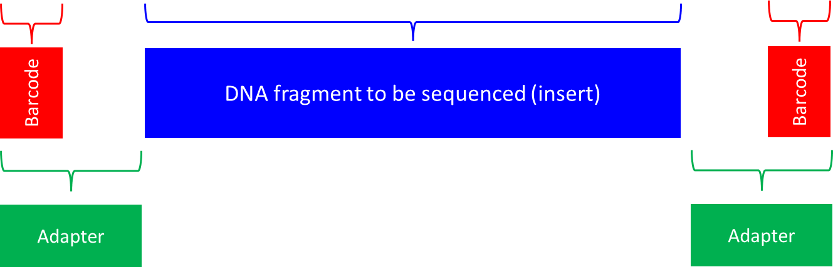
What are sequencing adaptors and barcodes?
Insert (Blue):
This is the segment of the DNA/RNA to be sequenced.
Adaptors (Green):
Function: Adaptors are synthetic DNA sequences added to the ends of the insert. They serve crucial purposes:
Binding to the Sequencing Platform: Adaptors contain sequences that are complementary to the oligonucleotides (oligos) present on the sequencing flow cell. This allows the DNA fragments to attach to the sequencing machine.
Priming Sites: They provide priming sites for the sequencing primers, enabling the initiation of the sequencing reaction.
Structure: Typically, adaptors have a structure that includes the following components:
Binding Region: Sequences that hybridize with the oligos on the flow cell of the sequencing machine.
Index or Barcode Region: Unique sequences that differentiate between different samples.
In DNA sequencing, multiplexing puts DNA fragments from different samples together for sequencing, and de-multiplexing sorts out the sequenced DNA reads back into their original samples for analysis. Index or barcodes are used for multiplexing and de-multiplexing.

Slide 8
Trimming & Cleaning Reads – Approach A (Trimmomatic)
Trimmomatic: A widely used tool to trim adapters and low-quality bases from reads. It can process paired-end data, ensuring both reads in a pair are retained or removed together.
Quality Control and Trimming of NGS sequences - Pseudo Tribulations
How it works: Uses a combination of operations – e.g., ILLUMINACLIP to remove adapter sequences (requires adapter FASTA file), SLIDINGWINDOW to trim once average quality in a window falls below threshold, and MINLEN to drop very short reads. Options also exist to trim poor-quality bases from the start or end (LEADING/TRAILING).
Quality Control and Trimming of NGS sequences - Pseudo Tribulations

Slide 9
Trimming & Cleaning Reads – Approach B (fastp)
Fastp: A fast, all-in-one tool that automates adapter trimming, quality filtering, and per-read quality cutting[5]. It’s lightweight (no Java needed) and very user-friendly.
OpenGene/fastp: An ultra-fast all-in-one FASTQ preprocessor (QC/adapters/trimming/filtering/splitting/merging...)
How it works: Fastp can find and remove adapters automatically without needing a provided adapter file. It also trims poly-G tails from newer Illumina machines by default (those appear as long G strings in NextSeq/NovaSeq reads).
Trimming reads and removing adapter sequences and polyG tails | Speciation & Population Genomics: a how-to-guide

Slide 10

Post-trimming Quality Check
Re-run FastQC: After cleaning, it’s good practice to run FastQC on your trimmed files to verify improvements. You may notice reads are shorter now but with a better quality. This is expected because low-quality ends and adapter sequences were removed. FastQC might flag “Sequence Length” as varying (a warning) – that’s normal after trimming.
Sometimes all you need is to cut adapters
Re-run MultiQC: If you processed many samples, generate a new MultiQC report on the trimmed FastQC outputs. This will let you confirm all samples improved and identify any that still have issues.

Slide 11
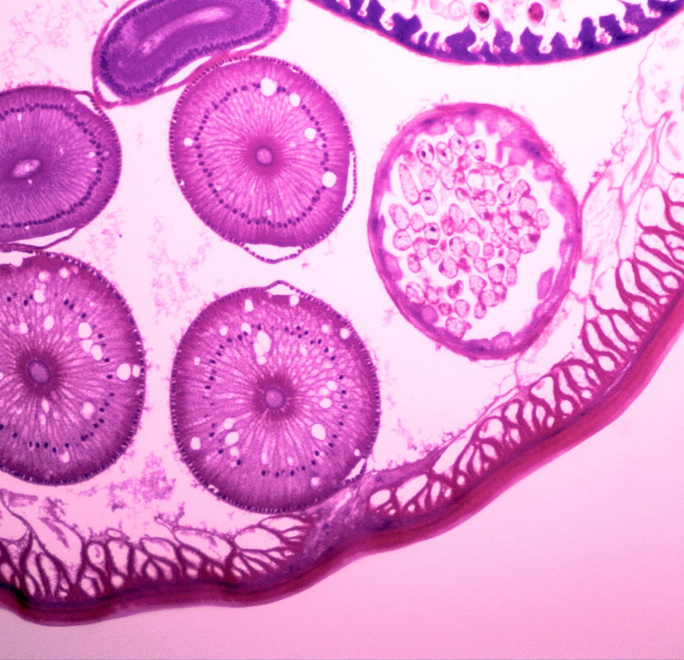
Species Identification with Kraken2
Why classify reads? After QC, we want to confirm what organism our data is from (and check for contaminants). In a typical scenario, reads from a pure culture should mostly map to the intended species. In more complex samples (metagenomes, or contaminated isolates), multiple species might be present.
Kraken2 approach: Kraken2 uses a k-mer database of reference genomes to classify each read by the lowest common ancestor match. It can handle millions of reads in minutes, using exact k-mer matching to known sequences.
Database: Requires a pre-built database (e.g., Standard Kraken2 DB or Bacteria DB).
Manual · DerrickWood/kraken2 Wiki

Slide 12
(Optional) Visualizing Taxonomy with Krona
Krona: A visualization tool that takes Kraken (or similar) output and creates an interactive multi-layered pie chart. Each ring of the pie corresponds to a taxonomic level, and you can zoom into sectors. It’s great for metagenomic community data, but also useful to show minor contaminants in what should be a pure sample.
Using Krona on Kraken2 results: We can convert Kraken’s report to a Krona chart using the ktImportTaxonomy script (comes with Krona Tools). For example: ktImportTaxonomy -t 5 -m 3 -o sample_krona.html sample.kraken2.report – This tells Krona which columns in our Kraken report contain the TaxID (-t 5) and the read counts (-m 3) It generates an HTML file where you can interactively explore the classification. Generating Krona plots from Kraken data | Microbiome binfies

