Slide 1


Bacterial Typing A practical guide using Vibrio cholerae and Mycobacterium tuberculosis
Arash Iranzadeh Ph.D.
University of cape town
September 2025

Slide 2

What is Bacterial Typing? Multi-Locus Sequence Typing | PubMLST
The process of classifying and distinguishing different strains of a single bacterial species, which is essential for:
Epidemiology: Tracing disease outbreaks to their source.
Pathogen Evolution: Understanding how bacteria spread and evolve.
Public Health: Monitoring important pathogens.
Typing Methods:
Phenotypic: Based on observable traits (e.g., serotyping).
Genotypic: Based on genetic makeup (e.g., MLST).

Slide 3

Vibrio cholerae
Pathogen: Causes cholera, a severe diarrheal disease.
Morphology: A gram-negative, comma-shaped bacterium.
Transmission: Spreads through contaminated water and food.
Global Impact: Caused multiple pandemics throughout history, still a major public health issue in many parts of the world.
CDC Yellow Book: :Kristen Heitzinger, Michael J. Hughes, and David C. Shih

Slide 4
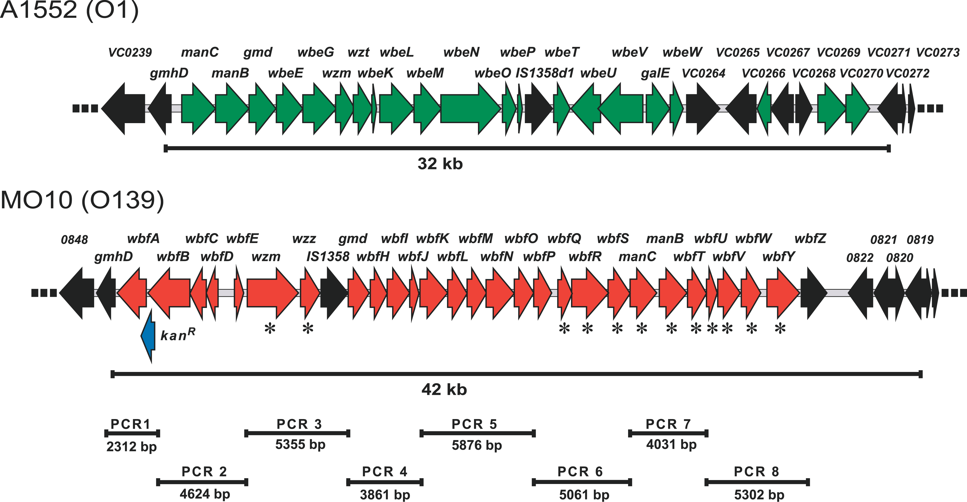
Serotyping for Vibrio cholerae
Definition: A typing method that classifies strains based on variations in the O-antigen part of the bacterial cell wall (lipopolysaccharide).
The serogroup of vibrio cholera is mostly determined by the O-antigen gene cluster (OAGC) on chromosome I of Vibrio cholera. Epidemiological Importance: For V. cholerae, the O1 and O139 serogroups are responsible for epidemic cholera. Rapid identification of these serogroups is crucial for public health surveillance.
Blokesch, Melanie, and Gary K. Schoolnik. "Serogroup conversion of Vibrio cholerae in aquatic reservoirs." PLoS pathogens 3.6 (2007): e81.

Slide 5

MLST for Vibrio cholerae
Definition: Multilocus Sequence Typing (MLST) is a genotypic method using sequencing data from seven housekeeping genes. Process:
Sequence fragments of the seven genes.
Each unique sequence is an "allele."
A unique combination of seven alleles is assigned a "Sequence Type" (ST).
Tools:
Ariba
Mlst (GitHub: tseemann/mlst). A fast and simple command-line tool that uses PubMLST databases to determine the ST directly from assembled genomes or raw reads.
FastMLST (GitHub: EnzoAndree/FastMLST).
Notes:
- Example issues: In this sample, quality drops into the warning/fail range by ~100 bp. This triggers FastQC warnings (yellow/red) indicating the run’s tail-end is low quality[3]. Such reads likely require trimming.

Slide 6

Mycobacterium tuberculosis (Mtb)
Morphology: An acid-fast, slow-growing bacterium with a waxy cell wall.
Transmission: Transmitted through airborne droplets.
Genetic Makeup: The Mycobacterium tuberculosis complex (MTBC) is highly clonal, meaning different strains have very little genetic variation.
Figure from:
https://www.yourgenome.org/theme/what-is-tuberculosis/

Slide 7
The Typing Challenge with M. tuberculosis
Standard MLST is Insufficient:
Due to the low genetic diversity of Mtb, standard 7-gene MLST lacks the discriminatory power to differentiate between strains effectively for outbreak tracing.
Whole-genome sequencing (WGS) is the standard for high-resolution Mtb typing.
Serotyping is Not Applicable: The waxy cell wall prevents effective serotyping based on standard surface antigens.

Slide 8
M. tuberculosis typing
Mycobacterium tuberculosis spoligotyping is a molecular technique that detects genetic variations within the Direct Repeat (DR) locus of the bacteria to classify strains into different lineages and study tuberculosis transmission.
Tools: TBProfiler

Slide 9
Summary
MTB is extremely clonal/monomorphic. The classic 7-locus MLST targets housekeeping genes that, in TB, are too conserved to separate strains meaningfully.
Little/no homologous recombination. MLST assumes allelic diversity across loci; TB mostly accumulates rare SNPs on a single clonal backbone. TB is routinely typed by SNP barcodes/lineages (e.g., TB-Profiler), or legacy spoligotyping and MIRU-VNTR—not MLST.
Is there a serotype or MLST scheme for TB? No, serotype is based on variable surface antigens (e.g., O/H antigens in Enterobacteriaceae or Vibrio). Mycobacterium has a waxy, mycolic-acid-rich cell wall and no standard serotyping system.
TB vs Vibrio: clonality & pangenome
TB (MTBC): Highly clonal, “closed” (or nearly closed) pangenome. Gene content is very stable; accessory genome is tiny.
Best analyses: reference-based mapping, core SNP phylogeny, lineage & AMR calling (TB-Profiler), outbreak SNVs.
Vibrio cholerae:
Recombining, diverse, “open” pangenome. Mobile elements (CTXφ, SXT), islands, plasmids, and variable O-antigen loci.
Best analyses: de novo assembly, QUAST, Prokka, Panaroo pangenome, MLST, O1/O139 serogrouping.
One-slide takeaway you can say aloud
“Use MLST/serogrouping for Vibrio cholerae (diverse, open pangenome).
Use SNP barcodes/lineage calling and reference-based SNP phylogeny for M. tuberculosis (clonal, near-closed pangenome).
Pangenome is informative for Vibrio, not very informative for TB.”

