Slide 1


Slide 2

Multi-Task Deep Model With Margin Ranking Loss for Lung Nodule Analysis
Lihao Liu et al.
MohammadHossein Amiri
Dr. Mousavi
Notes:
The main part of the paper that should be presented in a seminar is the proposal and detailed description of the Multi-Task Deep Model with Margin Ranking Loss (MTMR-Net) for automated lung nodule analysis. This includes the model architecture, which consists of a feature extraction module, a classification module, and a regression module. The utilization of residual blocks for feature extraction, fully-connected layers for classification and regression, and the incorporation of margin ranking loss to enhance discrimination capability for marginal nodules should be highlighted. Additionally, the training process using cross entropy loss, mean square error loss, and margin ranking loss, as well as the evaluation metrics such as accuracy, sensitivity, specificity, AUC for classification, and absolute distance error for regression should be presented. The results showing improved performance compared to state-of-the-art methods and the validation on the LIDC-IDRI dataset through five-fold cross-validation should also be emphasized.

Slide 3
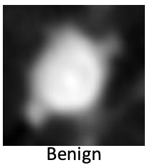
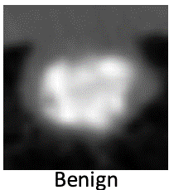
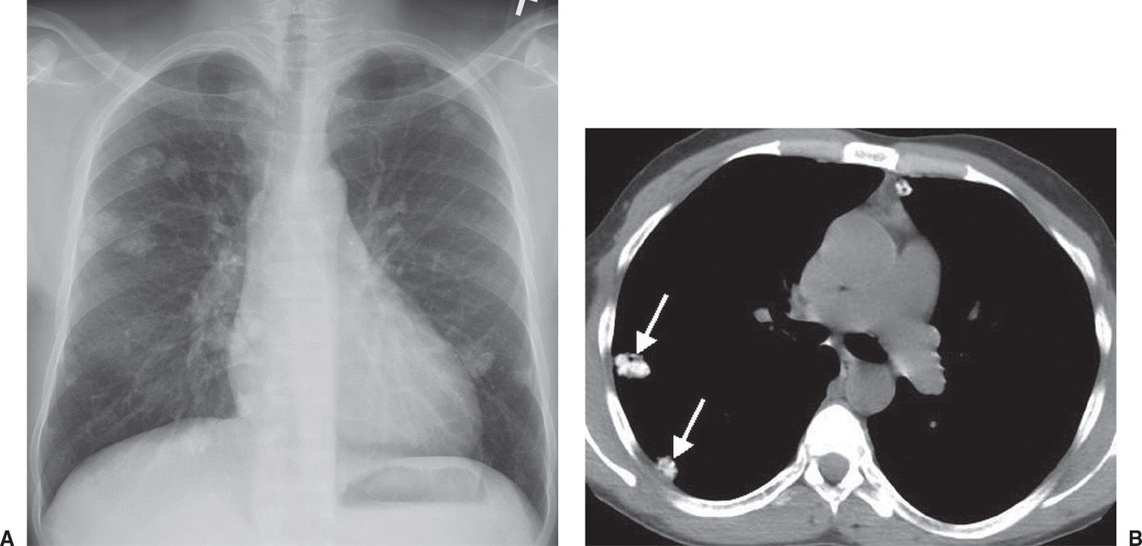
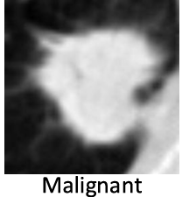
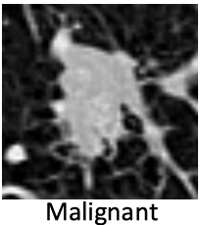
What is the Problem
subtlety, internal structure, calcification, sphericity, margin, spiculation, lobulation and texture.

Slide 4
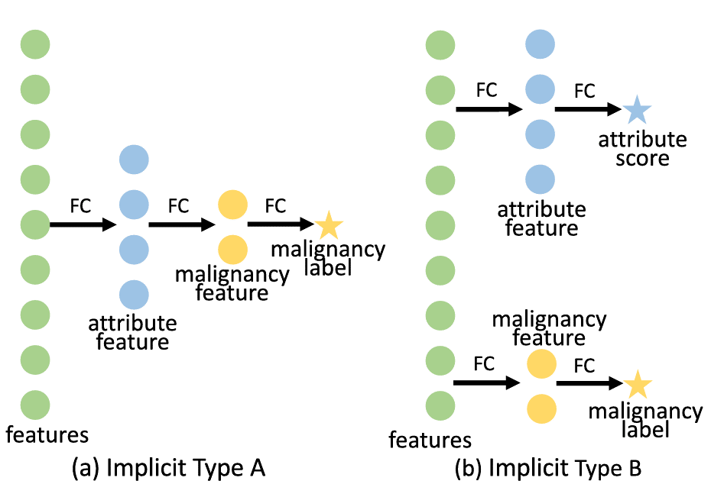
Hussein et al. 3D CNN-based multi-task learning framework
3D CNN-based multi-task learning framework to explore the internal relationship between malignancy and attribute score

Slide 5
The Main contributions
multi-task deep learning model which explicitly explores the relatedness between lung nodule benign-malignant classification and attribute regression in a cause-and-effect manner.
renowned Siamese network architecture
to better harness the heterogeneity of ambiguous lung nodules
validated our proposed framework on the public benchmark LIDC-IDRI dataset using 5-fold cross validation.

Slide 6
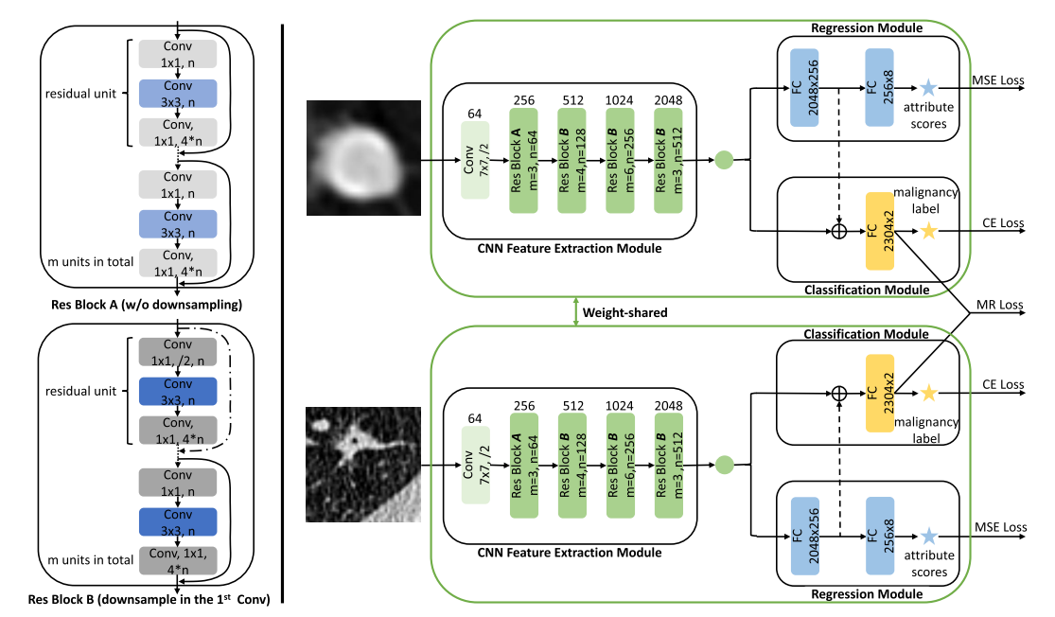
The schematic illustration of the proposed network
lobulation
spiculation

Slide 7




METHOD: Multi-Task Learning for Lung Nodule Analysis
1) Benign-Malignant Classification
cross entropy loss
2) Nodule Attribute Score Regression

Slide 8
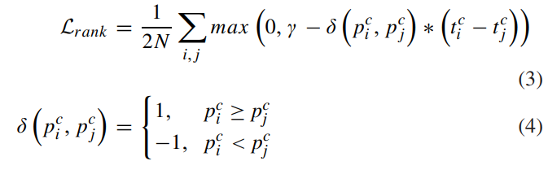

METHOD: Margin Ranking Loss for Discriminating Marginal Nodules

Slide 9

EXPERIMENTS
LIDC-IDRI Dataset
Five-Fold Cross Validation
1018 CT scans
1422 lung nodules
randomly split the data into 5 folds
972 benign
250 lung nodules
450 malignant
150 epochs using the Pytorch library
3 to 30 mm (3 to 30 slices)
γ = 1e-1
grid-search $→$ λ, β, $η$ as 1, 5e-1, 1e-3
9520 2D slices (6221 benign and 3299 malignant 2D slices).
rated from 1 to 5

Slide 10
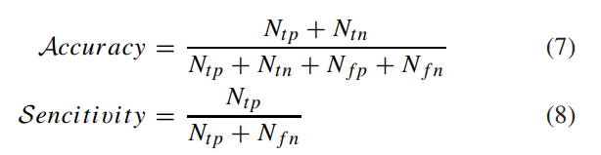
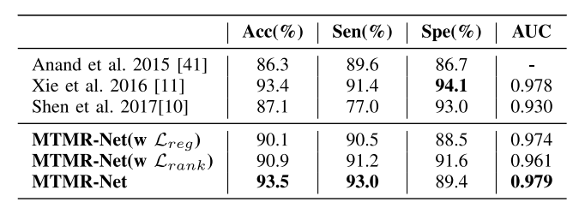

Evaluation Metrics

Slide 11
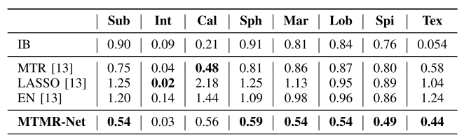
Evaluation Metrics

Slide 12
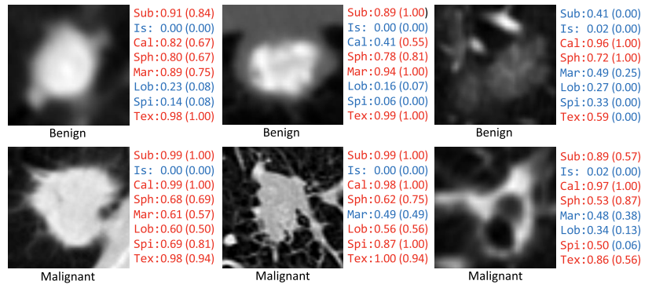
Evaluation Metrics

Slide 13
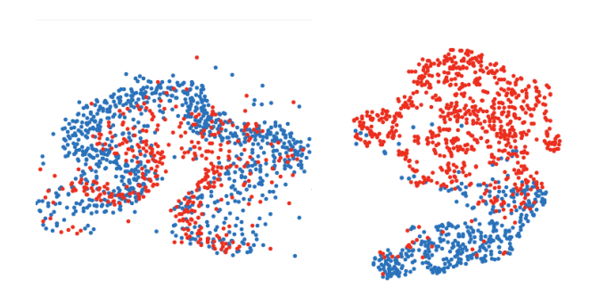
t-SNE visualizations

Slide 14
THE END

