Slide 1


BCDV 1010
Smart Contract Development Essentials
2023 January
week 02 - class 10
 | BCDV 1010 Smart Contract Development Essentials | Pratik Patil

Slide 2
Contract Debugging & Testing
 | BCDV 1010 Smart Contract Development Essentials | Pratik Patil

Slide 3
What is a Truffle?
A development environment, testing framework and asset pipeline for blockchains using the Ethereum Virtual Machine (EVM), aiming to make life as a developer easier
Installation Guide:
https://trufflesuite.com/docs/truffle/how-to/install/
 | BCDV 1010 Smart Contract Development Essentials | Pratik Patil

Slide 4
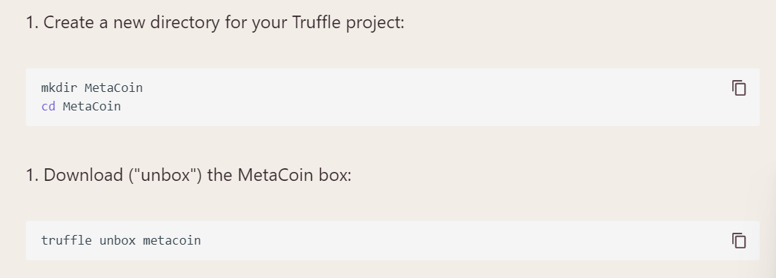
Create a Project
 | BCDV 1010 Smart Contract Development Essentials | Pratik Patil

Slide 5
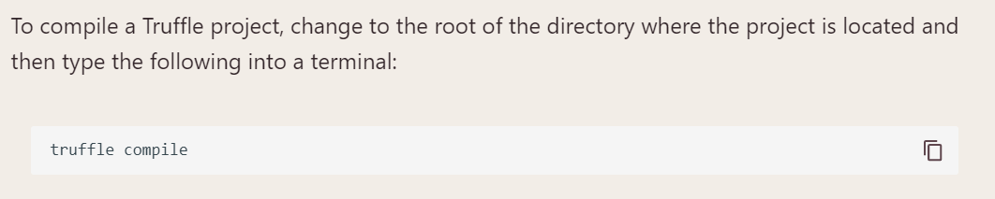
Compile a Project
 | BCDV 1010 Smart Contract Development Essentials | Pratik Patil

Slide 6
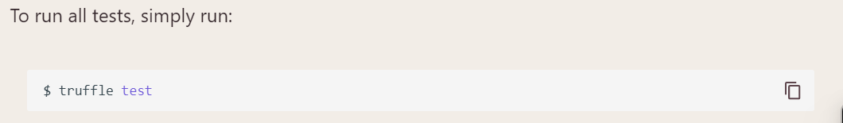
Running the Tests
 | BCDV 1010 Smart Contract Development Essentials | Pratik Patil

