Slide 1

Introduction
SOLIDITY
A BRIEF INTRODUCTION TO SOLIDITY
PROVIDERS
Arash Namaki , Mohammad Kamali Nasab
#
shamsipour technical and vocational college

Slide 2
#
WIKI
1
2
EXPLANATION
3-4
COMPILER
5
CONTRACT
6
SYNTAX
SYNTAX EXPLAINED
7
PROJECT
8

Slide 3
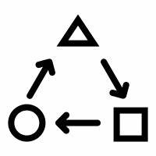


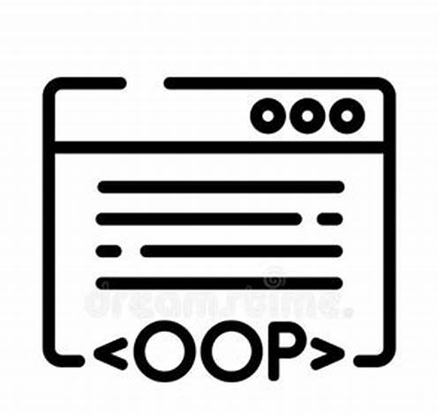




SOLIDITY
WIKI
Paradigm
Designed by
First appeared
Influenced by
OOP
Gavin Wood
August 2014
JS C++ Python
2014
2013
2015
1

Slide 4
SOLIDITY
EXPLANATION
a high-level programming language designed for developing smart contracts on the Ethereum blockchain.
2

Slide 5
SOLIDITY
COMPILER
Solidity is a compiled language. It compiles down to Ethereum Virtual Machine (EVM) bytecode, facilitating the execution of decentralized applications and automated agreements.
3

Slide 6

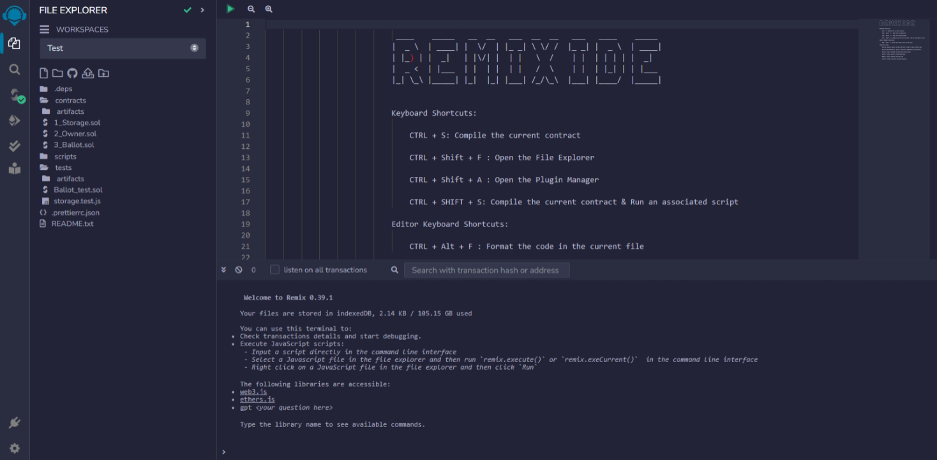


SOLIDITY
COMPILER
Remix
Truffle
Hardhat
Ethereum Virtual Machine IDE, Remix
4

Slide 7



SOLIDITY
CONTRACT
A smart contract is a self-executing agreement with the terms of the contract directly written into code.
5

Slide 8
SOLIDITY
SYNTAX
// Solidity version declaration
pragma solidity ^0.8.0;
// Contract definition
contract SimpleContract {
// State variable
uint256 public value;
// Event declaration
event ValueUpdated(uint256 newValue);
// Function to update the value
function updateValue(uint256 newValue) public {
value = newValue;
emit ValueUpdated(newValue);
}
}
// Function to update the value
function updateValue(uint256 newValue) public {
value = newValue;
emit ValueUpdated(newValue);
6

Slide 9
SOLIDITY
SYNTAX EXPLAINED
Pragma solidity ^0.8.0;: This line specifies the version of Solidity that the contract should use.
Contract simplecontract { ... }: This is the declaration of the smart contract named Simple Contract.
Uint256 public value;: This line declares a state variable value of type uint256 (unsigned integer) that can be accessed publicly.
Event valueupdated(uint256 newvalue);: This line declares an event named ValueUpdated, which can be emitted when the value is updated.
Function updatevalue(uint256 newvalue) public { ... }: This is a function named updateValue that takes a parameter newValue and updates the value with the new value. It also emits the ValueUpdated event.
7

Slide 10
SOLIDITY
PROJECT
SOLIDITY SIMPLE PROJECT
8

Slide 11
THANK YOU

