Slide 1

WP8 Data Management and Robotics Reproducibility Italian Institute of Technology TERRINet Meeting, Bucharest 20-2019

Slide 2
OUTLINE
Test in industry
Our proposal
Current state

Slide 3





THE CAST
The developer
The researcher
The tester
The integrator
The software bug

Slide 4
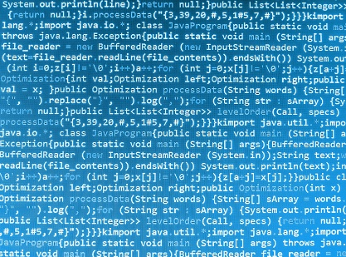


TESTING IN A ORGANIZATION USING WATERFALL METHODOLOGY
Dev team
Test or Integration team
software is released
Cons: slow feedback and conflictual collaboration.

Slide 5
TESTING IN ORGANIZATION USING AGILE METHODOLOGY
Agile team
Pro: fast feedback and good collaboration.

Slide 6
TESTING IN RESEARCH
Pro: very fast feedback and very good collaboration (!). Cons: the bug is still there.

Slide 7




TESTING IN BIG ORGANIZATION USING WATERFALL METHODOLOGY
Customer projects teams
Customer service team
Customer
Dev team
Integration team
Test team

Slide 8
TESTING STRATEGIES
Developer
Tester/Integrator
Researcher
Unit test
Code review
Peer programming
Feedback from tester
Subsystem test
Subsystem test
System test
(Unit test)
(Code review)
Automatic or manual test
Automatic or manual test
Automatic or manual test
TESTING TOOLS
cppunit, cpptest …
Colaborator, visual studio …
Simulators/Emulators
Simulators/Emulators
cppunit, cpptest …
Colaborator, visual studio …
Simulators/Emulators

Slide 9




WHAT IS A TEST CASE?
New feature
Agree with test case
Step | Step prerequisite | Final step check
Turn the robot on. | Unpack the robot from the box. | The green light turn on.
Execute ROS. | Install ROS. | The ROS icon is on the desktop.
… | … | …
Execute move API. | Robot stand up and is ready. | Check if robot CoM is 1 meter away.
Write some tests case
Execute the test by
hand or with a
automatic tool
Store the tests case

Slide 10
TEST MILESTONES
Tester/Integrator point of view
Developer/Researcher point of view
Easy to write
Easy to use
Easy to repeat
Easy to store/catalog
Easy to log
Easy report
Automatic
Possibility of doing parametric test
Possibility to impose preconditions
Possibility to impose postconditions
No need to debug the test
Natural language (test case)
Flexibile
Easy to write
Easy to use
Easy to repeat
Easy to log
Automatic
Can be extended
Can be complex

Slide 11


PROPOSAL – TEST WRITING
KEEP IT SIMPLE
Test
case
Blocks library:
each block is an action
Create the test from the small blocks

Slide 12

PROPOSAL – TEST EXECUTION
KEEP IT SIMPLE
Preconditions/Postconditions
Launcher
Test
Scenario

Slide 13
ACTIONS/BLOCKS
KEEP IT SIMPLE
Send position to joint
Each block is a predefine
action
Wait
Check position
Check if robot is vertical
Action libraries
Generic actions
Wait
Update file
Execute
Yarp actions
SendDirectPosition
SetVelocity
CheckIfRobotIsVertical
ROS actions
SendDirectPosition
SetVelocity
CheckIfRobotIsVertical
Custom actions
Walk
SendWrench
CheckCOM
Other middleware actions
…
…
…
Product
Developed by IIT
Developed by xxx
Developed by researcher
Developed by xxx

Slide 14
EASY TO WRITE
Test case in
natural
language
Close to natural language
Blocks library
each block is an action
Create the test from the small blocks

Slide 15
REPEATABILITY
THE SMALL BLOCKS ARE ALWAYS THE SAME
Blocks library
Create the test from the small blocks

Slide 16
ADVANCED TEST
Create your specialized block or blocks library
Create the test from the small block

Slide 17

PARAMETRIC
Parametric infos
Blocks library
Parametric test
Repeat the same test with different parameters.

Slide 18
FIXTURE-PREREQUISITE
Choose prerequisite
Launcher
Test
Choose scenario

Slide 19
REPORT & STORAGE
Test execution
Launcher
Test
Tests report storage area
Tests storage area

Slide 20
LOGGING
Test execution
Launcher
Test
Logging
i.e. logging joint position info.

Slide 21
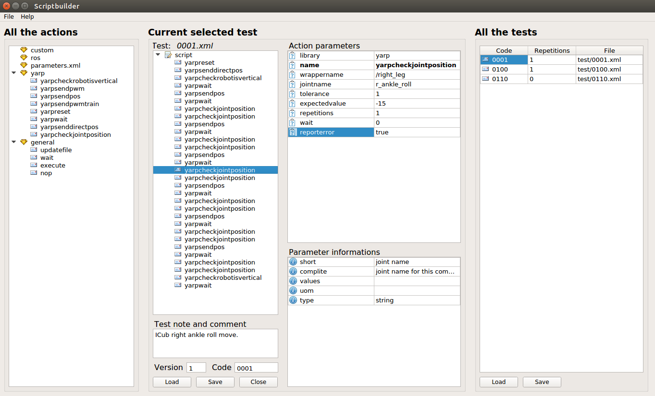

USEFUL – SCRIPT BUILDER
Test case in
natural
language
Blocks library
each block is an action
Write test

Slide 22
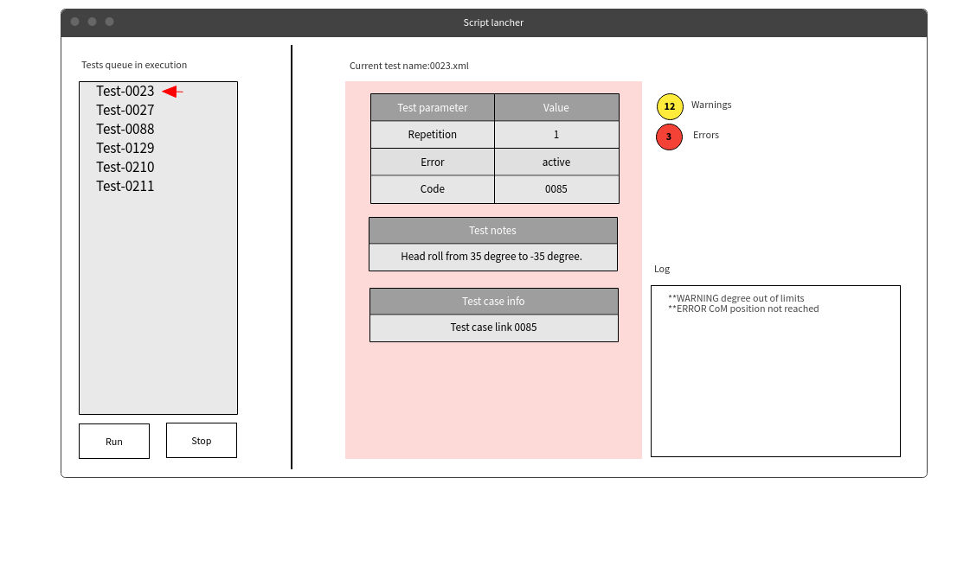
USEFUL – SCRIPT LAUNCHER
Test

Slide 23
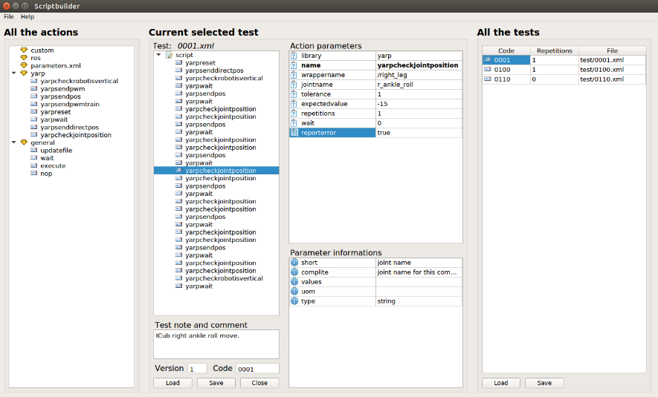
FUTURE – GENERATE TEST CASES
Test case
in natural
language
Test case
Write test
Scriptbuilder
Test

Slide 24


MAGIC – TRANSLATE NATURAL LANGUAGE TO TEST LANGUAGE
Test case
in natural
language
Generate test
Magic-machine
Write test
Test
Scriptbuilder

Slide 25

TECHNOLOGY
Topic | Technology
Makefile system | CMake 3.5
Back-end development | C++17
Clients development | Qt5
Version control system | git
Test language | xml
O.S. | Linux/Windows/Mac/Android(only clients)
Repository | github

Slide 26
SOFTWARE CURRENT STATUS
General requirements | Progress | Status | Note | Complexity
Test language syntax definition | 100% | In use | Some extension could be added. | Low
Base test application | 90% | In use | Some refactoring still need. | High
Parametric test | 70% | In use | Some refactoring still need. | Medium
Yarp integration | 50% | In use | Only some features added. | High
Custom test integration | 50% | In use | Some tests need. | Low
ROS integration | 0% | Not in use | To be developed. | High
Other framework support | 0% | Not in use | To be developed. | --
Script builder UI | 90% | In use | Some minor missing | High
Launcher UI | 0% | Not in use | To be developed. | Medium
Report generation | 50% | In use | Increase usability. | Low
Statistics | 0% | Not in use | To be developed. | Low
Logging generation | 30% | In use | Increase flexibility. | Low
Report-Logging-Chart UI | 0% | Not in use | To be developed. | High
Portability | 30% | Not in use | OS:Windows should be analyzed. | High

