Slide 1
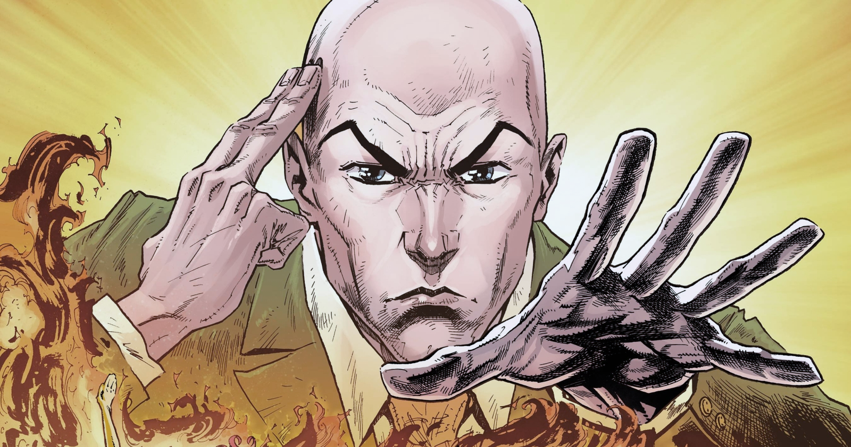
Control of differential mobile robot using EEG and EMG signals
by
Nishant Pratap Singh
Lalit Sharma
Mayank Kumar
Aditya Bhargava
Arashdeep Singh
Prachi Kaushal
Team DEEWANE

Slide 2
Objective
1. Moving the robot left or right using EEG (motor imagery)
2. Stopping the robot using EMG (Jaw clenching)

Slide 3
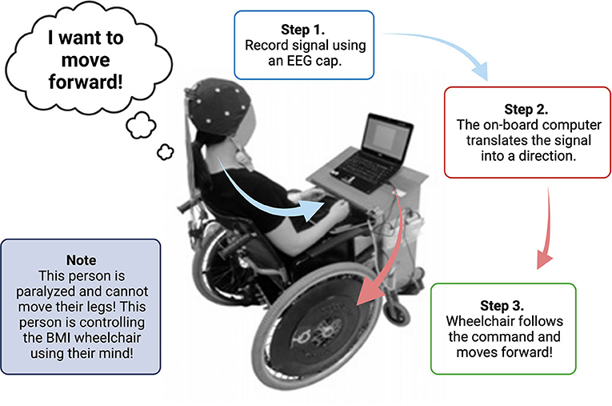
Motivation
We aim to implement this idea on a wheel chair for a person with paralysis (below head) restoring their independence and mobility.

Slide 4
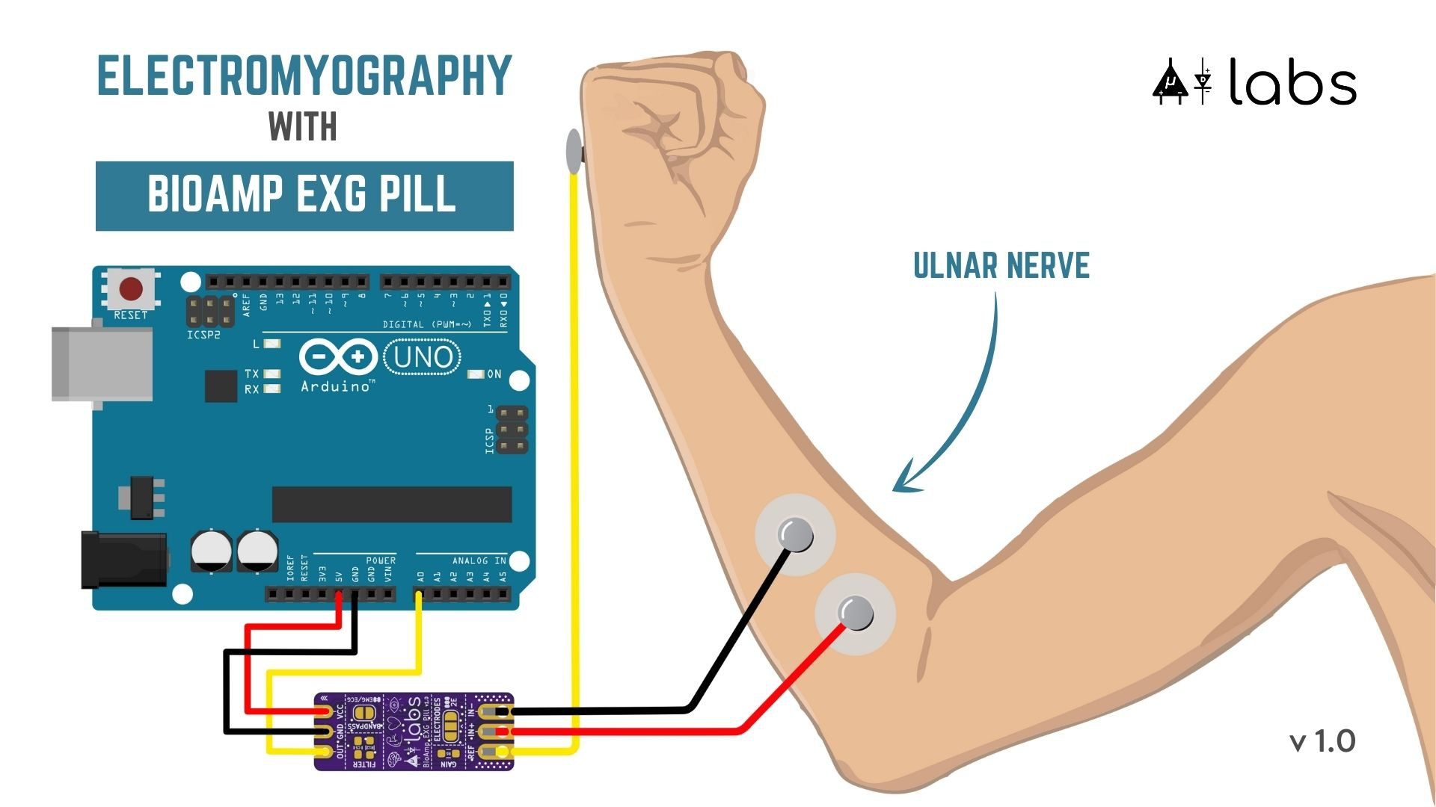
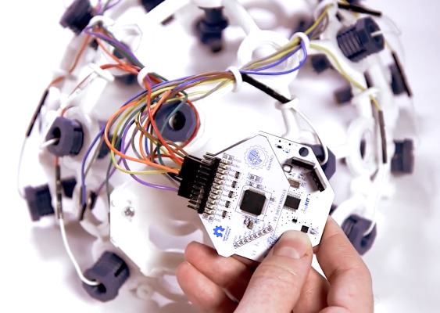
Method
EMG (Jaw Clenching) EEG (Motor Imagery)

Slide 5
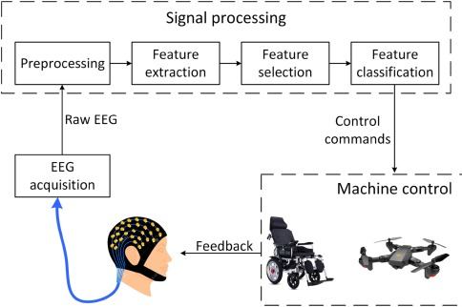
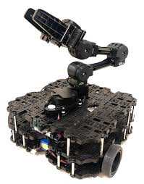
Pipeline

Slide 6
Pipeline
Data Acquisition (EEG + EMG)
Preprocessing (EEG)
Bandpass filter (8-30Hz- mu band)- PSD
Model Training
Random Forest classifier
Testing
Accuracy- 78%
Model Deployment on robot

Slide 7
Demo & Results

Slide 8
Limitations
Big dataset required to train the model.
Enough User’s training required with visual feedback.
Time constraint

Slide 9
Big Thanks to
NEURO-TECH Society, CBSA, SAIDE, IITJ

