Slide 1

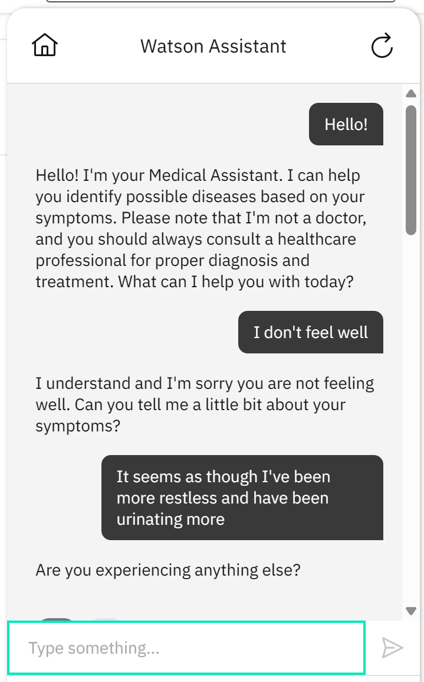
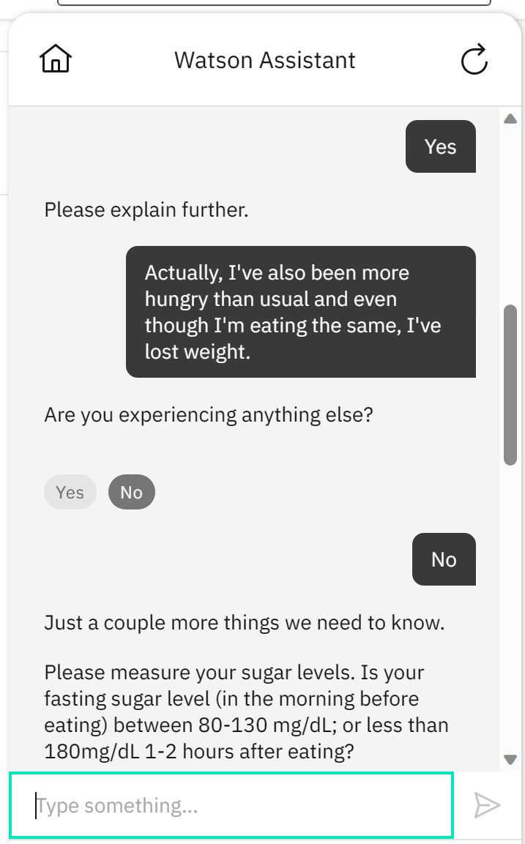
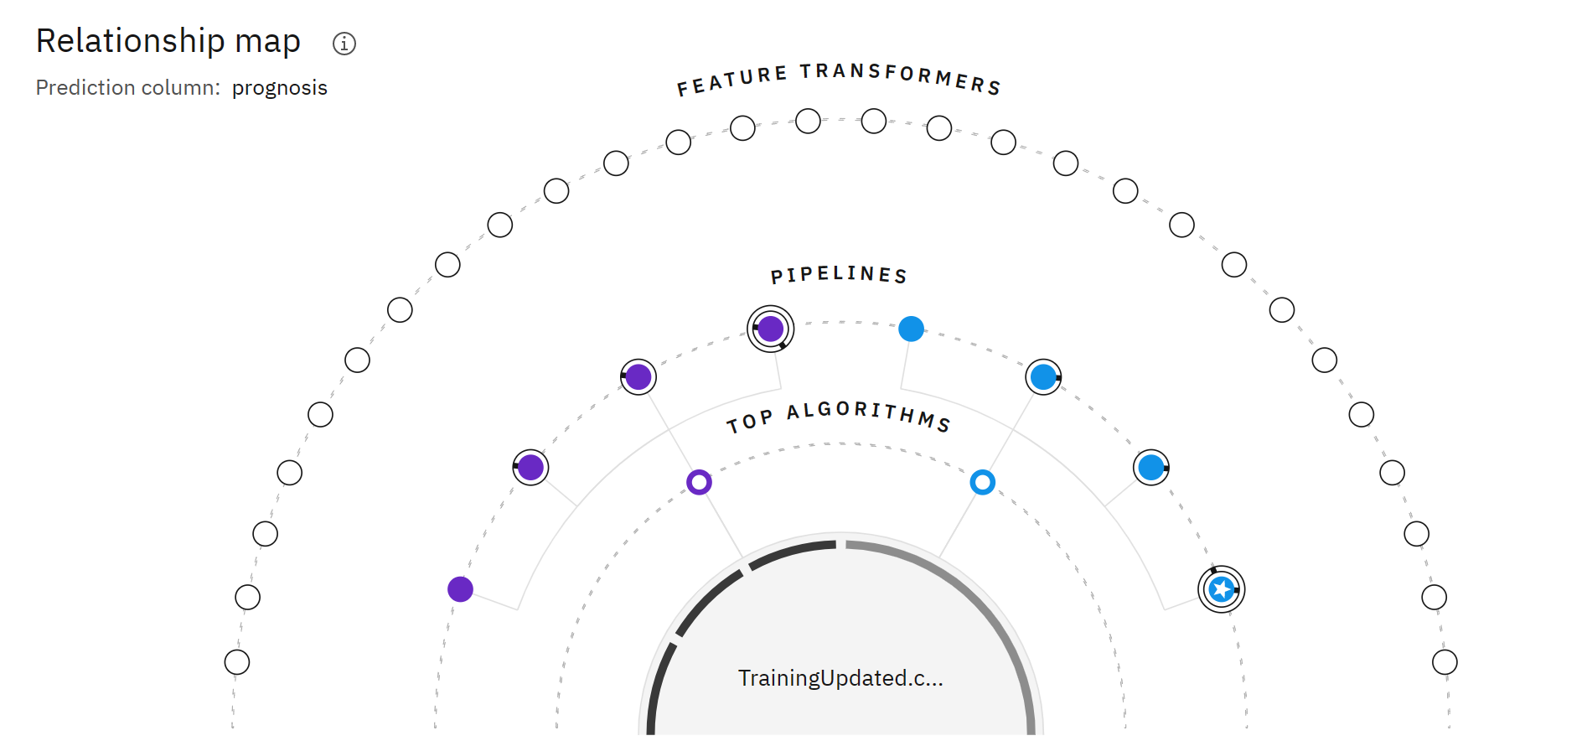
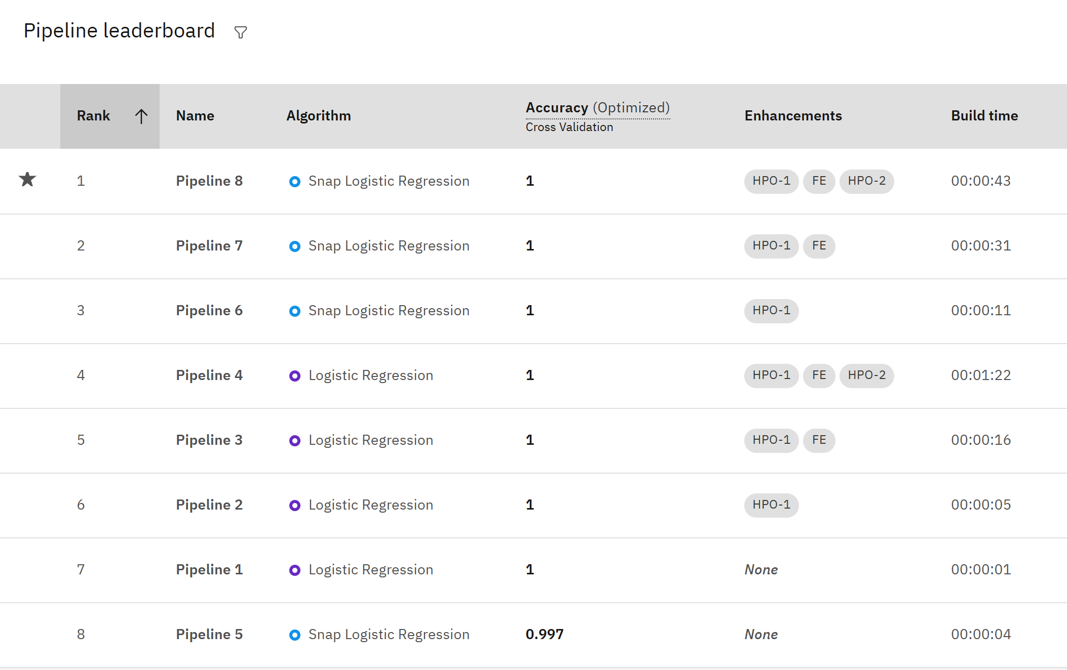
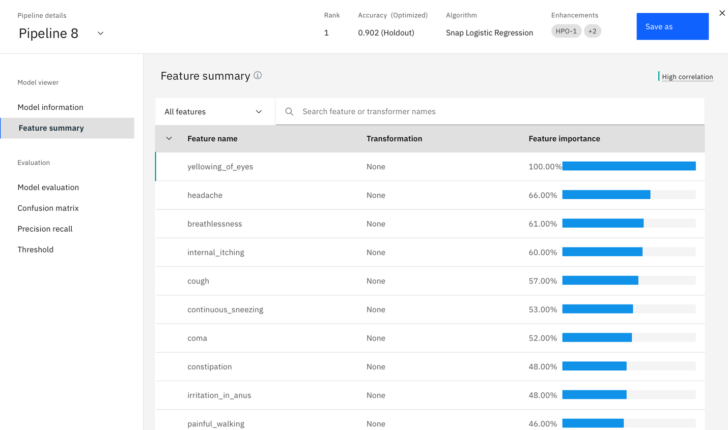
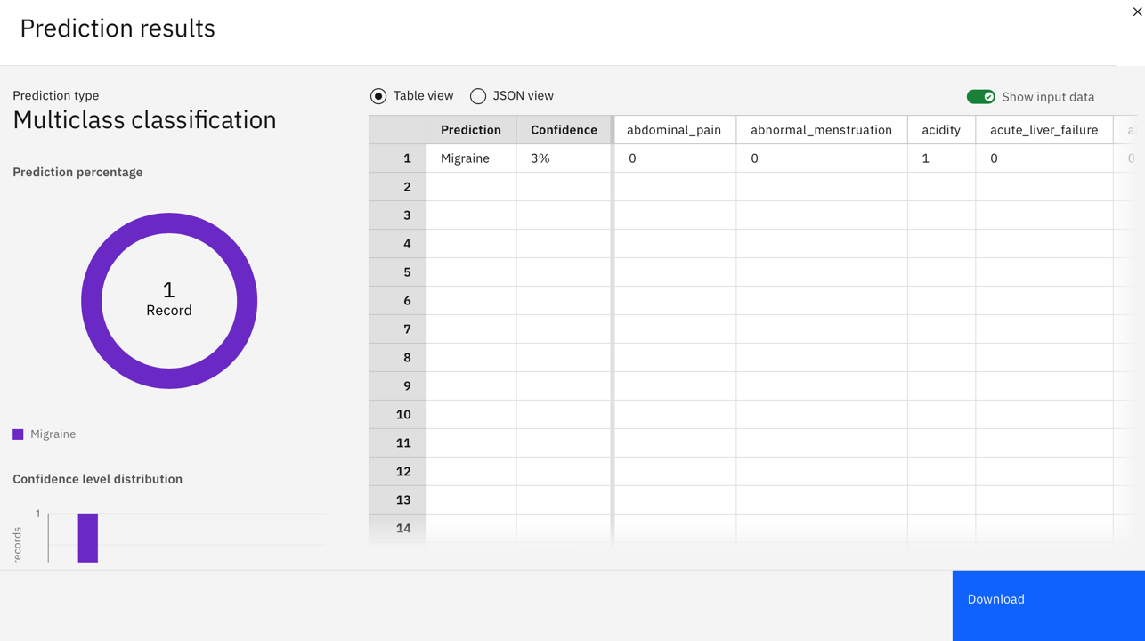
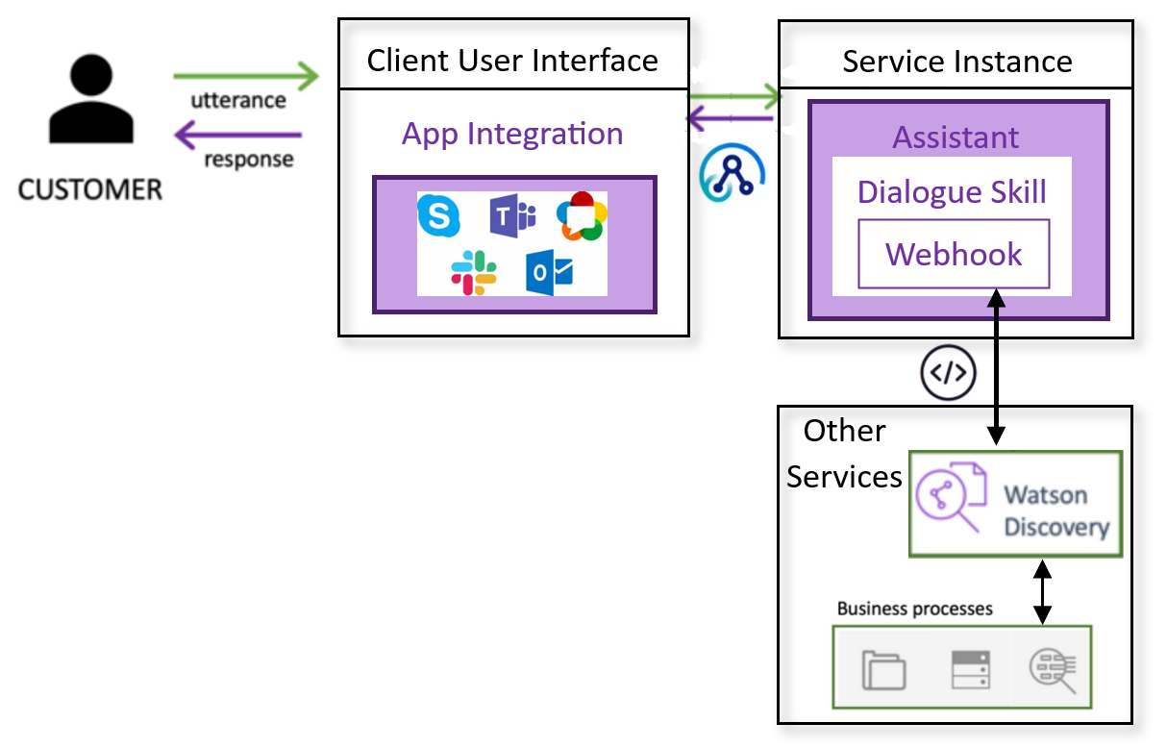
Medical Assistant Instant Medical Advice Contributors: Athina Cordero, Thomas Cruz, Phillip (Arash) Mirian
Business Intelligence & Analytics
Med Assist Chatbot
Analysis
Architecture
Methodology & Architecture
Impact/Goal
People in rural areas have several healthcare related issues that are unique and difficult to address.
Smart phones are ubiquitous with >80% use in the United States. We can leverage the use of a chatbot through an app to access these individuals to provide the right care at the right time for the right person.
For the user: this intelligence can communicate naturally to provide affordable healthcare access despite education, age, location or internet access.
For the healthcare system: this can more economically service their communities meanwhile leveraging data and information from many reputable facilities across the country.
Impact & Purpose
Customer naturally interacts with system via secure app that integrates with WA
Key/value pairs are recognized in dialogue of WA
3. These are passed to WS via webhook triggering
a cloud function action which performs an API
call to WS ML model
ML classification model created from highest accuracy pipeline trained on preprocessed data
5. Highest accuracy prognosis and corresponding
precaution guidance returned through cloud
function and integration to customer
Data & Scope
The data was sourced from Kaggle and contains information on diseases, their symptoms, and precautions to be taken.
The dataset was preprocessed and cleaned by the provider
There are a total of 135 symptoms accounted for in the data for over 40 prognoses.
Chronic diseases are the most prevalent and modifiable types of diseases. This proof of concept will demonstrate the ability to predict one of these diseases, in particular diabetes.
Data & Scope
Future Scope
Improve the classification model with more data from multiple healthcare institutes across the country.
Look to develop partnerships that can draw on specialty devices such as remote blood pressure or heart rate monitoring, or activity tracking to expand the breadth and depth of data improving the accuracy through our app.
Future Prospects
http://www.stevens.edu/school-business/masters-programs/business-intelligence-analytics

