Slide 1
STEMQUEST
Making STEM learning
feel like an adventure.
✦
LEARN
PLAY
GROW
A gamified learning platform that combines interactive lessons, educational games, simulations and a secure-ready data design.
16 lessons
30 activities
6 STEM worlds
interactive content
practice + play
subjects
PROJECT EXPO PRESENTATION
A browser-ready demo today.
A secure Supabase path for tomorrow.
Team Name: Dev Duo
Team Members: Adrija Saha • Arasi Irini
M.Tech AI & ML • Interactive STEM Learning Platform
Demo • Data • Discovery

Slide 2
THE CHALLENGE
Why STEMQuest matters
Learning works better when students actively try, receive feedback and see their progress.
01
02
03
Passive learning
Low practice motivation
Limited learning visibility
Many STEM lessons feel abstract when learners only read or listen.
Repeated worksheets may not provide an immediate sense of progress.
Teachers need a clear and safe way to understand activity progress.
Our response: turn a lesson into a short learning loop — explore → try → understand → progress.
Explore
→
Try
→
Understand
→
Progress
Choose a world
Solve a task
Read feedback
Earn new mastery
STEMQUEST • DEV DUO
2

Slide 3
THE SOLUTION
STEMQuest at a glance
A learner-first platform designed to make STEM concepts interactive, visible and motivating.
16
30
6
2
lessons across levels
learning activities
STEM subject worlds
science simulations
Learn
Play
Explore
Grow
short lessons • multiple activity types
robot maze • fraction games
gravity • circuits • code
XP • streaks • achievements
A simple promise
“Every interaction should either teach, motivate, or help the learner reflect on progress.”
STEMQUEST • DEV DUO
3

Slide 4
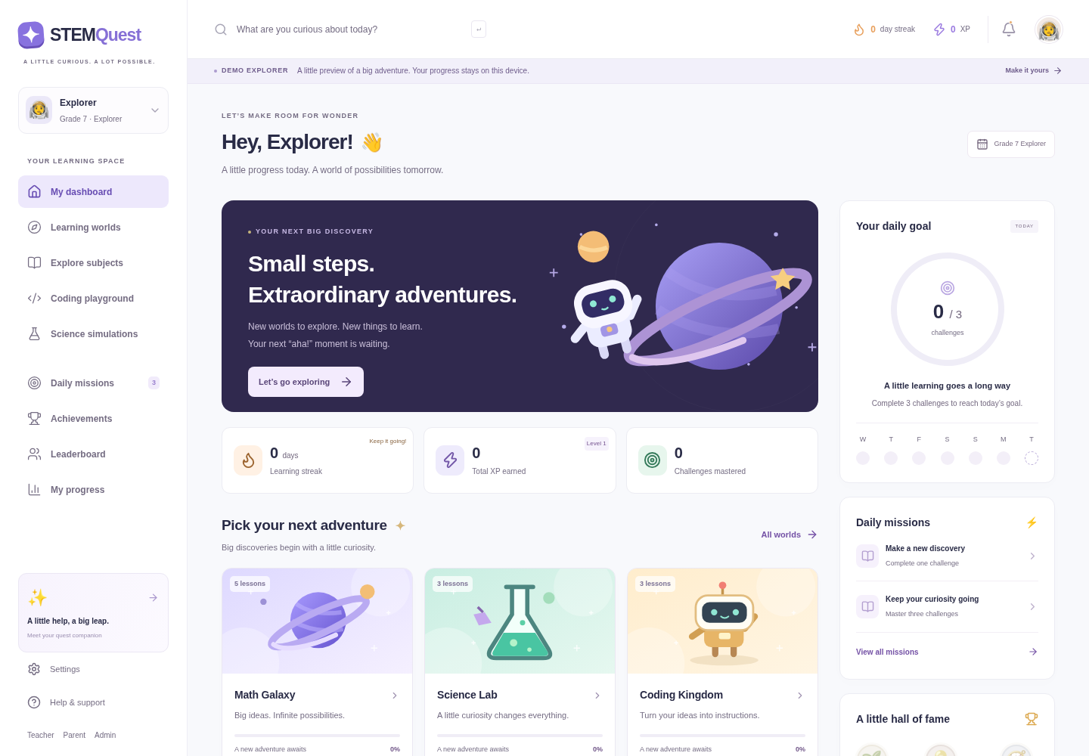
PRODUCT EXPERIENCE
A dashboard that makes progress visible
Real screenshot from the working STEMQuest demo.
What the dashboard communicates
Clear learner identity and navigation
XP, streak and daily mission cues
Subject worlds and next learning action
Progress-oriented cards without overwhelming the learner
Design principle: make the next learning step obvious.
LIVE DEMO • learner dashboard
STEMQUEST • DEV DUO
4

Slide 5
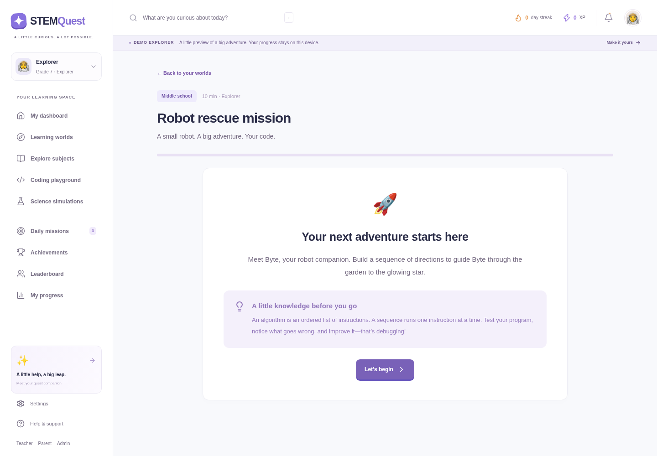
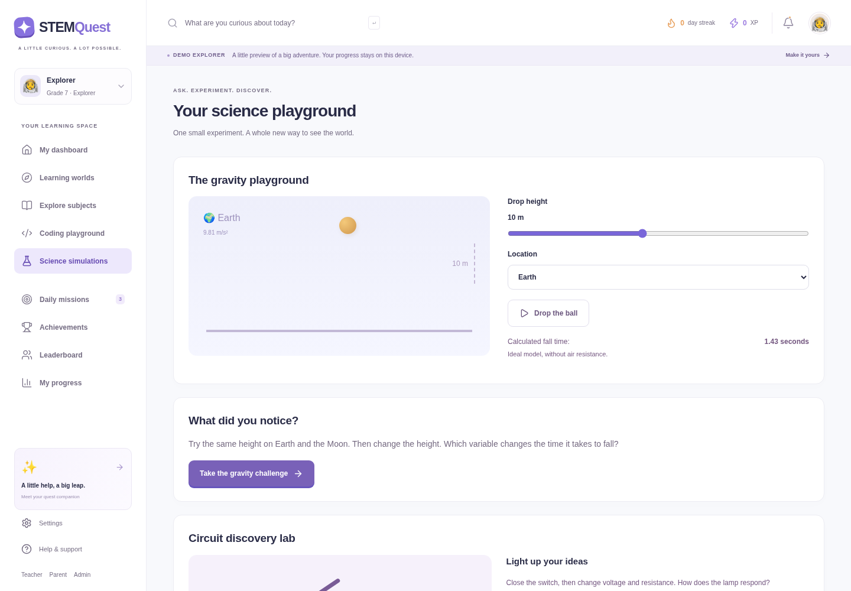
LEARNING BY DOING
Lessons, games, simulations and safe code practice
Different activity formats keep concepts active and memorable.
ROBOT RESCUE • sequencing + debugging
CIRCUIT LAB • ideal DC experiment
Games
Fraction fuel + matching
Simulations
Gravity + circuits
Safe coding
Restricted Python loops
STEMQUEST • DEV DUO
5

Slide 6
HOW IT WORKS
One learning cycle, from curiosity to progress
Example: a learner completes a robot maze activity.
1
2
3
4
5
Choose
Learn
Try
Check
Grow
Open a subject or lesson
→
Read a concise concept
→
Solve quiz / game / simulation
→
Receive instant feedback
→
New XP, progress and streak data
Behind the screen
LessonPlayer
→
engine.ts
→
award()
→
Insights
shows the activity
validates demo answer
updates XP + coins
shows progress views
The browser demo gives immediate learning feedback. When a user is connected, the same action can be validated by protected Supabase database logic.
STEMQUEST • DEV DUO
6

Slide 7
SYSTEM ARCHITECTURE
Two paths: ready-to-run demo and secure-ready connected mode
The project is intentionally honest about local demo storage versus server-backed records.
Student / Teacher / Admin
Next.js + React UI
Learning engine
uses browser UI
components + navigation
answer + reward logic
DEMO MODE
CONNECTED MODE
localStorage
Supabase client
PostgreSQL RPC + RLS
Public & private schemas
device-local progress
Auth + safe calls
server validation
records + answer keys
Optional Edge Functions
reminders • tutor • account actions
Security idea: the browser never holds private answer keys or server secrets. In connected mode, the database checks identity, permissions and rewards.
STEMQUEST • DEV DUO
7

Slide 8
TRUST BY DESIGN
How the connected backend protects learning data
The source includes production-oriented database design; live setup still needs verification.
Profiles
learner settings + role
student / teacher / guardian / admin
Learning progress
completed activity records
read only by authorised scope
XP transactions
one reward per activity
unique database constraint
Private answer keys
correct answers
not directly exposed to browser
Classes + memberships
teacher / learner relationships
RLS + protected functions
Custom lessons
admin authored content
validated publish/save RPC
Key security controls
RLS narrows which records a signed-in person can read.
Database functions validate answers and calculate rewards.
Private schema keeps answer keys and service logs away from browser tables.
STEMQUEST • DEV DUO
8
Edge Functions are the place for secret-provider actions, not React code.

Slide 9
CORE FEATURE SET
What makes the learning experience feel complete
Built around small wins, meaningful feedback and a friendly space-adventure visual language.
✦
Adaptive-feeling journey
✦
Immediate feedback
Levels, subject filters, search and recommendations guide learners toward suitable content.
Correct/wrong responses include explanations, hints and a clear next attempt.
✦
Motivation signals
✦
Role surfaces
XP, coins, streaks, daily missions, progress views and achievements reinforce consistency.
Teacher, guardian and admin interfaces demonstrate an extensible learning ecosystem.
Design choice: gamification supports learning progress — it does not replace learning content.
STEMQUEST • DEV DUO
9

Slide 10
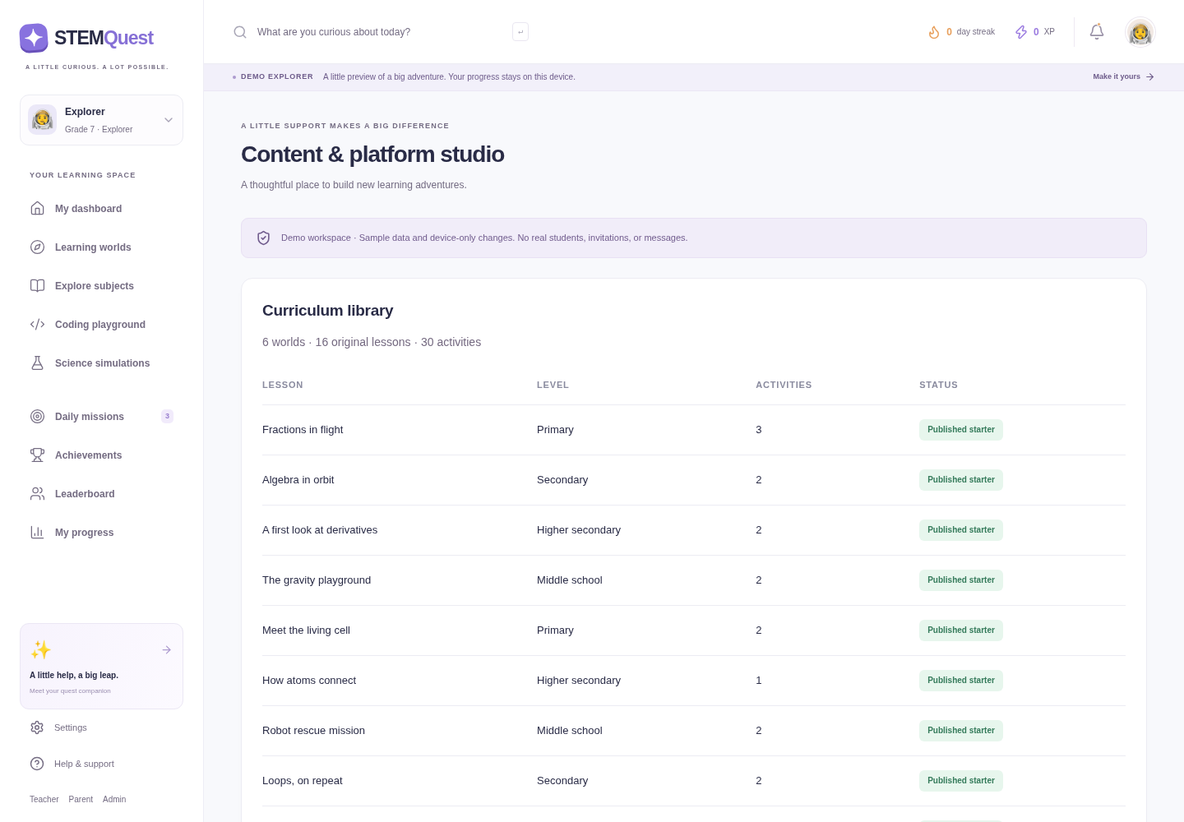
EXTENSIBLE LEARNING ECOSYSTEM
Beyond the learner screen: teacher, guardian and content tools
The demo shows the workflow locally; real multi-user roles need Supabase configuration.
Teacher view
Create a class, assign lessons and see authorised class progress.
Guardian view
A designed path for linked learner summaries.
Admin view
Content studio for controlled lesson authoring and publishing.
Why it matters: a platform becomes more useful when learning data can support the learner, educator and administrator — with clear permissions.
ADMIN STUDIO • create, edit, draft or publish a one-question lesson
STEMQUEST • DEV DUO
10

Slide 11
WHY STEMQUEST IS DIFFERENT
A thoughtful combination, not just a quiz app
Its value comes from how learning interactions, motivation and data design work together.
01
A real demo from day one
02
Learning-first gamification
No API key is needed to demonstrate the learning journey.
XP is tied to newly mastered activities, with explanations and no fake cloud claims.
Ready for expo / offline-style exploration
Motivation with academic purpose
03
Security-aware architecture
04
Multiple interaction styles
Private answer keys, RLS and protected RPCs show a serious production direction.
Games, simulations, quizzes and a safe coding exercise address different modes of engagement.
More than front-end mock screens
Not one repeated activity format
STEMQUEST • DEV DUO
11

Slide 12
TECHNOLOGY CHOICES
A modern stack chosen for clarity, interactivity and a path to scale
Each layer has a focused responsibility.
Experience
Next.js • React • TypeScript
Component-driven, responsive and typed UI
Interaction
Framer Motion • Lucide • custom CSS
Friendly motion, icons and distinctive design
Learning logic
engine.ts • typed content
Deterministic rewards, safe maze/code rules
Data & security
Supabase • PostgreSQL • SQL RLS
Identity, persistence, protected answer logic
Quality
Vitest • PGlite • Playwright • ESLint
Logic, database and user-journey confidence
Deployment configuration: Vercel-ready static output is included; use your own account and environment settings for an actual production release.
STEMQUEST • DEV DUO
12

Slide 13
QUALITY AND VALIDATION
What we tested — and what still needs live verification
Honest evaluation is part of professional engineering.
30
12
✓
✓
unit + database tests passed
browser journeys passed
lint + typecheck passed
production build succeeded
What the checks cover
What still needs external setup
XP cannot be collected twice for the same activity.
Live Supabase Auth and cross-device persistence
Maze, fraction games, circuit controls and content authoring flows work in browser tests.
Email provider credentials, sending domain and scheduled reminders
Database tests cover migrations, role checks, answer privacy and custom lesson permissions.
Optional AI tutor key, consent process and moderation validation
Accessibility scan checks serious/critical violations on the dashboard.
A real Vercel deployment in the team’s own account
Expo-ready claim: the demo and tested learning flows work. Production-service claims are intentionally marked as setup-dependent.
STEMQUEST • DEV DUO
13

Slide 14
IMPACT AND FUTURE SCOPE
From a compelling demo to a scalable learning ecosystem
The next phase turns the secure design into a verified live service.
Today
→
Next
→
Then
→
Future
interactive demo experience
configure + verify Supabase
pilot with learners / teachers
curriculum + analytics + scale
Potential impact
Engagement
Confidence
Visibility
Trust
short, interactive practice
feedback after every attempt
progress for the learner and teacher
secure-ready production path
Future enhancements: richer adaptive pathways, broader curriculum, advanced teacher analytics, live deployment monitoring, full accessibility review and verified provider integrations.
STEMQUEST • DEV DUO
14

Slide 15
SUGGESTED LIVE DEMO FLOW
A confident 3-minute walkthrough for judges
Lead with the learning experience, then explain the architecture behind it.
01
Open dashboard
Show the learner’s starting point, progress and subject worlds.
02
Play Robot Rescue
Explain algorithms, sequence and debugging through a game.
03
Open Circuit Lab
Change voltage/resistance and explain the interactive science model.
04
Show progress / leaderboard
Connect activity completion to XP, streaks and insights.
05
Show architecture slide
Explain local demo mode and secure Supabase production path.
Tip: keep the demo in local mode — no credential risk.
STEMQUEST • DEV DUO
15

Slide 16
STEMQUEST
Learning should feel
active, visible and
possible.
DEV
DUO
Interactive STEM learning
for curious minds.
Dev Duo built STEMQuest as a working learning experience today — with a thoughtful technical foundation for tomorrow.
THANK YOU
Questions & discussion
Adrija Saha • Arasi Irini
Explore • Try • Understand • Grow

