Slide 1

Planning of the DNA Tool application

Slide 2
Main Components
Local Database to store obtained ancestry results (JSON file)
Application windows / screens
1. Menu window (with access to all other windows)
2. Database window
Allows to view the database, sort and search there. Provides addition / removal from the database. Provides uploads from other formats
3. Ancestry tool window / section
Provides access to autosomal DNA comparisons and other tools based on local database and user input
3. Engine / Program to run data on (used by the Ancestry tool window)

Slide 3
Potential Design and Layout of Windows

Slide 4
Menu window
Database
Ancestry

Slide 5
Database Menu window
View Database
View Database
Upload Data
Clean Database

Slide 6

Table of Database Contents
Database Window
Each row is clickable / expandable
Add Sample
Remove Sample(s)
Edit sample
Filter

Slide 7
Database Add Window
Name, Surname (Alias)
One sample?
Enter Autosomal Percentages
Gedmatch Kit ID
Kit Region Name
mtDNA
Not one sample (sample average)
Y-DNA
Select samples
Is ancient sample?
Historical Time Period

Slide 8
Sample Window
Name, Surname
Kit ID
Gedmatch ID
mtDNA
Y-DNA
Kit Region Name
Calculator / Site name
Autosomal Percentages
Autosomal Percentages
As Pie Chart

Slide 9
Ancestry Window
Autosomal Distance
Autosomal Single
mtDNA
Y-DNA

Slide 10
Autosomal Distance and Autosomal Single Windows
List of Distance to Samples / Single
Database Reach
Target
Calculator Type
Closest Samples on Map
Filter
Run

Slide 11

Location / Region of Matching Samples highlighted on the map
Map Window (as a Popup)
List of matched distances without defined Location / Region

Slide 12
mtDNA and Y-DNA Windows
Database Reach
List of mtDNA / Y-DNA matches
Target
Consider Autosomal DNA
Search

Slide 13
About Engine / Program
The engine /program will be called by Ancestry section mainly
It should be able to provide a list of samples with closest distance to given target based on filters and calculator type
Similar idea should apply when calculating Single
The engine / program would also be used when searching for haplogroups considering the autosomal data

Slide 14
Planned UML diagrams for Java code

Slide 15
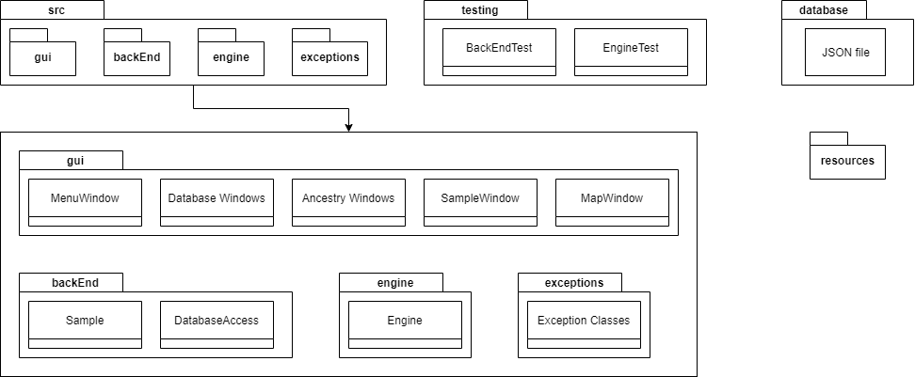
UML of packages

Slide 16
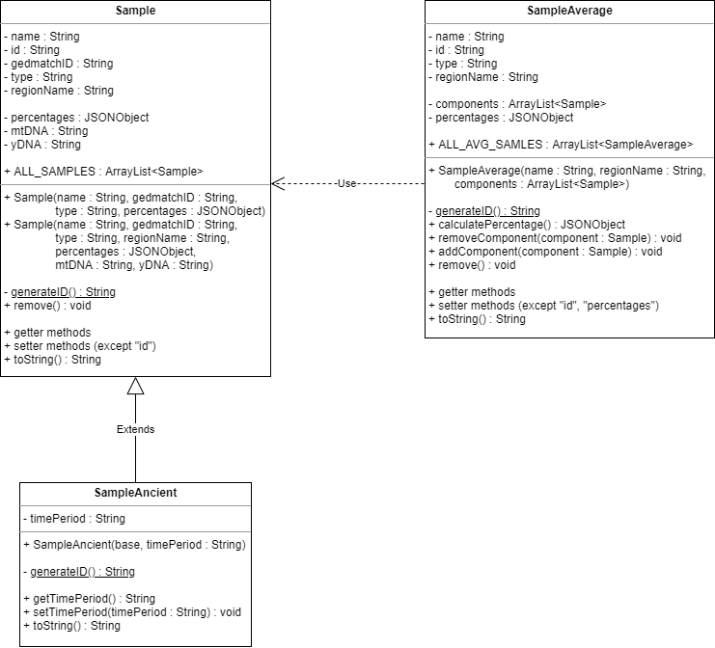
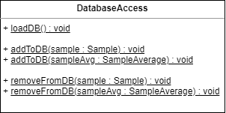
UML of back end

