Slide 1
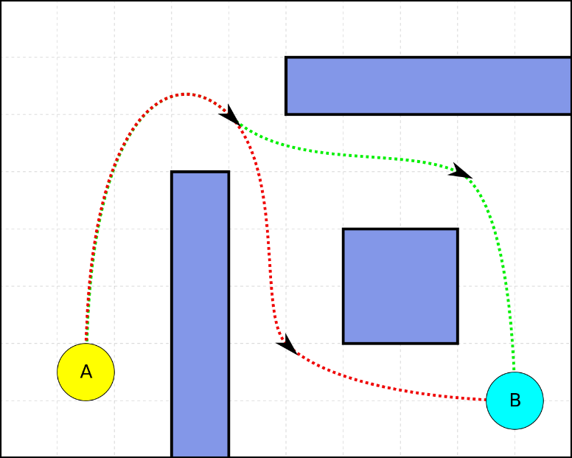
IDEA:
A pathfinder; given a map with obstacles optimal path from point1 to point2 can be found.
Map should be represented as a data structure, randomly generated and efficiently mapped onto an SFML graphic window.
Two player objects: runner and tracker. Tracker(s) always adjusts its path (to be optimal) and follows the runner (which is selected).
MapStruct or Map Class should hold a 2D array (based on the width and height of window) of Pixel object.
Pixel object will hold tile type (CLOSED, OPEN, TRACKER, RUNNER, PATH) have a corresponding position on map and reference to all its neighbors (and cost of path to neighbor) Pixel size will be based on pixel count and window size.
A* algorithm will be used to implement Path Finder. Heuristic will be sum of distance between neighbor pixels.

Slide 2
Movable object
Map will be a transformable, drawable object. Pixel texture will be loaded through “tile set”, so that design of pixels is flexible.
Set players function should set x number of players to random (OPEN) areas on the map. In future, there will also be another pixel type (MOVE) which can be moved by RUNNER.
App window will provide options to select a RUNNER (which TRACKER(s) will follow), pause the game (using space) and move the player.

Slide 3
PROJECT FILES
- main.ccp, appWindow.hpp, appWindow.ccp
- map.hpp, map.ccp, pixel.hpp, pixel.ccp
- pathfinder.hpp, pathfinder.ccp
Maybe separate map to map and textureMap?
Might change pixel to tile

Slide 4
