Slide 1
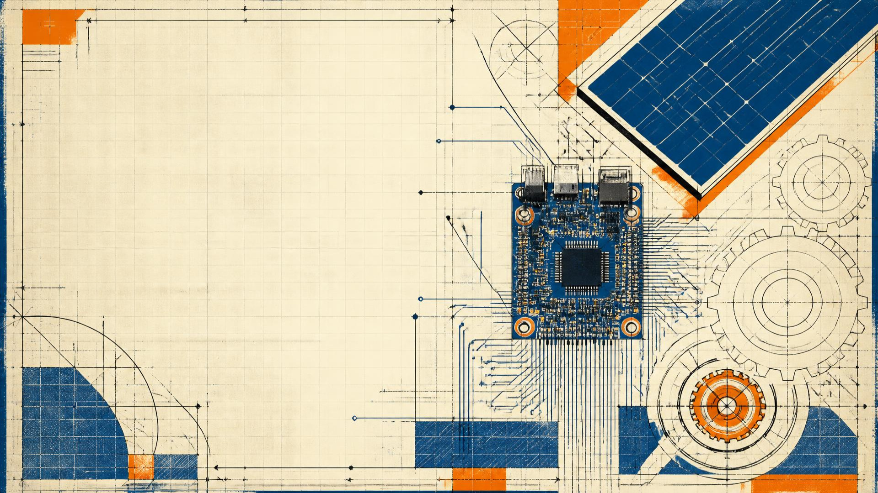
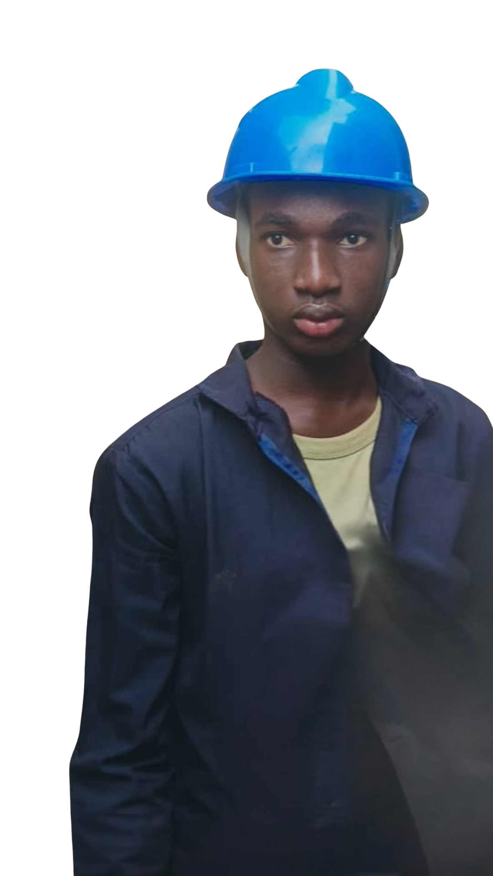
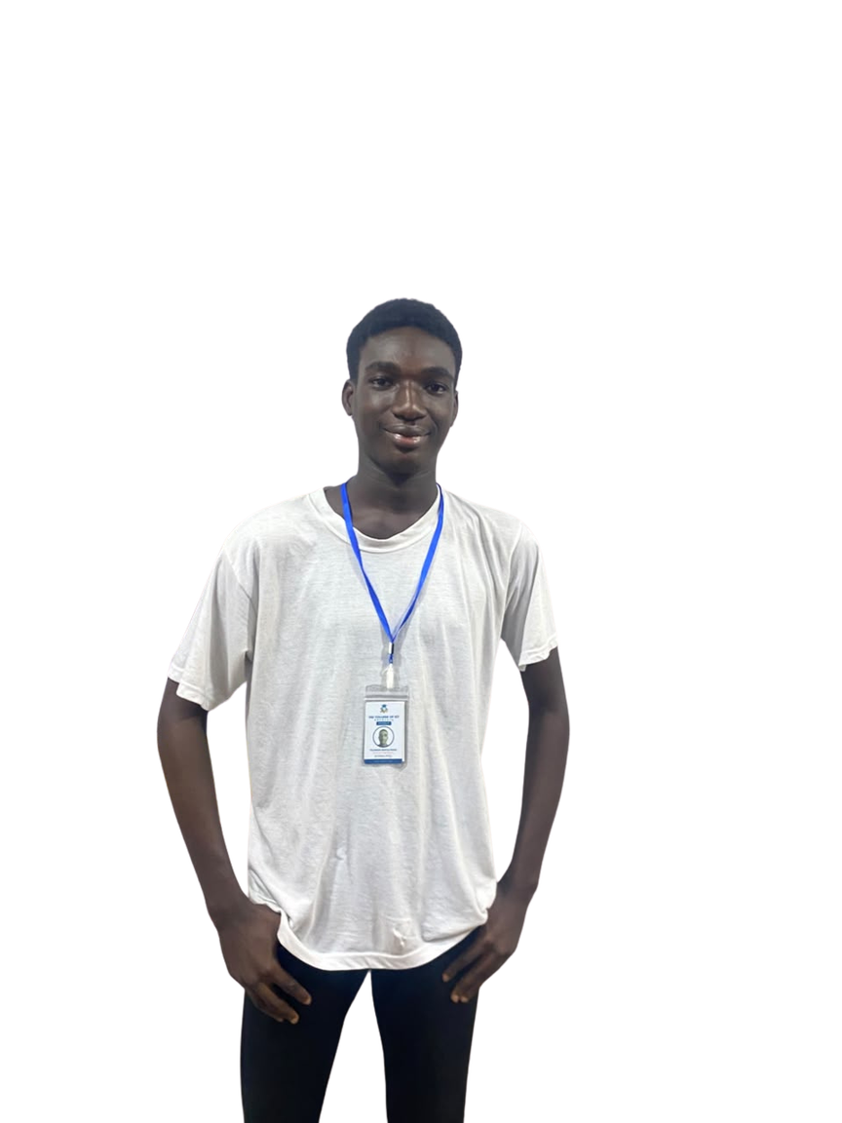
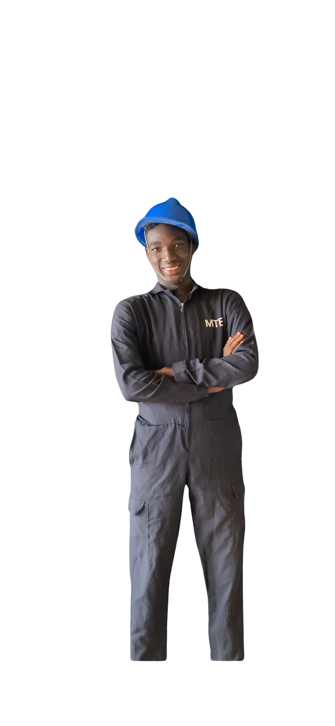
REPORT / 2025
INDUSTRIAL TRAINING / 12 WEEKS
SIWES
TECHNICAL
REPORT
Toluwade Aratoluwada 20232229
Mechatronics Engineering, FUNAAB
12 WEEKS. 4 DISCIPLINES. 1 PROJECT.

Slide 2
SECTION 02
AGENDA / NAVIGATION
SECTION 01
SECTION 02
INTRODUCTION
ORGANIZATION OVERVIEW
SECTION 03
SECTION 04
TRAINING AREAS
GRIDWATCH PROJECT
SECTION 05
SECTION 06
CHALLENGES
SKILLS GAINED
SECTION 07
SECTION 08
RECOMMENDATIONS
CONCLUSION & Q&A
02 / 17

Slide 3
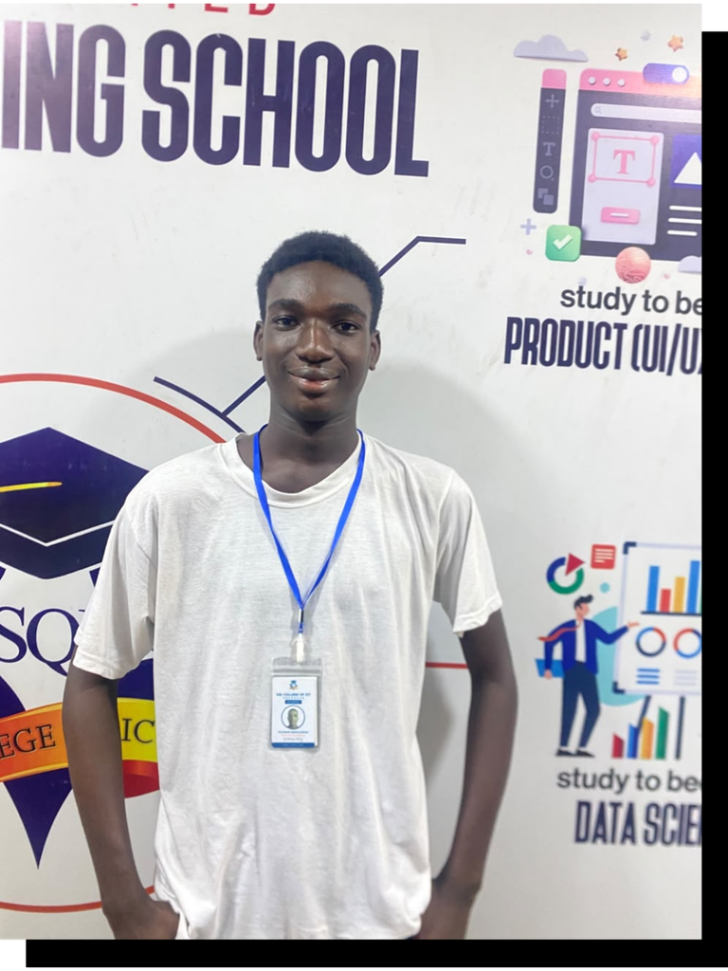
SECTION 03
INTRODUCTION TO SIWES
THE BRIDGE
FROM THEORY
TO PRACTICE.
CLASSROOM
INDUSTRY
SIWES is an industrial training programme designed to place engineering knowledge inside real working systems.
SKILL DEVELOPMENT / INDUSTRY EXPOSURE
Observe → build → test → improve
03 / 17

Slide 4
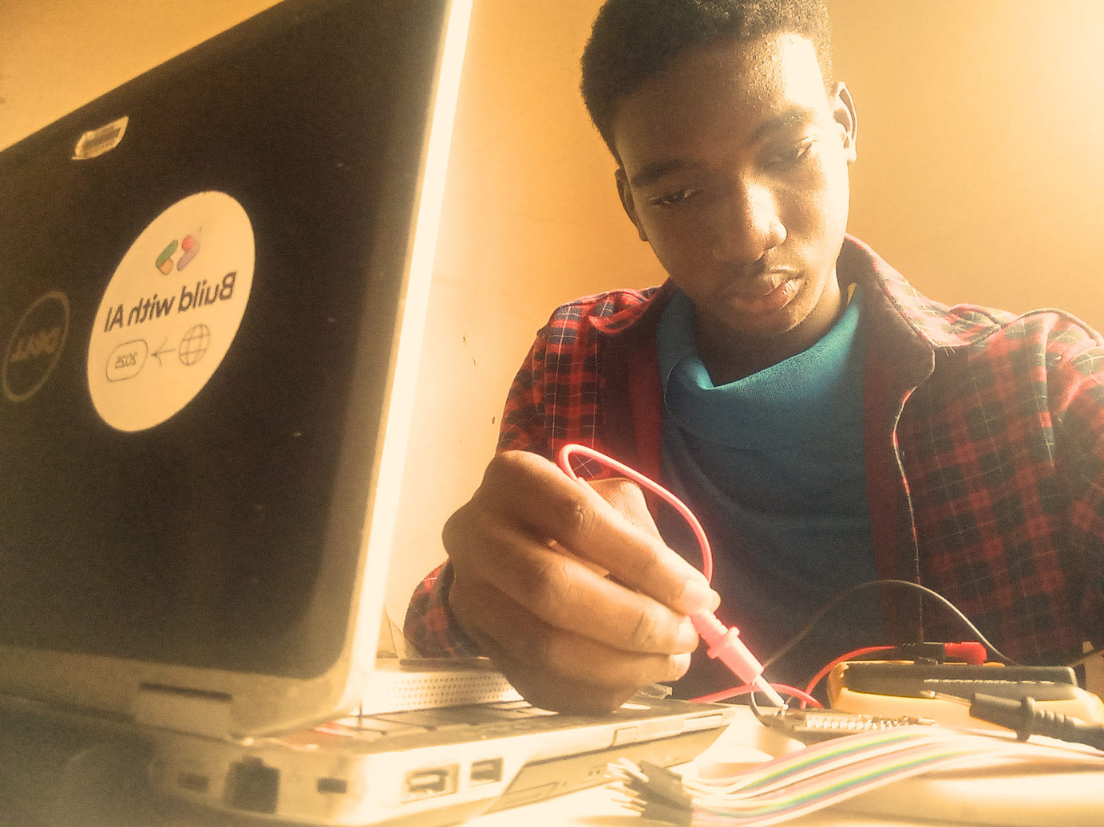
SECTION 04
ORGANIZATION OVERVIEW
WHERE SYSTEMS
MEET ENERGY.
01
SOFTWARE ENGINEERING
Firmware + connected devices
The training organization operates at the intersection of electronics, renewable energy and software delivery.
02
SOLAR INVERTER INSTALLATION
Solar design + integration
03
SYSTEM INTEGRATION
Software ↔ hardware
04 / 17

Slide 5
SECTION 05
SCOPE OF TRAINING
01
02
SOFTWARE ENGINEERING
CAD & 3D MODELLING
JavaScript / C++
Onshape / AutoCAD
03
04
SOLAR INSTALLATION
GRIDWATCH IOT PROJECT
PV / MPPT / batteries
ESP32 / MQTT / dashboard
05 / 17

Slide 6
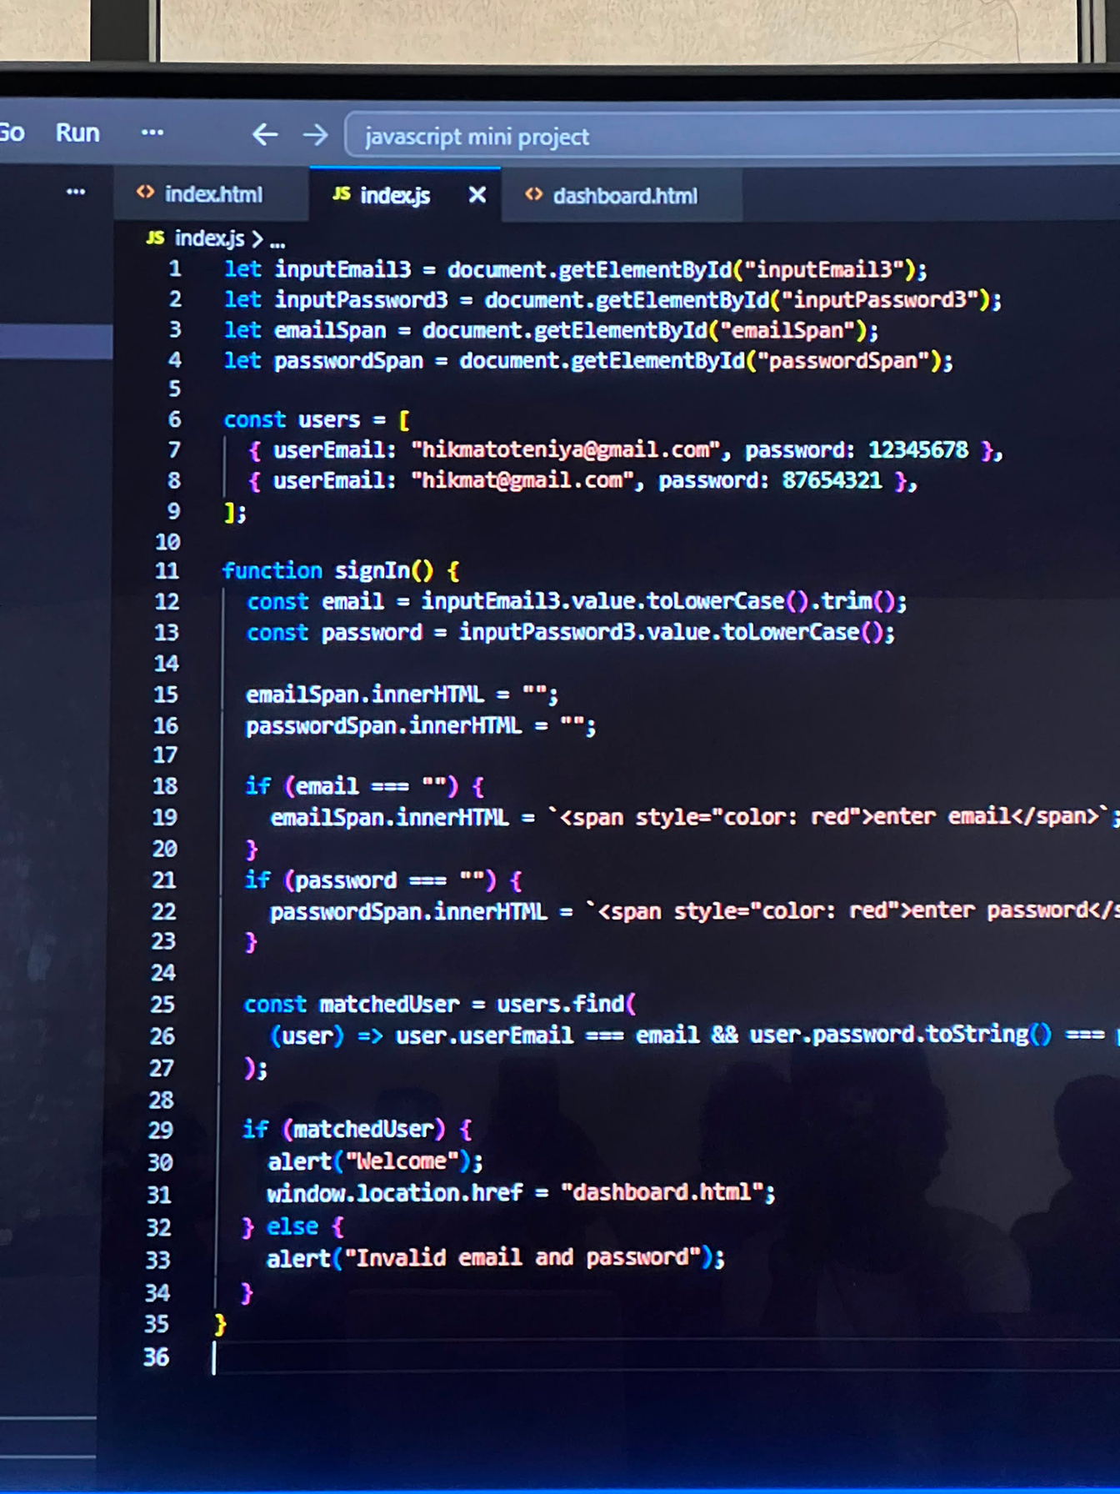
SECTION 06
SOFTWARE ENGINEERING
CODE BOTH
SIDES OF THE
SYSTEM.
JAVASCRIPT
Frontend + backend
C++
Embedded systems
AGILE
Iterative team delivery
[ INSERT SOFTWARE SCREENSHOTS / CODE HERE ]
< / > BUILD
06 / 17

Slide 7
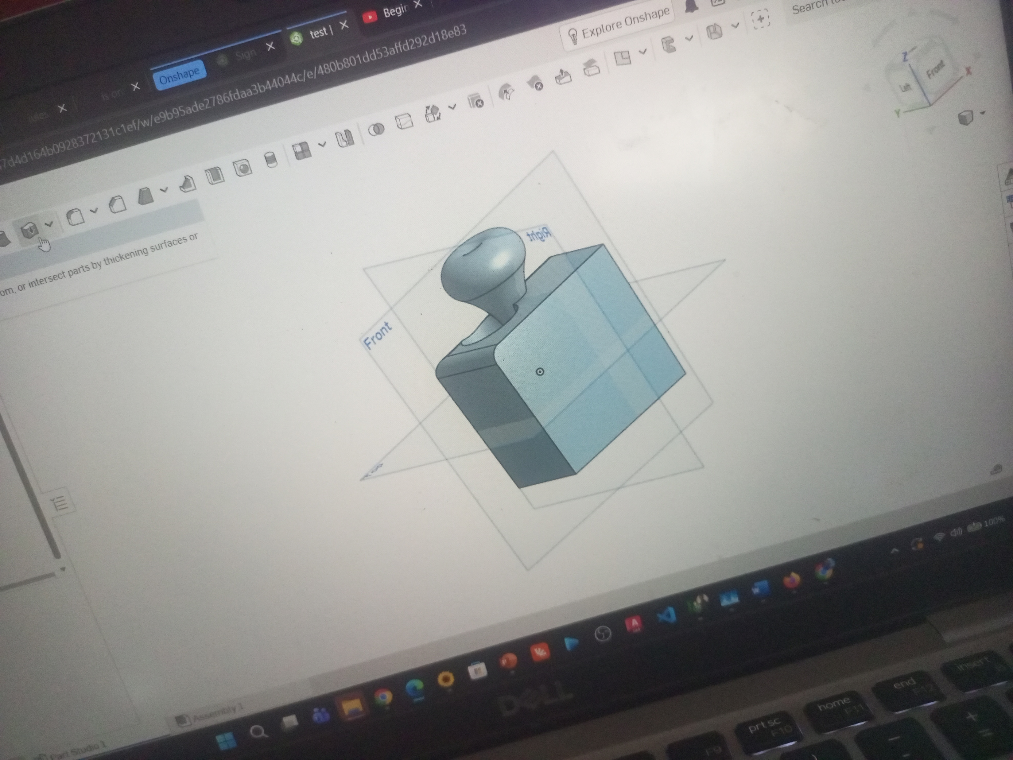
SECTION 07
CAD & 3D MODELLING
DESIGN IT
BEFORE YOU
BUILD IT.
[ INSERT CAD SCREENSHOTS / 3D RENDERS HERE ]
Sketching & concept design
Part modelling techniques
Onshape assemblies
DIMENSION / FIT / ASSEMBLE
07 / 17

Slide 8
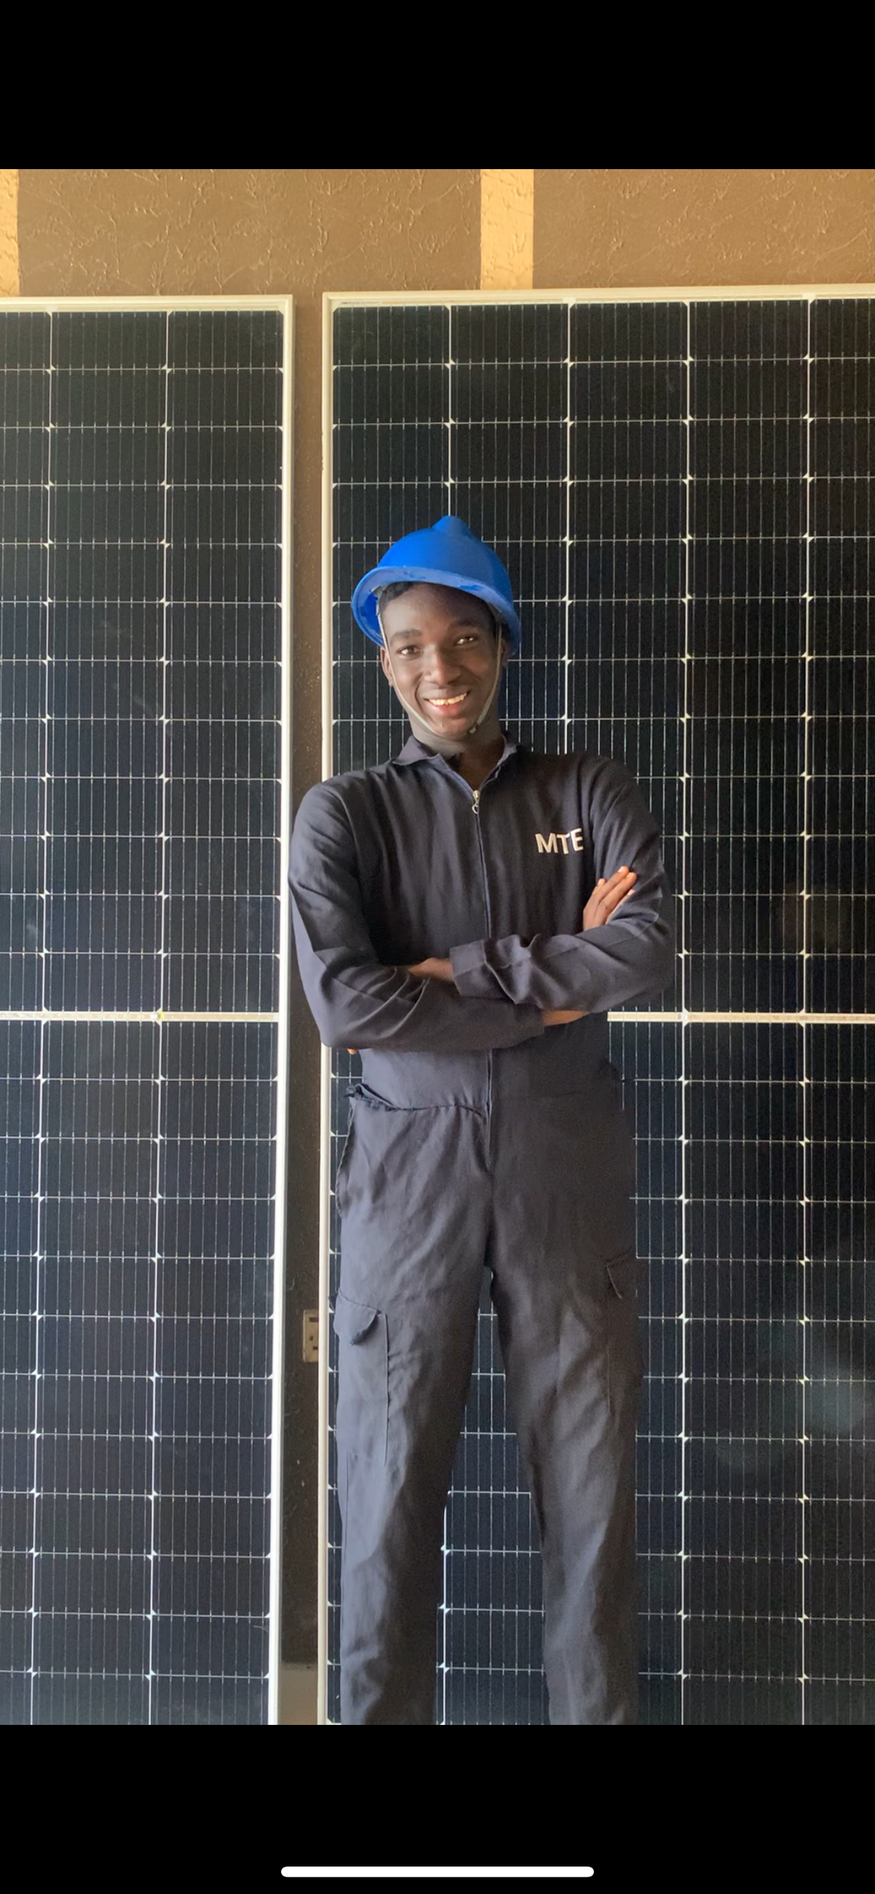
SECTION 08
SOLAR INSTALLATION
FROM SUNLIGHT
TO USABLE
POWER.
Photovoltaic theory
Panel setup & wiring
MPPT charge controllers
Battery & inverter integration
[ INSERT SOLAR INSTALLATION PHOTOS HERE ]
08 / 17

Slide 9
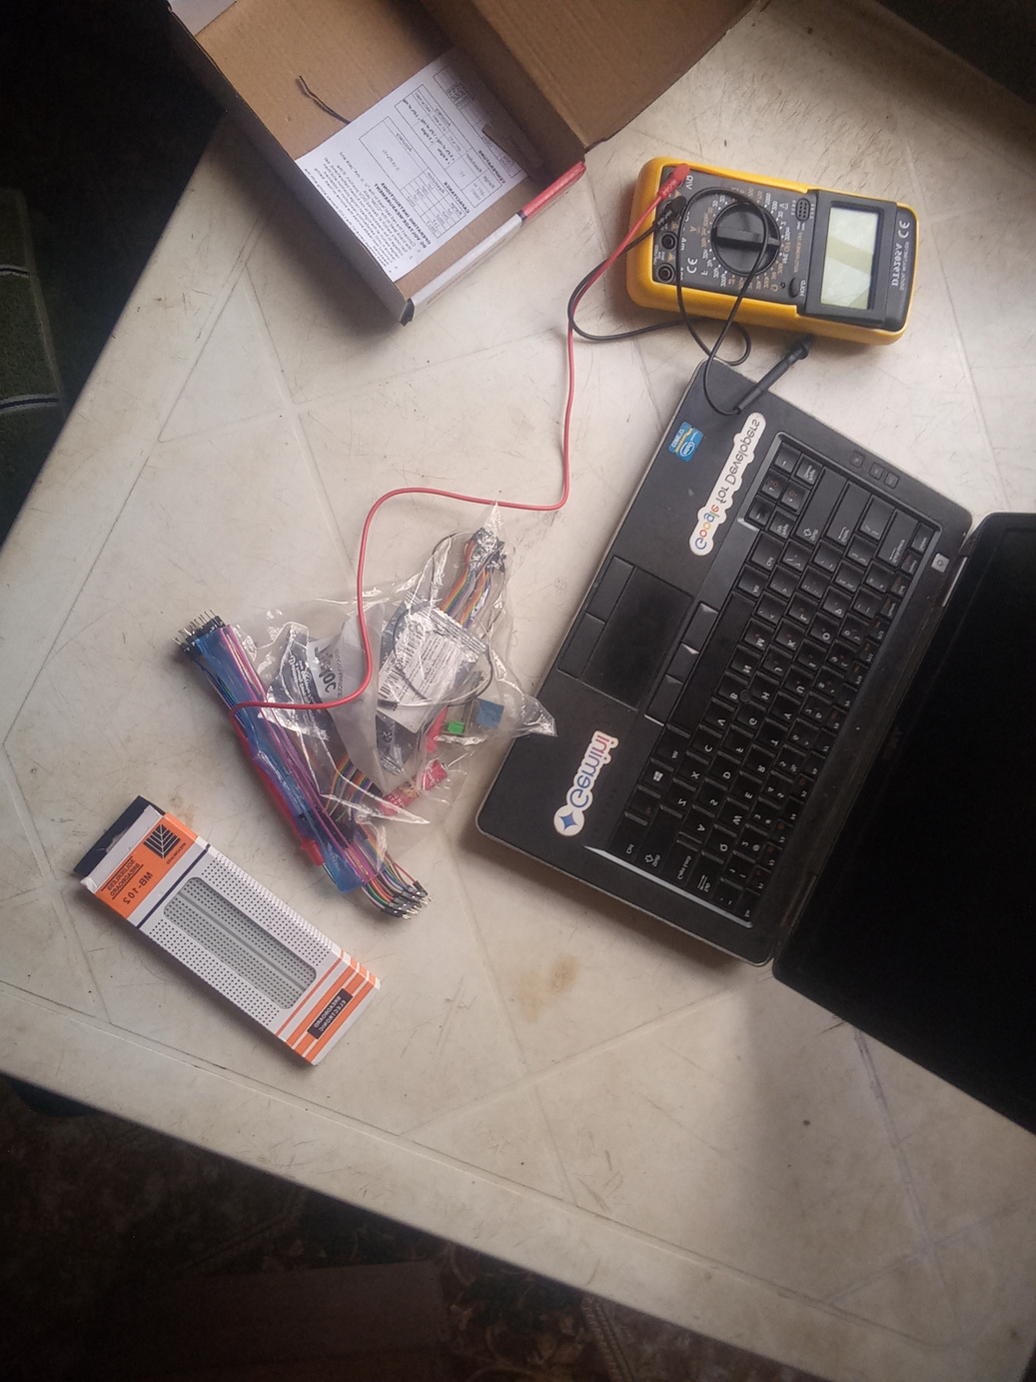
SECTION 09
GRIDWATCH — OVERVIEW
GRIDWATCH
PROBLEM / Grid monitoring needs reliable, real-time visibility from field hardware to the user interface.
ESP32
MQTT
NODE.JS
WEB DASHBOARD
[ ARCHITECTURE VISUAL / SYSTEM DIAGRAM ]
09 / 17

Slide 10
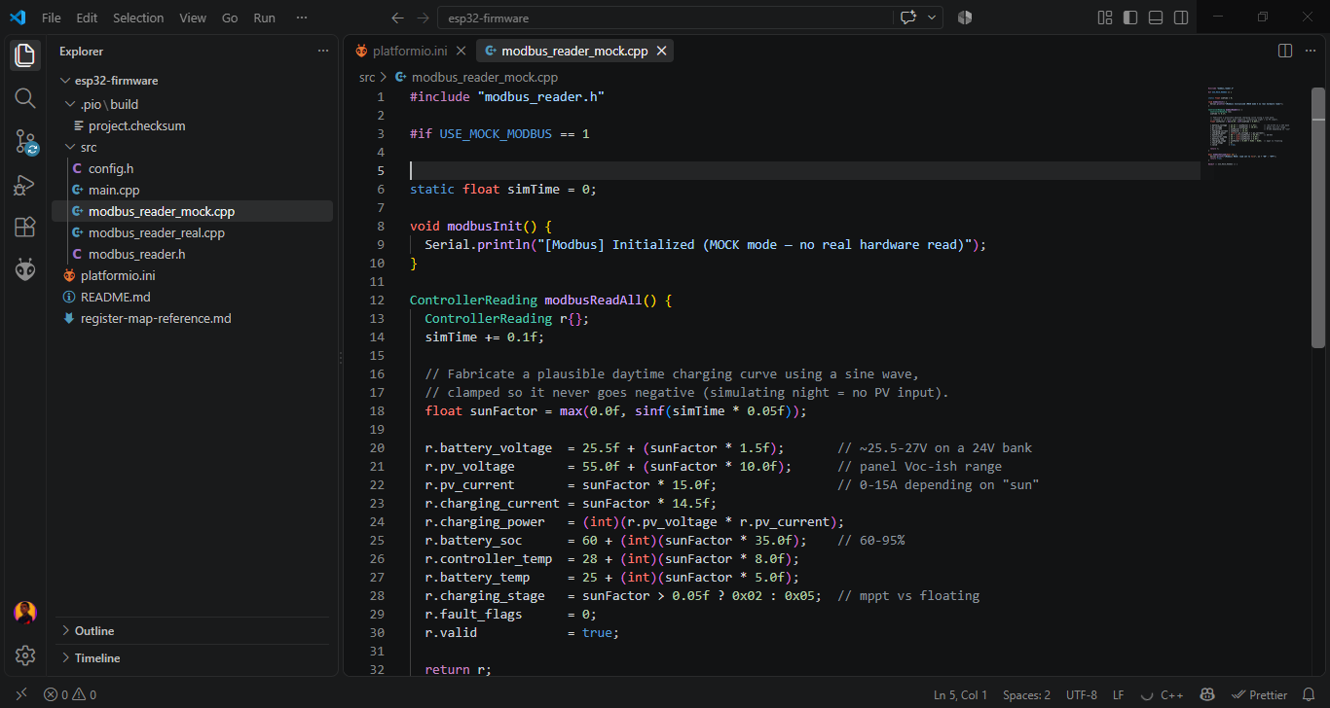
SECTION 10
GRIDWATCH — HARDWARE & FIRMWARE
FIELD LAYER
01 ESP32 microcontroller
02 RS485 / Modbus
03 SRNE MPPT integration
04 Wokwi simulation
[ INSERT HARDWARE PHOTOS / FIRMWARE SCREENSHOTS ]
CIRCUIT / FIRMWARE
10 / 17

Slide 11
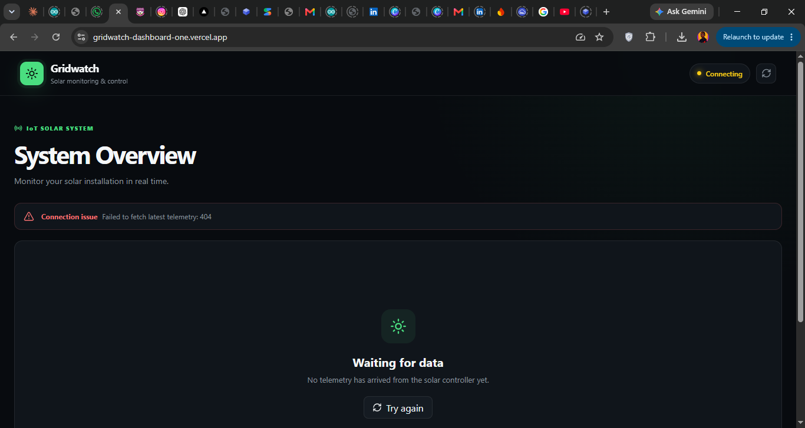
SECTION 11
GRIDWATCH — BACKEND & DASHBOARD
DATA IN.
INSIGHT OUT.
NODE.JS SERVER
HIVEMQ MQTT BROKER
RENDER DEPLOYMENT
REST API + WEBSOCKETS
[ INSERT DASHBOARD SCREENSHOTS HERE ]
{ LIVE DATA }
11 / 17

Slide 12
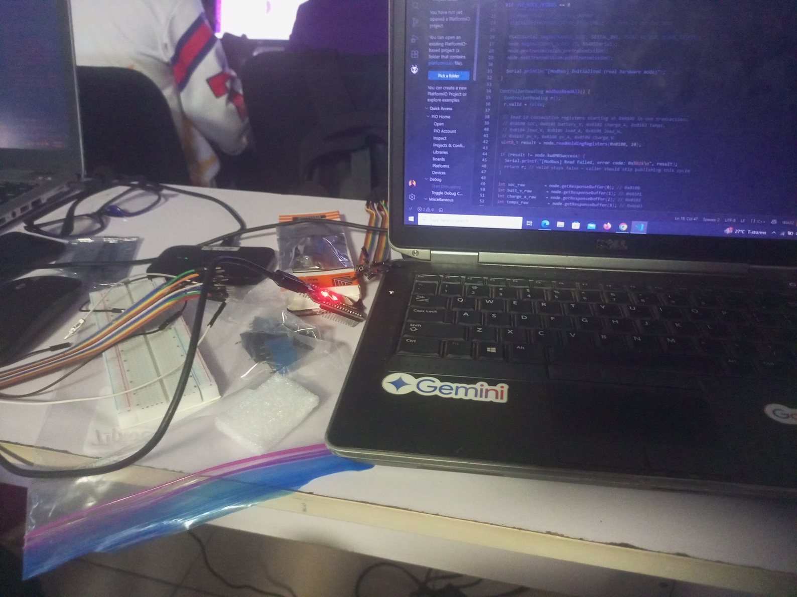
SECTION 12
GRIDWATCH — RESULTS
STABLE
Data acquisition
REAL-TIME
[ INSERT FINAL SYSTEM PHOTOS / CHARTS HERE ]
Dashboard updates
VERIFIED
System performance
12 / 17

Slide 13
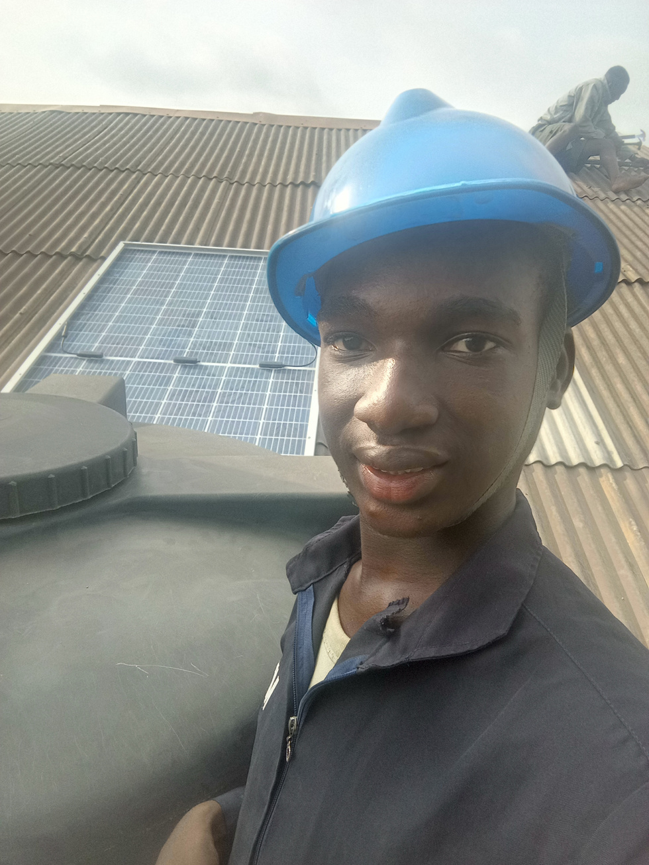
SECTION 13
CHALLENGES ENCOUNTERED
FRICTION
BECAME
FEEDBACK.
HARDWARE INTEGRATION
→ Test modules independently
PROTOCOL DEBUGGING
→ Trace data layer by layer
TIME MANAGEMENT
→ Prioritize critical paths
ADAPTABILITY
→ Iterate, document, improve
13 / 17

Slide 14
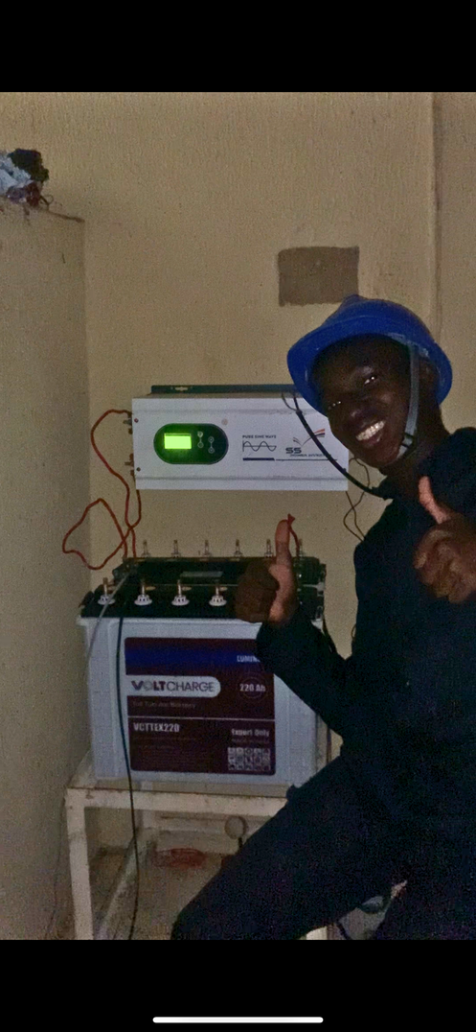
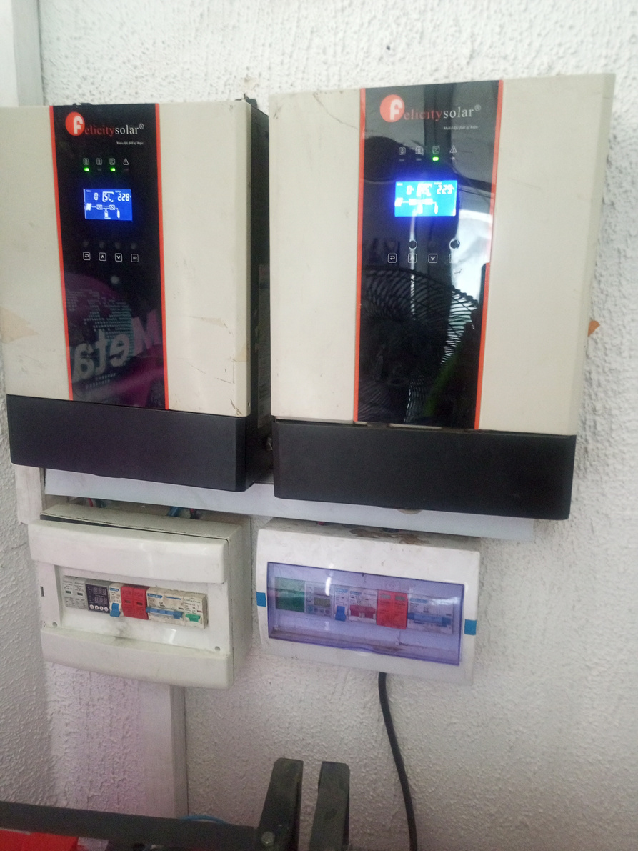
SECTION 14
SKILLS & KNOWLEDGE GAINED
A WIDER
ENGINEERING
TOOLKIT.
TECHNICAL
HUMAN
Embedded programming
CAD design
Solar technology
IoT systems
Teamwork
Communication
Critical thinking
Project management
14 / 17

Slide 15
SECTION 15
RECOMMENDATIONS
MAKE THE
LOOP TIGHTER.
INSTITUTION
ITF
ORGANIZATION
More hands-on workshops
More cross-disciplinary projects
Stronger mentorship + feedback
15 / 17

Slide 16
SECTION 16
CONCLUSION
SIWES TURNED
KNOWLEDGE INTO
ENGINEERING JUDGEMENT.
Real-world exposure. Multidisciplinary integration. A stronger foundation for the engineering challenges ahead.
BUILD → TEST → LEARN → REPEAT
16 / 17

Slide 17
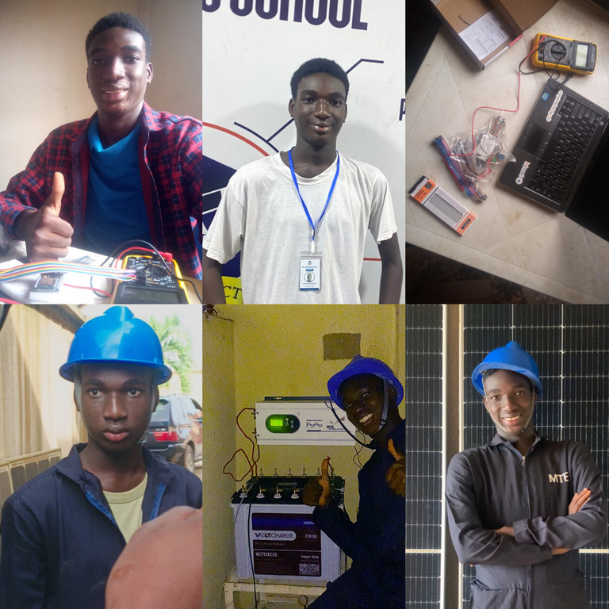
SECTION 17
THANK YOU / Q&A
Q&A
THANK YOU FOR YOUR ATTENTION
< / >
[aratoluwadatoluwade@gmail.com] / [0703 305 9736]
17 / 17

