Slide 1

Python Developer
Intern
PIXMONKS Pvt. Solutions ltd.

Slide 2
Ways of Data Scraping at Pimerce
API Request
API Driver
Selenium Driver

Slide 3
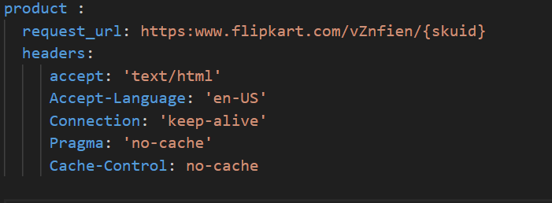
API Request
Accessing resources with the HTTP methods.
Generate template will be prepared in yaml.
URLs, headers and body have patterns
and variables will be handled in code
For e.g,
def update_params(config, skuid):
url = config[‘request_url’].replace(‘{skuid}’,skuid)

Slide 4
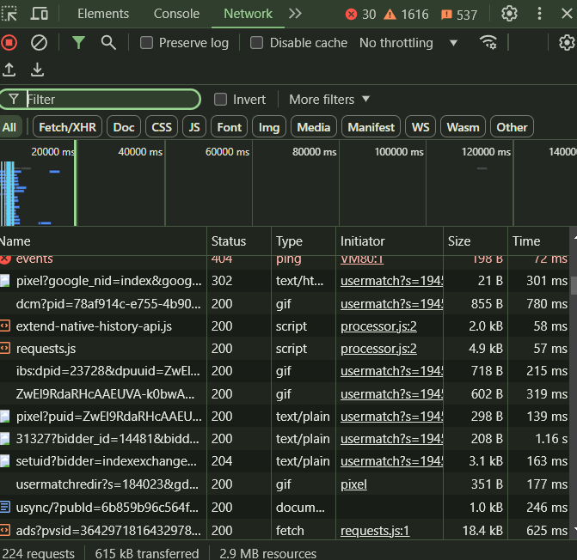
API Driver
Used when data cannot be accessed via requests.
This process is automation of following steps :-
1. Opening the desired webpage using driver
2. Accessing the middleware of the driver
3. Filtering the logs available in the network section.
(logs always have pattern)

Slide 5
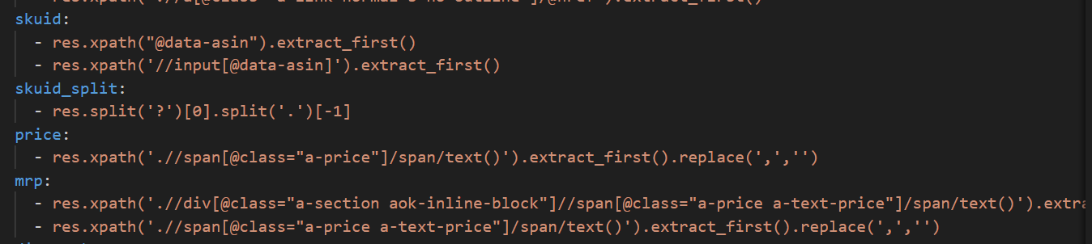
Selenium Driver
Complete browser automation leveraging python-selenium package
After landing in the required webpage, page source will be accessed.
To perform this scrapy package is used.
TextResponse(url,body) object is utilized

Slide 6
Mission
To automate the Data Scraping of e-commerce sites and scheduling it based on required frequency
This requires, development of sophisticated Generic Code framework which has been core of my intern.

Slide 7
Pimerce DB Overview
Data required for harvesting such as URLs, search keywords, category ids, shop ids, etc. are stored in master table
Harvested Data are stored in transaction table which gets added depending upon the scrap frequency.

Slide 8
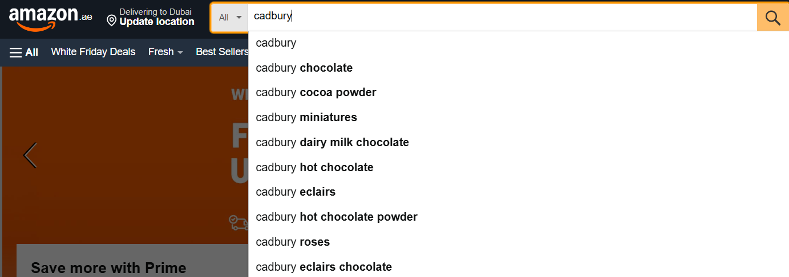
Contribution :-
1. Developed Code for Scraping Suggestion keywords which are available in search box of retailer website.

Slide 9
2. Seller type key added for Product Display Page Scrap
Retailers with official stores Retailers without Official store
Official , Authorized & 3p seller Authorized , 3p seller
Tracking sku -> Client identified products for which detailed analysis is done.
Non – tracking sku -> Own brand sku for which they analysis isn’t done or competitor sku
* Used for Assortment KPI

Slide 10
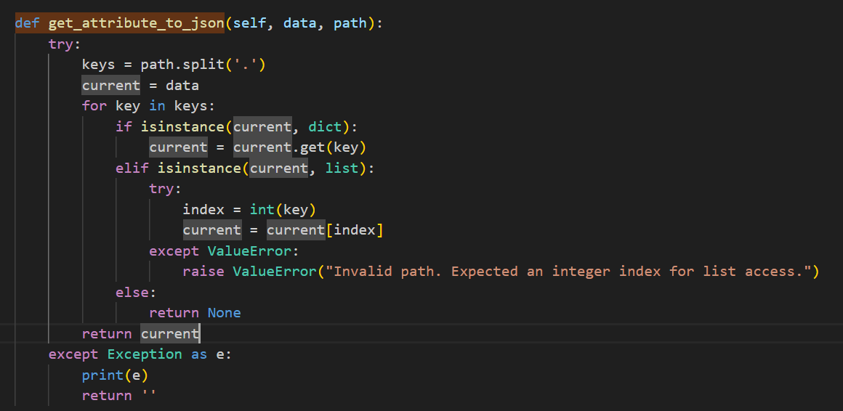
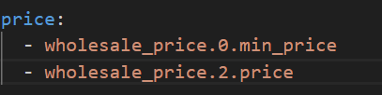
3. Developed code for Parsing JSONs containing data

Slide 11
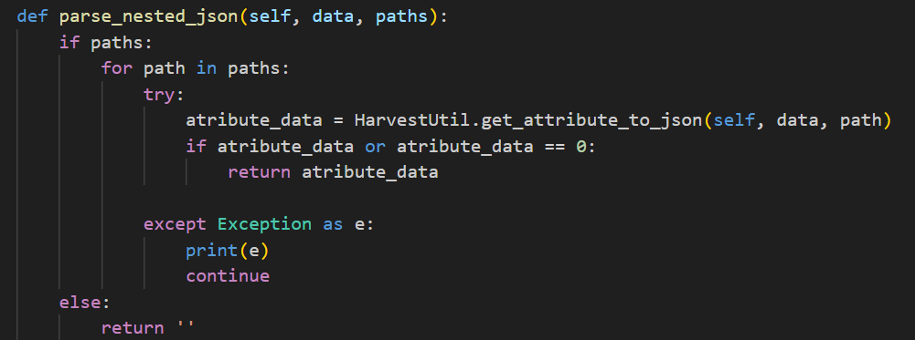
There is an issue of different path for same key in same different e-commerce retailer

Slide 12
4. Extracting Information from Retailer Sites which doesn’t have Product Display Page
- Implementing search based approach for extracting PDP level details of SKU
- Relevant keywords will be searched based on the tracking sku
- If sku-id of the tracking sku matches with list of sku-ids present in listing page, then response will be considered for further extraction

Slide 13
thank you

