Slide 1


Department of Information Technology
V R Siddhartha Engineering College
Explainable AI-Based Comparative Analysis of Deep Learning and Large Language Models for Symptom-Based Disease Prediction
Bachelor of Technology in Information Technology
Major Project Review Presentation
Presented by
Mr. G Aravind (228W1A1290)
Mr. P Srinivasa Bhargav (228W1A12B7)
Under the guidance of
Dr. C.S.Pavan Kumar
Sr. Assistant Professor

Slide 2
AGENDA
Motivation and Problem statement
Objectives and Outcomes of the Project
Literature Survey
Datasets and Requirement Specifications
Methodology and Algorithems involved
Architecture diagram
Complete Results Obtained
Result Analysis
References

Slide 3
INTRODUCTION
Early disease detection is important, as manual symptom-based diagnosis may lead to delayed or inaccurate treatment decisions.
Large volumes of medical symptom data require intelligent AI analysis, as different models exhibit varying performance in disease prediction.
Existing disease prediction systems focus mainly on accuracy, whereas healthcare applications require both accurate and interpretable AI models for reliable decision-making.
There is a need to compare Deep Learning and LLM models along with Explainable AI techniques to ensure reliable, transparent, and trustworthy medical predictions.

Slide 4
PROBLEM STATEMENT
Accurate disease prediction based on patient symptoms remains a challenging task in healthcare systems.
Existing AI-based prediction models differ in learning capability and performance.
Most systems emphasize prediction accuracy while lacking interpretability and transparency.
Limited research exists comparing Deep Learning and Large Language Models for symptom-based disease prediction.
There is a need for a system that provides both accurate and explainable disease predictions.

Slide 5
OBJECTIVES
To develop symptom-based disease prediction models using Deep Learning techniques (MLP, TabNet, Residual MLP) and LLM-based transformer models.
To apply Explainable AI (SHAP) for understanding model predictions.
To compare Deep Learning and LLM models using performance metrics and identify the most accurate and interpretable model for reliable disease prediction.
OUTCOMES
Development of multiple AI-based disease prediction models with performance comparison between Deep Learning and LLM approaches.
Generation of explainable predictions improving transparency and trust in AI-based healthcare systems.
Identification of the best-performing accurate and interpretable model forming a comparative framework for healthcare decision-support systems.

Slide 6
LITERATURE REVIEW AND SUMMARY
S. No. | Title | Year | Work Done | Dataset Used | Models | Conclusion | Limitations
1. | LLM-Based Chatbot for Surgical Training (Oral Boards) | 2024 | Built a GPT-4-based chatbot to assist in surgical exam training. | Symptom2Disease dataset, Diseases dataset | GPT-4, LLMs | Useful for surgical education, but requires better reasoning accuracy. | Errors in clinical reasoning, hallucinations, and lack of domain-specific adaptation.
2 | Chatbot for Chronic Disease Diagnosis using LLMs | 2024 | Introduced Chat Ella, a GPT-2-based chatbot for diagnosing chronic diseases. | Medical dataset with 24 chronic diseases | GPT-2, Adam Optimizer, CLR Scheduler | Improves remote healthcare services, particularly for patients lacking access to medical professionals. | Accuracy depends on training data, lacks clinical validation, NLP limitations.
3 | Predicting Medical Specialty from Text using BERT | 2022 | Fine-tuned BERT-based model to classify medical queries into specialties. | Online medical Q&A datasets | BERT, KM-BERT, CNN, LSTM | Improves hospital workflows but requires real-world testing. | Training data bias, challenges in overlapping specialties, and lack of real-world validation.

Slide 7
S. No. | Title | Year | Work Done | Dataset Used | Models | Conclusion | Limitations
4 | Medical ChatBot for Primary Clinical Guidance | 2024 | Developed Robotic Medical Support ChatBot (RMSCB) using probability-based classification for preliminary diagnosis. | Medical FAQs & symptom datasets | PFSWM, PFCLM, PFAQM | Enhances 24/7 healthcare accessibility, particularly in rural areas. | Relies on training data, classification errors in complex cases.
5 | NLP-Based Healthcare Chatbot for Patient Engagement | 2023 | Designed a chatbot using deep learning & NLP for symptom-based disease prediction. | Medical chat logs & symptom datasets | RNN, Encoder-Decoder Model, TF-IDF, Deep Learning | Improves medical consultations & patient engagement, reducing wait times. | NLP limitations in understanding symptoms, bias in training data.

Slide 8
DATASET AND REQUIREMENTS
Datasets:
Dataset containing symptoms of the diseases in the form of CSV file.
Health Risk Factors, Symptom-Disease Mapping Dataset.
https://www.kaggle.com/datasets/dhivyeshrk/diseases-and-symptoms-dataset
System Requirements:
Software: TensorFlow/Keras for model building, Python for coding, Hugging face.
Tools: Google Colab, Jupyter Notebook, Kaggle.

Slide 9
ALGORITHM
Deep Learning Models
Multilayer Perceptron (MLP)
MLP is a feedforward neural network consisting of input, hidden, and output layers
It processes structured symptom data by converting it into numerical features
Uses ReLU activation in hidden layers to learn non-linear patterns
Applies Softmax function in the output layer for multi-class disease classification
TabNet
TabNet is a deep learning model designed specifically for tabular data
Uses a sequential attention mechanism to select important features
Focuses on relevant symptoms during each training step
Provides better interpretability compared to traditional neural networks
Performs well on structured datasets with efficient feature selection

Slide 10
ALGORITHM
Residual MLP
Residual MLP is an improved version of MLP with skip connections
Uses residual links to pass information across layers
Helps in reducing vanishing gradient problem in deep networks
Improves training stability and convergence speed
Achieves performance close to MLP with better learning efficiency
Large Language Models (LLMs)
XLM-RoBERTa
XLM-RoBERTa is a multilingual transformer-based language model
Trained on large datasets to understand multiple languages and contexts
Converts symptom data into text format for processing
Uses attention mechanism to capture relationships between symptoms
Performs well in handling natural language-based disease prediction

Slide 11
ALGORITHM
ERNIE
ERNIE is a knowledge-enhanced transformer model
Integrates external knowledge sources for better understanding
Captures deep semantic and contextual relationships in text
Performs well on complex symptom descriptions
Provides slightly better accuracy than basic LLM models
ELECTRA
ELECTRA is a transformer-based model with efficient training mechanism
Uses replaced token detection instead of masked prediction
Requires less computational cost and faster training
Performs strongly in classification tasks like disease prediction

Slide 12
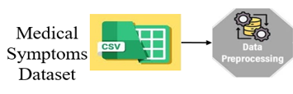
ARCHITECTURE DIAGRAM
Training Data
Training
Data Splitting
Testing Data
DL Models
(MLP, TabNet, Residual MLP)
LLM Models
(XLM-RoBERTa, ERNIE, ELECTRA)
Metrics Observation
Test the Model
Save the Model
Accuracy/Loss
Performance Evaluation
Explainable AI (SHAP)

Slide 13
IMPLEMENTATION AND EXECUTION STEPS
1. Data Collection
Collected symptom-based healthcare dataset from reliable sources.
Dataset includes patient symptoms and disease labels.
2. Data Preprocessing
Missing values handled and data cleaned.
Symptoms encoded into numerical format.
Dataset divided into training and testing sets.
3. Model Development
Implemented Deep Learning models such as MLP, TabNet, and Residual MLP.
Models trained to learn symptom–disease relationships.
Optimized model parameters for better performance.

Slide 14
4. LLM-Based Prediction
Transformer-based LLM used for symptom understanding.
Generates disease predictions from user input.
Enables natural language interaction.
5. Model Training & Evaluation
Models trained using processed dataset.
Performance evaluated using Accuracy, Precision, Recall, and F1-score.
Comparative analysis conducted between Deep Learning and LLM models.
6. Explainable Prediction
Identified key symptoms influencing predictions.
Provided interpretable prediction results enhancing transparency and trust in AI-based healthcare systems.

Slide 15
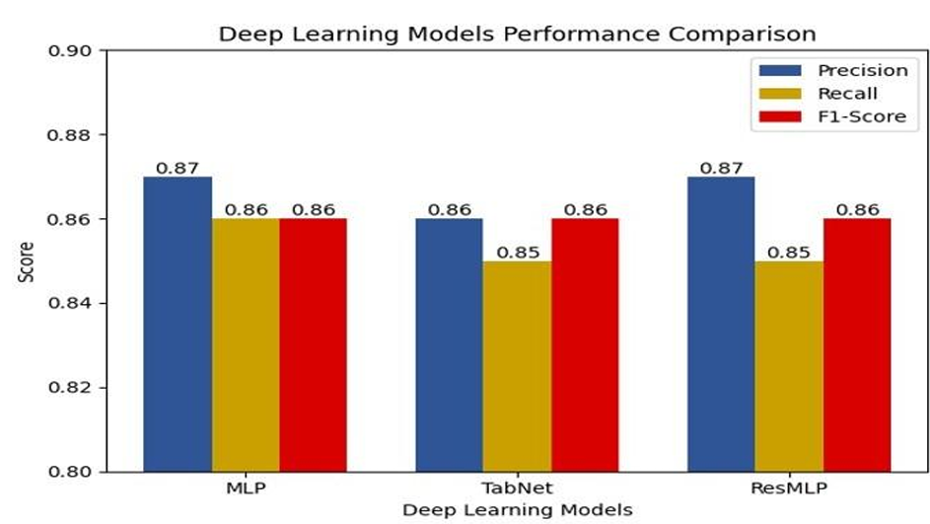
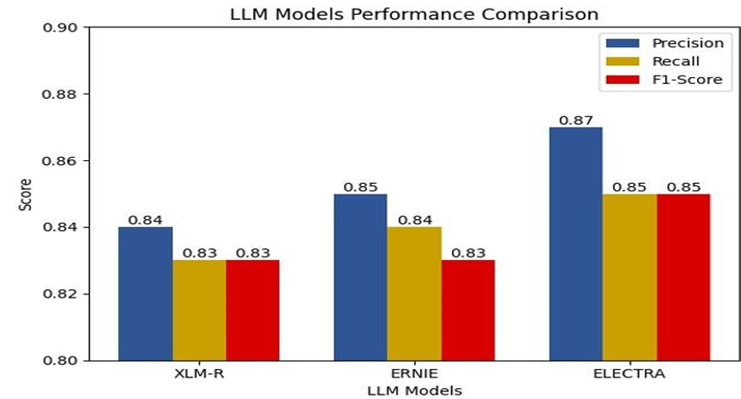
RESULTS OBTAINED

Slide 16
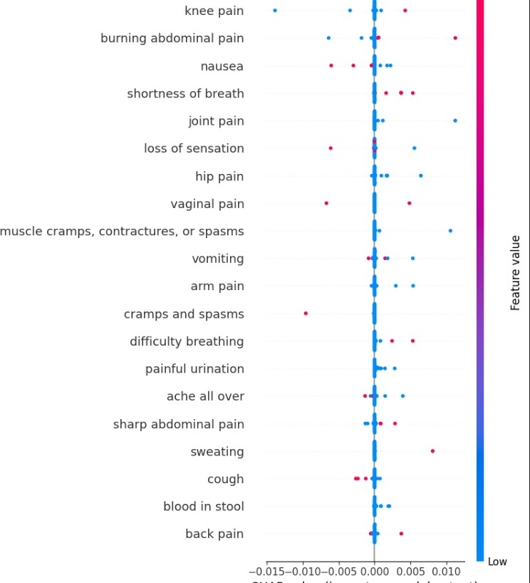
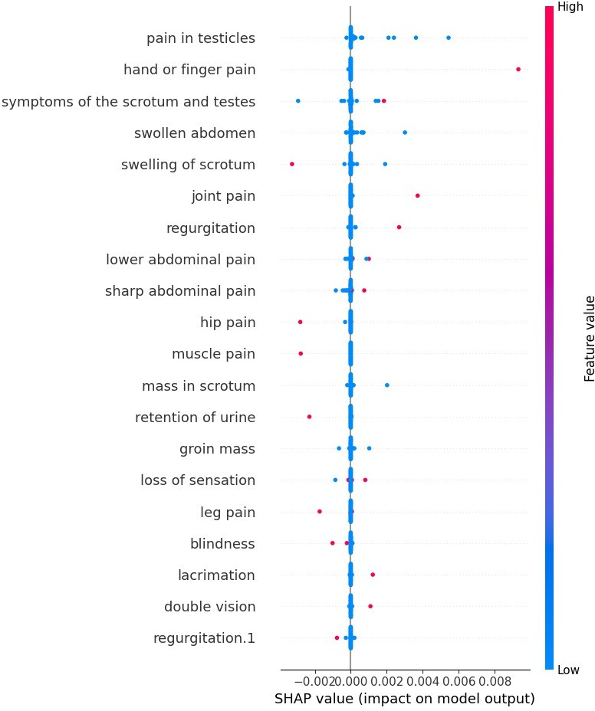
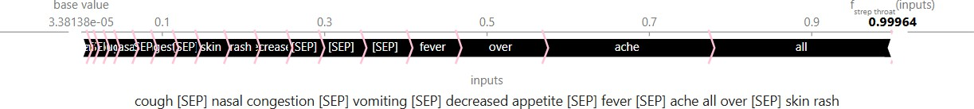
Explainable AI (XAI) analysis result for the deep learning model.
Explainable AI (XAI) analysis result for the Large language model.

Slide 17
RESULT ANALYSIS WITH CHART
Category | Model | Precision | Recall | F1-Score | Accuracy
LLM | XLM- Roberta | 0.84 | 0.83 | 0.83 | 0.8331
 | ERNIE | 0.85 | 0.84 | 0.83 | 0.8392
 | ELECTRA | 0.87 | 0.85 | 0.85 | 0.8542
DL | Multilayer Perceptron (MLP) | 0.87 | 0.86 | 0.86 | 0.8671
 | TabNet | 0.86 | 0.85 | 0.86 | 0.8427
 | Residual MLP | 0.87 | 0.85 | 0.86 | 0.8543

Slide 18
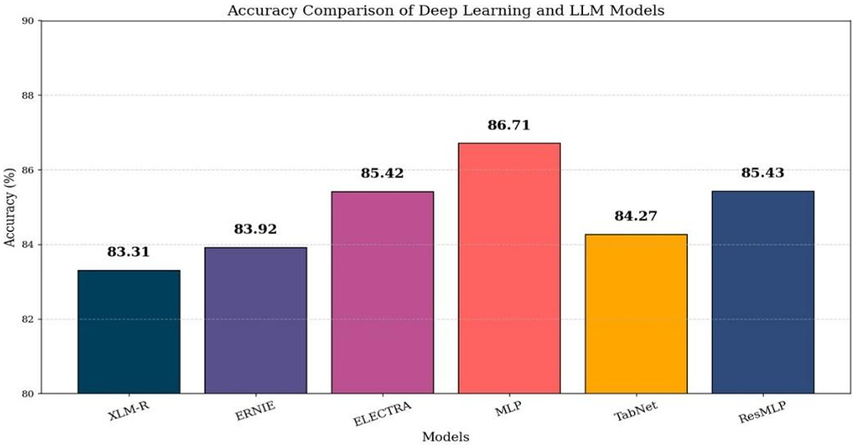
RESULT ANALYSIS

Slide 19
CONCLUSION
Built a disease prediction system using Deep Learning and LLM models.
Deep Learning models performed better, with MLP achieving highest accuracy (~87%).
SHAP was used to explain predictions by identifying important symptoms.
The system provides both accurate and interpretable results for healthcare use.
FUTURE WORK
Use real-time and clinical data to improve accuracy.
Include more data types like medical reports and images.
Improve performance using hybrid models.
Deploy as a web or mobile application.

Slide 20
REFERENCES
[1] S. Sreedhar Kumar, S. T. Ahmed, A. S. Fathima, M. Nishabai, and S. Sophia, “Medical ChatBot Assistance for Primary Clinical Guidance using Machine Learning Techniques,” in Procedia Computer Science, Elsevier B.V., 2024, pp. 279–287. doi: 10.1016/j.procs.2024.03.217.
[2] N. Xu, “The investigation of symptom to disease chatbot based on LLAMA-2,” Applied and Computational Engineering, vol. 55, no. 1, pp. 39–43, Apr. 2024, doi: 10.54254/27552721/55/20241433.
[3] S. Zhang and J. Song, “A chatbot based question and answer system for the auxiliary diagnosis of chronic diseases based on large language model,” Sci Rep, vol. 14, no. 1, Dec. 2024, doi:10.1038/s41598-024- 674294.
[4] B. Kevin, B. VIkin, and M. Nair, “BUILDING A CHATBOT FOR HEALTHCARE USING NLP,” Apr. 10, 2023. doi:10.36227/techrxiv.22578472.v1.
[5] Y. Kim, J. H. Kim, Y. M. Kim, S. Song, and H. J. Joo, “Predicting medical specialty from text based on a domain-specific pre-trained BERT,”Int J Med Inform, vol.170, Feb. 2023, doi:10.1016/j.ijmedinf.2022.104956.

Slide 21
[6] Yang, Rui, et al. "Large language models in health care: Development, applications, and challenges." Health Care Science 2.4 (2023): 255-263.
[7] Silvestri, Caitlin, et al. "Evaluation of a novel large language model (LLM)-powered chatbot for oral boards scenarios." Global Surgical Education-Journal of the Association for Surgical Education 3.1 (2024): 1-12.
[8] Sivasamy, S.: AI-Driven Medical Chatbot for Predicting and Managing Infectious Diseases. International Journal of Advanced Research in Science, Communication and Technology, 772–777 (2025)
[9] Biradar, S., Shastri, S.: Medical Chatbot: AI Based Infectious Disease Prediction Model. Journal of Scientific Research and Technology, 1–12 (2024)
[10] Barath Lakshman, A.N.: DocBot: Integrating LLMs for Medical Assistance (2024)
[11] Zhang, S., Song, J.: A chatbot based question and answer system for the auxiliary diagnosis of chronic diseases based on large language model. Scientific Reports 14(1), 17118 (2024)
[12] Yang, X., et al.: Application of large language models in disease diagnosis and treatment. Chinese Medical Journal 138(2), 130–142 (2025)

