Slide 1
Hospital Management System
Developed By
S. Aravind Nathan
BE CSE - 43111603
Sathyabama Institute of Science and Technology

Slide 2
Abstract
• Hospital Management System (HMS) is a web-based application designed to manage hospital operations efficiently.
• It automates tasks such as patient registration, doctor management, appointments, and reports.
• Reduces manual paperwork and improves workflow.

Slide 3
Existing System
• Hospitals use manual records or basic software for operations.
• Challenges:
Time-consuming patient record handling
High risk of errors in medical history and appointments
Poor accessibility and slow communication
• Limited reporting and analytics.

Slide 4
Proposed System
• Web-based Hospital Management System using Spring Boot (backend), H2/MySQL database, and HTML/CSS/JS frontend.
• Features:
Patient & doctor management
Appointment scheduling
Reports & analytics
User roles (Admin, Doctor, Patient)
• Provide a simple and user-friendly experience

Slide 5
Advantages
• Efficient management of hospital data
• Quick access to patient records and doctor schedules
• Reduced paperwork and manual errors
• Supports multiple users and roles

Slide 6
Disadvantages
Requires computer and internet access
Initial setup and maintenance costs
Training required for staff unfamiliar with software

Slide 7
Hardware Requirements
• Processor: Intel Core i3 or higher
• Doctor RAM: 4 GB minimum
• Storage: 100 GB HDD/SSD
• Network: Internet connectivity for web access

Slide 8
Software Requirements
• Backend: Java 24, Spring Boot 2.7.x
• Database: H2 (for testing) / MySQL (for production)
• Frontend: HTML, CSS, JavaScript,
• IDE: VS Code / IntelliJ IDEA / Eclipse
• Build Tool: Maven

Slide 9
Modules
Admin Module – Manages doctors, patients, appointments, and reports.
Doctor Module – Views appointments, patient history, and adds medical records.
Patient Module – Registers, views appointments, and accesses reports.
Appointment Module – Schedule, update, and track appointments.

Slide 10
Module Description
Module | Description
Admin Module | Complete control over the system including managing users, doctors, and reports
Doctor Module | View appointments, update patient records, manage availability
Patient Module | Register online, view medical history, schedule appointments
Appointment Module | Efficient scheduling and reminders for appointments

Slide 11
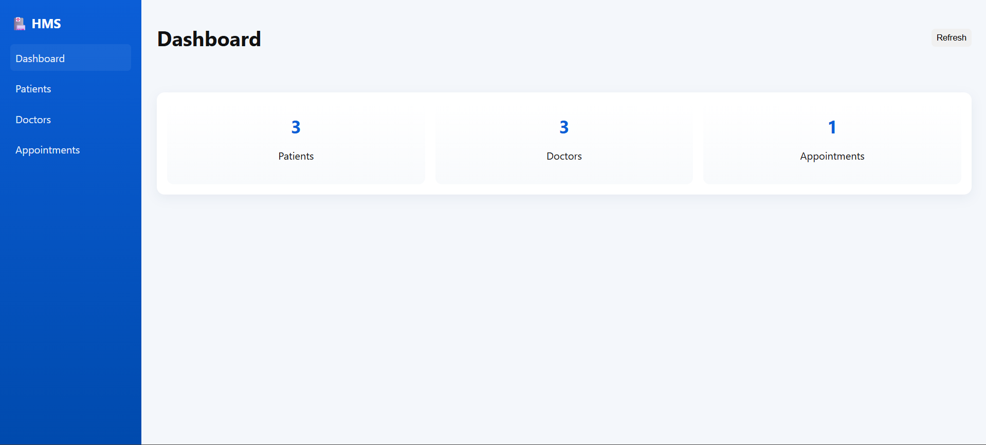
Screenshots

Slide 12
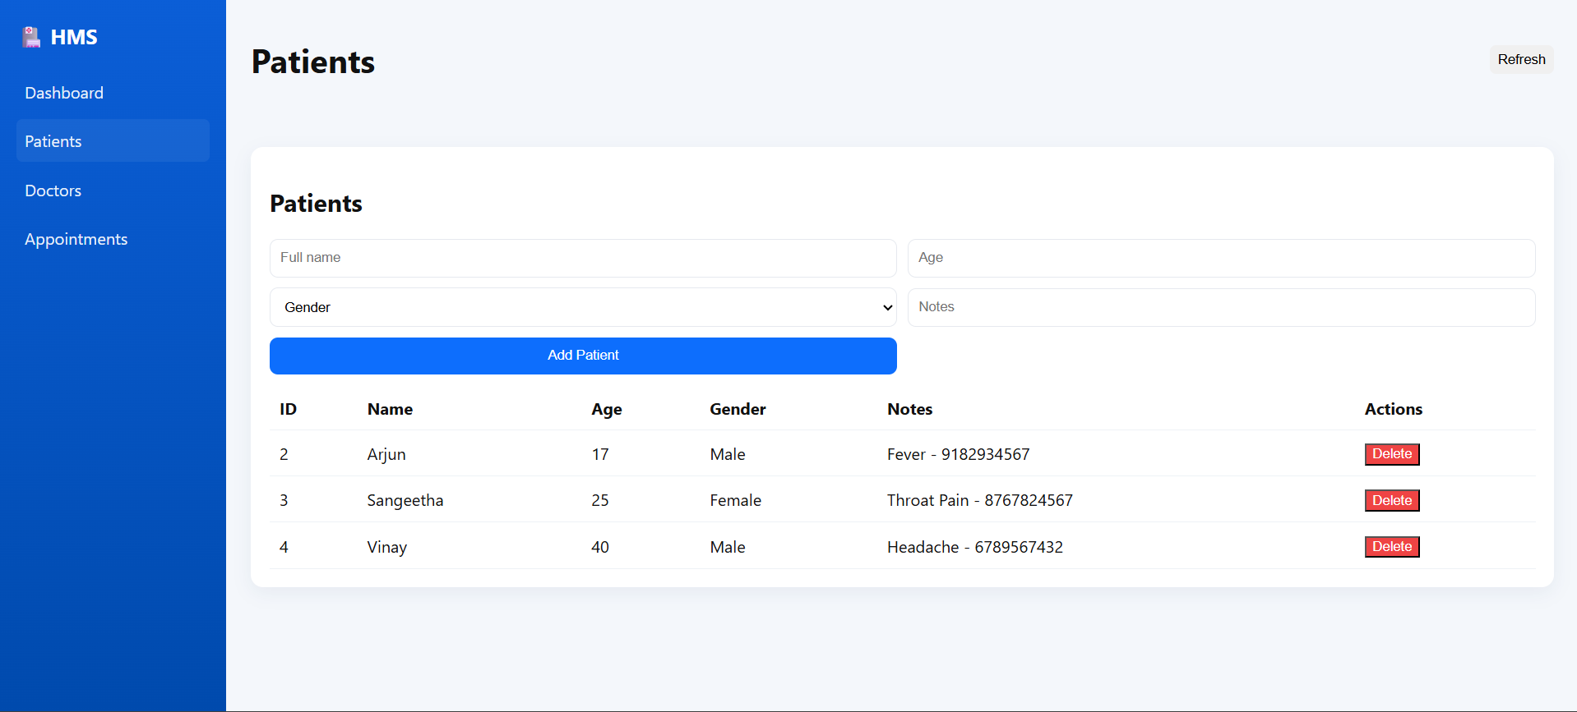

Slide 13
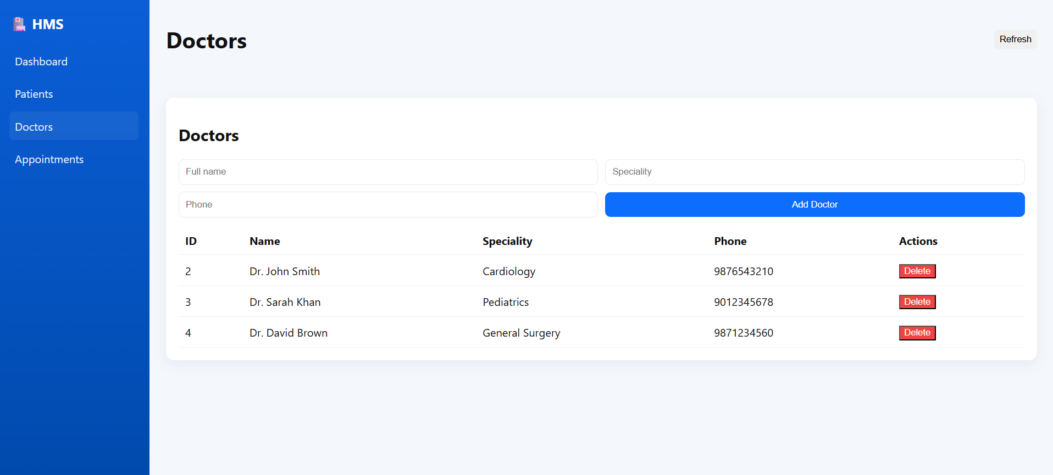

Slide 14
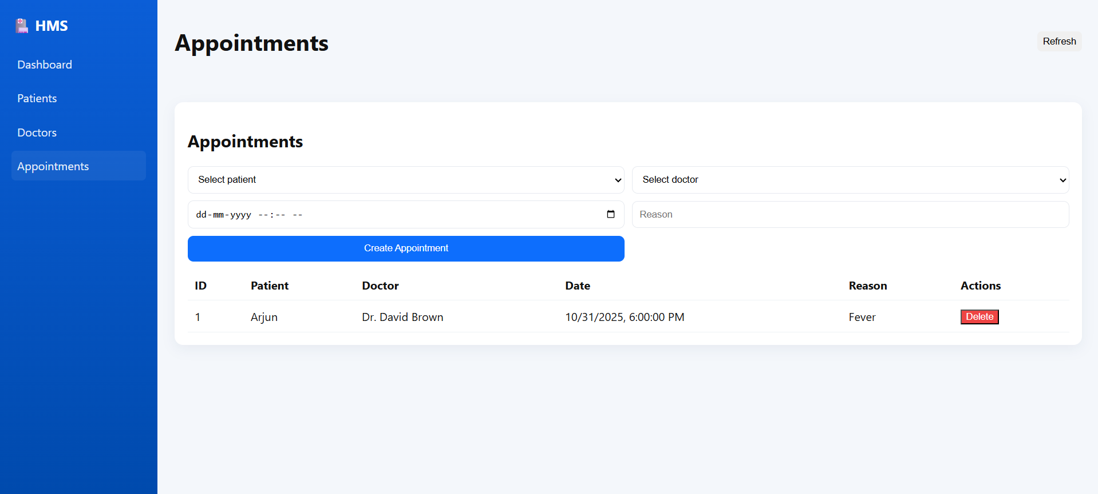

Slide 15
Conclusion
• The HMS project simplifies hospital management, reduces errors, and improves efficiency.
• It allows real-time access to data for doctors, patients, and admin.
• Scalable and can be enhanced with additional features such as online payment, email notifications, and analytics dashboards.

