Slide 1
EMPIRICAL CASE STUDY · 10-MINUTE TALK
Resolution-Induced Performance Collapse of a CNN Change Detector
POOLED F1 (%)
87.06
→ 4.41
Simulated and real Sentinel-2 evidence from one frozen checkpoint
0.5 m → 2 m simulated
2,048 LEVIR-CD test pairs
One frozen checkpoint
Aravind
Department of Computer Science and Engineering
Presidency University, Bengaluru, India
Draft talk · figures generated from saved results · citations pending
Resolution mismatch case study · saved evidence only
1 / 12
Notes:
Good morning. My talk is about a failure mode that aggregate benchmark scores hide: a change detector that looks strong at half a metre and almost stops detecting by two metres. This is a case study of one frozen checkpoint, not a new model, and not a claim that all CNNs fail. I will show a controlled degradation experiment on 2,048 aerial test pairs, a transfer evaluation on ten Sentinel-2 cities, and the limits of both. The question is narrow: what happens to a validated score when the input resolution changes? Please hold two questions: what is actually validated here, and what evidence would change the conclusion?

Slide 2
THE PROBLEM
A native-resolution score does not travel to 10 m
• The checkpoint is trained and scored at 0.5 m on LEVIR-CD aerial pairs.
• Sentinel-2 provides 10 m and 20 m bands, free and frequently revisited.
• Same model, coarser pixel support: small objects, boundaries and mixed pixels change.
• Question: what happens to this checkpoint when the same scenes are coarsened?
PIXEL FOOTPRINT, TO SCALE
10 m
Sentinel-2 pixel
0.5 m LEVIR-CD pixel
(orange square)
20× coarser linearly
400× the area per pixel
The orange square is one 0.5 m LEVIR-CD pixel; the full square is one 10 m Sentinel-2 pixel.
Resolution mismatch case study · saved evidence only
2 / 12
Notes:
The starting point is a mismatch of pixel support. The checkpoint was trained and scored on LEVIR-CD, which is half-metre aerial imagery. Sentinel-2 gives us ten-metre and twenty-metre bands, free and frequently revisited. Ten metres is twenty times coarser per side than half a metre, and four hundred times the area. On this diagram, the large square is one Sentinel-2 pixel; the orange square is one LEVIR-CD pixel, drawn to scale. At that size, small buildings, road edges and boundaries become sub-pixel or mixed. That is not a cosmetic difference. The question is whether a model validated on the fine grid still works when the input is coarsened. The paper does not assume the answer; it measures the same checkpoint under a controlled transform.

Slide 3
DESIGN
One frozen model, two evaluations, no retraining
Controlled degradation
Real Sentinel-2 (OSCD)
• 2,048 LEVIR-CD test pairs
• Six factors: 1, 2, 4, 8, 16, 20
• Gaussian blur + LANCZOS down/up
• Same scene content; only sampling changes
• 10 official test cities
• 3,077,936 pixels; 5.17% changed
• Zero-shot CNN; NDVI/NDBI and Otsu rules
• No SCL; confounded with sensor and season
Frozen checkpoint · one architecture · one training run · fixed 0.5 threshold
Resolution mismatch case study · saved evidence only
3 / 12
Notes:
Here is the design. Two evaluations, one frozen checkpoint, no retraining. On the left, the 2,048 LEVIR-CD test pairs at six factors from one to twenty. On the right, the ten official OSCD test cities: 3,077,936 pixels, 5.17 percent labelled change. The CNN weights are zero-shot on OSCD; the spectral rules are train-selected reference points, not a proposed solution. One architecture, one training run, threshold fixed at 0.5 throughout. That scope is deliberate. This is a case study of a deployed checkpoint, not an architecture comparison, and I will not generalise from one model to all CNNs.

Slide 4
DEGRADATION PROTOCOL
Coarsen, then upsample back to 256×256
1
2
3
4
256×256
Gaussian blur
LANCZOS down
LANCZOS up
before / after pair
radius f / 2
to (256/f)²
back to 256×256
Factors 1, 2, 4, 8, 16, 20 → 0.5, 1, 2, 4, 8, 10 m
At 10 m: a 12×12 intermediate
ImageNet normalization · threshold 0.5
for a 256×256 input
pooled TP / FP / FN over 2,048 pairs
This isolates blur and resampling. It is not a Sentinel-2 simulation.
Resolution mismatch case study · saved evidence only
4 / 12
Notes:
The degradation protocol is simple and reproducible. Start with a 256 by 256 pair. Blur with a Gaussian whose radius is the factor divided by two. Downsample with LANCZOS to 256 over the factor, squared. Upsample back to 256. At factor twenty, the intermediate is only twelve by twelve pixels. Factors one, two, four, eight, sixteen and twenty map to half a metre through ten metres. Then ImageNet normalization, a fixed 0.5 threshold, and pooled true positives, false positives and false negatives over all 2,048 pairs. The blur and resampling isolate the effect of pixel support. They do not simulate Sentinel-2 spectra, atmosphere, mixed-pixel physics or noise. I will come back to that distinction.

Slide 5
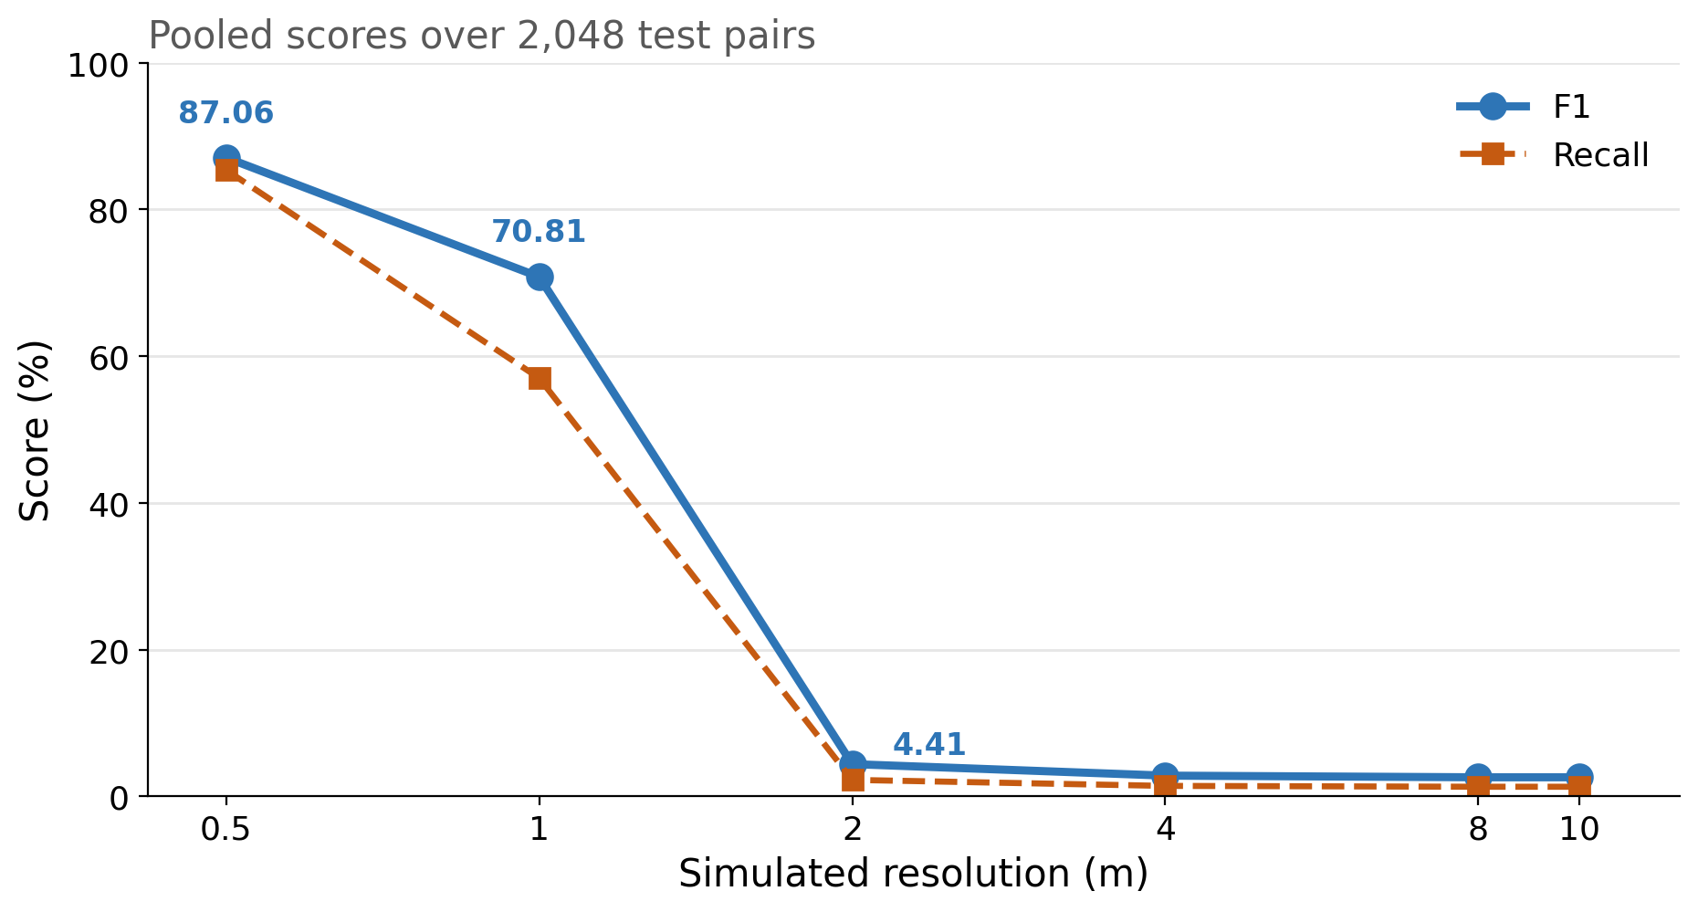
RESULT
F1 falls from 87.06% to 4.41% by 2 m
POOLED F1 (%)
87.06 → 4.41
0.5 m
87.06
1 m
70.81 (−16.25)
2 m
4.41
8–10 m
2.61
Recall: 85.36% → 1.32%
The decline is recall-dominated.
Pooled counts; one checkpoint.
Resolution mismatch case study · saved evidence only
5 / 12
Notes:
Here is the main result. At half a metre, pooled F1 is 87.06 percent. At one metre it is 70.81, a drop of 16.25 points. At two metres it is 4.41 percent. From eight to ten metres it is 2.61. The dashed line is recall: 85.36 percent at native resolution, 57.01 at one metre, 2.26 at two metres, and 1.32 at eight to ten. The decline is recall-dominated. Precision actually rises, from 88.8 percent at native resolution to 99.5 percent at ten metres. So the model is not becoming noisy; it is becoming silent. That is why the next slide matters more than the F1 number alone.

Slide 6
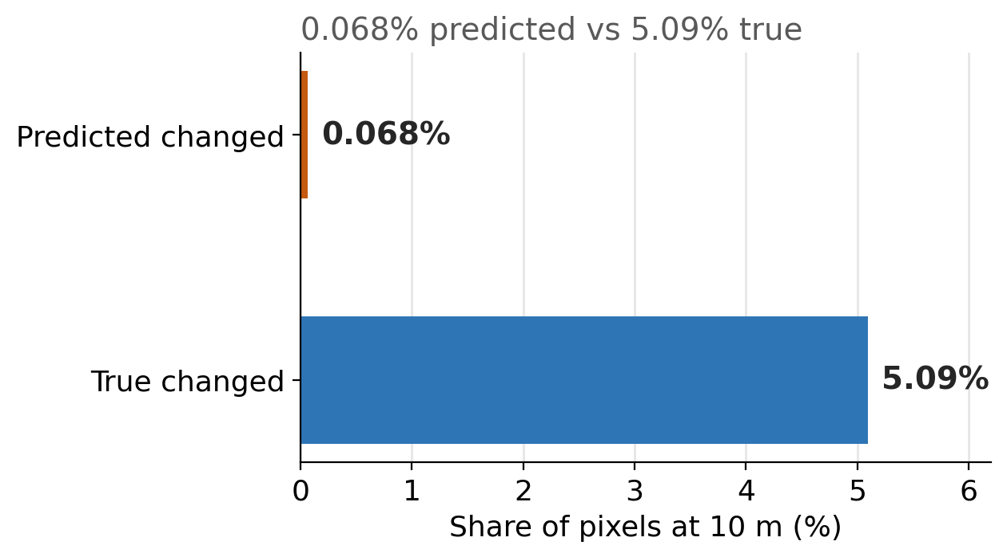
WHY PRECISION MISLEADS
At 10 m, the model predicts almost nothing
0.068%
of pixels predicted changed at 10 m
91,006 of 134,217,728
924 / 935
changed images with zero predicted change
(98.82%)
99.47%
precision, from 90,527 TP and 479 FP
the mask is nearly empty
High precision means the mask is nearly empty — not that localisation is good.
Resolution mismatch case study · saved evidence only
6 / 12
Notes:
At ten metres the model predicts 91,006 pixels changed out of 134,217,728. That is 0.068 percent. 924 of the 935 images that actually contain change receive no predicted change at all, which is 98.82 percent. Precision is 99.47 percent, but it comes from 90,527 true positives and only 479 false positives. A precision-only summary would call this excellent; a recall or predicted-fraction summary exposes that the mask is almost empty. This is the central reporting lesson: precision is not interpretable without prevalence and predicted fraction. The paper therefore reports all three.

Slide 7
REAL SENTINEL-2
OSCD transfer: near-empty CNN, weak spectral rules
Method | Pred. % | Precision | Recall | Score | 95% CI (F1)
Hardcoded NDVI/NDBI | 2.24 | 0.1292 | 0.0561 | F1 0.0782 | 0.0168–0.1846
Percentile 99.0 | 1.66 | 0.2419 | 0.0777 | F1 0.1176 | 0.0540–0.1802
Otsu | 67.35 | 0.0513 | 0.6684 | OA 0.3439 | F1 0.0953; 0.0495–0.1245
CNN joint percentile | 0.01 | 0.2983 | 0.0003 | F1 0.0007 | 0.0000–0.0017
CNN reflectance | 0.00 | — | 0.0000 | F1 0.0000 | —
Random at prevalence | 5.17 | 0.0517 | 0.0517 | F1 0.0517 | —
True change 5.17% · 10 official test cities · 3,077,936 pixels
The test cities had been scored before the reported run. These are descriptive scores, not an independent test.
Resolution mismatch case study · saved evidence only
7 / 12
Notes:
Now the real Sentinel-2 evaluation. OSCD, ten official test cities, 3,077,936 pixels, 5.17 percent true change. The percentile rule has the best pooled F1 among the spectral rules, 0.1176, with a city-bootstrap interval from 0.054 to 0.180. The hardcoded NDVI/NDBI rule is 0.0782, interval 0.017 to 0.185. Those intervals overlap, and the paired difference interval includes zero, so I do not rank them. Otsu predicts 67.35 percent of pixels changed; its headline is overall accuracy 0.3439, not F1. The CNN is near empty: F1 0.0007 for joint-percentile preprocessing, which was chosen on the training cities, and 0.0000 for reflectance. One disclosure is essential: these ten cities had been scored before the reported run. These are descriptive scores, not an independent test, and the paper says so.

Slide 8
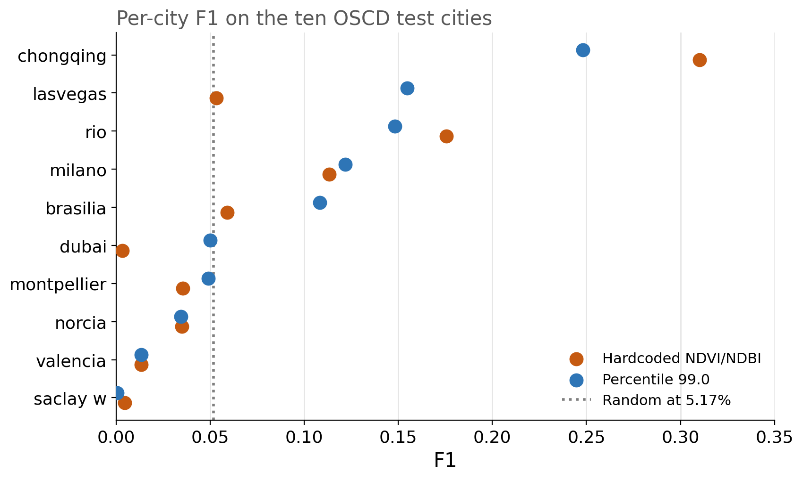
CITY-LEVEL VARIATION
Pooled scores hide large, inconsistent city differences
F1 ACROSS 10 CITIES
Percentile
0.0005 – 0.2481
Hardcoded
0.0032 – 0.3102
Random (analytic)
0.0517
CNN joint
zero in 8 / 10 cities
Descriptive ranges; ten cities. Intervals resample cities or pixels, not training runs.
Resolution mismatch case study · saved evidence only
8 / 12
Notes:
Pooled numbers hide the city variation. Percentile F1 ranges from 0.0005 in saclay_w to 0.2481 in chongqing. Hardcoded ranges from 0.0032 in dubai to 0.3102 in chongqing. The random-at-prevalence F1 is 0.0517, shown as the dotted line; many city values sit near or below it. The CNN predicts nothing in eight of ten cities. These are descriptive ranges from ten cities. The intervals resample cities or pixels; neither includes training or threshold-selection uncertainty. So the pooled score is a summary, not a stable estimate of how the tool will behave in a new city.

Slide 9
INTERPRETATION
Test the resolution path you will deploy
Test the deployed resolution path.
1
A native-resolution benchmark score does not reveal coarse-resolution failure.
Report precision with predicted fraction and prevalence.
2
99.47% precision meant 0.068% of pixels predicted changed.
Do not treat simple indices as a validated fallback.
3
Both spectral rules under-predict; Otsu predicts 67.35% changed.
The paper identifies a risk in evaluation, not a new detector.
Resolution mismatch case study · saved evidence only
9 / 12
Notes:
What does this mean in practice? Start with the resolution path you will deploy. A native-resolution benchmark score does not reveal a coarse-resolution failure; if the product runs on ten-metre data, the evaluation should too. Second, report precision with predicted fraction and prevalence. A near-empty mask can look nearly perfect. Third, do not treat simple spectral indices as a validated fallback. The percentile rule is the best of the spectral options here, but it under-predicts change, and Otsu predicts two thirds of pixels as changed. The paper identifies an evaluation risk. It does not explain the real Sentinel-2 gap or propose a new detector.

Slide 10
WHAT THIS DOES NOT SHOW
One checkpoint, one synthetic degradation, a used test split
• One architecture and one training run; no retraining or seed variation.
• Synthetic degradation: no spectra, atmosphere, mixed pixels or noise.
• OSCD confounds resolution with sensor, geography and season; no SCL.
• Ten cities; the test split had been scored before the reported run.
• The deployed app and scene selection are not validated end to end.
CLAIM BOUNDARY
No causal claim
about the Sentinel-2 gap
No priority claim
No operational claim
The paper reports descriptive evidence, not a validated system.
Resolution mismatch case study · saved evidence only
10 / 12
Notes:
The limits matter. One architecture and one training run; no retraining, fine-tuning or seed variation. The degradation is synthetic: no Sentinel-2 spectra, atmosphere, mixed-pixel physics or noise. The OSCD evaluation uses real data, but it confounds resolution with sensor, geography and season, and the benchmark layout has no SCL, so clouds are uncontrolled. Ten cities, and the test split had been scored before the reported run. Finally, the deployed application, its scene selection and its interface are not validated end to end. So: no causal claim about the real Sentinel-2 gap, no priority claim, no operational claim. What remains is descriptive evidence of an evaluation risk.

Slide 11
NEXT EVIDENCE
What would make the result stronger
1
A second architecture and checkpoint, with multiple seeds.
2
Real same-scene acquisitions at multiple resolutions.
3
An untouched city set or a new dataset.
4
An SCL-preserving benchmark and a wider threshold grid.
An operator study on whether warnings change decisions.
These are evidence needs, not results.
Resolution mismatch case study · saved evidence only
11 / 12
Notes:
What would change the conclusion? A second architecture and checkpoint, with multiple seeds. Real acquisitions of the same scenes at multiple resolutions, rather than synthetic resampling. An untouched city set or a new dataset. An SCL-preserving benchmark and a wider threshold grid. And an operator study on whether warnings actually change decisions. These are evidence needs, not results; none of them is in the paper. If you take one thing for your own evaluation practice, prioritise these two: test the deployed path, and do not reuse a test split.

Slide 12
TAKEAWAY
A 0.5 m score is not a 10 m validation.
87.06% → 4.41%
0.068%
924 / 935
pooled F1 from 0.5 m to 2 m
under blur + resampling
of pixels predicted changed at 10 m
91,006 of 134,217,728
changed images with zero
predicted change (98.82%)
Real OSCD: CNN F1 0.0007 · spectral rules 0.078–0.118 · neither is a validated fallback.
Paper, figures and artifact: TODO — insert verified repository URL and DOI.
Draft; citations and PDF pending. Thank you.
Resolution mismatch case study · saved evidence only
12 / 12
Notes:
Takeaway: a half-metre score is not a ten-metre validation. F1 fell from 87.06 to 4.41 percent by two metres under blur and resampling. At ten metres, 0.068 percent of pixels were predicted changed, and 924 of 935 changed images were empty. On real OSCD, the CNN F1 was 0.0007, the spectral rules were 0.078 to 0.118, and neither is a validated fallback. The paper reports these limits explicitly. The evidence is saved, the code and figures are in the artifact, and citations are still being verified. Thank you; I am happy to take questions.

