Slide 1
VIT CHENNAI | SCHOOL OF COMPUTER SCIENCE AND ENGINEERING
CONTEXT-AWARE OCR CORRECTION
WITH GRAPH RAG & PROPOSED ROBOTIC SORTING
Review III | Final-Year CSE Capstone
Aravind Raghuram T A | 23BCE1493
Akshith Srinivas M | 23BCE5078
Swaroopa Mangal M | 23BRS1223
Guide Dr. Jayaram B
Review date 16 September 2026
IMPLEMENTED SOFTWARE PIPELINE -> PROPOSED PHYSICAL INTEGRATION
Notes:
Project review cover. Robotics integration is a proposed design; the OCR software pipeline is implemented and tested.

Slide 2
PROJECT SCOPE
02
One project, two clearly separated deliverables
IMPLEMENTED AND DEMONSTRATED
DESIGNED FOR NEXT PHASE
ContextOCR software
Robotic sorting extension
15-stage local OCR pipeline
Confidence-aware token selection
BGE-M3 / FAISS evidence retrieval
Knowledge graph + local Qwen selection
Validation and searchable PDF export
Dynamic evaluation dashboard
AI output mapped to physical decisions
NodeMCU-based controller architecture
Sensors, motors and actuator selection
CAD concept and bill of materials
Implementation plan and risk controls
No physical prototype claimed in Review III
Review claim
Software is executable and attributable; the robotics subsystem is an engineering proposal supported by CAD and component design.
CONTEXT OCR | REVIEW III | 16 SEP 2026
2

Slide 3
PROBLEM STATEMENT
03
Why post-OCR correction needs context, evidence and restraint
01
02
03
OCR confidence can mislead
Naive correction is risky
Outputs must remain usable
A line may score highly while individual tokens contain substitutions such as govemment or regulatlon.
Whole-document language-model rewriting can change names, numbers and meaning without traceable evidence.
The corrected deliverable must preserve provenance and be searchable, selectable and downloadable as a PDF.
Engineering question
Can a local, selective and evidence-grounded pipeline correct only uncertain tokens while preserving document fidelity?
CONTEXT OCR | REVIEW III | 16 SEP 2026
3

Slide 4
REVIEW STRATEGY
04
Evidence mapped directly to the Review III rubric
20 marks | implementation, accuracy, results and presentation
IMPLEMENTATION
Live 15-stage workflow, local models, selectable PDF output
5 marks
TECHNICAL ACCURACY
Algorithms, thresholds, retrieval method and validation rules
5 marks
RESULTS OBTAINED
Real correction trace, dataset metrics and generated charts
5 marks
PRESENTATION AND CLARITY
Implemented/proposed boundary, limitations and next steps
5 marks
CONTEXT OCR | REVIEW III | 16 SEP 2026
4

Slide 5
IMPLEMENTED ARCHITECTURE
05
Local-first software system with evidence-preserving stages
INPUT
PERCEPTION
REASONING
SELECTION
DELIVERY
PDF / image
Preprocess + layout + OCR
Confidence + candidates + GraphRAG
Local Qwen + validation
Searchable PDF + evaluation
All correction stages operate locally; the original OCR is retained alongside corrected output and provenance.
No cloud language-model API is required for correction.
CONTEXT OCR | REVIEW III | 16 SEP 2026
5

Slide 6
EXECUTION PIPELINE
06
Every stage exposes its input, method, parameters, output and diagnostics
01
Document Input
02
Preprocessing
03
Layout Detection
04
Reading Order
05
OCR Extraction
06
Confidence Analysis
07
Low-Confidence Detection
08
Candidate Generation
09
Semantic Retrieval
10
Knowledge Graph
11
Hybrid GraphRAG
12
Dynamic Prompt
13
Qwen Selection
14
Validation
15
Final Output
Selective path: only tokens below the configured confidence threshold enter candidate, retrieval and Qwen stages.
CONTEXT OCR | REVIEW III | 16 SEP 2026
6

Slide 7
IMPLEMENTATION STACK
07
Actual components used in the running system
API
READY
OCR
READY
LAYOUT
READY
FastAPI + Uvicorn
PaddleOCR PP-OCRv5 mobile
DocLayout-YOLO
EMBEDDING
READY
VECTOR SEARCH
READY
READY
GRAPH
BGE-M3 Q4_K_M via llama.cpp
FAISS IndexFlatIP
In-memory graph; Neo4j optional
LOCAL SLM
READY
UI
READY
EXPORT
READY
Qwen2.5-3B-Instruct Q4_K_M
React + Vite
Searchable PDF + provenance JSON
Neo4j enhances persistent graph retrieval when Docker is running; the pipeline still constructs a local document graph without it.
CONTEXT OCR | REVIEW III | 16 SEP 2026
7

Slide 8
EVALUATION FRAMEWORK
08
Reference-free quality score uses transparent, renormalized weights
ACTIVE MODE
Without ground truth
Unavailable CER/WER terms are removed and the remaining configured weights are renormalized to 100%.
CLASSIFICATION
Quality bands
High >= 90
Medium 75-89.99
Low < 75
CONTEXT OCR | REVIEW III | 16 SEP 2026
Source: backend/evaluation_config.json + evaluation report
8
Notes:
Source: E:\Projects\OCR_Proj1\backend\evaluation_config.json and data/evaluations/83b4c9f3-ed5a-4f92-9a47-059552d00d9f/report.json

Slide 9
SCORING METHOD
09
Quality calculation and missing-data policy
Q = 100 x SUM(w_i x m_i) / SUM(w_i active)
RULE 1
RULE 2
RULE 3
No fabricated metrics
Dynamic recomputation
Traceable inputs
CER and WER remain unavailable when verified transcription is absent.
Every evaluation creates a new ID and recalculates metrics and charts.
Input signatures and per-document SHA-256 values preserve reproducibility.
CONTEXT OCR | REVIEW III | 16 SEP 2026
9

Slide 10
EVALUATION MODES
10
The same engine supports evidence-rich and reference-free datasets
MODE A
MODE B | CURRENT DATASET
With verified ground truth
Without ground truth
Character Error Rate (CER)
Word Error Rate (WER)
Before/after improvement when available
Classification metrics when labels exist
All quality components remain active
OCR confidence where available
Valid-word and dictionary ratios
Noise and artifact cleanliness
Language and structural consistency
CER/WER explicitly shown as unavailable
Current review results use Mode B; this limitation is shown on every results slide.
CONTEXT OCR | REVIEW III | 16 SEP 2026
10

Slide 11
METRIC DEFINITIONS
11
What the evaluation engine actually measures
OCR confidence
Valid-word ratio
Dictionary match
Mean token confidence when produced by the OCR engine
Share of extracted words passing lexical validity checks
Share matching the configured English lexicon
Noise cleanliness
Artifact cleanliness
Language consistency
Penalty for detected noise characters
Penalty for repeated-character OCR artifacts
Probability that extracted text is English
Structural consistency
Symbol cleanliness
Density quality
Bounding-box, fragmentation, balance and line coherence
Penalty for excessive non-alphanumeric symbols
Characters per megapixel within expected bounds
CONTEXT OCR | REVIEW III | 16 SEP 2026
11

Slide 12
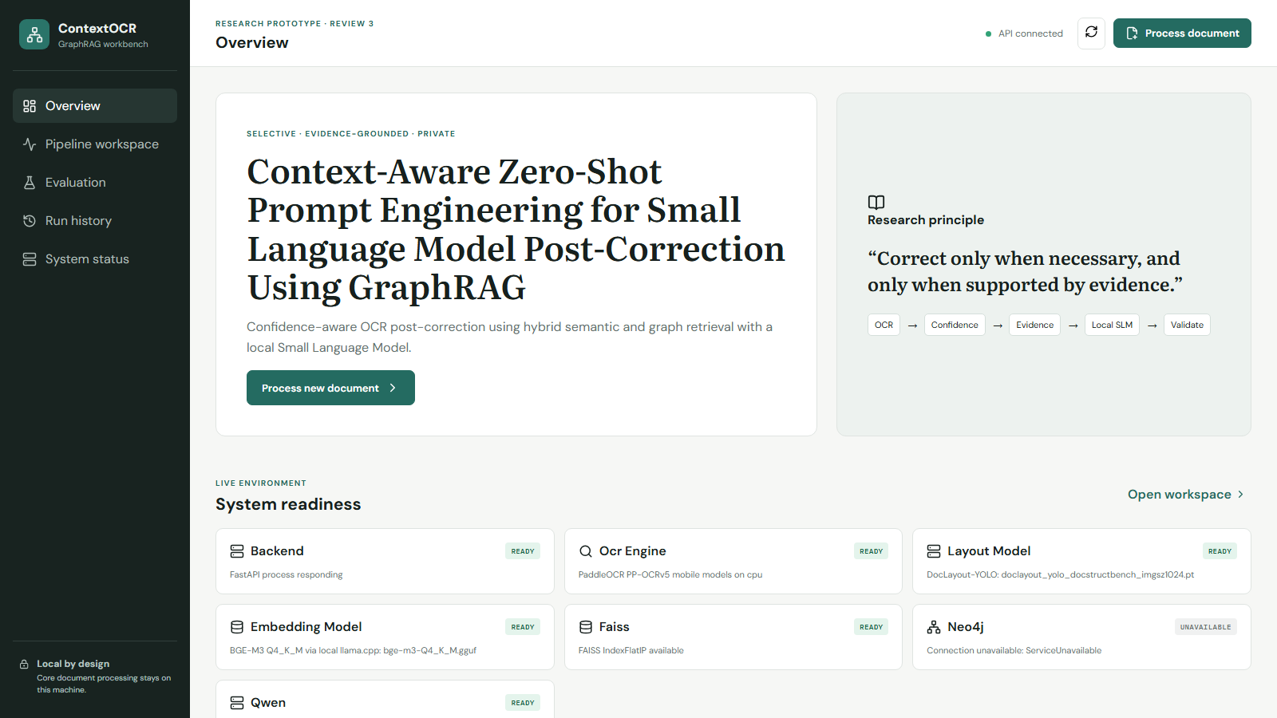
LIVE IMPLEMENTATION EVIDENCE
12
Actual website readiness snapshot
READY
Core local pipeline
FastAPI, PaddleOCR, DocLayout-YOLO, BGE-M3, FAISS and Qwen are detected by the live application.
OPTIONAL SERVICE
Neo4j via Docker
Unavailable in this capture because Docker Desktop was not running. The in-memory document graph remains available.
CONTEXT OCR | REVIEW III | 16 SEP 2026
Actual capture: 14 Sep 2026 | localhost application
12

Slide 13
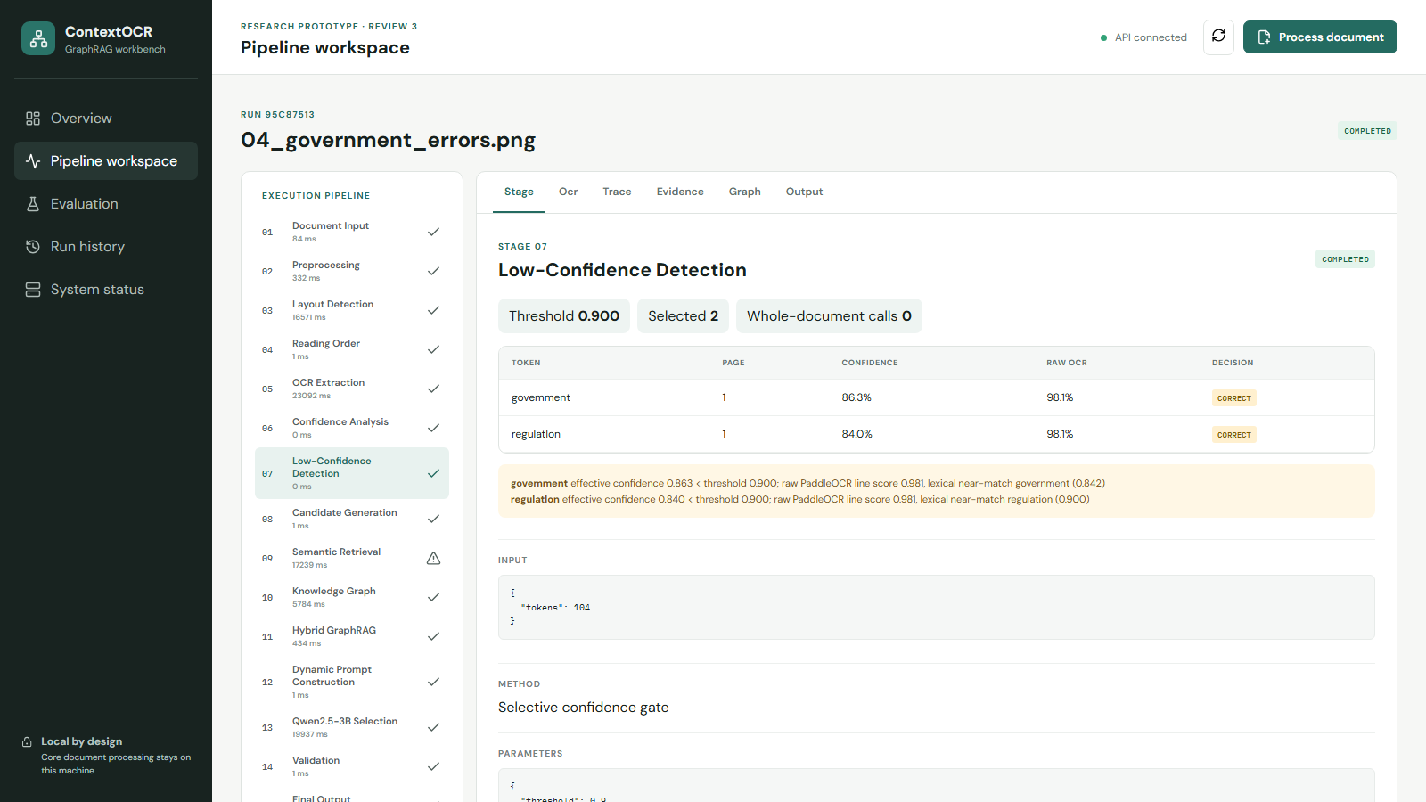
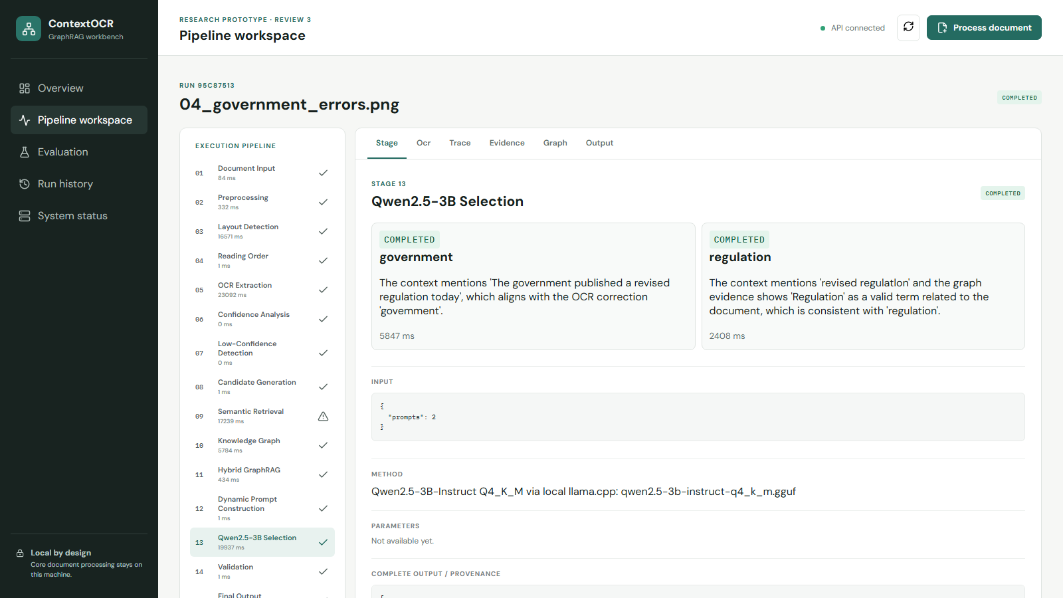
REAL CORRECTION TRACE
13
Low-confidence detection -> local Qwen selection
DETECTION
Threshold 0.900 | 2 selected tokens
SELECTION
2 local Qwen calls | 2 completed
govemment -> government | regulatlon -> regulation | both validated and accepted
CONTEXT OCR | REVIEW III | 16 SEP 2026
Actual run: 95c87513-630e-47f2-979d-6864ee489304
13
Notes:
Source: local API run 95c87513-630e-47f2-979d-6864ee489304.

Slide 14
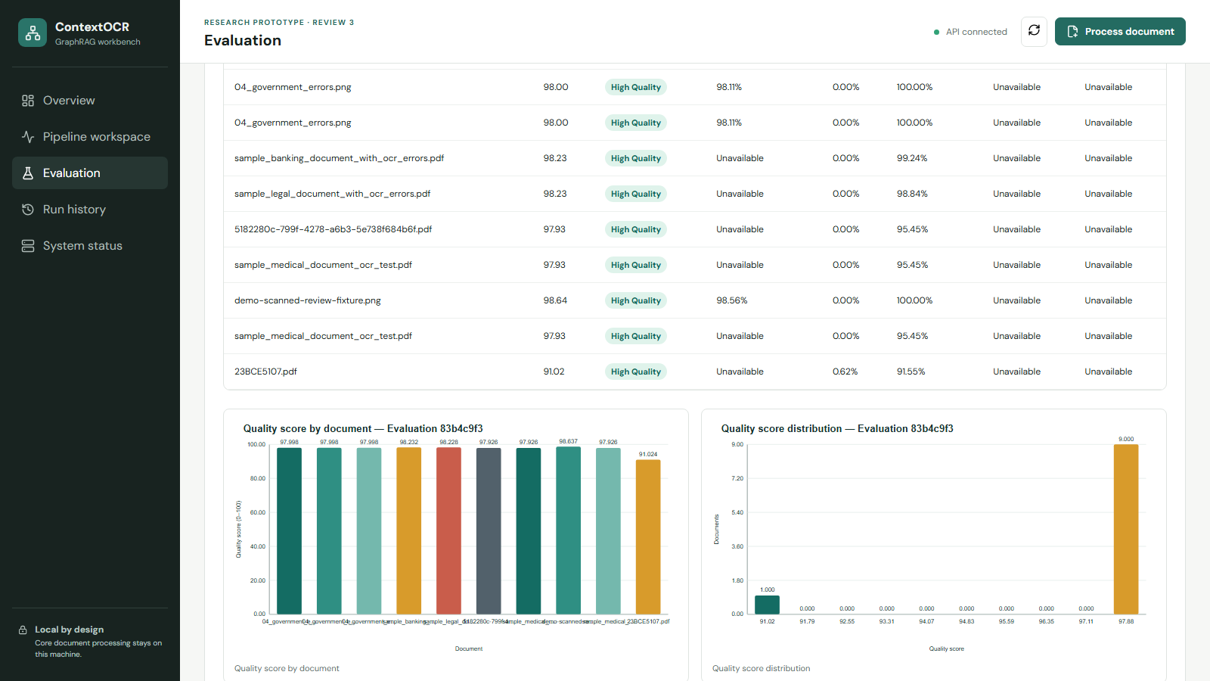
RESULTS OBTAINED SO FAR
14
Dynamic dataset evaluation - actual current pipeline outputs
10
97.39
98.00
10 / 10
DOCUMENTS
AVERAGE QUALITY
MEDIAN QUALITY
HIGH QUALITY
DATASET MODE
Without ground truth
Average CER and WER are unavailable, not estimated, because verified transcriptions were not supplied.
OUTPUTS
8 regenerated charts
JSON, CSV, graph source data, SVG charts and an evaluation log are written per evaluation ID.
CONTEXT OCR | REVIEW III | 16 SEP 2026
Actual evaluation: 83b4c9f3-ed5a-4f92-9a47-059552d00d9f
14

Slide 15
PER-DOCUMENT QUALITY
15
Actual scores from the latest completed dataset evaluation
RANGE
91.02-98.64
The lowest score is the two-page 23BCE5107 PDF; the demo scan achieved the highest score.
INTERPRETATION
Score meaning
Scores reflect consistency and cleanliness indicators, not transcription accuracy against a verified reference.
CONTEXT OCR | REVIEW III | 16 SEP 2026
Source: evaluation report graph_source_data.quality_by_document
15

Slide 16
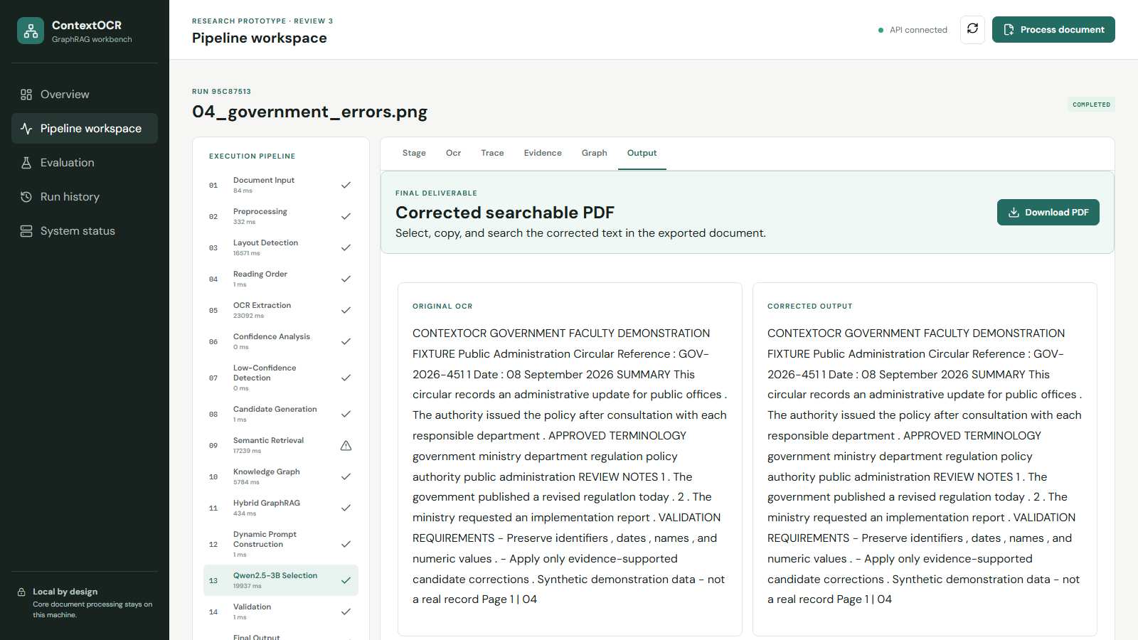
FINAL DELIVERABLE
16
Corrected output is a searchable, selectable PDF
PRESERVED
Original OCR
The source transcription remains visible for comparison and provenance.
DELIVERED
Corrected PDF
Validated token substitutions are written into a downloadable text-searchable PDF.
CONTEXT OCR | REVIEW III | 16 SEP 2026
Actual output: data/output/95c87513-...-corrected.pdf
16

Slide 17
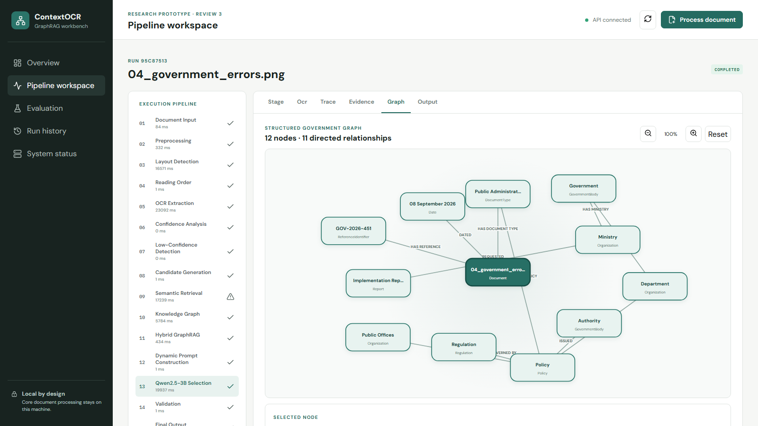
KNOWLEDGE GRAPH EVIDENCE
17
Readable document-centred graph from the real government fixture
GRAPH
12 nodes
Document, date, reference, organizations, policy and regulation entities.
PURPOSE
Grounded selection
Candidate terms are linked to semantic and graph evidence before local Qwen selection.
CONTEXT OCR | REVIEW III | 16 SEP 2026
Actual graph view: run 95c87513
17

Slide 18
VERIFICATION EVIDENCE
18
Automated tests, build and API checks
25
13
SUCCESS
HTTP 200
backend tests passed
evaluation tests passed
frontend production build
chart endpoint
pytest suite
metrics, charts, stale-data checks
Vite build completed
image/svg+xml returned
Evidence is executable and attributable: the same repository contains the API, UI, tests, model adapters, outputs and evaluation artifacts.
CONTEXT OCR | REVIEW III | 16 SEP 2026
Verification completed in the project environment
18

Slide 19
REPRODUCIBILITY & STATE INTEGRITY
19
Fresh computation without fabricated or stale results
01
02
03
New evaluation ID
Deterministic signature
Machine-readable evidence
Each request creates a new UUID and timestamp. Existing result folders are never silently reused as a new run.
The current pipeline outputs and configuration produce an input signature for audit and comparison.
JSON, CSV, source data, charts and logs are stored together under the evaluation ID.
Same input state -> same metrics/signature; changed input state -> changed signature and regenerated artifacts.
CONTEXT OCR | REVIEW III | 16 SEP 2026
19

Slide 20
LIMITATIONS & NEXT VALIDATION
20
Claims are bounded by the evidence available today
No verified ground truth
CER/WER and correction accuracy cannot yet be claimed.
NEXT | Prepare faculty-reviewed transcriptions.
Small local dataset
Ten unique document outputs support functional, not statistical, conclusions.
NEXT | Expand balanced domain fixtures.
Memory-sensitive local models
BGE-M3 and Qwen share Windows memory/pagefile resources.
NEXT | Benchmark sequential loading and quantization.
Robotics not fabricated
CAD, control logic and BoQ are proposed; hardware is not built.
NEXT | Prototype after software review sign-off.
CONTEXT OCR | REVIEW III | 16 SEP 2026
20

Slide 21
SYSTEM INTEGRATION
21
From implemented document intelligence to proposed physical action
IMPLEMENTED NOW
PROPOSED NEXT
OCR -> confidence gate
GraphRAG -> local Qwen
Validation -> searchable PDF
Quality evaluation -> charts
Document class -> control command
NodeMCU -> motor/actuator
Sensors -> position feedback
Physical bin -> audit event
The following slides retain the team's robotics design and are explicitly presented as proposed physical integration.
CONTEXT OCR | REVIEW III | 16 SEP 2026
21

Slide 22
AI-Driven Intelligent Document Analysis
and Robotic Sorting System
Project-1
Integrating OCR + Small Language Model + Decision Intelligence + Physical Robotic Actuation
Document Input
OCR
SLM Analysis
Decision
Robotic Action
Aravind Raghuram T A - 23BCE1493
Akshith Srinivas M - 23BCE5078
Swaroopa Mangal M - 23BRS1223
Guide: Dr. Jayaram B | Review: 16 Sep 2026
PROPOSED PHYSICAL INTEGRATION

Slide 23
1. Problem Statement
Why a software-only document intelligence system is insufficient for this project-1
Current Challenge
Technical Gap
Robotics Gap
Large volumes of documents arrive in mixed formats and require extraction, understanding, validation and routing. Manual handling is slow and error-prone.
OCR alone extracts text but does not provide domain-aware contextual interpretation and confidence-based intervention.
A classification result remains virtual unless it triggers a meaningful physical action such as routing, sorting or manual intervention.
PROPOSED PHYSICAL INTEGRATION

Slide 24
2. Project Objective and Expected Output
• Build an intelligent pipeline that accepts physical or digital documents in heterogeneous formats.
• Extract text using OCR and normalize it into a machine-readable representation.
• Use a domain-adapted Small Language Model (SLM) for contextual classification/decision support.
• Generate an interpretable decision with confidence or predefined rule conditions.
• Convert the digital decision into physical robotic action using sensors, actuators and a controller.
INPUT
Document image / scanned paper / PDF / structured or semi-structured text
INTELLIGENT PROCESSING
OCR → preprocessing → SLM → classification → confidence/rules
OUTPUT
Digital result + physical routing to Accepted / Review / Rejected tray
PROPOSED PHYSICAL INTEGRATION

Slide 25
3. Core Concept: Closed-Loop AI-to-Robotics Pipeline
Physical Document
Camera / Scanner
OCR & Pre-processing
SLM Inference
Decision Engine
ESP32 Control
Servo / Motor Action
• Perception layer captures the real-world document.
• Intelligence layer understands the extracted content and determines its category/status.
• Decision layer maps AI confidence and project rules to a deterministic action.
• Robotics layer executes the action and uses sensors to confirm document position.
Why this is Robotics Integration
The robot is not merely displaying a classification result. The AI output becomes an actuator command that physically changes the state/location of the document.
PROPOSED PHYSICAL INTEGRATION

Slide 26
4. What are the Input and Output?
INPUTS
OUTPUTS
• Physical paper document placed in feeder
• Digital image / PDF / scanned page
• OCR text extracted from document
• Sensor signals: entry and position confirmation
• Optional metadata / predefined domain rules
• Predicted document category / semantic label
• Confidence score and explanation fields
• Decision: Accept / Route / Manual Review
• Controller command to actuator
• Physical movement of document into the selected tray
PROPOSED PHYSICAL INTEGRATION

Slide 27
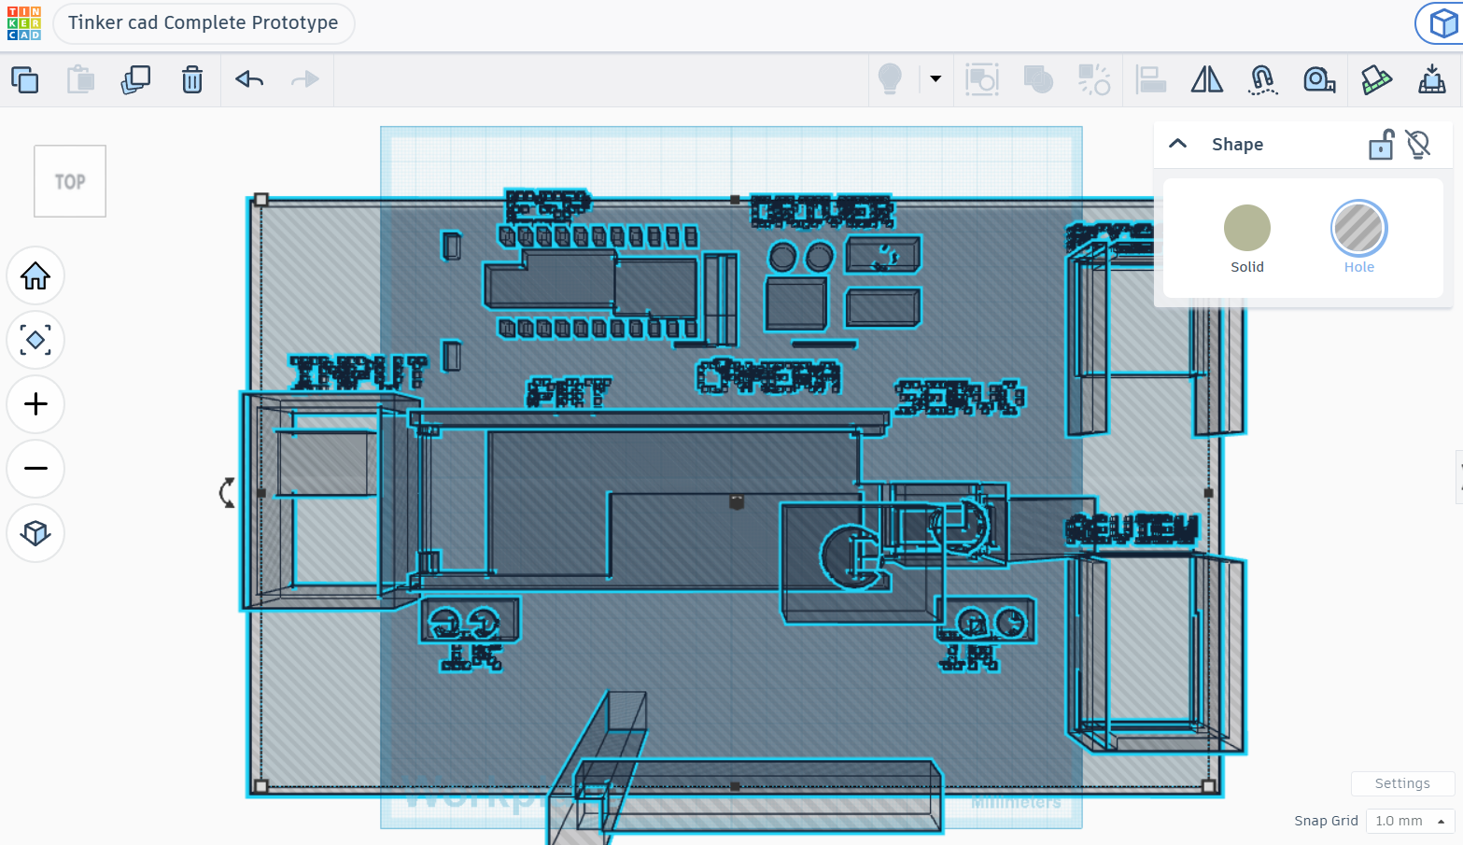
Top View
PROPOSED PHYSICAL INTEGRATION

Slide 28
Bill of Quantities
A. Core Hardware Components
Component | Qty | Purpose
ESP32 | 1 | Main Controller
USB Camera | 1 | Document Perception
Servo Motor | 1 | Sorting Actuation
IR Sensors | 2 | Document Detection
Motor Driver | 1 | Motor Control
DC Geared Motor | 1 | Conveyor Movement
PROPOSED PHYSICAL INTEGRATION

Slide 29
Bill Of Quantites
B.Mechanical Components
Component | Qty | Purpose
Conveyors Rollers/Belt | 1 Set | Document Transportation
Input Tray | 1 | Document Feeding
Output Tray | 2 | Accept/ Review Seperation
Base Frame | 1 | Component Mounting
Camera Stand | 1 | Camera Positioning
PROPOSED PHYSICAL INTEGRATION

Slide 30
5. Why Small Language Model (SLM) Instead of a Large Language Model?
LLM
Chosen Approach: SLM
Domain Training
High general capability
Large memory footprint
Higher latency/cost
Often excessive for a narrow, fixed domain
Compact model fine-tuned/adapted for the project domain.
Advantages:
• Faster inference
• Lower hardware requirement
• Easier deployment
• Better privacy/control
• Suitable for constrained, repeatable tasks
The SLM is not intended to know everything. It is optimized for the specific document domain and target classes defined by the project.
PROPOSED PHYSICAL INTEGRATION

Slide 31
6. SLM Dataset and Model Selection Strategy
Collect Domain Documents
OCR / Text Cleaning
Anonymize
Annotate Labels
Train / Fine-tune
Validate
Deploy
Dataset Composition
Candidate Model Criteria
Final Model Decision
Domain-specific documents + publicly permitted datasets + synthetically varied samples where appropriate.
Each record mapped to a target class and validation criteria.
Small parameter footprint, instruction-following ability, fine-tuning support, CPU/GPU deployment feasibility and consistent classification performance.
Select experimentally after benchmarking candidate compact models on accuracy, latency, memory and robustness—not only popularity.
PROPOSED PHYSICAL INTEGRATION

Slide 32
7. OCR for Different Document Formats
PDF / Image / Scan
Format Detection
Image Rendering
Pre-processing
OCR
Text Normalization
SLM Input
• Digital PDFs: extract embedded text when available; otherwise render pages and apply OCR.
• Scanned PDFs/images: deskew, denoise, contrast enhancement and OCR.
• Photographed documents: perspective correction and illumination normalization.
• Handwritten content: use handwriting-capable OCR where the quality and supported language permit reliable extraction.
• All extracted text is normalized into a common representation before intelligence processing.
PROPOSED PHYSICAL INTEGRATION

Slide 33
8. What Do We Classify or Cluster—and Why?
Classification (Primary)
Clustering (Optional / Analysis)
Assign each document to a known project-relevant class.
Examples:
• Category A → automated route
• Category B → alternate route
• Uncertain → manual review
Why: physical sorting requires a deterministic action.
Group semantically similar documents when labels are incomplete or for discovering new patterns.
Why: useful during dataset exploration, anomaly discovery and future category expansion—not necessarily required for every real-time routing decision.
PROPOSED PHYSICAL INTEGRATION

Slide 34
9. Practical Use Case
Scenario
Intelligence
Physical Outcome
Mixed physical documents are placed into the input feeder. Each document is automatically captured and analyzed.
OCR extracts content. The SLM performs domain-aware contextual classification and the decision engine evaluates confidence/rules.
A servo-controlled diverter routes the document to the correct output tray. Low-confidence cases are preserved for human review.
PROPOSED PHYSICAL INTEGRATION

Slide 35
10. Novelty with Respect to Existing NLP Systems
• Existing attention, Transformer, BERT and encoder-decoder models primarily improve language representation and prediction.
• Our novelty is system-level: connecting contextual document intelligence to a closed-loop physical decision system.
• Domain-adapted SLM enables lightweight inference rather than depending on a large general-purpose model.
• Confidence-aware routing creates a human-in-the-loop path instead of blindly automating every prediction.
• Sensor confirmation links AI decisions with the physical state of the document.
• The contribution is an end-to-end cyber-physical architecture: perception → understanding → decision → actuation → verification.
NLP Model Only +
Domain SLM + Confidence Logic + Sensors + Actuator + Closed-Loop System
PROPOSED PHYSICAL INTEGRATION

Slide 36
11. How Exactly Is the Robotic Component Integrated?
Sensor Detects Document
Feed Motor Moves Document
Camera Captures
AI Decision
ESP32 Receives Command
Servo Gate Rotates
Sensor Confirms Exit
Sensors
Actuators
Control Logic
IR / break-beam sensors determine document entry and position. These are conditions that synchronize software and physical movement.
DC motor / roller feeds the document. Servo motor changes the diverter position according to the final decision.
IF sensor confirms scan position AND AI confidence ≥ threshold → route automatically. ELSE → send to manual review.
PROPOSED PHYSICAL INTEGRATION

Slide 37
12. Proposed Decision Logic (Strong Panel Explanation)
Document Detected
Move to Scan Position
OCR + SLM
Confidence / Rule Check
HIGH CONFIDENCE
ALTERNATE CATEGORY
LOW CONFIDENCE / ERROR
Classification valid + conditions satisfied
→ Servo Gate Position A
→ Accepted / Category Tray
Classification valid but belongs to another class
→ Servo Gate Position B
→ Alternate Output Tray
OCR unclear OR confidence below threshold OR sensor mismatch
→ Safe route
→ Manual Review Tray
PROPOSED PHYSICAL INTEGRATION

Slide 38
13. Complete System Architecture
Document Feeder
Camera
OCR & Preprocess
SLM
Decision Engine
UART / Serial
ESP32
Motor Driver + Servo
Input Tray
Entry Sensor
Scanning Platform
AI Processing Unit
ConfidenceRules
Embedded Controller
Sorting Gate
Output Trays
• High-level computing unit performs OCR and SLM inference.
• ESP32 handles deterministic real-time I/O and actuator control.
• Communication layer transfers only the required decision command and status signals.
• Separation of intelligence and motor control keeps the design modular and easier to debug.
PROPOSED PHYSICAL INTEGRATION

Slide 39
14. Proposed Hardware and Software Requirements
Camera / USB Camera
ESP32
Servo Motor
DC Geared Motor / Rollers
Document perception
Sensors + servo/motor control
Sorting gate actuation
Document feeding
IR / Break-beam Sensors
Motor Driver
Power Supply
Frame / Platform
Position confirmation
Safe motor interface
Controller + actuator power
Physical prototype
PROPOSED PHYSICAL INTEGRATION

Slide 40
15. Proposed CAD Layout and Labels
CAMERA
INPUT
TRAY
ROLLER
FEED
SCANNING
ZONE
SERVO
GATE
ACCEPT
TRAY
REVIEW
TRAY
PROPOSED PHYSICAL INTEGRATION

Slide 41
16. Implementation Plan from Current Stage to Final Demonstration
Phase 1
Dataset + Problem
Phase 2
OCR Pipeline
Phase 3
SLM Training
Phase 4
Decision Engine
Phase 5
CAD Prototype
Phase 6
Hardware Build
Phase 7
Integration + Testing
• Phase 1: Finalize domain, classes, input formats and evaluation criteria.
• Phase 2–3: Build OCR baseline and benchmark compact language models.
• Phase 4: Implement confidence thresholding and safe fallback rules.
• Phase 5–6: Complete CAD assembly, procure components and fabricate prototype.
• Phase 7: Connect AI decision output to ESP32, actuators and sensor feedback; evaluate end-to-end accuracy and physical reliability.
PROPOSED PHYSICAL INTEGRATION

Slide 42
17. Evaluation Metrics
OCR
SLM
Robotics
End-to-End
Character/word extraction quality
Format robustness
Processing time
Classification accuracy
Precision / Recall / F1
Inference latency
Successful routing rate
Actuation time
Sensor synchronization
Correct final tray
Manual-review safety
Failure recovery
PROPOSED PHYSICAL INTEGRATION

Slide 43
18. Expected Outcome and Contribution
• A proposed proof-of-concept design demonstrating that document intelligence can trigger a reliable physical response.
• Lightweight domain-adapted NLP suitable for constrained deployment.
• Multiformat document handling through OCR normalization.
• Confidence-aware human-in-the-loop intervention for uncertain cases.
• Clear robotics contribution through sensing, actuation, embedded control and physical routing.
• A modular architecture that can later support additional categories, sensors and robotic mechanisms.
Final Demonstration (planned)
1. Insert document
2. Sensor detects entry
3. Camera captures page
4. OCR + SLM analyze
5. Decision generated
6. Servo routes document
7. Output tray verifies result
PROPOSED PHYSICAL INTEGRATION

Slide 44
19. Summary
Input / Output
SLM vs LLM
Dataset
Narrow domain, lower latency, lower compute, easier deployment
Document → OCR/SLM decision → digital label + physical routing
Domain documents + permitted public data + labeled classes
Model
OCR
Classify / Cluster
Benchmark compact candidates; choose based on accuracy/latency/memory
Classification for routing; clustering optional for exploration
Format-aware preprocessing → OCR → normalized text
Use Case
Novelty
Robotics
Automated document understanding and physical sorting
Closed-loop AI → confidence decision → sensor/actuator response
Sensors + feeder + controller + servo gate + verification
PROPOSED PHYSICAL INTEGRATION

Slide 45
Conclusion
Our project combines an implemented NLP pipeline with a proposed robotic sorting architecture.
IMPLEMENTED: OCR, evidence-grounded SLM selection, validation and searchable PDF output.
PROPOSED: sensors, controller and actuators that convert the software decision into a physical action after hardware testing.
PERCEIVE
UNDERSTAND
DECIDE
ACT
VERIFY
Thank You | Questions & Discussion
PROPOSED PHYSICAL INTEGRATION

