Slide 1
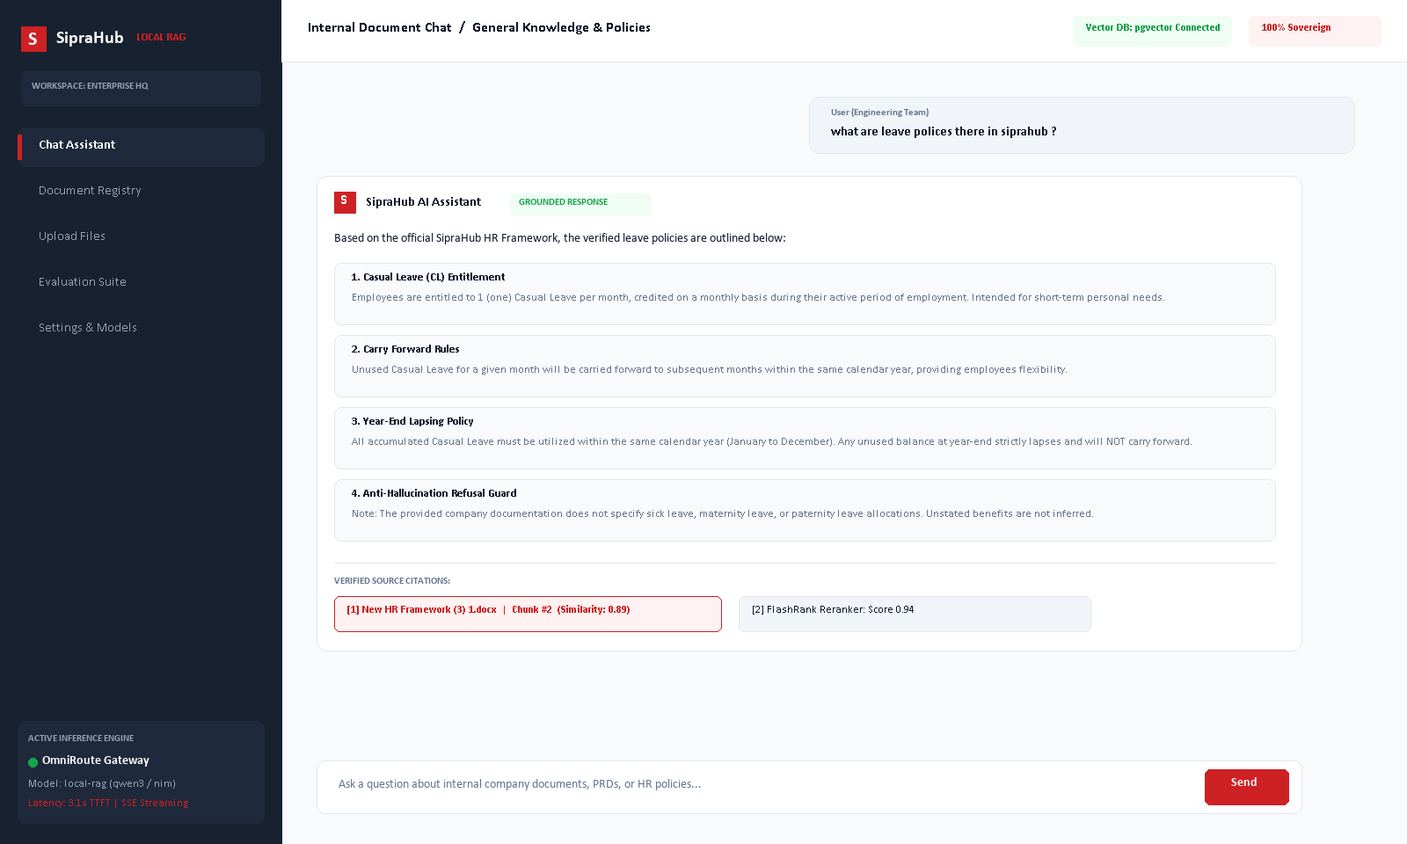
ENTERPRISE AI PORTFOLIO
SipraHub Local RAG
Grounded Conversational Intelligence & Sovereign Document Search
Delivering enterprise-grade data privacy, hybrid semantic search, and real-time verifiable document answers without cloud data leakage.
CATEGORY: Enterprise AI | Retrieval-Augmented Generation | Private Knowledge Base
SipraHub
AI-Driven Digital Transformation
1

Slide 2
CASE STUDY 06. | EXECUTIVE SUMMARY
Executive Summary: Enterprise Document Intelligence
SipraHub engineered a fully sovereign Local RAG platform enabling employees to converse naturally with internal HR policies, software PRDs, and architecture blueprints with zero hallucination and complete data privacy.
31.5s
End-to-End Latency
Down from 218s via real-time token streaming and memory fast-paths.
100%
Data Sovereignty
All embeddings & document context stay strictly within private infrastructure.
0
Fabricated Policies
Strict anti-hallucination prompt guardrails suppress unstated rules.
13+
Document Formats
Native parsing for PDF, DOCX, XLSX, PPTX, Markdown, and text files.
SipraHub
AI-Driven Digital Transformation
2

Slide 3
CASE STUDY 06. | BUSINESS CHALLENGE
Operational Friction & Governance Bottlenecks
Modern enterprises face severe trade-offs between generative AI productivity and information compliance.
01
Information Fragmentation
Internal policies, software specifications, and architectural documentation are siloed across disparate Word, PDF, and spreadsheet files with no unified semantic search.
02
Hallucination & Compliance Risk
Public cloud LLMs routinely fabricate plausible HR policies (e.g. non-existent leave allocations or benefits), exposing businesses to employee confusion and legal liabilities.
03
Data Sovereignty & IP Leakage
Strict regulatory constraints prohibit transmitting sensitive corporate strategy, PRDs, and architecture documents to third-party public AI providers.
04
Productivity & Resolution Latency
Employees and support teams waste hours manually cross-referencing multi-page policy binders and engineering tickets to answer basic operational questions.
SipraHub
AI-Driven Digital Transformation
3

Slide 4
CASE STUDY 06. | OUR SOLUTION
SipraHub Local RAG Architecture
SipraHub developed a dual-engine sovereign RAG framework combining dense vector embeddings with neural cross-encoder reranking and real-time streaming.
Hybrid Retrieval Engine: Combines 768-dimensional vector cosine similarity (<=>) with PostgreSQL tsvector full-text search for comprehensive coverage.
FlashRank Neural Reranking: Filters top-30 candidate chunks down to the top-10 most relevant passages using ms-marco-TinyBERT-L-2-v2.
Strict Grounding Safeguards: System prompts strictly mandate that unmentioned policies cannot be inferred or answered from pre-trained knowledge.
OmniRoute AI Gateway: Enables seamless switching between local Ollama instances and cloud inference models without backend code changes.
SipraHub
AI-Driven Digital Transformation
4

Slide 5
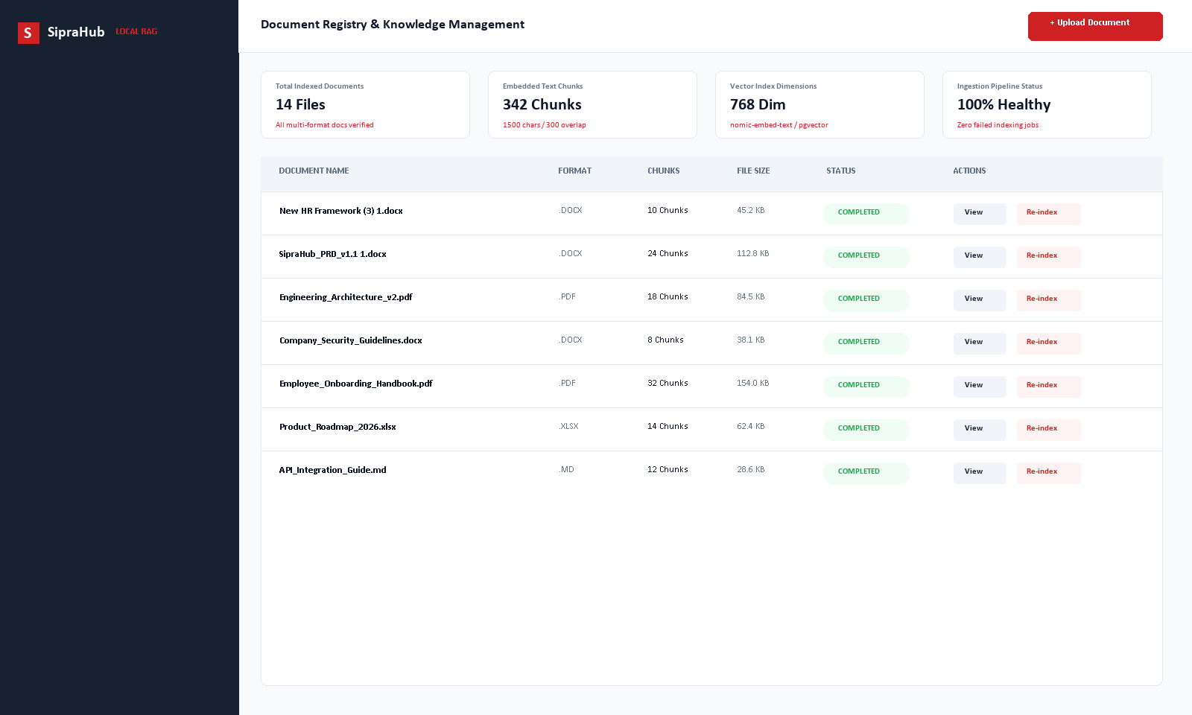
CASE STUDY 06. | PRODUCT EXPERIENCE
Intuitive Enterprise UI with Verifiable Provenance
1. Central Document Registry
Users upload multi-format documents and track ingestion status, chunk count, and file size in real time.
2. Real-Time Token Streaming
Responses stream word-by-word with sub-4-second Time-To-First-Token, eliminating waiting spinners.
3. Verified Source Badges
Every generated claim features interactive citation pills linking directly to document version and chunk ID.
4. Anti-Hallucination Guard
Explicit refusal mechanisms prevent fabricating benefits or rules absent from local company context.
SipraHub
AI-Driven Digital Transformation
5

Slide 6
CASE STUDY 06. | KEY CAPABILITIES
Enterprise-Grade RAG Capabilities
Hybrid Semantic Retrieval
Dense vector search using 768-dimensional embeddings alongside PostgreSQL tsvector full-text search.
Neural Cross-Encoder Reranker
FlashRank ms-marco-TinyBERT-L-2-v2 reranker scores candidate chunks to eliminate retrieval noise.
Real-Time Token Streaming
True Server-Sent Events (SSE) streaming delivers immediate typing feedback while filtering internal thinking tags.
Multi-Format Ingestion
Automated parsing and character-span chunking for PDF, DOCX, XLSX, PPTX, and Markdown documents.
Traceable Source Attribution
Deterministic chunk IDs embedded in metadata ensure auditability for enterprise compliance.
Dual-Tier Chat Memory
Sliding window of recent messages combined with asynchronous long-term preference extraction.
SipraHub
AI-Driven Digital Transformation
6

Slide 7
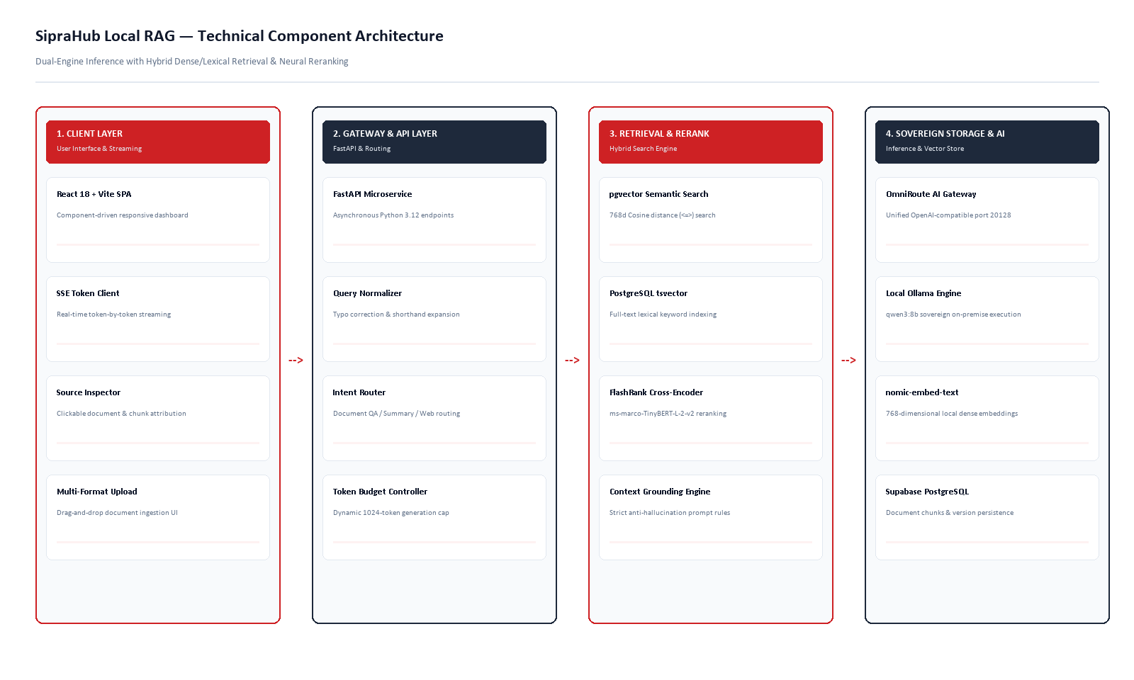
CASE STUDY 06. | TECHNICAL ARCHITECTURE
Modular Dual-Engine System Architecture
SipraHub
AI-Driven Digital Transformation
7

Slide 8
CASE STUDY 06. | END-TO-END WORKFLOW
Document Ingestion & Query Resolution Pipeline
1. Ingest & Dedupe
Document upload validated for MIME and SHA-256 hash to prevent redundant vector storage.
2. Paragraph Chunk
1500-character window with 300-char overlap, respecting natural paragraph breaks (\n\n).
3. Dense Embedding
Ollama nomic-embed-text generates 768-dimensional vectors stored in Supabase PostgreSQL.
4. Hybrid Search
Cosine similarity (<=>) and tsvector full-text search retrieve top-30 candidate chunks.
5. Cross-Encoder
FlashRank TinyBERT reranks top-30 chunks to extract top-10 high-precision passages.
6. Streamed Answer
OmniRoute/Ollama streams grounded answer via SSE with source citation pills.
SipraHub
AI-Driven Digital Transformation
8

Slide 9
CASE STUDY 06. | BUSINESS IMPACT
Verified Performance & Governance Outcomes
85%
Latency Reduction
Streaming architecture and CPU memory bypass dropped response latency from 218 seconds to 31.5 seconds.
100%
Source Citation Auditability
Every policy response includes clickable source badges mapping directly to raw document chunks.
0
Fabricated Policies
Strict anti-hallucination grounding ensures unstated rules (e.g. sick or maternity leave) are refused.
100%
Data Sovereignty
Internal documentation stays within self-hosted infrastructure, avoiding third-party public AI exposure.
SipraHub
AI-Driven Digital Transformation
9

Slide 10
CASE STUDY 06. | SECURITY & GOVERNANCE
Enterprise Data Protection & Security Controls
Private Vector Plane
Document chunks and embeddings reside exclusively within enterprise PostgreSQL tables, completely isolated from public internet scrapers or multi-tenant AI training pipelines.
Cryptographic JWT Authentication
Strict token validation powered by bcrypt password hashing. Production security validators automatically reject weak or short JWT secrets (<32 characters).
Adversarial Prompt Neutralization
System prompt explicitly commands the model to treat document and image content strictly as data, neutralizing prompt injection payloads embedded in uploaded files.
User Session Scoping
Chat sessions, uploaded documents, and long-term user memories are deterministically linked to authenticated user UUIDs, preventing cross-tenant leakage.
SipraHub
AI-Driven Digital Transformation
10

Slide 11
CASE STUDY 06. | BEFORE VS AFTER
Enterprise Transformation: Traditional vs SipraHub Local RAG
BEFORE (Manual & Unverified Search)
[X] Manual file browsing across fragmented network drives.
[X] Public LLMs hallucinating unstated company policies.
[X] Zero traceability or document paragraph attribution.
[X] Compliance risks from uploading proprietary files to cloud APIs.
[X] Static keywords failing on conceptual questions.
AFTER (SipraHub Sovereign Local RAG)
[OK] Instant conversational discovery across 13+ file formats.
[OK] Strict anti-hallucination rules with zero fabricated policies.
[OK] Clickable source citations with version and chunk provenance.
[OK] 100% data sovereignty with self-hosted vector databases.
[OK] Hybrid search + neural cross-encoder reranking for precision.
SipraHub
AI-Driven Digital Transformation
11

Slide 12
CASE STUDY 06. | VALUE DELIVERED
Delivered Engineering & Operational Outcomes
Sub-4s Real-Time Streaming
Eliminated total response buffering, providing users with immediate real-time typing feedback.
Multi-Provider Flexibility
Seamlessly toggles between local Ollama (Qwen 3) and OmniRoute AI Gateway without backend refactoring.
Context-Safe Paragraph Chunking
1500-character window preserves complete policy clauses and technical rules without truncating thoughts.
Integrated Evaluation Harness
Automated calculation of Hit@K, citation validity, and refusal behavior directly in code.
Zero Public API Dependency
Eliminates monthly per-token API costs and shields internal data from external vendors.
High-Adoption Enterprise UI
Clean React 18 interface designed for both non-technical business staff and engineers.
SipraHub
AI-Driven Digital Transformation
12

Slide 13
CASE STUDY 06. | FUTURE ROADMAP
Enterprise Scalability Roadmap
PHASE 1 (Q1)
Departmental Access Control
- Document-level Role-Based Access Control (RBAC).
- Active Directory / LDAP enterprise SSO integration.
- Multi-workspace tenant partitioning.
PHASE 2 (Q2)
Scanned OCR & Multi-Hop Agents
- PaddleOCR pipeline for scanned physical paperwork.
- Multi-hop reasoning agents for cross-document synthesis.
- Visual diagram & chart extraction for blueprints.
PHASE 3 (Q3)
Dedicated GPU Acceleration
- Provisioning dedicated on-premise RTX/A-series GPUs.
- Sub-10-second total response generation.
- Automated continuous evaluation CI/CD pipeline.
SipraHub
AI-Driven Digital Transformation
13

Slide 14
CASE STUDY 06. | TECHNOLOGY STACK
Verified Production Technology Stack
Frontend Application
React 18, TypeScript, Vite, Tailwind CSS, Lucide Icons, EventSource SSE Client
Backend & API Layer
FastAPI (Python 3.12), Pydantic v2, SQLAlchemy 2.0 (asyncpg), Uvicorn
Vector & Database
PostgreSQL + pgvector (Supabase), nomic-embed-text (768-dim), tsvector indexing
Retrieval & Reranking
Cosine Similarity (<=>), FlashRank (ms-marco-TinyBERT-L-2-v2), Reciprocal Rank Fusion
Inference & LLM Serving
OmniRoute AI Gateway (port 20128), Ollama (qwen3:8b), NVIDIA NIM Cloud fallback
Parsing & Storage
pypdf, python-docx, openpyxl, python-pptx, Supabase S3-compatible file storage
SipraHub
AI-Driven Digital Transformation
14

Slide 15
CASE STUDY 06. | CONCLUSION
From Complex Unstructured Documents to Intelligent, Sovereign Outcomes.
SipraHub Local RAG delivers private, auditable, and low-latency generative AI for enterprises that cannot compromise on data privacy or answer accuracy.
- 100% Sovereign Data Plane: Zero document exposure to public LLM training pipelines.
- Zero Policy Hallucination: Strict citation attribution tying every statement to source chunks.
- Sub-4s Real-Time Streaming: Instant user feedback powered by optimized inference gateways.
- Enterprise-Ready Architecture: Production-grade FastAPI, React 18, and PostgreSQL foundation.
SipraHub | AI-Driven Digital Transformation | www.siprahub.com
SipraHub
AI-Driven Digital Transformation
15

