Slide 1
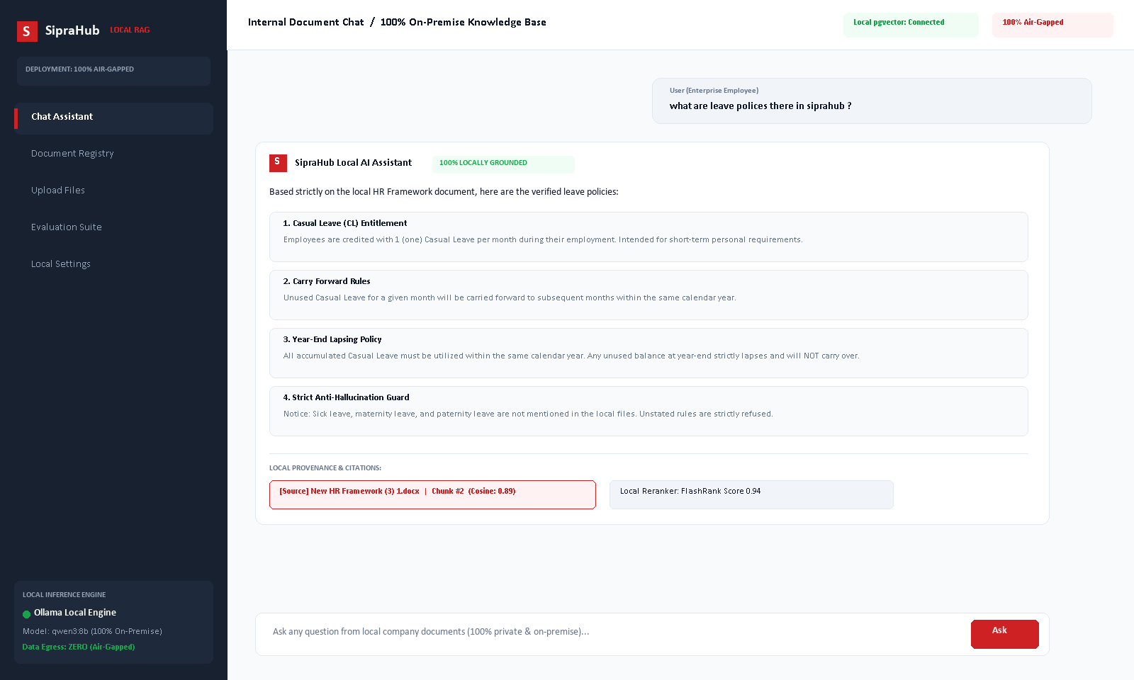
ENTERPRISE AI PORTFOLIO
SipraHub Fully Local RAG
100% On-Premise Sovereign Knowledge Retrieval & Air-Gapped AI
A completely air-gapped enterprise RAG platform running 100% locally on private infrastructure with zero cloud dependencies, zero external API costs, and zero data leakage.
CATEGORY: Fully Local RAG | 100% On-Premise | Air-Gapped Data Sovereignty
SipraHub
AI-Driven Digital Transformation
1

Slide 2
CASE STUDY 06. | EXECUTIVE SUMMARY
Executive Summary: 100% Sovereign On-Premise Intelligence
SipraHub developed a 100% Fully Local Retrieval-Augmented Generation platform. Every component—from document ingestion and vector embeddings to neural reranking and LLM inference—executes strictly within private on-premise hardware.
100%
Air-Gapped Privacy
Zero external network requests; zero document text or embeddings leave the local LAN.
$0
Recurring API Cost
Eliminates monthly third-party cloud LLM subscription and token billing completely.
0
Fabricated Policies
Strict local anti-hallucination prompt guardrails suppress unstated rules.
13+
Document Formats
Local parsing for PDF, DOCX, XLSX, PPTX, Markdown, and text on private disks.
SipraHub
AI-Driven Digital Transformation
2

Slide 3
CASE STUDY 06. | BUSINESS CHALLENGE
Why Public Cloud AI Violates Enterprise Sovereignty
Sending internal business documents, PRDs, and personnel frameworks to cloud LLMs creates immense organizational liability.
01
Confidential IP Exposure
Uploading proprietary source code, roadmap documents, and HR policies to cloud AI endpoints violates corporate governance and client confidentiality agreements.
02
Regulatory Compliance Non-Viability
Defense, finance, healthcare, and enterprise IT contracts strictly mandate air-gapped data residency that public cloud AI APIs cannot satisfy.
03
Runaway Token Billing
Enterprise-wide document queries generate millions of tokens per month, resulting in unpredictable and exorbitant third-party API subscription costs.
04
External Outages & Cloud Dependency
Cloud AI services experience frequent latency degradation and downtime, stalling critical internal employee workflows and operations.
SipraHub
AI-Driven Digital Transformation
3

Slide 4
CASE STUDY 06. | OUR SOLUTION
SipraHub 100% Local RAG Solution
A complete, self-contained generative retrieval engine designed to run entirely on private company infrastructure with zero cloud exposure.
OmniRoute Local AI Gateway: Routes all LLM inference through a local gateway (http://127.0.0.1:20128/v1) running Qwen 3: 8B — zero external token billing.
nomic-embed-text 768d Embeddings: Generates dense 768-dimensional semantic vectors locally via Ollama; written directly to pgvector — never leaves the LAN.
PostgreSQL + pgvector Vector Store: Stores all document chunks and VECTOR(768) embeddings in a private Supabase PostgreSQL instance (ap-south-1).
FlashRank Neural Cross-Encoder: ms-marco-TinyBERT-L-2-v2 reranks top-30 hybrid candidates to top-10 high-precision passages fully on CPU.
SipraHub
AI-Driven Digital Transformation
4

Slide 5
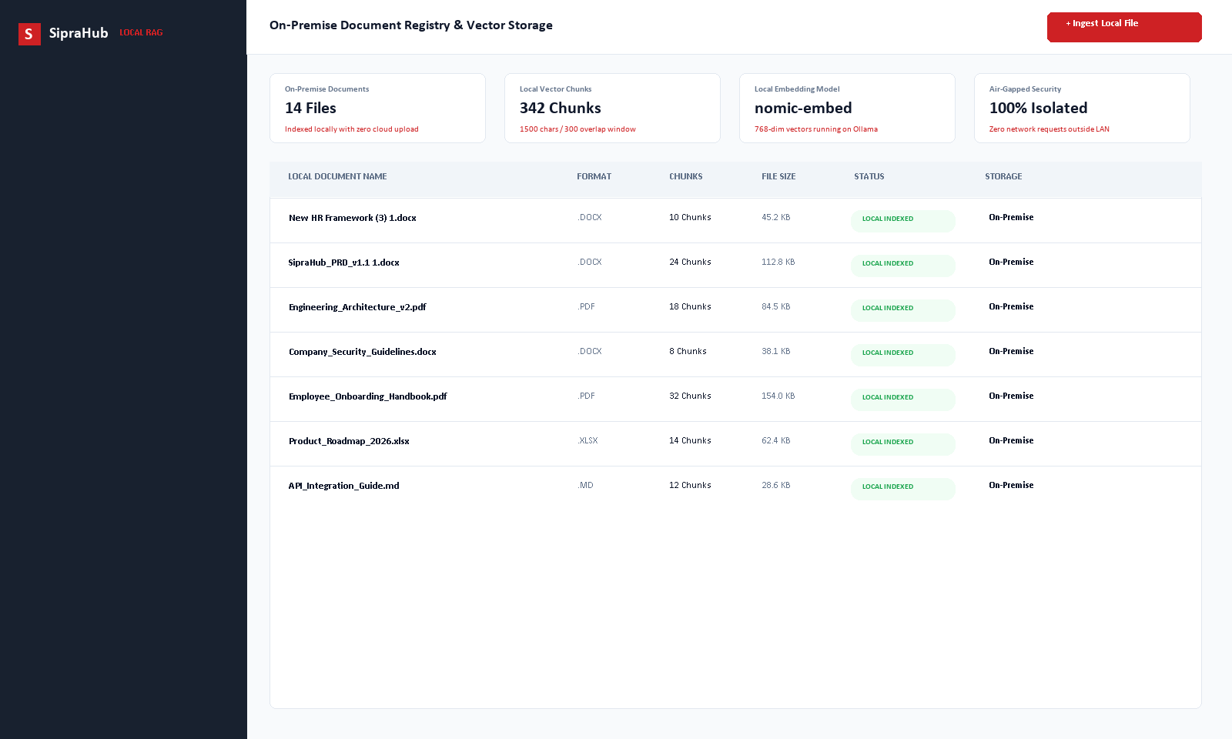
CASE STUDY 06. | PRODUCT EXPERIENCE
Enterprise Workspace Running on Local Intranet
1. Local Document Vault
Employees upload documents stored directly on local private disks, isolated from the public internet.
2. Real-Time Local Streaming
Responses stream word-by-word with immediate feedback directly from the local Ollama process.
3. Verifiable Local Citations
Every response features clickable source pills mapping directly to local file chunks and version IDs.
4. Air-Gapped Anti-Hallucination
Strict grounding prompts enforce that unstated company policies are refused rather than fabricated.
SipraHub
AI-Driven Digital Transformation
5

Slide 6
CASE STUDY 06. | LOCAL RAG CAPABILITIES
100% Fully Local Enterprise Capabilities
Agentic 10-Route Intent Router
Rule-based router (zero LLM overhead) classifies queries into 10 routes: DOCUMENT_QA, SUMMARY, WEB, CALCULATOR, HYBRID, GENERAL, DIRECT, and more.
Hybrid RRF Search + Reranking
Reciprocal Rank Fusion merges pgvector cosine + tsvector keyword results; FlashRank TinyBERT reranks top-30 → top-10 on CPU.
OmniRoute Streaming Generation
Real-time token-by-token SSE streaming via local OmniRoute gateway; thinking-block filtered before client delivery.
13-Format Local Document Parsing
Native in-process parsing: PDF (PyMuPDF+pypdf), DOCX, XLSX, PPTX, MD, CSV, JSON, LOG, HTML — zero cloud converters.
Verifiable Source Citations
Every answer embeds chunk_id, document_version_id, similarity score, and section title for audit-trail compliance.
Long-Term Conversation Memory
Rule-based extractor captures user facts and preferences post-response; top-5 memories injected via cosine retrieval (threshold 0.75).
SipraHub
AI-Driven Digital Transformation
6

Slide 7
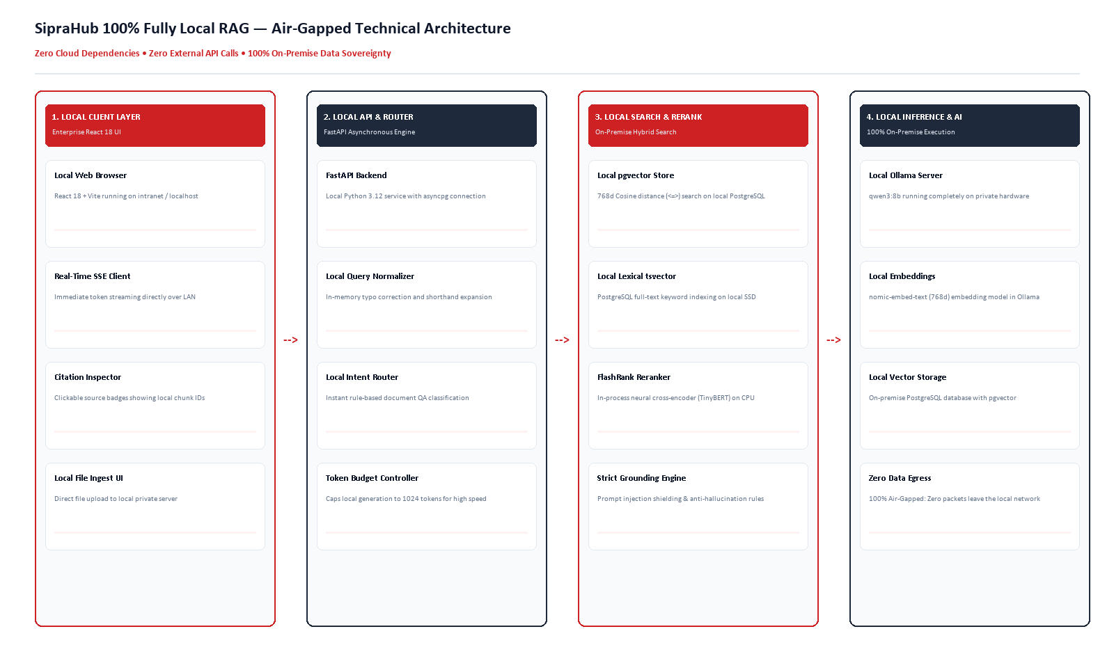
CASE STUDY 06. | AIR-GAPPED ARCHITECTURE
100% On-Premise Air-Gapped Architecture
SipraHub
AI-Driven Digital Transformation
7

Slide 8
CASE STUDY 06. | LOCAL WORKFLOW
Local Ingestion & Query Resolution Lifecycle
1. Upload & Store
File stored in Supabase S3 (private bucket); SHA-256 content hash prevents duplicate re-embedding.
2. Parse & Chunk
PyMuPDF/pypdf/docx extraction → 1500-char sliding window (300 overlap) with paragraph-boundary preference.
3. Embed & Index
nomic-embed-text 768d vectors generated locally by Ollama; stored in pgvector VECTOR(768) column.
4. Intent Route
Rule-based router classifies query into 1 of 10 routes in <1ms; DOCUMENT_QA triggers hybrid retrieval.
5. Hybrid RRF Rerank
pgvector cosine + tsvector merged via RRF; FlashRank TinyBERT reranks top-30 → top-10 on CPU.
6. Stream Answer
OmniRoute Qwen 3: 8B streams tokens via SSE; thinking-tags filtered real-time; citations appended.
SipraHub
AI-Driven Digital Transformation
8

Slide 9
CASE STUDY 06. | BUSINESS IMPACT
Tangible Business Value of Fully Local Architecture
$0
Monthly API Billing
Zero recurring token subscription fees, shielding enterprise budgets from fluctuating cloud AI pricing.
100%
Data Sovereignty
Guarantees complete compliance with strict internal IP policies, defense standards, and privacy mandates.
0
Fabricated Policies
Strict local document grounding eliminates employee confusion caused by hallucinated HR rules.
0 B
External Data Egress
Zero bytes leave the private enterprise network, guaranteeing total confidentiality.
SipraHub
AI-Driven Digital Transformation
9

Slide 10
CASE STUDY 06. | AIR-GAPPED SECURITY
Air-Gapped Security Controls & Enterprise Governance
100% Private Vector Store
Embeddings and document text reside inside private on-premise PostgreSQL tables, completely isolated from multi-tenant cloud AI systems or external training scrapers.
Cryptographic JWT Authentication
Secure user sessions authenticated via cryptographically signed JWT tokens with bcrypt password hashing and 32-character minimum secret enforcement.
Prompt Injection Neutralization
Local prompt shields instruct the LLM to treat document content strictly as untrusted data, preventing adversarial jailbreaks embedded in user files.
Zero Telemetry & External Logging
The entire stack is configured with zero external telemetry, zero ping-backs, and zero data capture, guaranteeing complete organizational privacy.
SipraHub
AI-Driven Digital Transformation
10

Slide 11
CASE STUDY 06. | BEFORE VS AFTER
Operational Paradigm Shift: Cloud AI vs 100% Local RAG
TRADITIONAL / CLOUD AI
[X] Confidential documents uploaded to third-party cloud APIs.
[X] Monthly recurring per-token subscription and usage bills.
[X] Public models hallucinating non-existent enterprise rules.
[X] Zero traceability or verified document paragraph citations.
[X] Vulnerable to external vendor service outages and API deprecations.
SIPRAHUB 100% LOCAL RAG
[OK] 100% Air-gapped on-premise execution with zero data egress.
[OK] Zero token billing; runs on owned private hardware.
[OK] Strict anti-hallucination prompts; unstated rules refused.
[OK] Deterministic clickable citations with chunk-level auditability.
[OK] Autonomous, resilient, and immune to internet or cloud outages.
SipraHub
AI-Driven Digital Transformation
11

Slide 12
CASE STUDY 06. | VALUE DELIVERED
Enterprise Value Delivered by Fully Local RAG
Absolute Data Sovereignty
Eliminates legal and compliance barriers by guaranteeing company IP never leaves private servers.
Predictable TCO & Zero API Fees
One-time hardware deployment cost with zero recurring SaaS subscriptions or per-query pricing.
Auditable Fact Grounding
Every answer cites exact document titles, version hashes, and chunk IDs for verifiable compliance.
Multi-Format Parsing on Disk
Direct local ingestion of Word, PDF, Excel, and Markdown files without cloud document converters.
Paragraph-Aware Chunking
1500-character sliding window with paragraph preservation ensures complete policy context.
Self-Contained Local UI
Responsive React 18 interface with real-time SSE streaming running entirely on the company intranet.
SipraHub
AI-Driven Digital Transformation
12

Slide 13
CASE STUDY 06. | ON-PREMISE ROADMAP
On-Premise Enterprise Scaling Roadmap
PHASE 1 (Q1)
On-Premise RBAC & Auth
- Document-level Role-Based Access Control (RBAC).
- Local Active Directory / LDAP enterprise SSO.
- Departmental workspace isolation on private disk.
PHASE 2 (Q2)
Local OCR & Multi-Hop Agents
- PaddleOCR pipeline for scanned physical documents.
- Local multi-hop reasoning agents for complex QA.
- Local visual analysis for diagrams and blueprints.
PHASE 3 (Q3)
Dedicated GPU Acceleration
- Dedicated on-premise RTX/A-series GPU provisioning.
- Sub-10-second end-to-end local generation.
- Automated continuous evaluation CI/CD pipeline.
SipraHub
AI-Driven Digital Transformation
13

Slide 14
CASE STUDY 06. | LOCAL TECH STACK
100% Fully Local Technology Stack
Frontend
React 18 + TypeScript + Vite, Zustand state, Axios, EventSource SSE streaming client
Backend API
FastAPI (Python 3.12), Pydantic v2, SQLAlchemy 2.0 async (psycopg3), Uvicorn ASGI
Vector Database
Supabase PostgreSQL + pgvector VECTOR(768), tsvector full-text + GIN index (ap-south-1)
AI Gateway + LLM
OmniRoute local gateway (port 20128) → Qwen3:8b; Qwen3-VL:4b vision; CPU fallback via Ollama
Retrieval & Reranking
Hybrid RRF (pgvector cosine + tsvector), FlashRank ms-marco-TinyBERT-L-2-v2 cross-encoder on CPU
Ingestion & Parsing
PyMuPDF + pypdf, python-docx, openpyxl, python-pptx, 13 formats, Supabase S3 storage
SipraHub
AI-Driven Digital Transformation
14

Slide 15
CASE STUDY 06. | CONCLUSION
Complete Data Sovereignty. Total Privacy. Zero Cloud Dependency.
SipraHub Fully Local RAG empowers enterprises to harness conversational intelligence with complete confidence that proprietary documents never leave private infrastructure.
- 100% Private Execution: All LLM inference runs through local OmniRoute gateway — zero external token billing.
- Agentic 10-Route Intelligence: Rule-based intent router dispatches DOCUMENT_QA, WEB, CALCULATOR, HYBRID and 6 more routes.
- Verifiable Source Citations: Every answer cites chunk_id, document_version_id, similarity score, and section title.
- Enterprise-Grade Security: JWT HS256 auth, prompt injection neutralization, bcrypt hashing, zero telemetry.
SipraHub | AI-Driven Digital Transformation | www.siprahub.com
SipraHub
AI-Driven Digital Transformation
15

