Slide 1
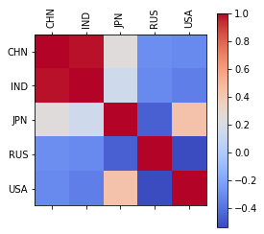
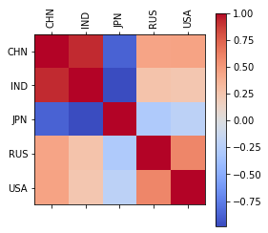
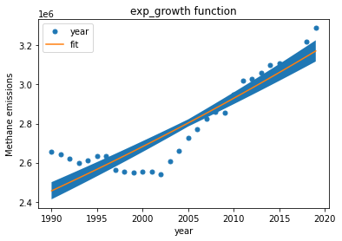
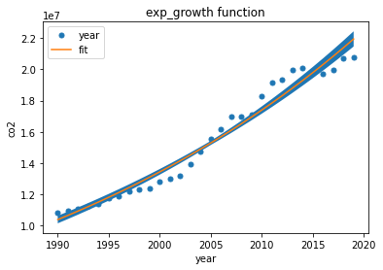
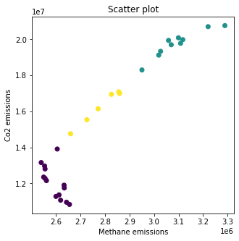
Climate change analysis
Aravind Devarakonda
Student ID: 22032880
Climate change analysis is the study of the factors that contribute to changes in the planet's climate as well as their effects and potential remedies. It includes using scientific data, models, and simulations to learn how human activities—such as the use of carbon dioxide, deforestation, and agriculture—affect climate change, weather patterns, and natural systems of the world.
The analysis of climate change requires studies that are interdisciplinary, combining each other scientists work from many different fields, including environmental science, earth sciences, the environment, the field of biology, and social science. It also incorporates policy analysis, as climate change has substantial ramifications for economies, society, and international relations.
The world bank API provides n numerous data which causes climate change such as Co2 emissions, methane emissions, population of world and pollutions, gases burn from different subjects like petrol, coal etc.. By all these information, we can analyze and make predictions which can results in reduce in pollution as part of climate change.
In these analysis, I have chosen the main reason for climate change i.e., Co2 and Methane emissions for top 5 countries, China, India, United states of America, Russia and Japan.
CO2 and methane emissions refer to the release of harmful gas into the atmosphere when human activities like burning fossil fuels, deforestation, and industrial operations release carbon dioxide gas into the atmosphere. As a greenhouse gas that can trap heat in the atmosphere of the Earth, carbon dioxide plays a role in both global warming and climate change.
The correlation graph was plot between each country for unique indicators i.e, Co2 emissions and Methane emissions. We have seen that China is in top of the selected list among selected countries. Over the years, We have observed that there is substantially increase the emissions of Co2 and methane for the selected countries.
The beside images shows the exponential growth of 5 countries for Methane and Co2 emissions. We have used upper and lower ranges over the fitted curves over the past 25 years. The exponential function was used to find the curve between and plotted over the data.
The K-Nearest Neighbours (KNN) clustering technique groups data points according to closeness after determining how similar they are using a distance measure, such as Euclidean distance.
In this clustering, we have chosen 3 nearest neighbours over the data points. The Co2 and Methane emissions are calculated between 3 clusters and divided accordingly. We have chosen the unique data points from the data for this clustering.
We have plotted the scatter plot for Kmeans clustering and seen that there how clusters are defined for Co2 emissions and Methane emissions.
Conclusion: In this analysis, We have done Kmeans clustering and data fitting on the data for the selected top 5 countries over the period of 20 years. We have observed from the correlation between countries in correlation maps for each individual indicator of Co2 and Methane emissions. Data has been fitted through the data and used the lower & upper limits to know the tolerance of the fitted data. We have performed Kmeans clustering on the data by clustering into 3 parts as shown in the given image. By this analysis, we have seen that United States of America has been producing higher Co2 and methane emissions among selected 5 countries.
References:
https://data.worldbank.org/topic/climate-change
https://en.wikipedia.org/wiki/Climate_change
https://www.c2es.org/content/internationalemissions
GitHub Repo: https://github.com/Aravind22032880/Climate-change-analysis.git

