Slide 1

Slide 1
Aravind Kagganti Anjinamurthy
Final Project 2025
Analysis of Global Terrorism Trends (1970–2017)
Insights from the Global Terrorism Database (GTD)

Slide 2
Github link: https://github.com/Aravind235/final_project_winter2025
Streamlit link: https://finalprojectwinter2025.streamlit.app/

Slide 3
Objective & Dataset
Objective: To analyze historical terrorism data to uncover patterns in frequency, geographic distribution, and operational tactics over the last 50 years.
Dataset Source: Global Terrorism Database (GTD) via Kaggle/START UMD.
Dataset Scope:
  Period: 1970 to 2017.
  Volume: ~180,000+ recorded incidents.
  Key Variables: Dates, Locations (Lat/Lon), Attack Types, Weapons, Casualties, and Group Names.

Slide 4
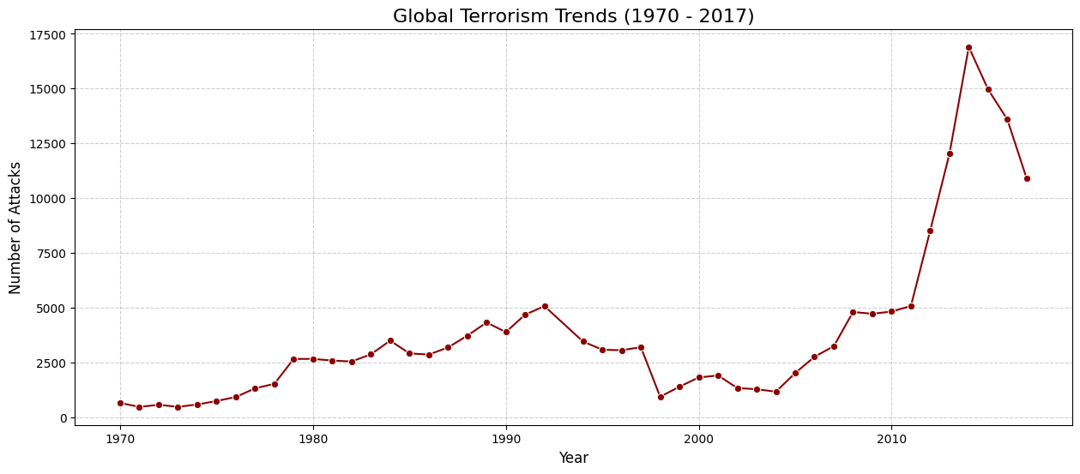
The "When" – Global Trends Over Time
Key Insights:
Terrorism was relatively stable from 1970 to 2000.
Major Finding: A sharp, exponential rise in attacks began around 2010–2012.
Context: This surge correlates with regional destabilization in the Middle East (Arab Spring, rise of ISIS) and conflicts in South Asia.

Slide 5
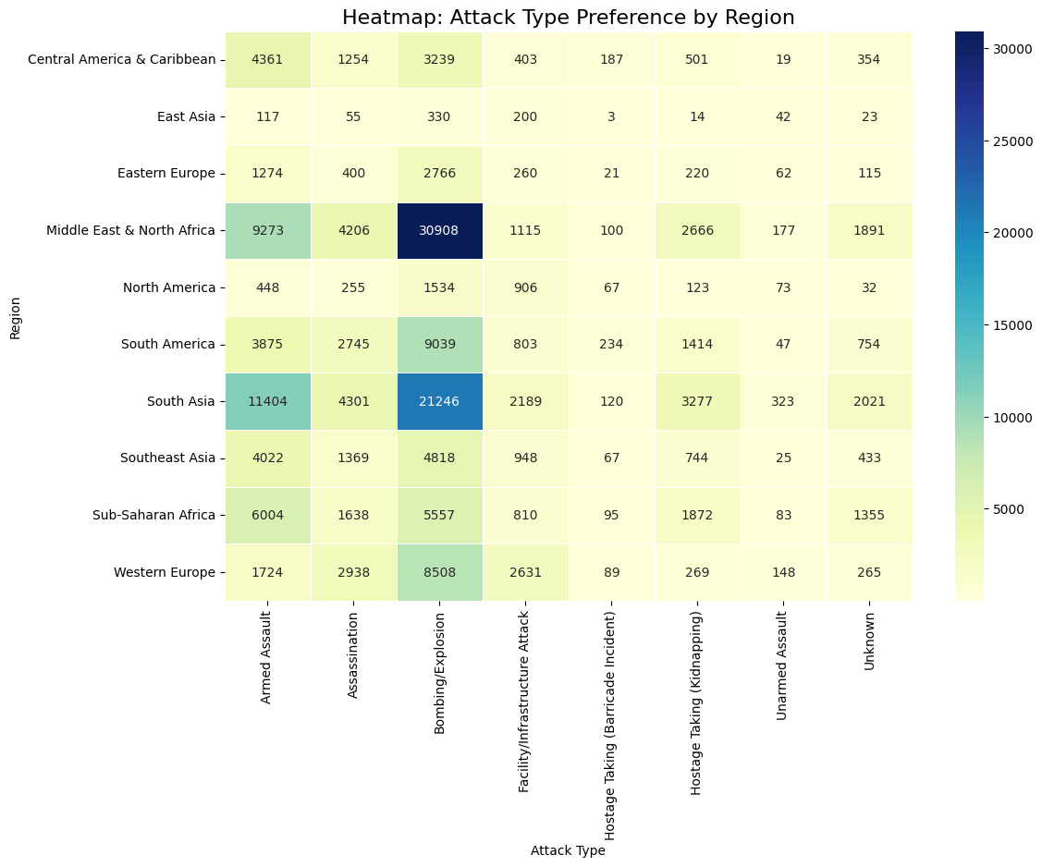
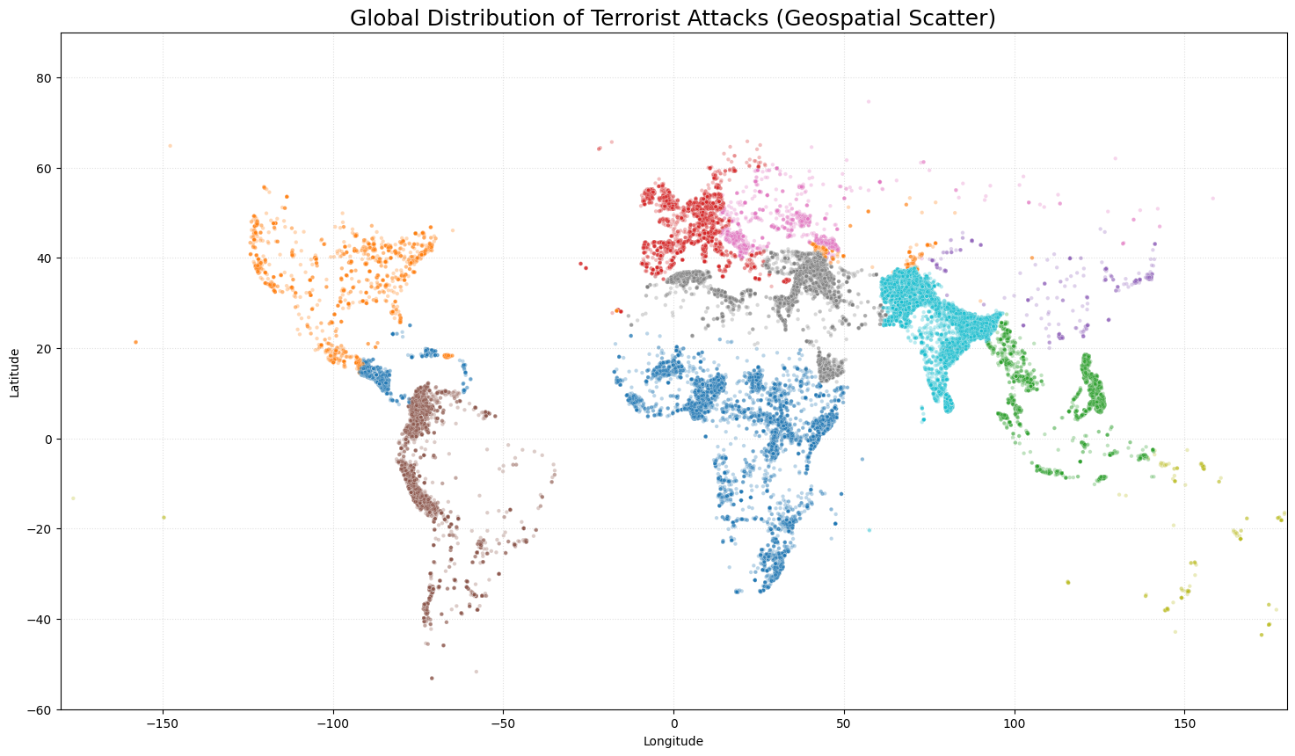
The "Where" – Geospatial Hotspots
Key Insights:
Terrorism is not evenly distributed; it is highly concentrated in specific "hotspots.“
Dominant Regions: Middle East & North Africa (MENA) and South Asia account for the majority of incidents.
Contrast: North America and Western Europe see comparatively lower frequency, despite high media attention.

Slide 6
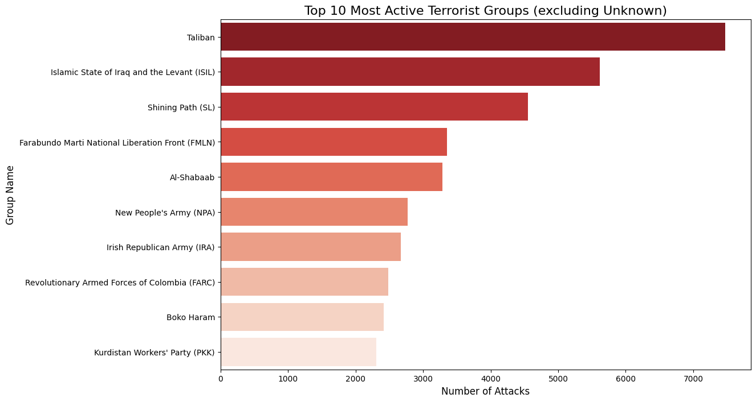
The "Who" – Major Perpetrators
Key Insights:
Top Groups: When excluding "Unknown" actors, the Taliban and ISIL (Islamic State) are the most active groups historically.
Historical Shift: The data reflects a transition from political/revolutionary groups (e.g., Shining Path in the 80s) to religious extremist groups in the modern era.

Slide 7
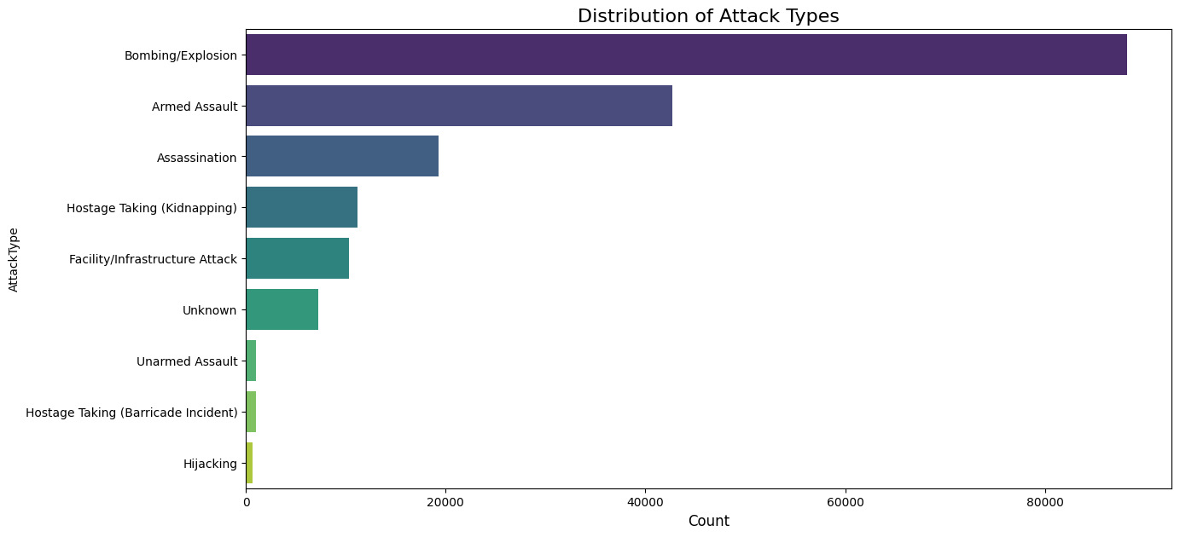
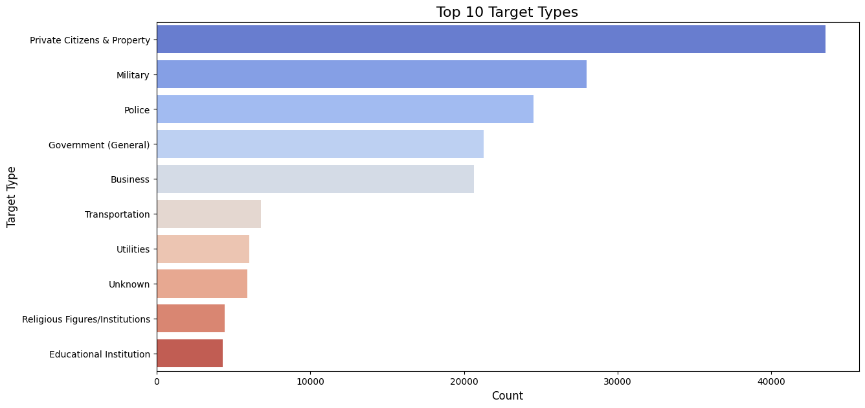
The "How" – Tactics & Targets
Key Insights:
Preferred Method: "Bombing/Explosion" is the most common tactic (likely due to IED usage).
Primary Targets: Private Citizens & Property are the #1 target, consistently higher than Military or Government targets.
Conclusion: Modern terrorism disproportionately affects soft targets (civilians).

Slide 8
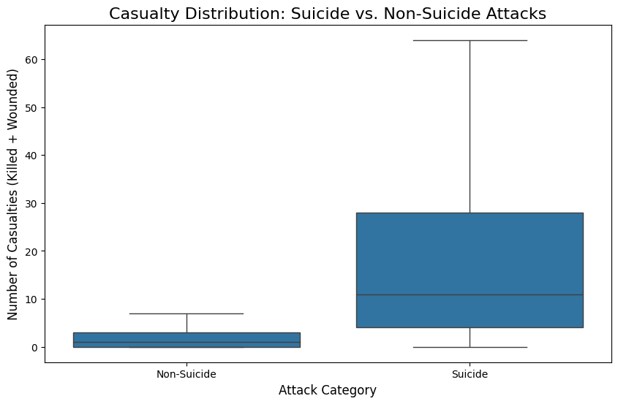
Impact Analysis – Lethality
Key Insights:
Lethality Driver: Suicide attacks are statistically more lethal than non-suicide attacks.
Data: The median casualty count for suicide missions is significantly higher.
Implication: Suicide tactics allow attackers to infiltrate denser crowds, maximizing the "success" of their casualty goals.

Slide 9
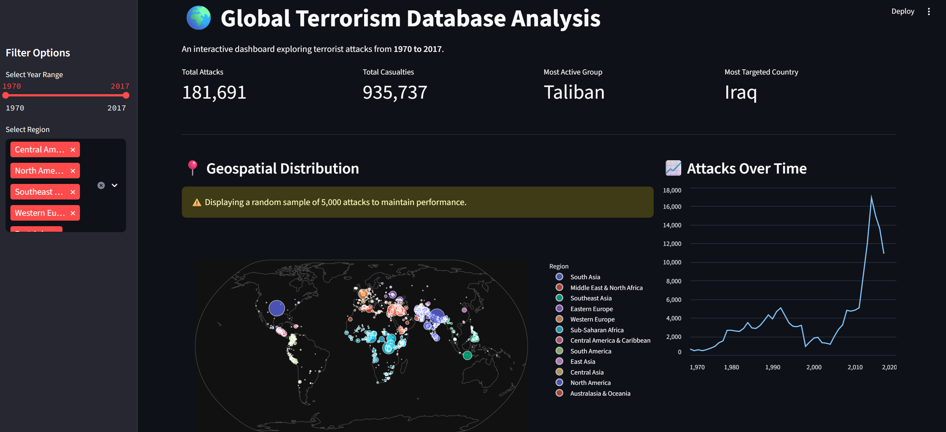
Interactive Streamlit Dashboard
Upcoming Deposits
$704.78
$191.01
Upcoming Deposits
$189.31
$186.54

Slide 10
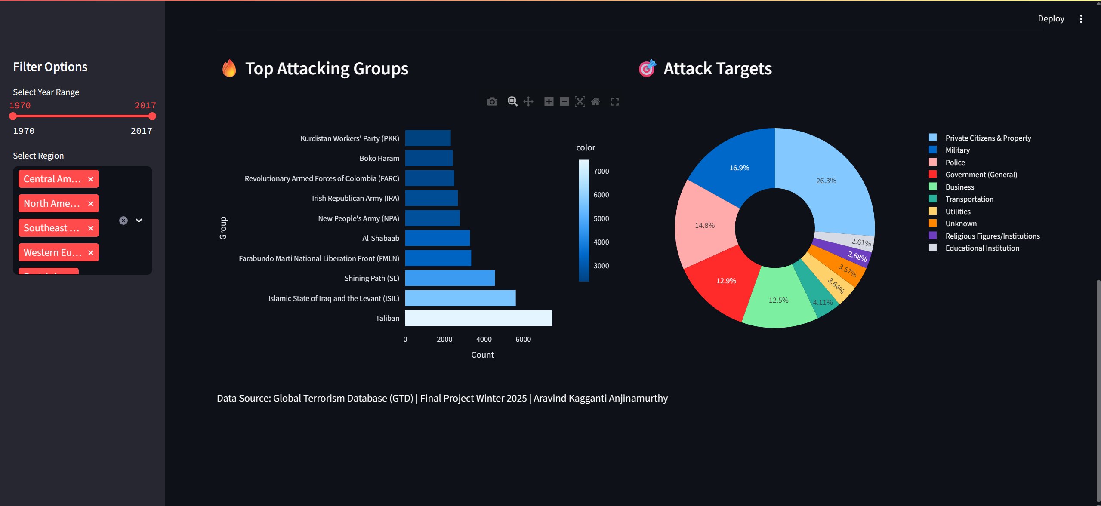
Interactive Streamlit Dashboard
Upcoming Deposits
$704.78
$191.01
Upcoming Deposits
$189.31
$186.54

Slide 11
Conclusion
Summary:
  Volume: Terrorism has increased drastically in the 21st century compared to the 20th.
  Geography: Violence is highly localized in conflict zones (Iraq, Afghanistan, Pakistan), not global.
  Tactics: Explosives and attacks on civilians remain the primary modus operandi.
  Final Thought: Data analysis reveals that while terrorism is a global concern, its most devastating impacts are concentrated in specific regions and eras.

Slide 12

Slide 10
THANK YOU

