Slide 1

Media Streaming with cloud Video Streaming.

Slide 2
Login Interface:
Login and Registration interface which are made in a simple to understand manner for all the users.
An easy interface is designed with simplicity and user-friendliness in mind. It prioritizes intuitive navigation and minimizes complexity, making it effortless for users to interact with a system or application.
Such interfaces often employ clear, straightforward menus, icons, and labels, reducing the learning curve and allowing users to quickly grasp how to accomplish tasks. Additionally, easy interfaces incorporate thoughtful design choices, such as consistent layouts and a logical flow, ensuring a smooth and efficient user experience.
Ultimately, the goal of an easy interface is to enhance usability and accessibility, empowering users to complete their tasks or access information with ease and confidence.

Slide 3
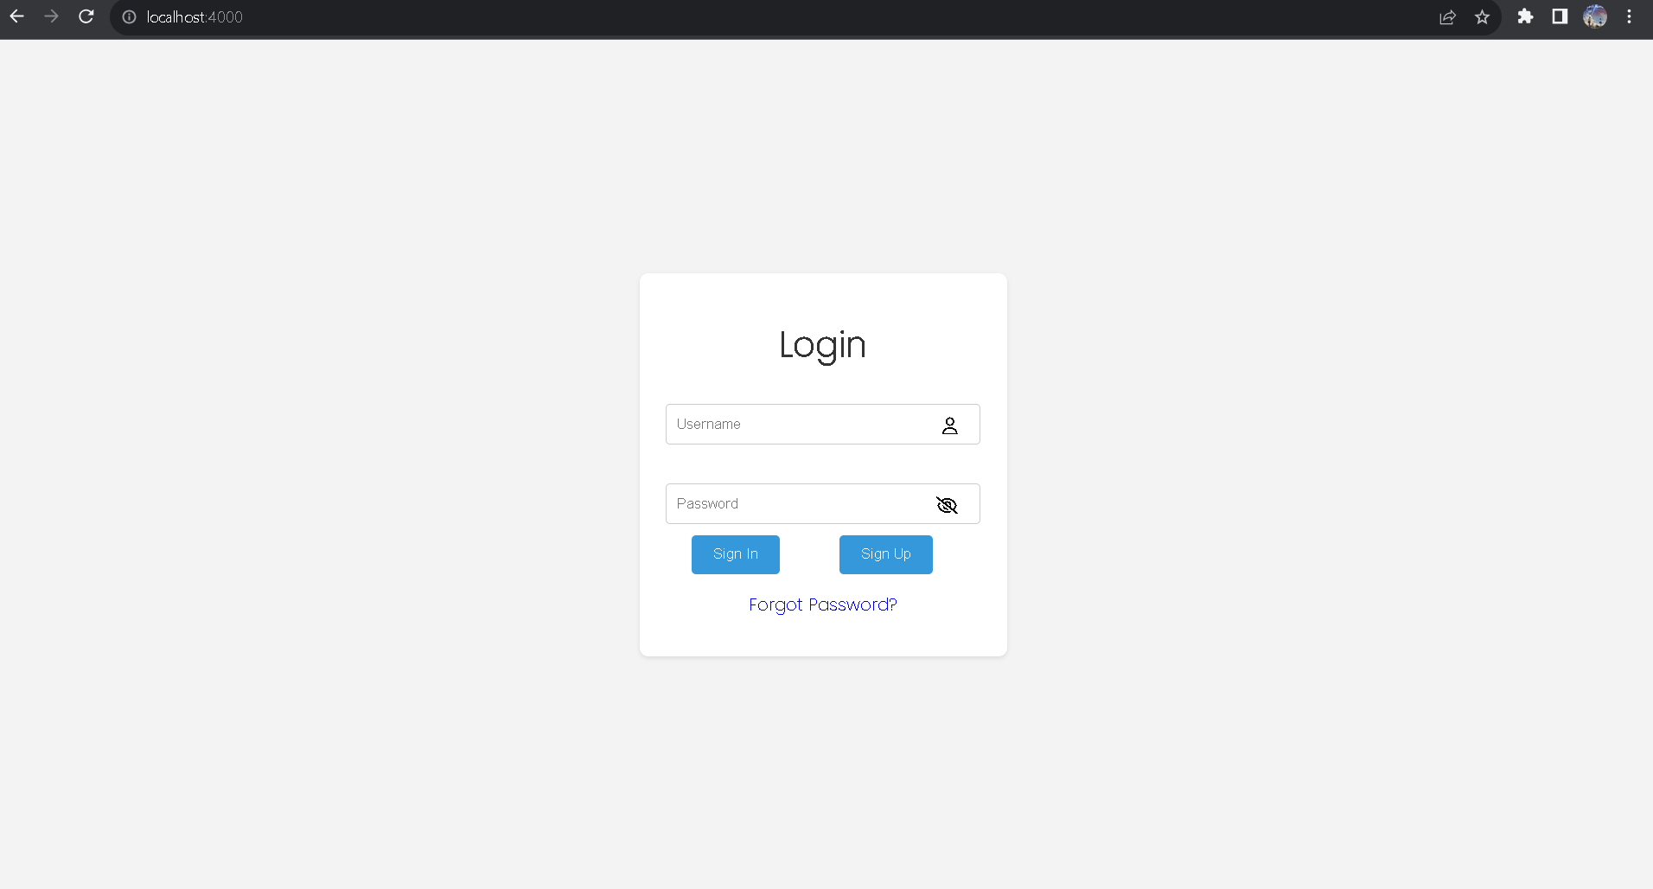
Login System:
A simple login interface typically consists of two primary fields: a username or email input box and a password input box.
Users enter their registered username or email address in the first field and their password in the second.
Additionally, there's a "Login" button that users click to access their accounts. Some login interfaces may also include a "Forgot Password" link for password recovery and a "Register" button for new users to sign up.
Overall, a simple login interface aims to provide a straightforward and secure means for users to access their accounts while keeping the design clean and user-friendly.

Slide 4
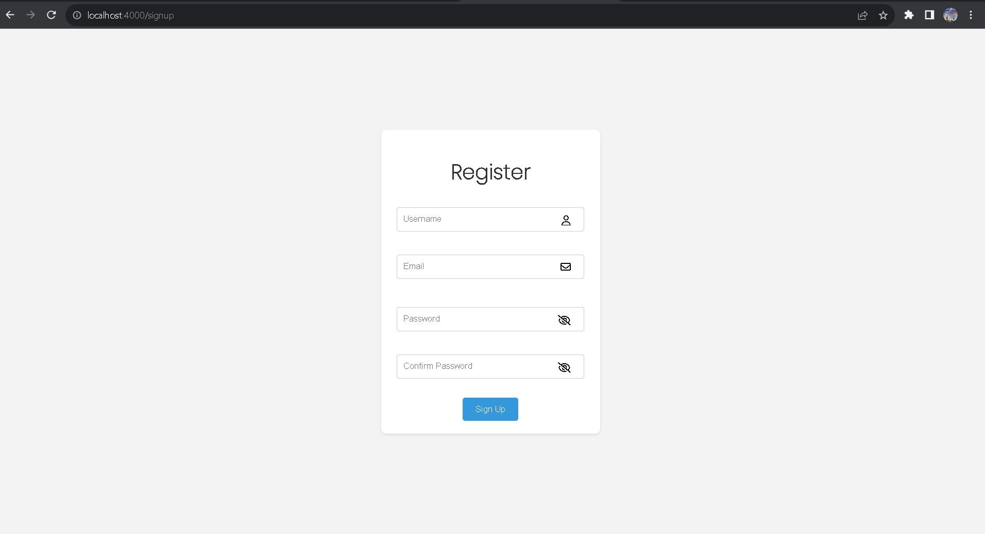
Registration For new Users:
.
For new users is a vital step in gaining access to various online platforms and services.
It typically involves providing essential information such as a valid email address, username, and a secure password, along with any additional required details. New users might also be asked to confirm their password and agree to terms of service or privacy policies.
This process is designed to establish a unique identity for the user within the system, enabling them to personalize their experience, access restricted content, and maintain security.
A well-designed registration process aims to be user-friendly, guiding individuals through the necessary steps and providing helpful feedback, making it as seamless and efficient as possible while ensuring the security of user data.

Slide 5
Authentication Mechanisms:
User registration and login functionalities must be established, verifying credentials against the database during login and securely storing user data during registration.
The most important thing is to secure the password and other confidential details of the uses using the “bycrypt ” package in node to encrypt the data.And store it in the database.
Middleware plays a crucial role in protecting specific routes, allowing only authenticated users to access sensitive parts of the application.
Lastly, security considerations, including rate limiting, account lockout, and protection against common web vulnerabilities like XSS and CSRF, are paramount to fortify the authentication system against potential threats.

Slide 6
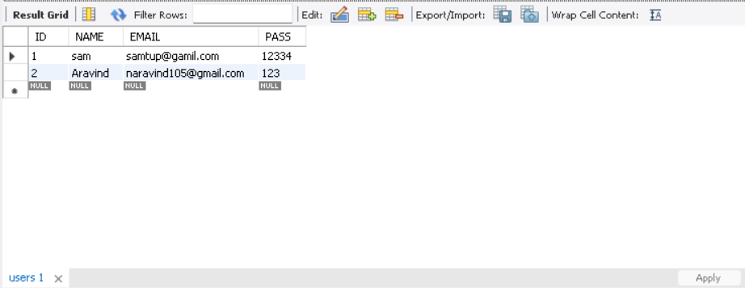
Data base to store data:
The data that were given by the users are directly stored in the MYSQL database.
We normally use MYSQL databases to handle large set of confidential data.
It also used to authentication of user data such as email id duplication, or incorrect password etc.
It stores values in tables which is a type of relational databases.

