Slide 1

Media Streaming with cloud Video Streaming.

Slide 2
Integrating the user Interface:
The application should have the ability to stream and upload the video to the database and use it for later use.
This strategic move will empower our users with seamless access to a wide array of multimedia content, ensuring that they can enjoy live streams and access their favorite videos whenever they choose.
By harnessing the scalability, security, and reliability of IBM Cloud, we aim to provide an exceptional user experience, while also leveraging the latest advancements in cloud technology to stay at the forefront of the digital landscape.
This integration marks a significant step towards offering a comprehensive and immersive multimedia experience to our users, solidifying our commitment to innovation and excellence.
To further enhance our platform's capabilities, we are committed to integrating video streaming services and enabling on-demand playback through the robust infrastructure of IBM Cloud.

Slide 3
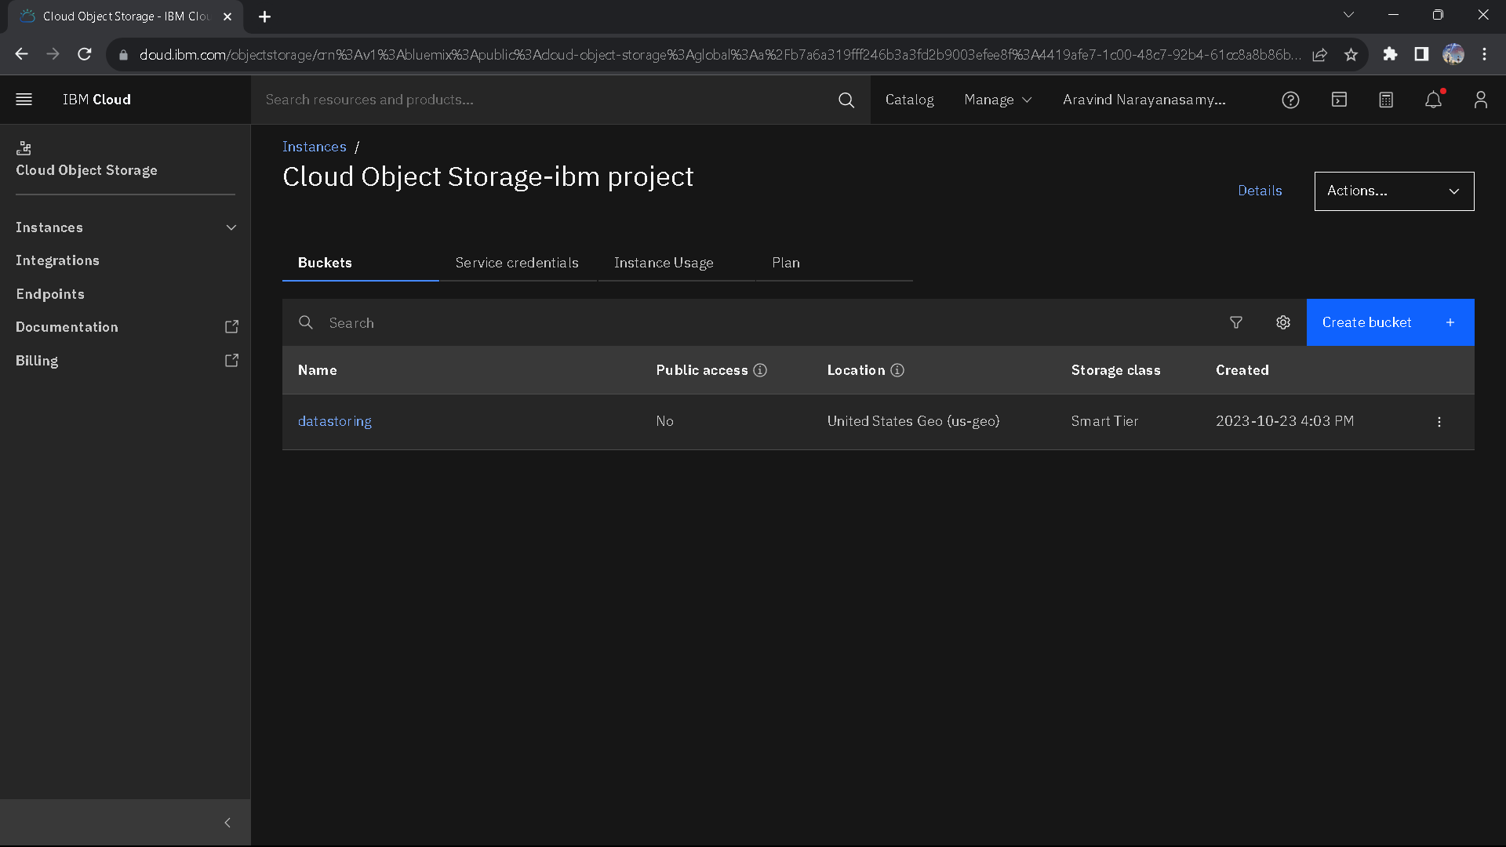
Storing data on IBM Object Storage:
Storing data on IBM Object Database through a website or app represents a cutting-edge approach to managing and accessing information. Leveraging the power of IBM's database technology, our platform ensures data storage that is both efficient and highly adaptable.
Users can seamlessly input and retrieve data through the user-friendly interface of our website or app, while the underlying IBM Object Database facilitates scalability, data integrity, and security.
This innovative approach not only streamlines data management but also paves the way for extensive data analytics, real-time insights, and advanced data-driven decision-making, making it an ideal solution for businesses and individuals alike.

Slide 4
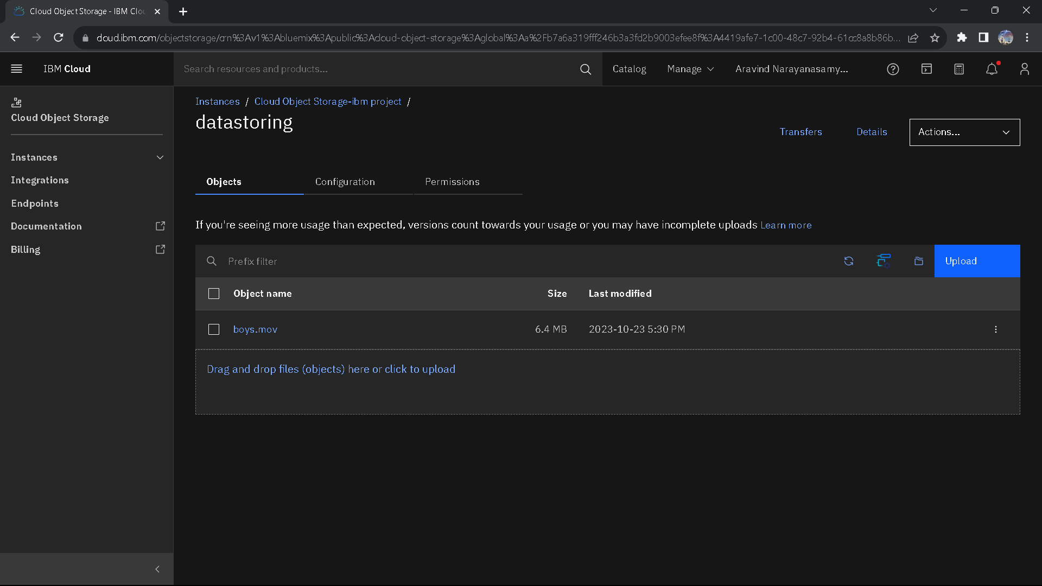
Use of Buckets:
Buckets in IBM Cloud serve as a fundamental organizational structure for data storage, making it easier to manage and access data efficiently.
These storage containers allow users to categorize and store their data, ensuring a logical and structured approach to handling information.
Buckets are particularly integral in IBM Cloud Object Storage, providing a versatile way to manage large volumes of unstructured data, such as images, videos, documents, and more.
hey offer enhanced security features, data redundancy, and scalability, making it a robust choice for various applications, including data archiving, backup, and content distribution.

Slide 5
Integrate IBM Cloud Video Streaming services :
Integrating IBM Cloud Video Streaming services is a strategic move aimed at delivering a seamless and high-quality video playback experience.
By harnessing the power of IBM Cloud's advanced infrastructure and video streaming capabilities, we ensure that users can enjoy content without interruptions or buffering issues.
This integration not only guarantees superior video quality but also offers the scalability and reliability needed to accommodate varying audience sizes and geographic locations.
Whether it's for live events, on-demand content, or interactive streaming, this integration empowers us to provide an exceptional video playback experience, meeting the demands of today's media-hungry audiences with ease and precision.

